Slide 1

Data Structures and Algorithms
Finding Shortest Way
From Here to There, Part II

Slide 2
Acknowledgement
The contents of these slides have origin from School of Computing, National University of Singapore.
We greatly appreciate support from Dr. Steven Halim for kindly sharing these materials.

Slide 3
Policies for students
These contents are only used for students PERSONALLY.
Students are NOT allowed to modify or deliver these contents to anywhere or anyone for any purpose.

Slide 4
Recording of modifications
Currently, there are no modification on these contents.

Slide 5

CS2010 – Data Structures and Algorithms II
Lecture 09 – Finding Shortest Way
from Here to There, Part II
stevenhalim@gmail.com

Slide 6
Outline
VisuAlgo: http://visualgo.net/sssp.html
Four special cases of the classical SSSP problem
Special Case 1: The graph is a tree
Special Case 2: The graph is unweighted
Special Case 3: The graph is directed and acyclic (DAG)
Special Case 4ab: The graph has no negative weight/cycle
Review of the SSSP problem, with VisuAlgo test mode

Slide 7
Basic Form and Variants of a Problem
In this lecture, we will revisit the same topic that we have seen in the previous lecture:
The Single‐Source Shortest Paths (SSSP) problem
An idea from the previous lecture and this one
(and also from our PSes so far) is that a certain problem can be made ‘simpler’ if some assumptions are made
These variants (special cases) may have better algorithm
– PS: It is true that some variants can be more complex than their basic form, but usually, we made some assumptions in order to simplify the problems ☺

Slide 8
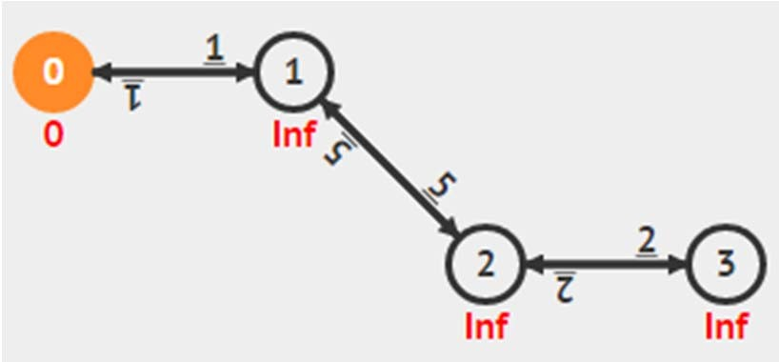
Special Case 1:
The weighted graph is a Tree
When the weighted graph is a tree, solving the SSSP problem becomes much easier as every path in a tree is a shortest path. Q1: Why?
There won’t be any negative weight cycle. Q2: Why?
Thus, any O(V) graph traversal, i.e. either DFS or BFS
can be used to solve this SSSP problem.
Q3: Why O(V) and not the standard O(V+E)?
Important note: You can try this on PS5 Subtask A ☺

Slide 9
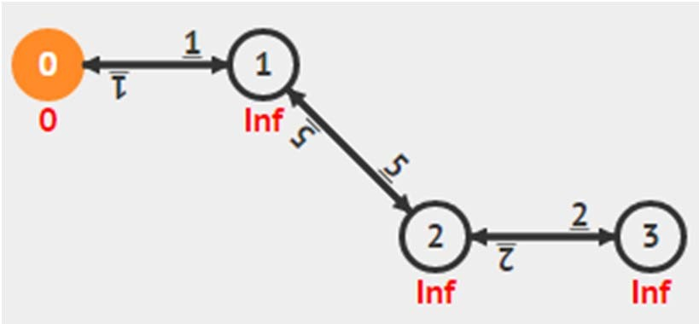
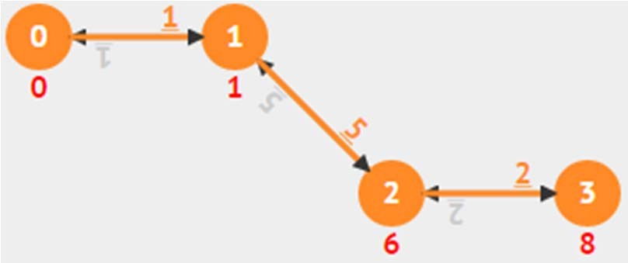
Try in VisuAlgo!
(for now, use Bellman Ford’s or Dijkstra’s in VisuAlgo)
Try finding the shortest paths from source vertex 0 to other vertices in this weighted (undirected) tree
Notice that you will always encounter unique (simple) path between those two vertices
Try adding negative weight edges,
it does not matter if the graph is a tree ☺

Slide 10
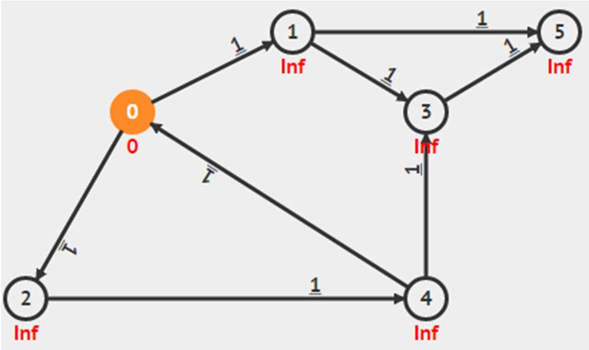
Special Case 2:
The graph is unweighted
This has been discussed last week ☺
Solution: O(V+E) BFS
Important note:
For SSSP on unweighted graph, we can only use BFS
For SSSP on tree, we can use either DFS/BFS
You can try this on PS5 Subtask A+B

Slide 11
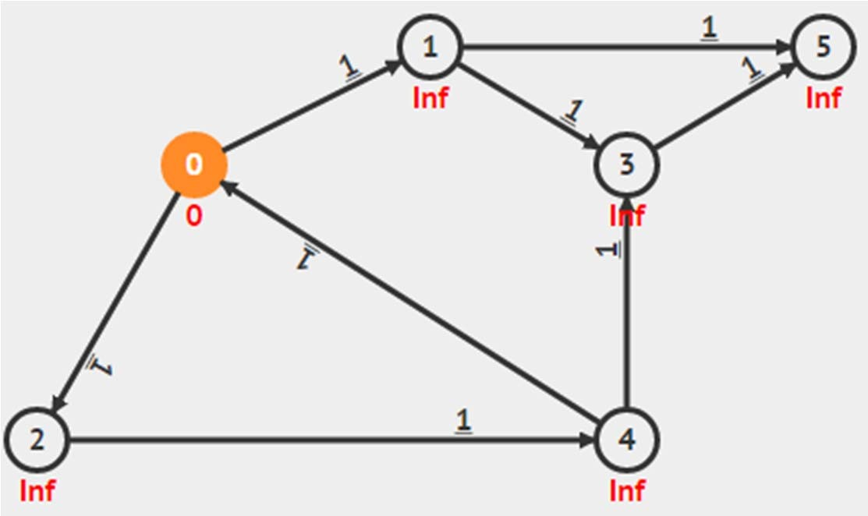
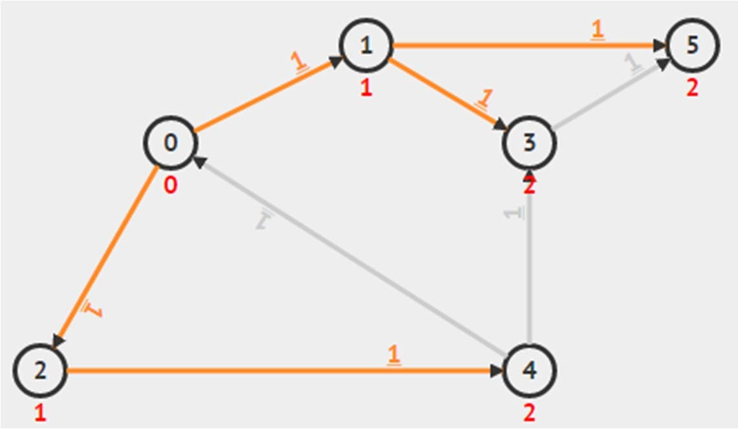
Try in VisuAlgo!
This graph is unweighted (i.e. all edge weight = 1)
Try finding the shortest paths from source vertex 0 to other vertices using BFS

Slide 12
Special Case 3:
The weighted graph is directed & acyclic (DAG)
Cycle is a major issue in SSSP
When the graph is acyclic (has no cycle),
we can “modify” the Bellman Ford’s algorithm
by replacing the outermost V‐1 loop to just one pass
i.e. we only run the relaxation across all edges once
– But in topological order, recall toposort in Lecture 06
Why it works?
More details later in the introductory lecture on Dynamic Programming (Week 10)

Slide 13
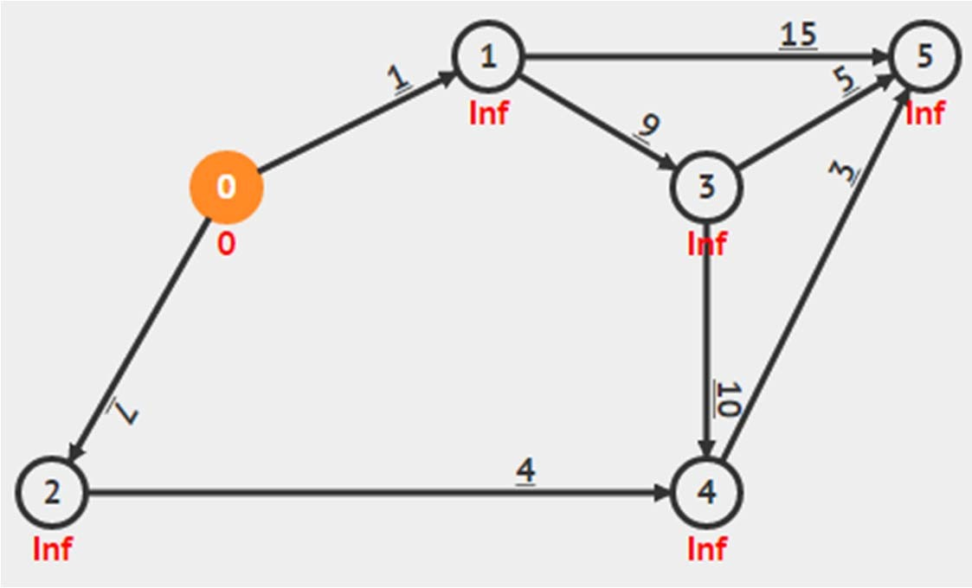
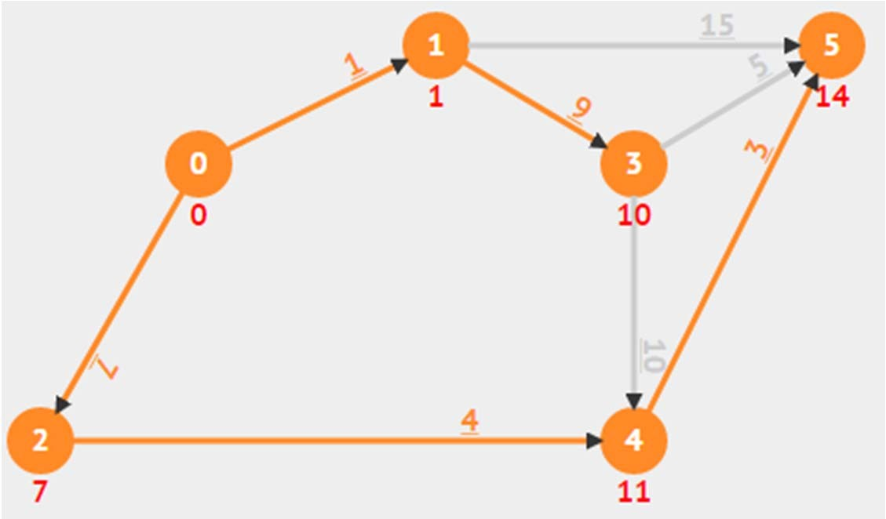
Try in VisuAlgo!
Topological Sort of this DAG is {0, 2, 1, 3, 4, 5}
Try relaxing the outgoing edges of vertices listed in the topological order above
With just one pass, all vertices will have the correct dist[v]
(This will be revisited in Lecture 10)

Slide 14
Special Case 4a:
The graph has no negative weight
Bellman Ford’s algorithm works fine for all cases of SSSP on weighted graphs, but it runs in O(VE)… ☹
For a “reasonably sized” weighted graphs with
V ~ 1000 and E ~ 100000 (recall that E = O(V²) in a complete simple graph), Bellman Ford’s is (really) “slow”…
For many practical cases, the SSSP problem is performed on a graph where all its edges have non‐negative weight
Example: Traveling between two cities on a map (graph) usually takes positive amount of time units
Fortunately, there is a faster SSSP algorithm
that exploits this property: The Dijkstra’s algorithm

Slide 15
The ‘original version’
DIJKSTRA’S ALGORITHM

Slide 16
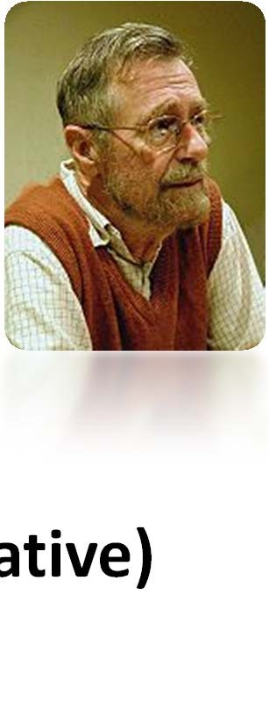
Key Ideas of (the original) Dijkstra’s Algorithm
ative)
Formal assumption:
For each edge(u, v) ∈ E, we assume w(u, v) ≥ 0 (non‐neg
Key ideas of (the original) Dijkstra’s algorithm:
Maintain a set S(olved) of vertices whose final shortest path weights have been determined, initially Solved = {s(ource)}, the source vertex s only
Repeatedly select vertex u in {V‐Solved} with the min shortest path estimate, add u to Solved, and relax all edges out of u
This entails the use of a kind of “Priority Queue”, Q: Why?
This choice of relaxation order is “greedy”: Select the “best so far”
But it eventually ends up with optimal result (see the proof later)

Slide 17
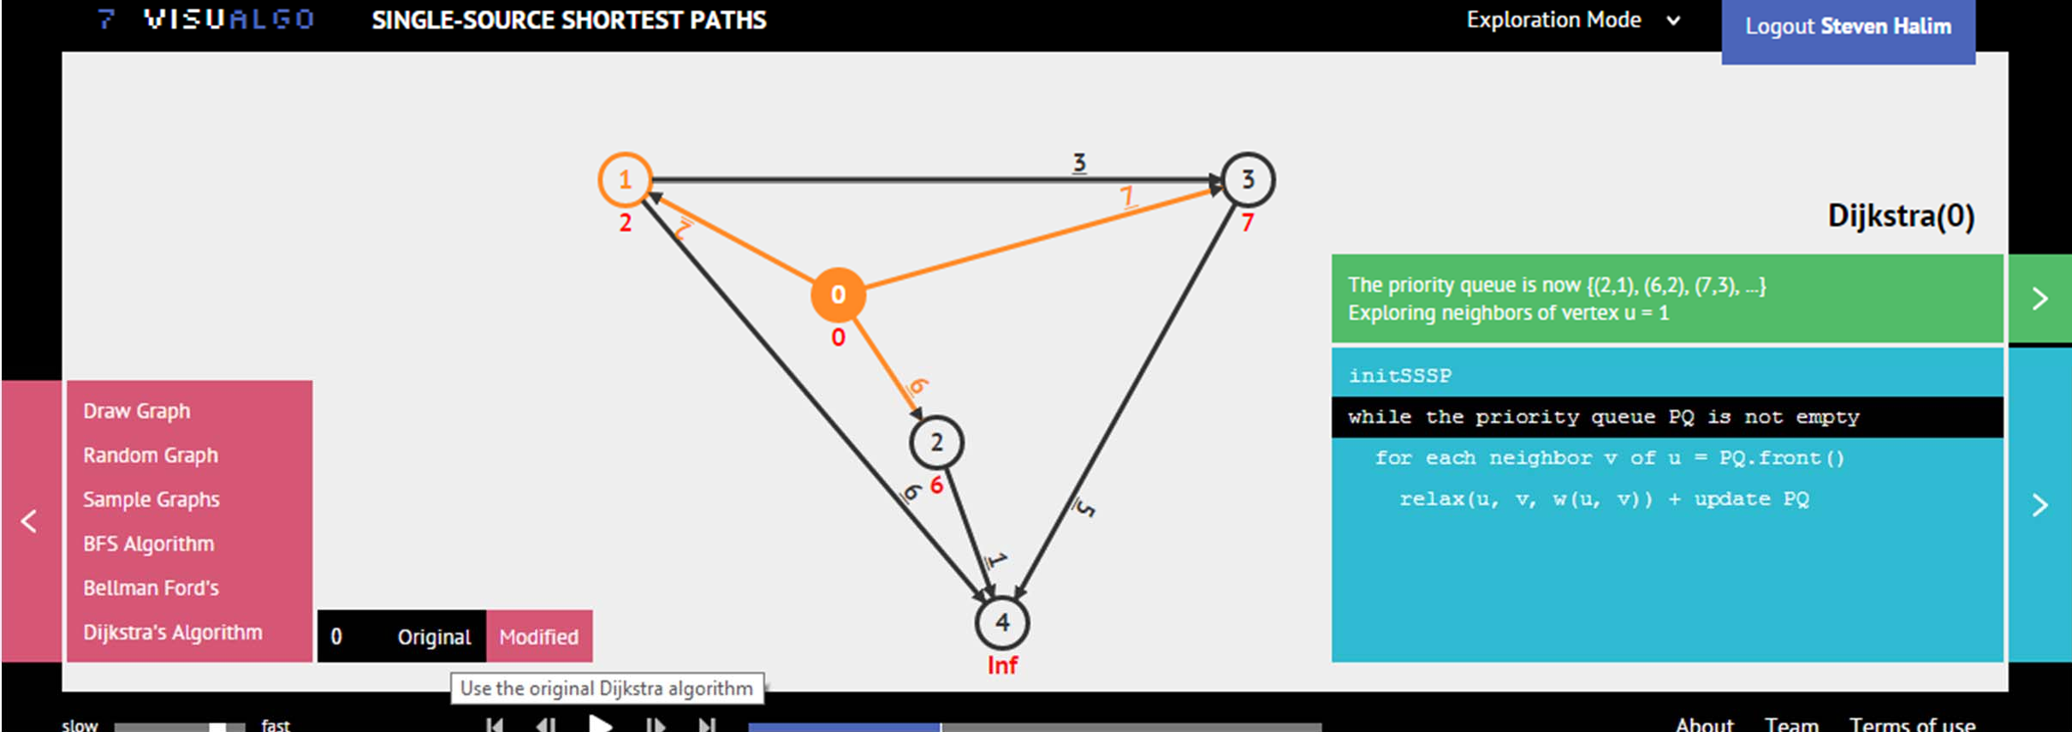
SSSP: Dijkstra’s (Original)
Ask VisuAlgo to perform Dijkstra’s (Original) algorithm
from various sources on the sample Graph (CP3 4.17)
The screen shot below shows the initial stage of
Dijkstra(0) (the original algorithm)

Slide 18
Why This Greedy Strategy Works? (1)
i.e. why is it sufficient to only process each vertex just once?
Loop invariant = Every vertices in set Solved have correct shortest path distance from source
This is true initially, Solved = {s} and dist[s] = δ(s, s) = 0
– FYI, to make it easier to vocalize the variable S, d, and δ, I purposely rename it to ‘S(olved)’, ‘dist(ance)’, and delta
Dijkstra’s algorithm iteratively adds the next vertex u
with the lowest dist[u] into set Solved
Is the loop invariant always valid?
Let’s see the next short proof first

Slide 19
Theorem: Subpaths of a shortest path are shortest paths
Let p be the shortest path: Let p_{ij} be the subpath of p:
p = ⟨v₀ , v₁, v₂ ,😐, v_{k} ⟩
^{p}ij
= ⟨v_{i} , v_{i+1} ,😐, v _{j} ⟩,0 ≤ i ≤ j ≤ k
Then p_{ij} is a shortest path (from i to j)
Proof by contradiction:
p
p
p
0i ij jk
Let the shortest path p = v₀ v_{i} v_{j} v_{k}
p_{ij}'
If p_{ij} is not the shortest path, the we have another p_{ij}’ that is shorter than p_{ij}. We can then cut out p_{ij} and replace it with p_{ij}’, which result in a shorter path from v₀ to v_{k}
But p is the shortest path from v₀ to v_{k} → contradiction!
Thus p_{ij} must be a shortest path between i and j

Slide 20
Why This Greedy Strategy Works? (2)
i.e. why is it sufficient to only process each vertex just once?
Dijkstra’s algorithm iteratively adds the next vertex u
with the lowest dist[u] into set Solved
What we know: Vertex u has the lowest dist[u]
It means that there is a vertex x already in Solved (hence dist[x] = δ(s, x)) connected to vertex u via an edge(x, u) and weight(x, u) is the shortest way to reach vertex u from x
Then dist[u] = dist[x]+weight(x, u) = δ(s, x)+δ(x, u) = δ(s, u)
– Recall: Subpaths of a shortest path are shortest paths too
Thus, when (the original) Dijkstra’s algorithm terminates, we have dist[v] = δ(s, v) for all v ∈ set V

Slide 21
Original Dijkstra’s – Analysis (1)
In the original Dijkstra’s, each vertex will only be extracted from the priority queue once
As there are V vertices, we will do this max O(V) times
Each extract min runs in O(log V) if implemented using binary min heap, ExtractMin() as discussed in Lecture 02 or using balanced BST, findMin() as discussed in Lecture 03‐04
Therefore this part is O(V log V)

Slide 22
Original Dijkstra’s – Analysis (2)
Every time a vertex is processed, we relax its neighbors
In total, all O(E) edges are processed
If by relaxing edge(u, v), we have to decrease dist[v], we call the O(log V) DecreaseKey() in binary min heap (harder to implement) or simply delete old entry and then re‐insert new entry in balanced BST (which also runs in O(log V), but this is much easier to implement)
– PS: The easiest implementation is to use Java TreeSet as the PQ
This part is O(E log V)
Thus in overall, Dijkstra’s runs in O(V log V + E log V), or more well known as an O((V+E) log V) algorithm

Slide 23
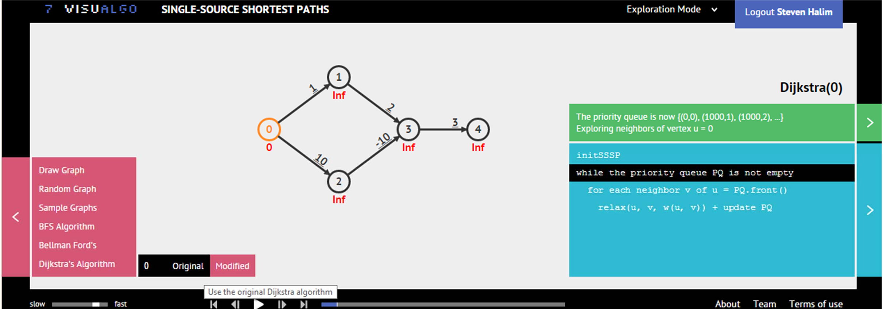
Wait… Let’s try this!
Ask VisuAlgo to perform Dijkstra’s (Original) algorithm from source = 0 on the sample Graph (CP3 4.18)
Do you get correct answer at vertex 4?

Slide 24
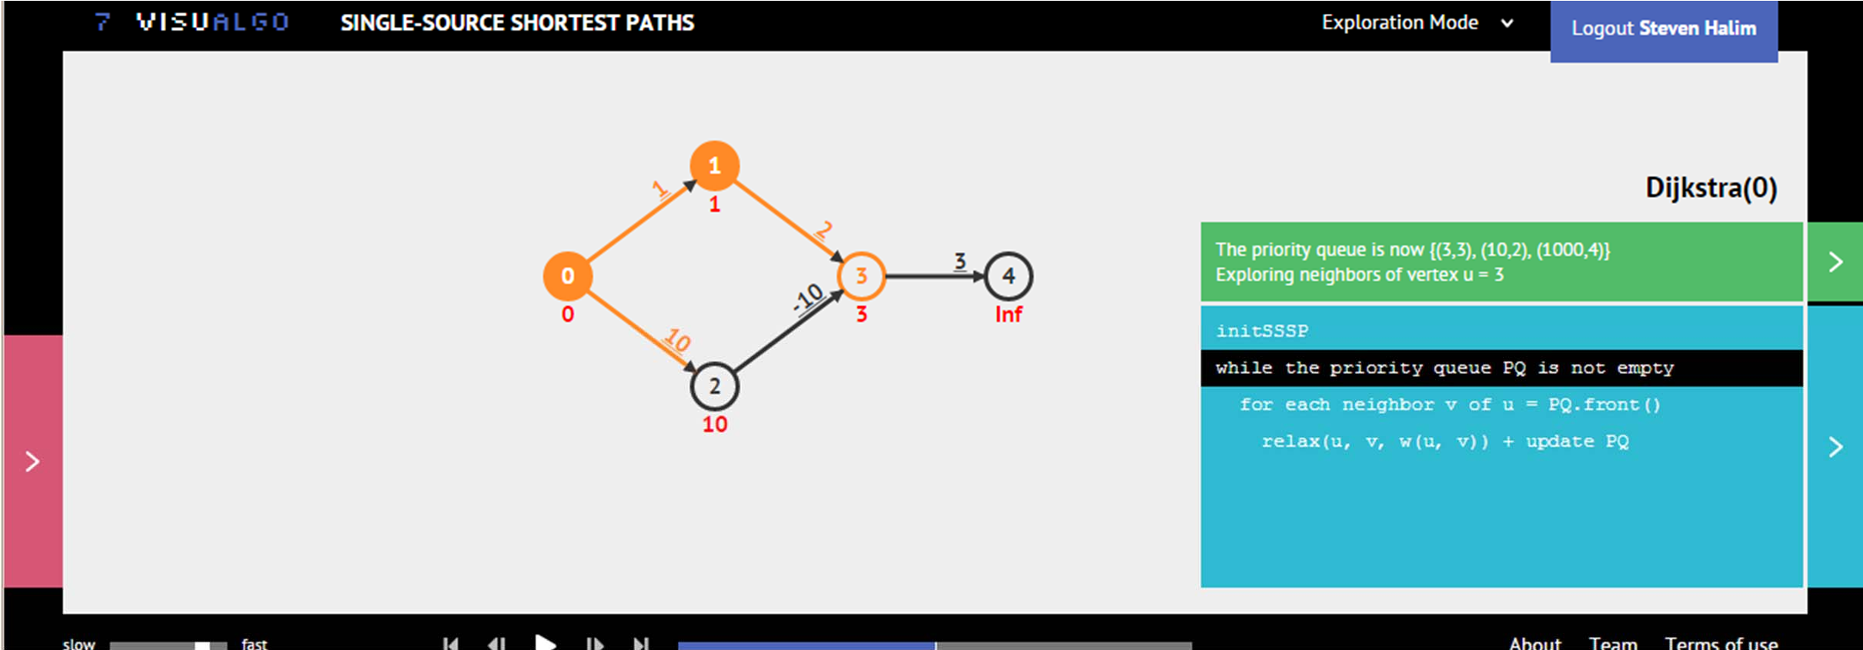
Why This Greedy Strategy Does Not Work This Time ☹?
The presence of negative‐weight edge can cause the vertices “greedily” chosen first eventually not the true “closest” vertex to the source!
It happens to vertex 3 in this example
The issue is here…

Slide 25
The ‘modified’ implementation
DIJKSTRA’S ALGORITHM

Slide 26
Special Case 4b:
The graph has no negative weight cycle
For many practical cases, the SSSP problem is performed on a graph where its edges may have negative weight but it has no negative cycle
Example: Traveling between two cities on a map (graph) using electric car with battery to minimize battery usage:
We take (+) energy from the battery if the road is flat or go uphill
We recharge the battery (i.e. take ‐energy) if the road goes downhill
But we cannot keep cycling around to recharge the battery forever due to kinetic energy loss, etc
We have another version of Dijkstra’s algorithm that can handle this case: The Modified Dijkstra’s algorithm

Slide 27
Modified Implementation (1)
of Dijkstra’s Algorithm (CP3, Section 4.4.3)
Formal assumption (different from the original one):
The graph has no negative weight cycle
(but can have negative weight edges :O)
Key ideas:
We use a built‐in priority queue in C++ STL/Java Collections
to order the next vertex u to be processed based on its dist[u]
– This vertex information is stored as IntegerPair (dist[u], u)
But with modification: We use “Lazy Data Structure” strategy to avoid implementing “DecreaseKey()” in C++/Java PQ library

Slide 28
Modified Implementation (2)
of Dijkstra’s Algorithm (CP3, Section 4.4.3)
Lazy DS: Get pair (d, u) in front of the priority queue PQ
with the minimum shortest path estimate so far
if d = dist[u], we relax all edges out of u,
else if d > dist[u], we have to delete this inferior (d, u) pair
See below to understand that we do not delete the wrong (d, u) pair immediately, but instead, we wait until the last possible moment (lazy)
If dist[v] of a neighbor v of u decreases, enqueue (dist[v], v) to
PQ again for future propagation of shortest path distance info
Here we adopt a lazy approach not to delete the “wrong (d, u) pair” at this point of time. Q: Why?
Because C++/Java PriorityQueue (Binary Heap) does not have feature to efficiently search for certain entries other than the minimum one!

Slide 29
Modified Dijkstra’s Algorithm
initSSSP(s)
PQ.enqueue((0,
s)) //
store
pair
of (dist[u], u)
while
(d,
PQ is not empty
u) ←
// order:
increasing
dist[u]
PQ.dequeue()
if d == dist[u] //
important v adjacent
check, to u
lazy DS
for each vertex
if dist[v]
> dist[u]
+ weight(u,
v) // can
relax
dist[v] = dist[u] + weight(u,
v) //
relax
PQ.enqueue((dist[v], v)) // (re)enqueue
this

Slide 30
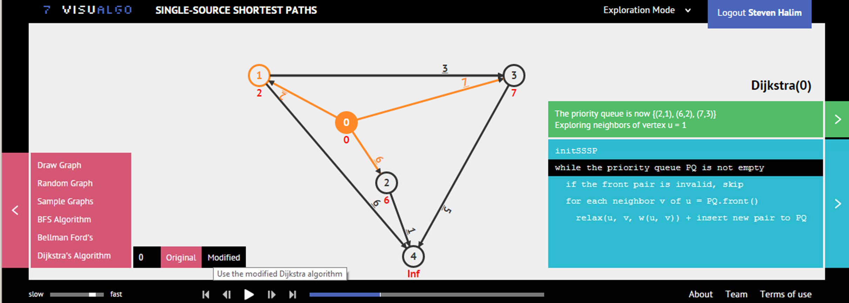
SSSP: Dijkstra’s (Modified)
Ask VisuAlgo to perform Dijkstra’s (Modified) algorithm
from various sources on the sample Graph (CP3 4.17)
The screen shot below shows the initial stage of
Dijkstra(0) (the modified algorithm)

Slide 31
Modified Dijkstra’s – Analysis (1)
We prevent processed vertex to be re‐processed again if its d > dist[u]
If there is no‐negative weight edge, there will never be another path that can decrease dist[u] once u is greedily processed. Q: Why? (PS: we have just seen this case)
Each vertex will still be processed from the PriorityQueue once; or all vertices are still processed in O(V) times
Each extract min still runs in O(log V) with Java PriorityQueue (essentially a binary heap)
– PS: There can be more than one copies of u in the PriorityQueue, but this will not affect the O(log V) complexity, see the next slide

Slide 32
Modified Dijkstra’s – Analysis (2)
Every time a vertex is processed, we try to relax all its neighbors, in total all O(E) edges are processed
– If relaxing edge(u, v) decreases dist[v], we re‐enqueue the same vertex (with better shortest path distance info), then duplicates may occur, but the previous check (see previous slide) prevents re‐processing of this inferior (dist[v], v) pair
∃ O(E) copies of inferior (dist[v], v) pair if each edge causes a relaxation
Each insert still runs in O(log V) in PriorityQueue/Binary heap
This is because although there can be at most E copies of (dist[v], v) pairs, we know that E = O(V²) and thus O(log E) = O(log V²) = O(2 log V) = O(log V)
Thus in overall, modified Dijkstra’s run in O((V+E) log V)
if there is no‐negative weight edge

Slide 33
Try!
Ask VisuAlgo to perform Dijkstra’s (modified) algorithm from source = 0 on the sample Graph (CP3 4.18)
Do you get correct answer at vertex 4?

Slide 34
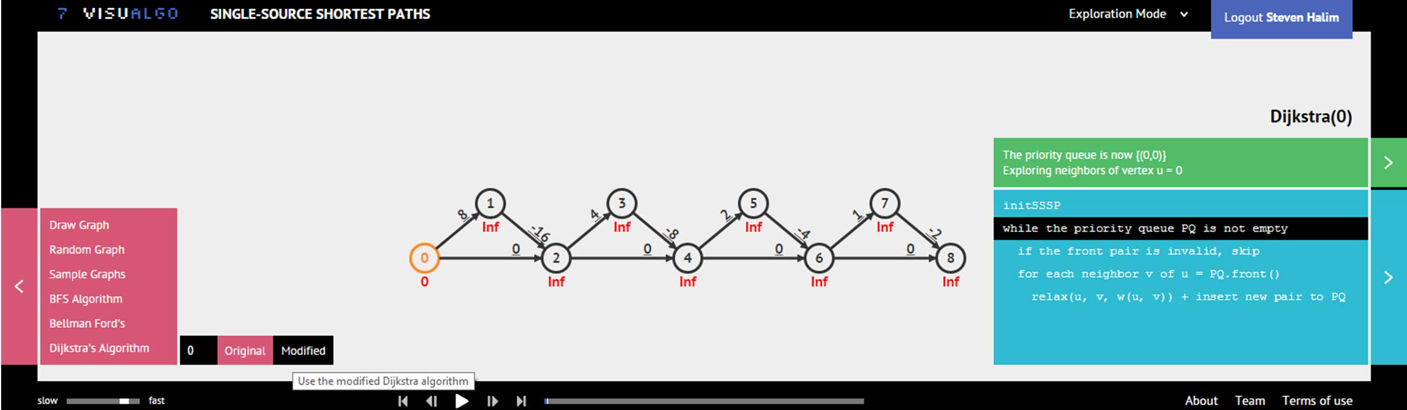
Not an all‐conquering algorithm… Check this
If there are negative weight edges without negative cycle, then there exist some (extreme) cases where the modified Dijkstra’s re‐process the same vertices several/many/crazy amount of times…
Your Lab TA will discuss this case on Thursday of Week09

Slide 35
About that Extreme Test Case
Such extreme cases that causes exponential time complexity (discussed in Lab Demo) are rare and thus in practice, the modified Dijkstra’s implementation runs much faster than the Bellman Ford’s algorithm ☺
If you know if your graph has only a few (or no) negative weight edge, this version is probably one of the best current implementation of Dijkstra’s algorithm
But, if you know for sure that your graph has a high probability of having a negative weight cycle, use the tighter (and also simpler) O(VE) Bellman Ford’s algorithm as this modified Dijkstra’s implementation can be trapped in an infinite loop

Slide 36
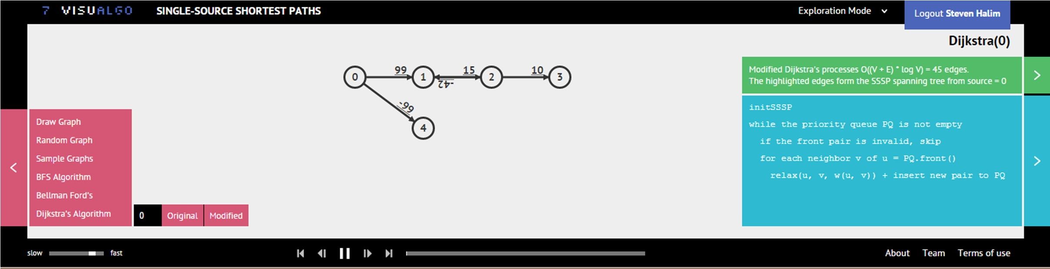
Try Sample Graph, CP3 4.19!
Find the shortest paths from s = 0 to the rest
Which one can terminate?
The original or the modified Dijkstra’s algorithm?
Which one is correct when it terminates?
The original or the modified Dijkstra’s algorithm?

Slide 37
Java Implementation
There is no DijkstraDemo.java this time (you will implement the pseudo‐code shown in this lecture by yourself when you do your PS5 Subtask B
But I will show the algorithm performance on:
Small graph without negative weight cycle
OK
Small graph with some negative edges; no negative cycle
Still OK ☺
Small graph with negative weight cycle
SSSP problem is ill undefined for this case
The modified Dijkstra’s can be trapped in infinite loop

Slide 38
Summary of Various SSSP Algorithms
General case: weighted graph
Use O(VE) Bellman Ford’s algorithm (the previous lecture)
Special case 1: Tree
Use O(V) BFS or DFS ☺
Special case 2: unweighted graph
Use O(V+E) BFS ☺
Special case 3: DAG (precursor to DP, revisited next week)
Use O(V+E) DFS to get the topological sort,
then relax the vertices using this topological order
Special case 4ab: graph has no negative weight/negative cycle
Use O((V+E) log V) original/modified Dijkstra’s, respectively

Slide 39
Online Quiz 2 (OQ2) Preparation ☺
After Lecture 09, I will set a random test mode
@ VisuAlgo to see if you are ready for OQ2
OQ2 material: A bit of OQ1 material, and mostly Graph DS, Graph Traversal (DFS/BFS), MST (Prim’s/Kruskal’s),
SSSP (Bellman Ford’s/Dijkstra’s)
Meanwhile, train first:
http://visualgo.net/training.html?diff=Hard&n=20&tl=40&module=graphds,graphtraversal,mst,sssp

Slide 40
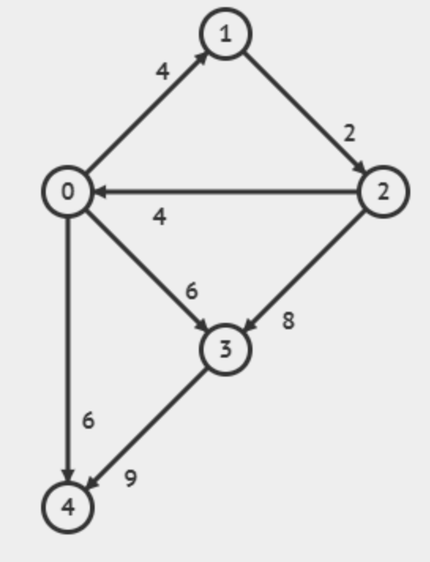
Revision
Dùng giải thuật Dijkstra bắt đầu từ đỉnh 1, tìm đường đi ngắn nhất trong đồ thị sau:

