Slide 1
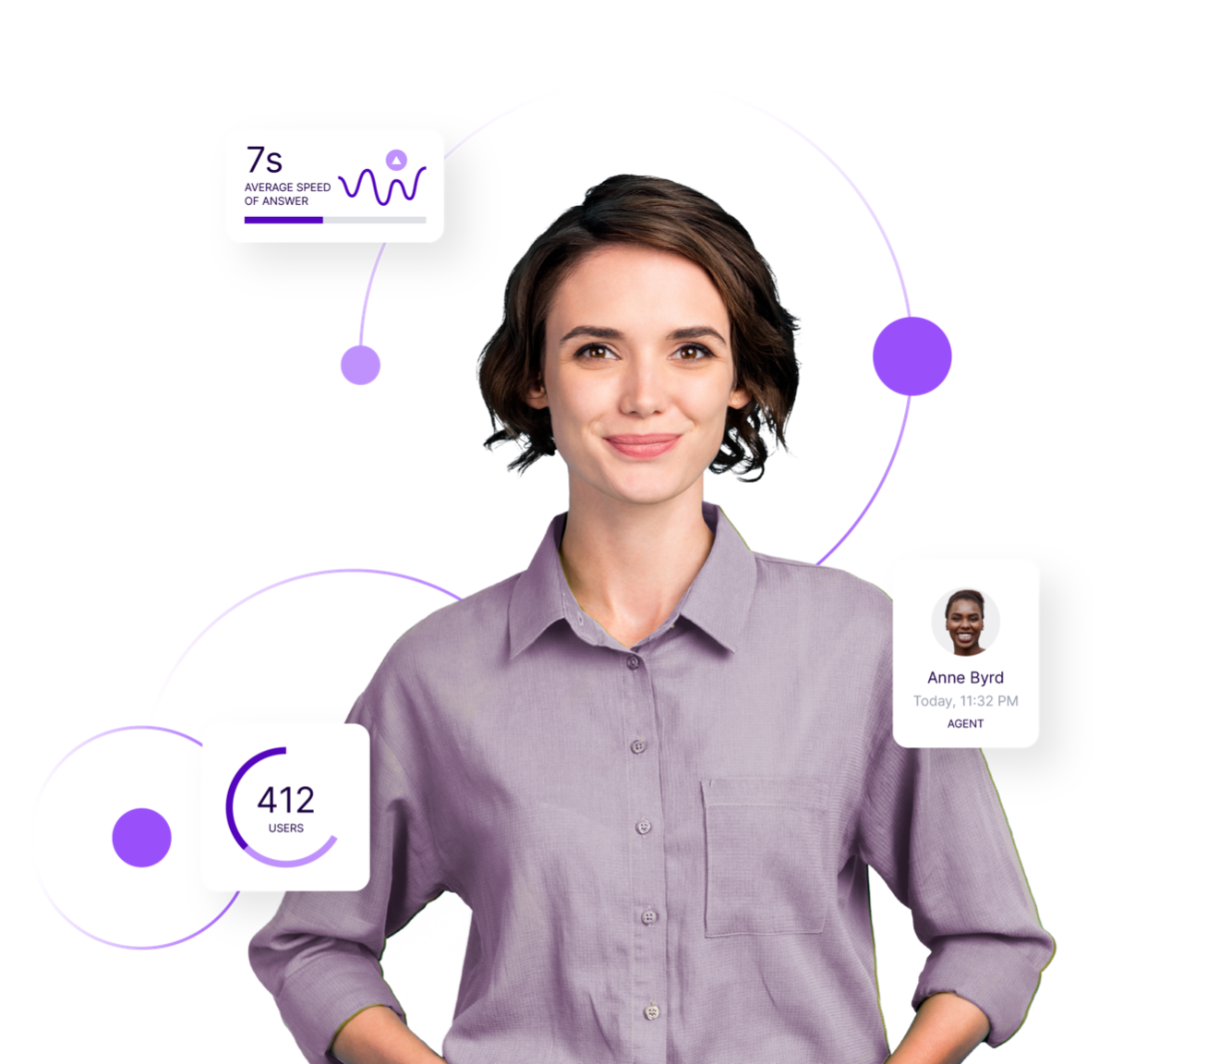
Semi annual report presentation
July - August 2021

