Slide 1
Questionnaire app

Slide 2
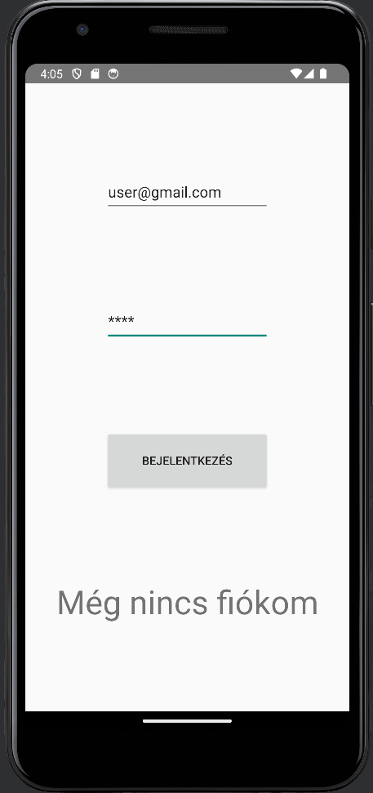
Login Screen
Checks email and password from database
Redirect users without an account to registration
Redirects Admin and Student to different activity (not implemented yet

Slide 3
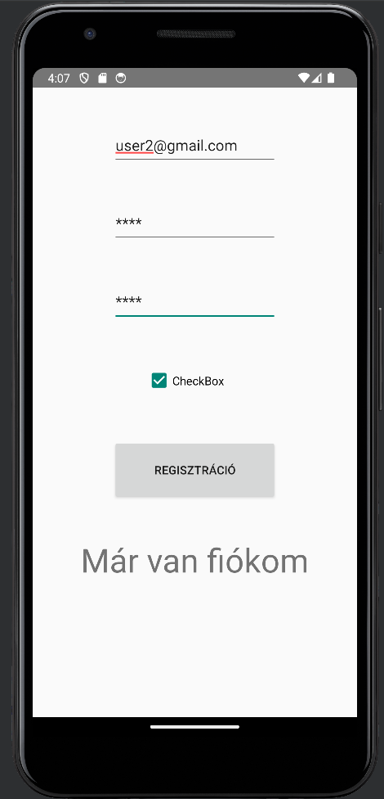
Sign up Screen
-Stores the new user’s data into the database
-Redirects users with an account to the login screen

Slide 4
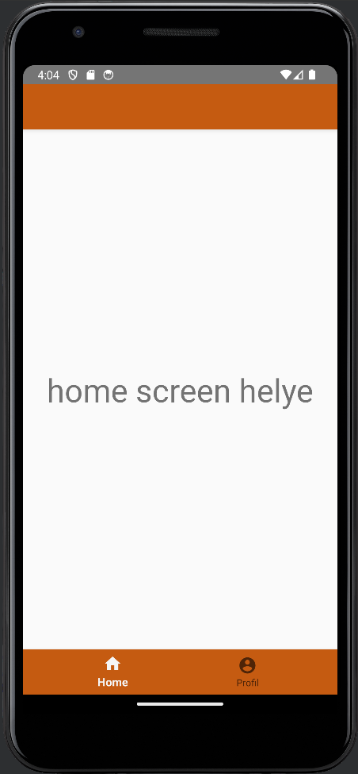
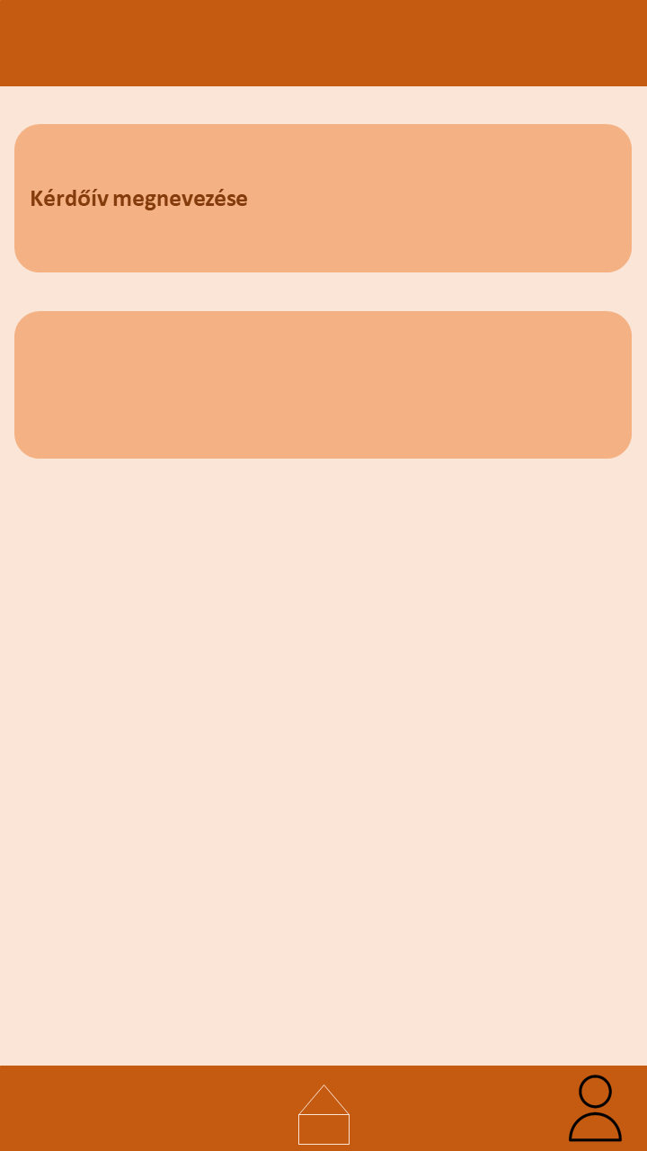
Home Screen
- Will diplay the questionnaires to the user

Slide 5
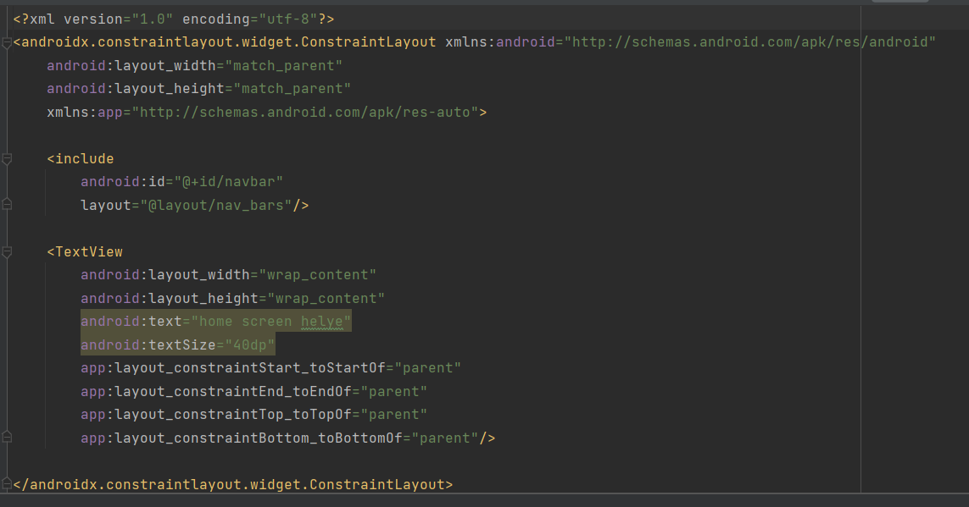

Slide 6
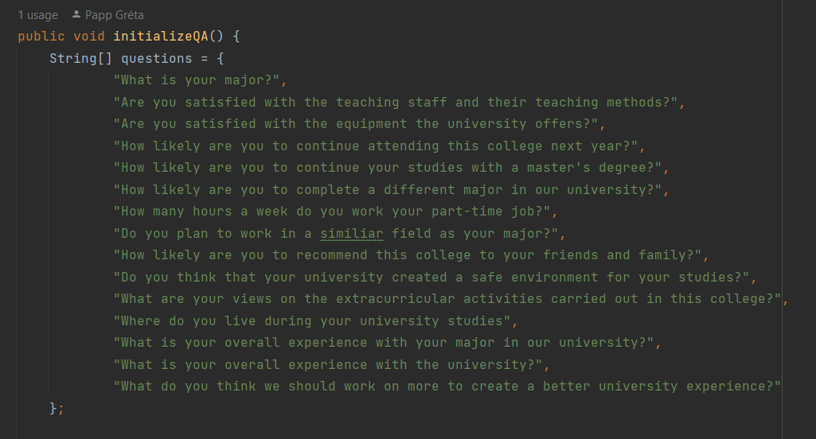
Questions

Slide 7
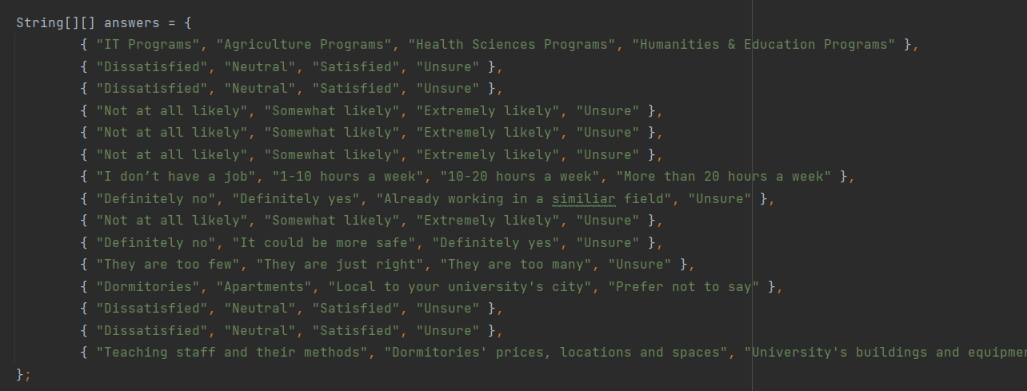
Possible Answers

Slide 8
Things that are still before us
Questionnaire screen, profile screen and statistic screen
Display Questions and Answers
Store user answers
Evaulate the collected data
Login and sing up backend

