Slide 1
Exploring US Import & Export Data with the Census API
Group Members:
Evan Grillo
Ayman Alklaqe
Tom Danner

Slide 2
What’s ahead…
Did you know that there was a $160 billion decrease in total import value in the year 2020?
Some might be surprised that Savannah, GA and New Orleans, LA & Detroit, MI are in the top 10 of US ports by total import value…

Slide 3
Key Questions Explored
This project aims to address fundamental queries concerning US import and export data:
What is the US Trade Deficit between imports and exports?
What are the top US ports for imports and exports?
What are the top products imported and exported?
What are the top US trading partners for imports and exports?

Slide 4
Where to get US import and export data?
API:
https://api.census.gov/data/timeseries/intltrade/exports/hs/variables.html
US Census API
Imports
Exports
Import / Export Ports

Slide 5
Data Cleanup & Exploration
Evan
Navigating Census API documentation & testing endpoints with Postman
Formatting large dollar sums
Fetching latitude and longitude coordinates for geo plots
Tom
Type casting / formatting pre v.s. post concat
Formatting HVplots
Ayman
Dropping unnecessary columns in a DataFrame
Changing the index of a DataFrame
Turning strings into integers using pd.to_numeric()

Slide 6
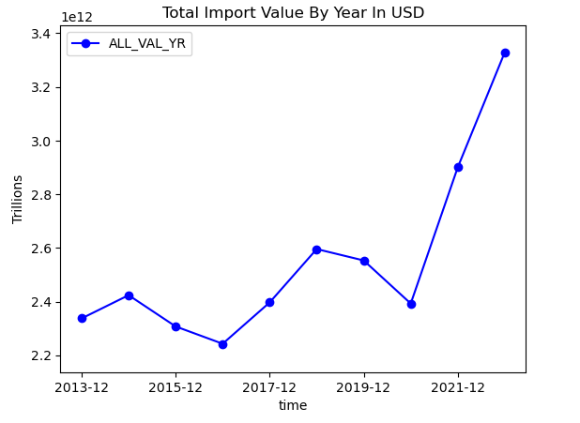
Were there any years with an overall decrease in total import value?
Total Import Value:
Year | Amount In USD
12-2013 | 2,337,205,579,089
12-2014 | 2,423,791,959,001
12-2015 | 2,307,278,565,689
12-2016 | 2,242,798,371,753
12-2017 | 2,396,814,030,861
12-2018 | 2,595,696,327,457
12-2019 | 2,553,173,110,266
12-2020 | 2,392,676,604,862
12-2021 | 2,900,188,307,696
12-2022 | 3,328,976,095,745
Amount In USD

Slide 7
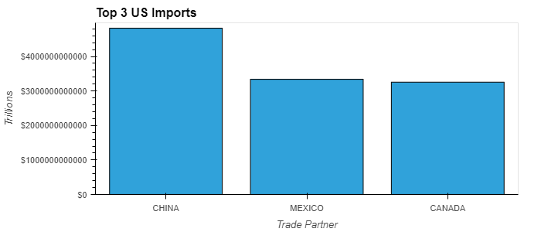
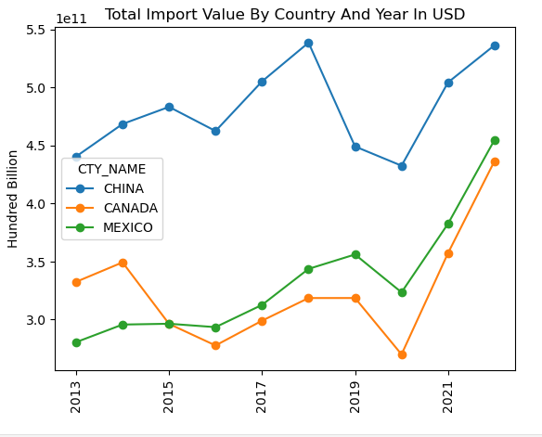
What Are The Top 3 Countries By Import Value?
‘

Slide 8
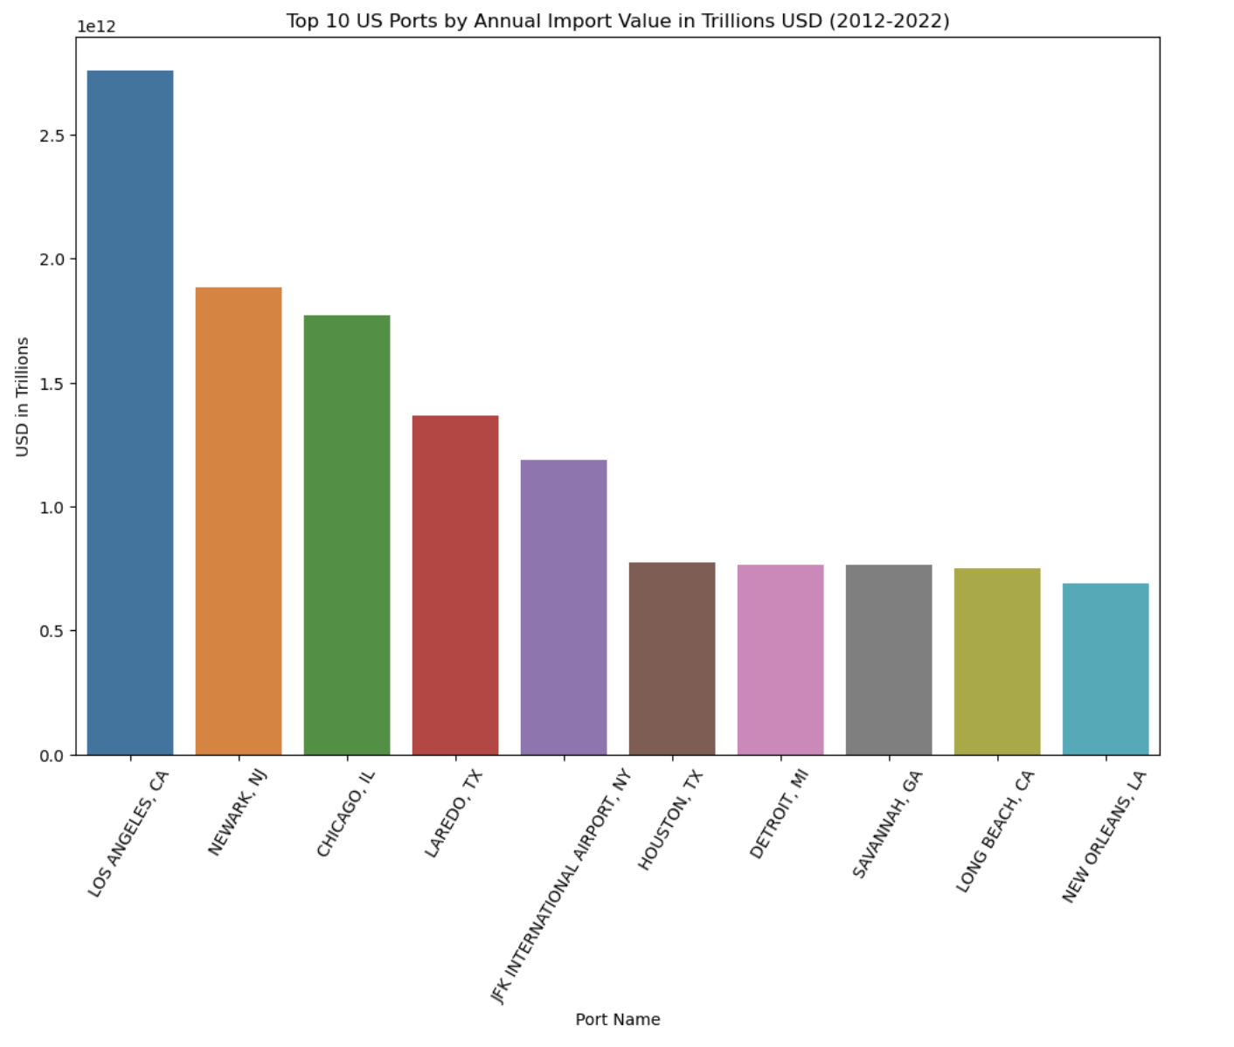
US Ports & Imports
Top Imported Commodity into Los Angeles, CA:
ELECTRICAL MACHINERY AND EQUIPMENT AND PARTS THEREOF; SOUND RECORDERS AND REPRODUCERS, TELEVISION RECORDERS AND REPRODUCERS, PARTS AND ACCESSORIES
Value: $4.76 bn
Top Imports by Country into Los Angeles, CA:
ASIA: $2.55 tn
APEC: $2.50 tn
PACIFIC RIM COUNTRIES: $2.19 tn
CHINA: $1.39 tn
OECD: $620.29 bn
ASEAN: $465.75 bn
JAPAN: $354.94 bn
VIETNAM: $189.52 bn
TAIWAN: $136.31 bn
KOREA, SOUTH: $126.89 bn

Slide 9
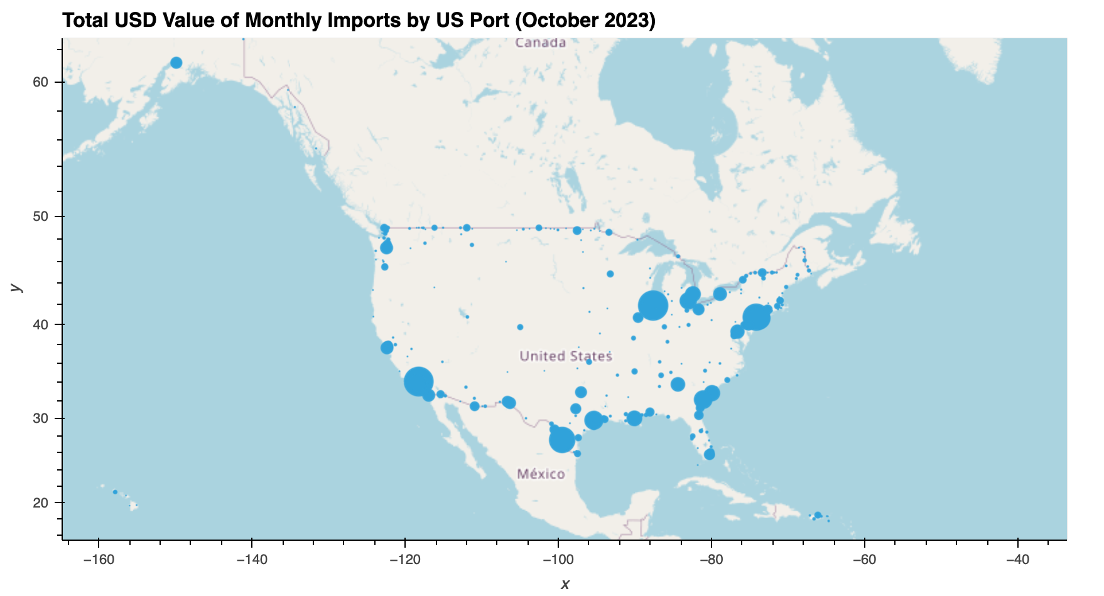
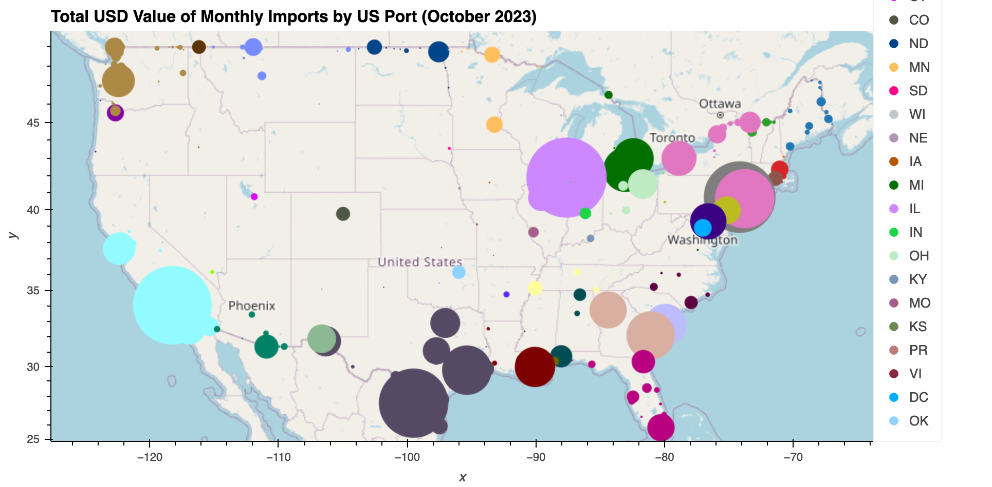
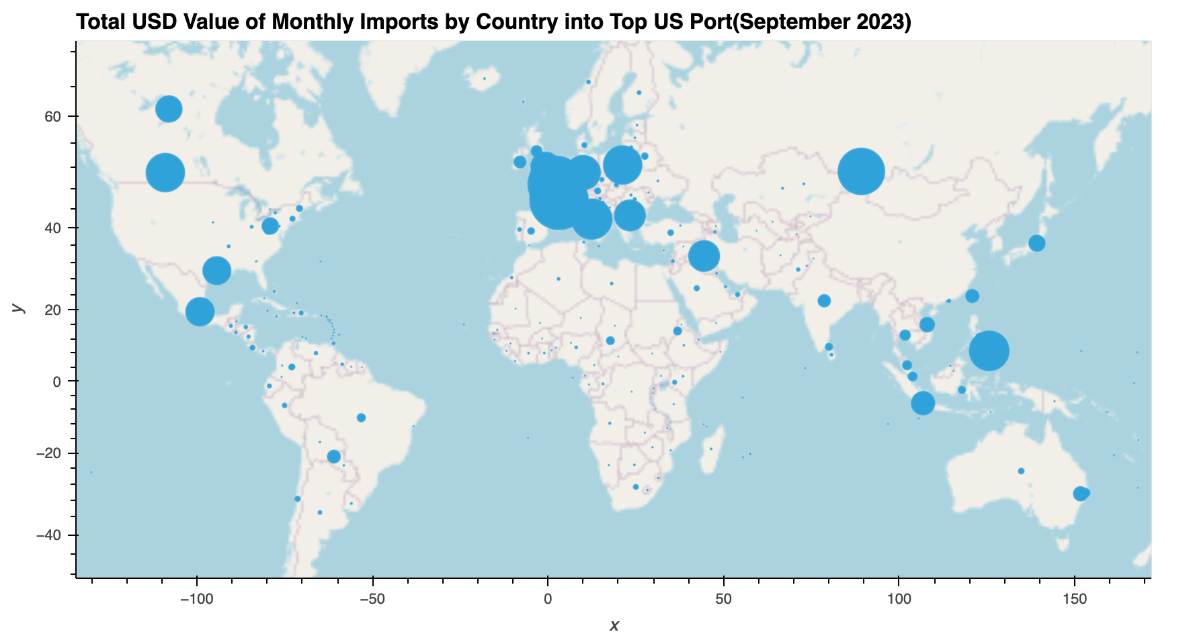
Geo Mapping
Imports Ports (geopy > Nominatim)

Slide 10
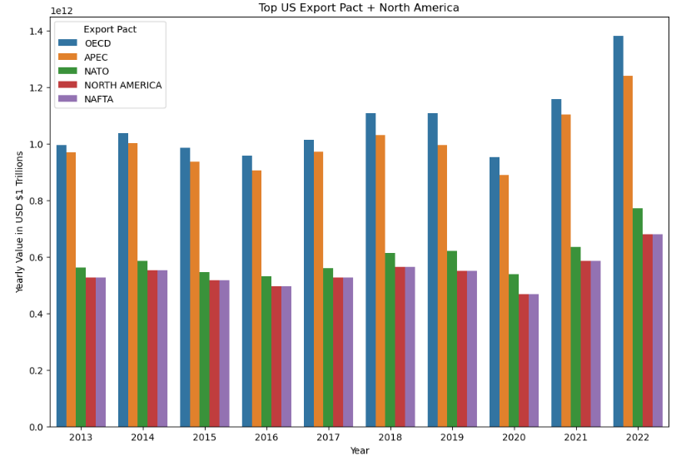
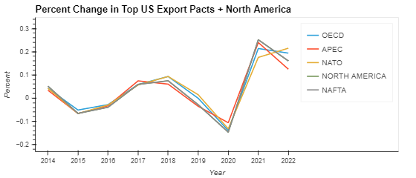
Top US Export Pacts + NA
2015 strengthening dollar / weakening global economy
2020 covid
2021 bounce back after covid
2022 Supply line strengthening / forced economic growth
Total Exported In USD From 2013 - 2022
Pact / Continent | Amount
OECD - Organisation for Economic Co-operation and Development | $10.70 Trillion
APEC - Asia-Pacific Economic Cooperation | $10.05 Trillion
NATO - North Atlantic Treaty Organization | $5.97 Trillion
North America - Continent (non specific) | $5.47 Trillion
NAFTA - North American Free Trade Agreement | $5.47 Trillion

Slide 11
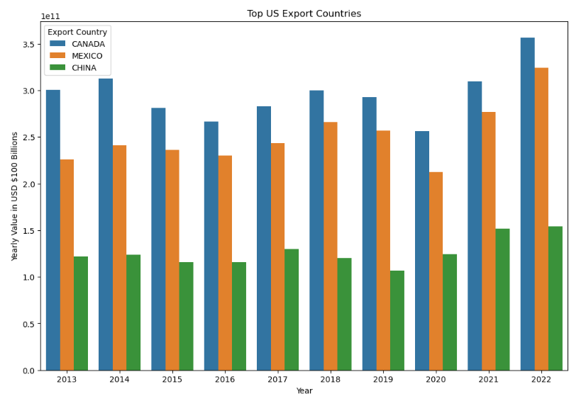
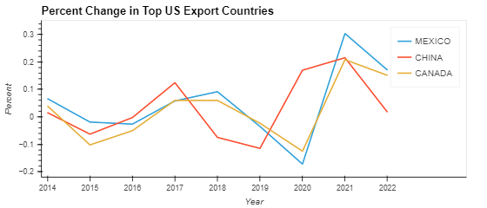
Top US Export Countries
2015 strengthening dollar / weakening global economy
2020 covid
July 2018 - Jan 2020 US - China Trade War
2020 China recovering from Covid and agree to receive soy beans and natural gas from US in trade truce
2020 covid hit the world hard outside of China
2021 bounce back after covid
2022 Supply line strengthening / forced economic growth
Total Exported In USD From 2013 - 2022
Country | Amount
CANADA | $2.96 Trillion
MEXICO | $2.51 Trillion
CHINA | $1.26 Trillion

Slide 12
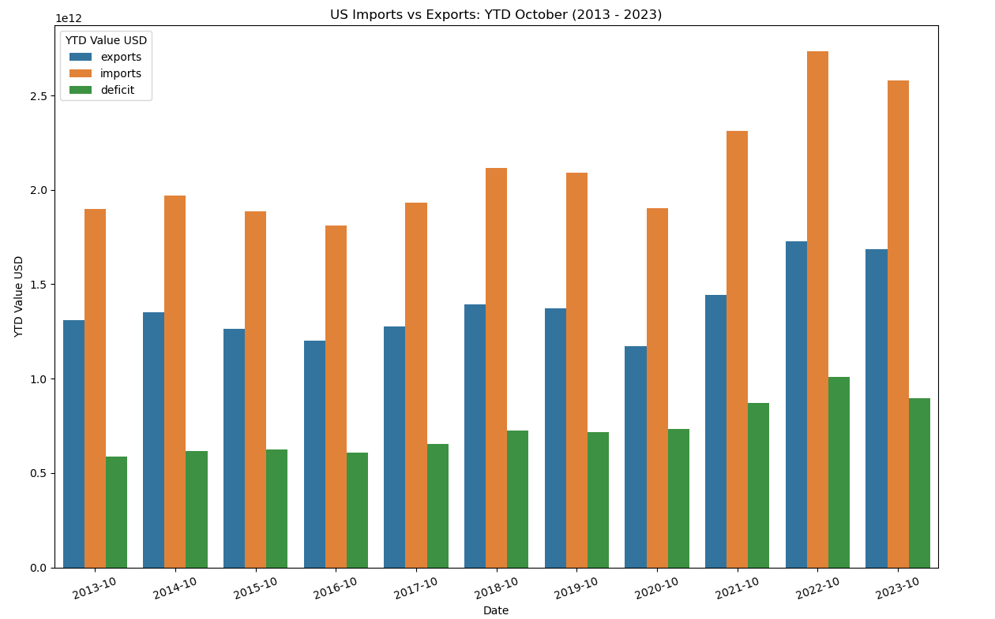
What’s the US Trade Deficit?
YTD October 2013 - 2023
Average: $731.04 bn
Standard Deviation: $137.38 bn
Latest: $895.03 bn (2023)
Max: $1.01 trn (2022)
Min: $586.51 bn (2013)
Year | Deficit Decrease from Previous Year
2016 | $14.13 bn
2019 | $6.00 bn
2023 | $112.58 bn

Slide 13
Postmortem
Challenges:
Inconsistent data (e.g CTY_NAME)
Geomapping returned odd results for some values
Commodity data categorized by container instead of individual commodity.
Next Steps:
Quantify trends against influential factors like policy changes and social events
Sharpen queries and aim to answer more specific and focused questions

Slide 14
Q & A

