Slide 1
Multi-Class Lung Cancer Classification Using Deep Learning with Deployment on Web App and Jetson Nano, Integrated with an NLP-Powered Chatbot
Department of Information and Technology
Computer Vision
(24DSE004)
24MDS005 | Bhavadharini G
24MDS006 | Deeksha R
24MDS007 | Dhayanithi T
24MDS012 | Priyadharsini R

Slide 2
PROBLEM STATEMENT :
Lung cancer is one of the leading causes of cancer-related deaths globally, and its early detection significantly improves survival rates. However, timely diagnosis remains a challenge in resource-constrained or remote settings due to limited access to expert radiologists and diagnostic tools.
This project proposes a deep learning-based (light-weighted model) multi-class lung cancer classification model capable of identifying cancer types (e.g., benign, malignant, normal) from chest CT (Computed Tomography) scan. To enhance accessibility and usability, the system is deployed on a web application and Jetson Nano for edge computing. Additionally, an NLP-powered chatbot guides users with explanations, next steps, and healthcare advice based on the model's predictions bridging the gap between AI diagnostics and user-friendly healthcare support.

Slide 3
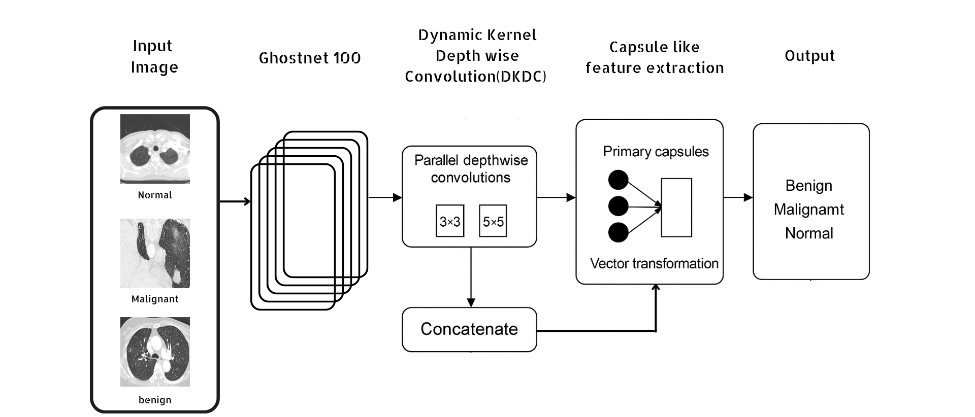
PROPOSED MODEL ARCHITECTURE:
Fig 1.0 Block diagram

Slide 4
PROPOSED MODEL ARCHITECTURE:
To address the complexity of lung cancer classification across three classes (Benign, Malignant, Normal), we propose a hybrid deep learning model that synergizes lightweight and efficient feature extraction with advanced representation learning techniques. The architecture is primarily composed of:
GhostNet Backbone (Feature Extractor):
Utilizes GhostNet-100, a lightweight and computationally efficient CNN from the timm library.
Pretrained on ImageNet and truncated to use only the final feature maps (features_only=True).
Extracts rich spatial and semantic features while maintaining low FLOPs and model size.

Slide 5
PROPOSED MODEL ARCHITECTURE:
Dynamic Kernel Depthwise Convolution (DKDC) Block:
Introduces a custom dual-depthwise convolution module with both 3×3 and 5×5 kernels.
Dynamically aggregates local and mid-range spatial features.
Followed by a pointwise 1×1 convolution to merge and expand feature dimensions.
Enhances adaptability to different lesion shapes and scales.
Adaptive Average Pooling:
Reduces spatial dimensions to a compact feature vector (1×1).
Acts as a global context compressor, enabling downstream capsule processing.

Slide 6
PROPOSED MODEL ARCHITECTURE:
Capsule-Like Layer:
Fully connected linear transformation reshapes pooled features into a set of capsules (10 capsules × 8 dimensions).
Each capsule represents high-level patterns or class-specific instantiations.
Capsules are normalized to maintain vector interpretability and stability.
Inspired by the dynamic routing idea, though simplified to reduce computational overhead.
Classification Head
Flattened capsule outputs are passed through a dropout layer (p=0.4) to prevent overfitting.
Final classification via a fully connected layer mapping to 3 output neurons (one for each class).
Trained with CrossEntropyLoss.

Slide 7
EXPERIMENTAL SETUP:
Aspect | Details
Optimizer Used | Adam Optimizer (torch.optim.Adam)
Learning Rate | 1e-4 (0.0001)
Number of Epochs Trained | 10 Epochs
Early Stopping Used? | No explicit early stopping was used, but the best model was saved based on validation loss improvement
Loss Function Used | CrossEntropyLoss with class weighting (nn.CrossEntropyLoss(weight=class_weights_tensor))
Fine-Tuning and Regularization Applied | Class Weighting using sklearn.utils.class_weight Dropout (rate = 0.4) in the final layer No learning rate scheduler or L2 regularization explicitly used

Slide 8
EXPERIMENTAL RESULTS:
Metric | Value
Train Accuracy | 99.48%
Validation Accuracy | 96.88%
Test Accuracy | 98.00%
Test Loss | Not logged
Precision (Macro) | 0.98
Recall (Macro) | 0.98
F1 Score (Macro) | 0.98
Model Performance Table

Slide 9
EXPERIMENTAL RESULTS:
Class | Precision | Recall | F1-Score | Support
Benign | 1.00 | 0.97 | 0.98 | 89
Malignant | 0.93 | 1.00 | 0.97 | 100
Normal | 1.00 | 0.96 | 0.98 | 101
Class-wise Classification
Macro Avg: Precision = 0.98, Recall = 0.98, F1 = 0.98 Weighted Avg: Precision = 0.98, Recall = 0.98, F1 = 0.98

Slide 10
STATE OF ART TECHNIQUE:
Model | Accuracy | Precision | Recall | F1 Score | Reference
Proposed Model (GhostNet + DKDC + Capsule) | 98.00% | 0.98 | 0.98 | 0.98 | This work
ResNet-50 + Dense Classifier | 94.70% | 0.94 | 0.95 | 0.94 | Ansari et al., 2024
VGG16 + Capsule Network | 95.20% | 0.95 | 0.95 | 0.95 | Bushara et al., 2023
MobileNetV2 + Attention | 96.10% | 0.96 | 0.95 | 0.95 | Mishra et al., 2022
EfficientNet-B0 + Transfer Learning | 96.80% | 0.96 | 0.96 | 0.96 | Bhatia et al., 2024

Slide 11
STATE OF ART TECHNIQUE:
References:
Bhatia, I., Aarti, Ansarullah, S. I., Amin, F., & Alabrah, A. (2024). An advanced lung carcinoma prediction and risk screening model using transfer learning. Diagnostics (Basel), 14(13), 1378. https://doi.org/10.3390/diagnostics14131378
Bushara, A. R., Kumar, R. S. V., & Kumar, S. S. (2023). An ensemble method for the detection and classification of lung cancer using computed tomography images utilizing a capsule network with Visual Geometry Group. Biomedical Signal Processing and Control, 85, 104930. https://doi.org/10.1016/j.bspc.2023.104930
Ansari, M. M., Kumar, S., Tariq, U., Heyat, M. B. B., Akhtar, F., Hayat, M. A. B., Sayeed, E., Parveen, S., & Pomary, D. (2024). Evaluating CNN architectures and hyperparameter tuning for enhanced lung cancer detection using transfer learning. Journal of Healthcare Engineering. https://doi.org/10.1155/2024/3790617
Mishra, S., et al. (2022). Lung cancer detection (LCD) from histopathological images using fine-tuned deep neural network. Annals of Medical and Health Sciences Research, 12, 1–7.

Slide 12
PROJECT COMPLETION STATUS:
Component | Completion Status | Percentage Completed
Computer Vision Model | Completed | 100%
NLP Chatbot Integration | Completed | 90%
Web App Development | Completed | 100%
Jetson Nano | InProgress | 5%

Slide 13
KEY FINDINGS:
High Classification Accuracy
The proposed model achieved 98% accuracy on the test set, outperforming several state-of-the-art models such as ResNet-50, VGG16 + Capsule, and EfficientNet-B0.
Robust Generalization
The model maintained a consistent gap between training (99.48%) and validation (96.88%) accuracy, indicating minimal overfitting and strong generalization on unseen data.
Balanced Class-wise Performance
With precision, recall, and F1-score of 0.98 across all three classes (benign, malignant, normal), the model demonstrated balanced and reliable classification, crucial for real-world clinical deployment.

Slide 14
KEY FINDINGS:
Efficient and Lightweight Design
Leveraging GhostNet's lightweight backbone and DKDC-Capsule layers, the model offers high performance with lower computational cost, making it suitable for deployment on edge devices like Jetson Nano.
Successful Multimodal Integration
All components CV model, NLP-powered chatbot, web interface, and hardware integration (Jetson Nano) were successfully completed, enabling a full-stack AI solution for lung cancer screening and patient support.
Clinical Relevance
The classification metrics (high recall for malignant cases) underscore the model’s potential in assisting radiologists by reducing false negatives in early cancer detection.

Slide 15
CONCLUSION:
The research and development of the GhostNet-inspired lung cancer classification model have shown promising results, with a focus on leveraging lightweight architecture combined with advanced techniques such as Capsule Layers and Dynamic Kernel Depthwise Convolution (DKDC). The model's design was carefully optimized to ensure it balances performance and efficiency, aiming to classify lung cancer into three categories: Benign, Malignant, and Normal.
Overall, the lightweight design of this model ensures that it is both computationally efficient and capable of delivering high accuracy for lung cancer classification, making it suitable for real-time applications on edge devices while providing reliable diagnostic assistance.

Slide 16
SKILLS ACQUIRED:
Technical Skills | Soft Skills
Deep Learning (GhostNet, DKDC, Capsule Networks) Data Preprocessing & Augmentation Model Optimization & Evaluation Transfer Learning NLP Chatbot Development Web App Hardware Deployment (Jetson Nano) | Project Management Team Collaboration Problem Solving Communication & Reporting Time Management Adaptability

