Slide 1
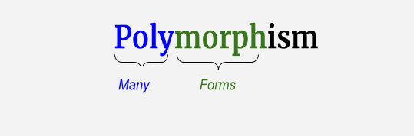
Presented By:
Name: DHAYANITHI T
ID : STB030018
Associated with Scifor Technologies

Slide 2
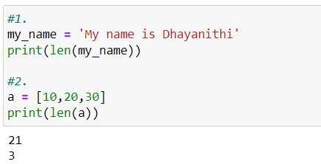
Polymorphism
Polymorphism is taken from the Greek words Poly(many) and morphism(forms).
In programming, it refers to methods/functions/operators with the same name that can be executed on many objects or classes.
Function polymorphism : An example of python function is the len() function that can be used
on different objects.

Slide 3
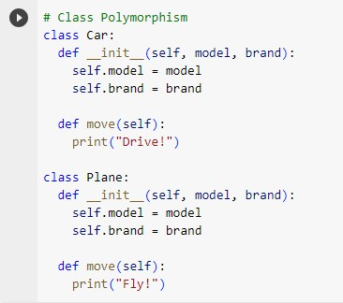
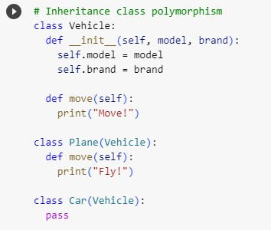
Class polymorphism : Polymorphism is often used in Class methods, where we can have multiple
classes with the same method name. For example, we have two classes: Car , Plane and they
all have same method called move():
Inheritance class polymorphism: In python, polymorphism lets us define methods in the child class that have the same name as the methods in the parent class.

Slide 4
Polymorphism
You all must have used GPS for navigating the route, Isn’t it amazing how many different routes you come across for the same destination depending on the traffic, from a programming point of view this is called ‘polymorphism’. It is one such OOP methodology where one task can be performed in several different ways. To put it in simple words, it is a property of an object which allows it to take multiple forms.
Polymorphism is of two types:
❑ Compile-time Polymorphism
❑ Run-time Polymorphism

Slide 5
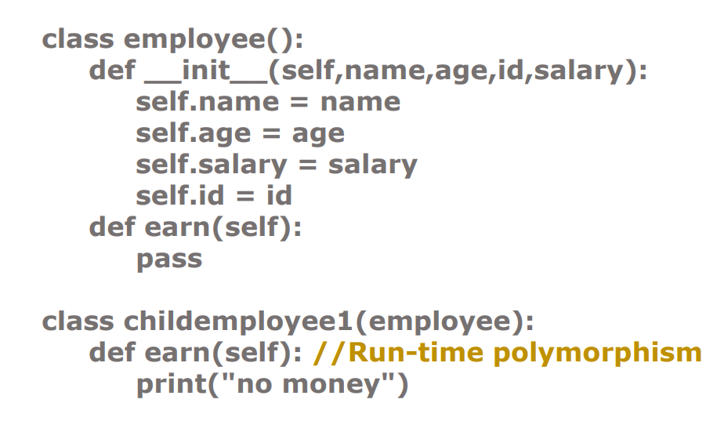
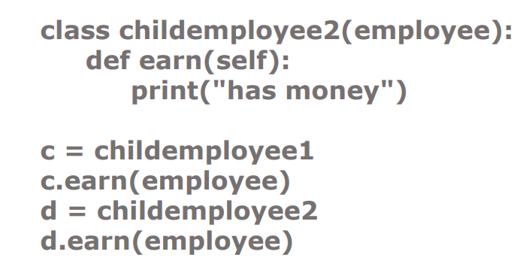

Polymorphism
Run-time Polymorphism:
A run-time Polymorphism is also, called as dynamic polymorphism where it gets resolved into the run time. One common example of Run-time polymorphism is “method overriding” .

Slide 6
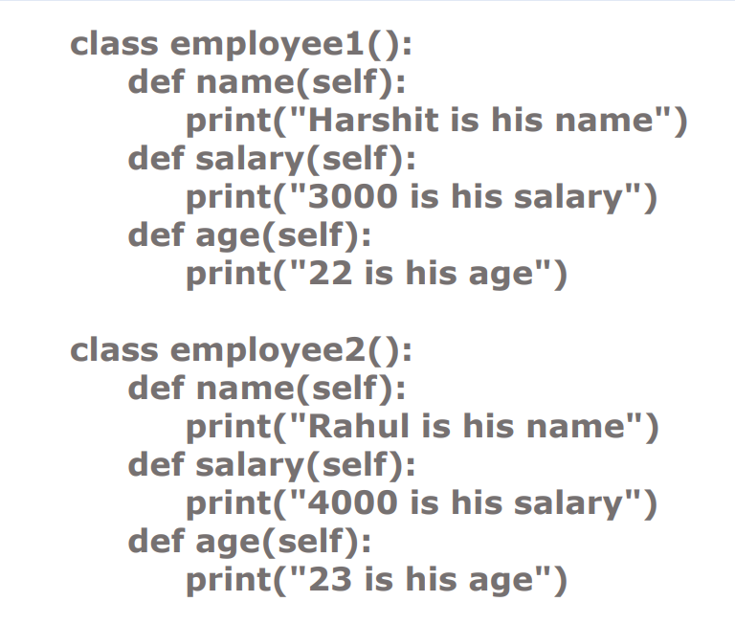
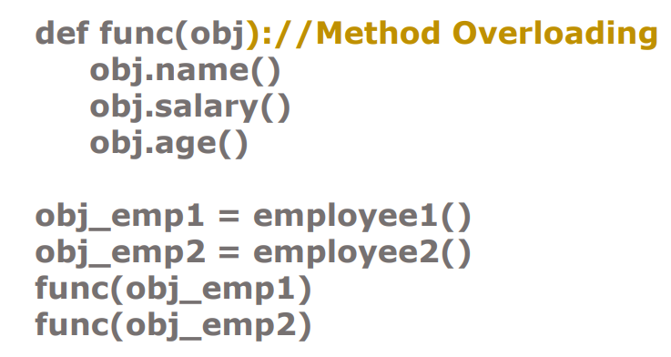
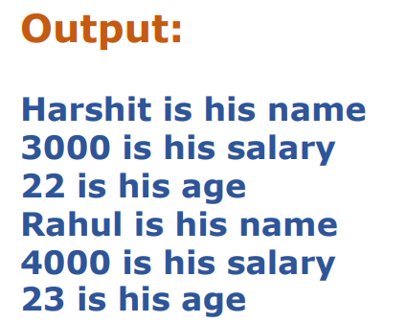
Polymorphism
Compile-time Polymorphism:
A compile-time polymorphism also called as static polymorphism which gets resolved during the compilation time of the program. One common example is “method overloading”

Slide 7
THANK YOU

