Slide 1
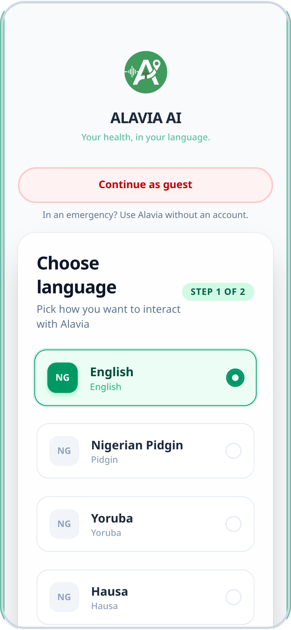
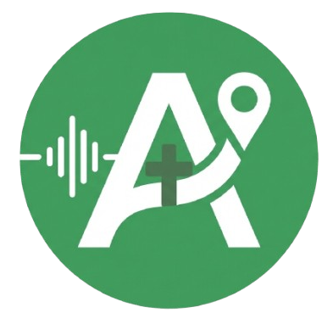
Your health, in your language.
ALAVIA AI
A voice-first AI health partner for Nigeria. Say what is wrong in English, Pidgin, Yoruba, Hausa or Igbo, and Alavia tells you what to do next.
Live MVP alavia-ai.vercel.app
Team NIBBLE
Notes:
Open with the line, not the product. "Your health, in your language." Alavia is a voice-first health partner for Nigeria: you describe what is wrong in English, Pidgin, Yoruba, Hausa or Igbo and it tells you what to do next. The app on the right is the live MVP.

Slide 2
Alavia means health route
Part 1
Root
Part 2
Together
Ala
Via
Alavia
From Alafia, Yoruba for health, wellbeing and peace
The route, the way to the right care
A health route, from symptoms to the right care
What the name stands for
How it shows up
Alafia: wellbeing and peace of mind
Via: the way to the right care
A route from symptoms to action
Said and heard in five Nigerian languages
Voice-first, in your language
First-aid steps for the moment
Hospitals ranked for your case
A follow-up after every check

Slide 3
When something feels wrong, most people are left to guess
Most digital health tools assume English, typing and a clear sense of how serious a symptom is. Real life is messier.
1
Language barrier
Hard to explain a concern in a second language
2
Text-heavy screens
Typing and reading shut people out
3
No sense of urgency
“Is this serious? Where do I go?”
Waiting too long, or the wrong next step
4
Chatbots stop at talking
An answer, but no action
5
The wrong facility
The nearest hospital is not always the right one
Notes:
The problem is not a lack of health information. It is five small frictions that stack up: the language barrier, text-heavy screens, not knowing how urgent it is, chatbots that answer but do not act, and picking a facility that cannot actually help. Everyone in this room has asked "is this serious, and where do I go?"

Slide 4
One journey, from “something is wrong” to “I know what to do next”
1
2
3
4
5
Speak
Ask
Assess
Guide
Route
Describe it by voice or text, in your language
Targeted questions, one at a time
Red flags checked. Urgency from Low to Critical
Safe first-aid steps for the moment
The nearest suitable hospital, on a map
Not a doctor. Not an emergency service. Alavia is the first point of guidance, and it sends serious cases to professional care.
Notes:
Five steps, one flow. You speak, it asks the right questions one at a time, it checks for red flags and sets an urgency level, it gives safe first-aid steps, and it routes you to a hospital. The difference from a chatbot is that every conversation ends in an action. And we are clear about the limits: it is guidance, not a doctor.

Slide 5
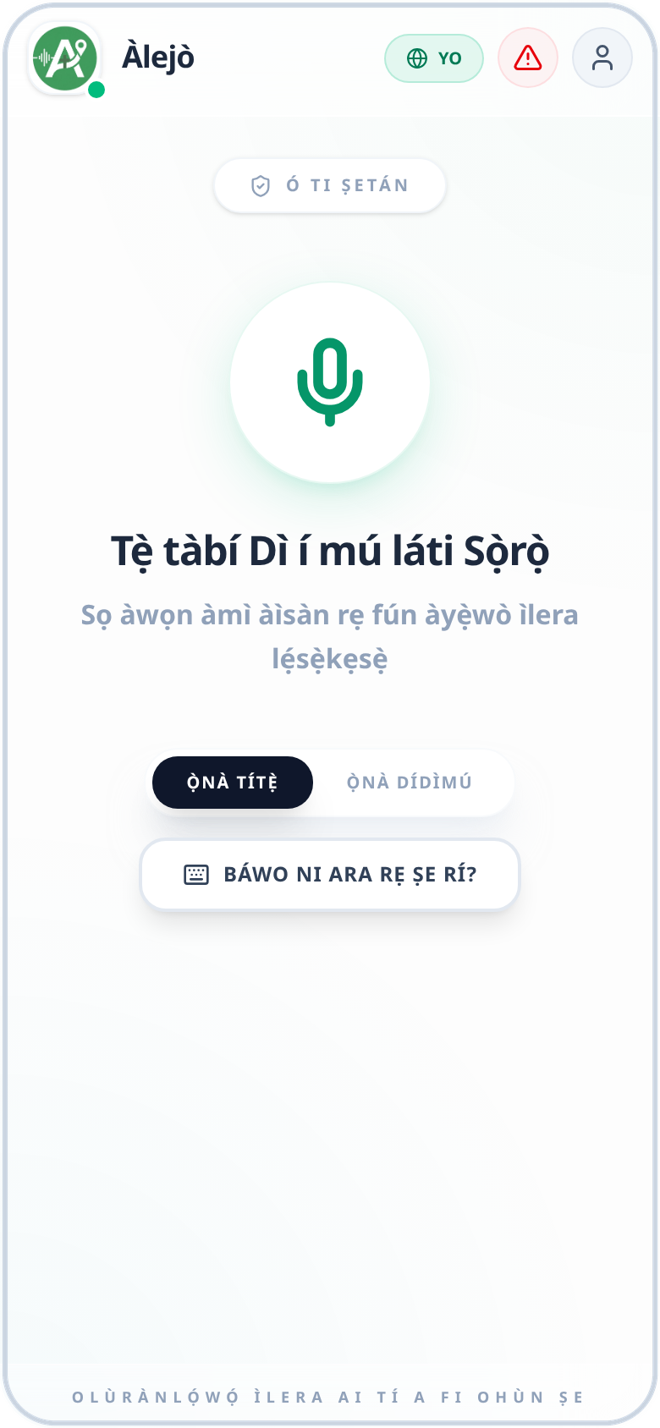
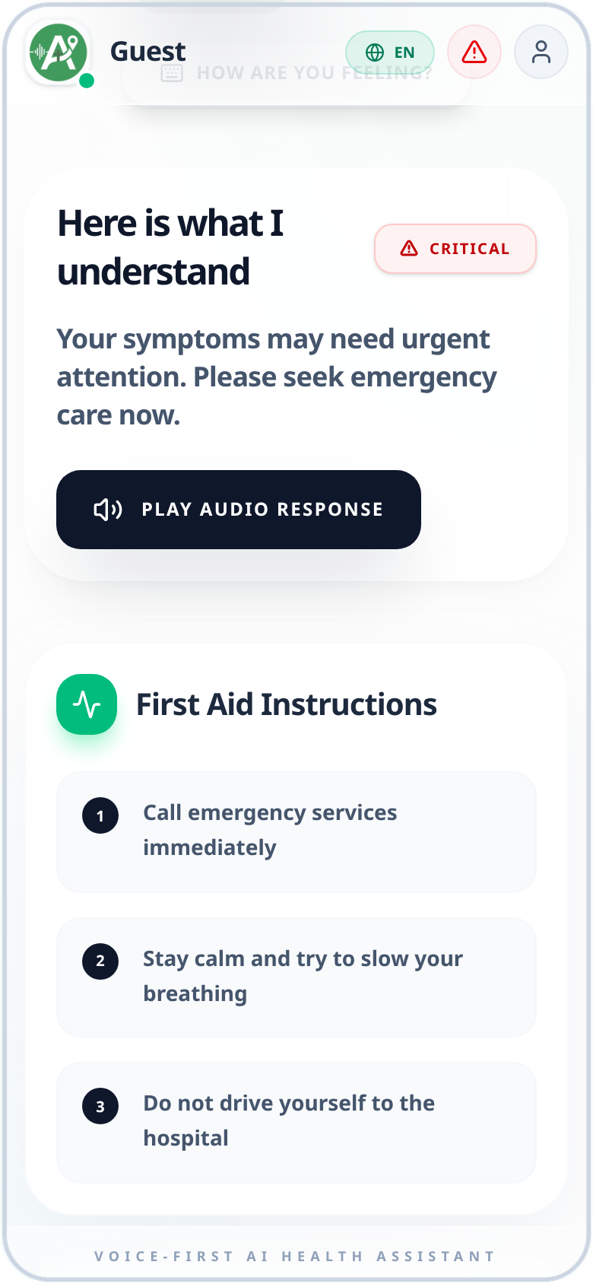
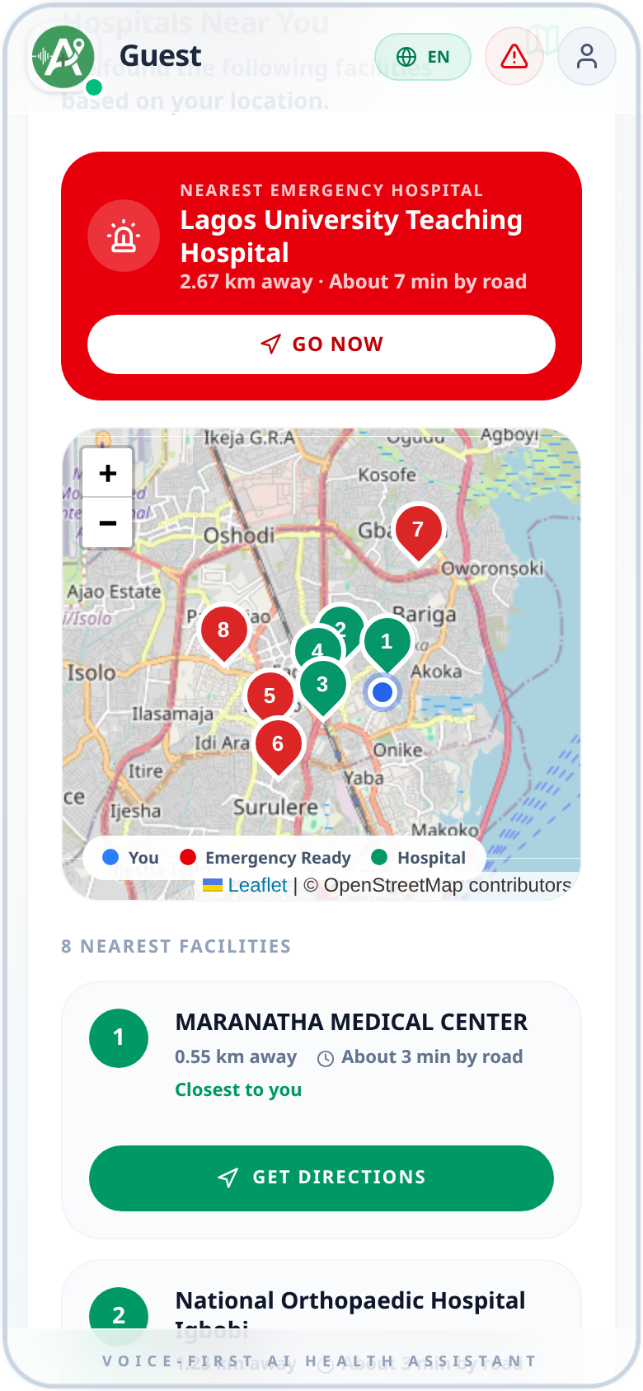
Live today: the whole journey, end to end
Pick your language
The whole app speaks it
Urgency and first aid
Nearest emergency hospital
Notes:
This is the real app, not mock-ups. Language first. The whole interface switches, here in Yoruba. After the questions you get an urgency level and first-aid steps, in this case Critical for chest pain with trouble breathing. Then the nearest emergency hospital on a real map, with directions. If this is the moment for a live demo, do it here: pick Pidgin, tap the keyboard, type "my chest dey pain me, I no fit breathe", and let it run to the map.

Slide 6
What’s new in the app
Result screen
Shipped
Voice
Input
First aid first
One voice, faster
A bigger mic
What to do comes before hospitals, for every severity
First sentence plays as soon as it is ready
Tap or Hold, with the mode always visible
On the result screen
Across the app
First-aid steps first, hospitals second
No reply bar once the check is done
Hospitals ranked by distance and capability
Feedback and follow-up check-in
English, Pidgin, Yoruba, Hausa and Igbo
Only one voice speaks at a time
Voice speed 1.1x by default
Old audio never plays over the next question

Slide 7
Safety first, conversation second
Four urgency levels
Red flags escalate at once
Low
Stable, no major warning signs
Trouble breathing, chest pain, heavy bleeding, collapse and stroke signs are recognised in English, Pidgin, Yoruba, Hausa and Igbo.
Medium
May need care soon, not an emergency now
It checks back on you
Later, Alavia asks how you feel now. Answer “worse” and emergency help opens straight away.
High
Could be serious. Needs urgent assessment
Never a diagnosis
Critical
Possible emergency. Get professional care now
No prescribing and no dosing. The limits are stated plainly to every user.
Notes:
This is a health product, so safety is the feature. Four urgency levels. Red-flag symptoms escalate immediately, and we tested that the same chest-pain-with-breathing-trouble complaint comes out Critical in English, Pidgin and Yoruba, because under-triage in a local language is the dangerous failure. Alavia also checks back later, and if you say you are worse it opens emergency help. And it never diagnoses or prescribes.

Slide 8
Free for people, funded by the healthcare system around them
Who it serves
How it earns
Individuals and families
Hospital partnerships
Hospital software
Hospitals and clinics
Verified profiles and better patient discovery
Navigation, intake, referrals and analytics as a subscription
HMOs
Employers and universities
Institutions
Consumer access
NGOs and community programmes
HMOs, employers, universities and NGOs offer Alavia to their people
Free or very low cost, so reach stays wide
First market: Lagos pilot
Notes:
People pay little or nothing, which keeps reach wide. The money comes from the healthcare ecosystem that benefits when patients arrive at the right door: hospitals paying for verified profiles and discovery, a hospital software subscription later, and institutions such as HMOs, employers, universities and NGOs deploying Alavia for their people. We start with a Lagos pilot. Have your own market-size and pricing numbers ready for questions: the product document deliberately does not state any.

Slide 9
Start in Lagos, then grow through hospitals and communities
Stage 1
Built today
Stage 2
Stage 3
AI health companion
Healthcare navigation
Access ecosystem
Understand symptoms, ask the right questions, set urgency
Verified hospitals, clinics and professionals
Hospitals, HMOs, employers and NGOs on one trusted platform
What the pilot proves
How people find us
Adoption and repeat use
Voice usability in each language
Triage and routing quality
Hospital partnerships and trust
QR codes and posters in partner hospitals
Schools and universities
Churches, mosques and youth groups
NGOs and community health workers
Notes:
Three stages. Stage one, the AI health companion, is built and live. Stage two connects people to verified hospitals, clinics and professionals. Stage three is the access layer connecting hospitals, HMOs, employers and NGOs. The Lagos pilot proves adoption, voice usability per language, routing quality and hospital trust. Distribution runs through the places people already trust: partner hospitals with QR codes, schools, faith and community groups, and community health workers.

Slide 10
Planned: our own voice, working offline
Next
Planned
Then
Always
Our own voice
Works offline
One voice identity
A voice model trained with native speakers
Triage on the phone with Gemma 4
The same voice in the app and our product video
How we get there
Why it matters
Recruit and pay community voice contributors
Record native speakers in all five languages
Train and test the voice language by language
Replace third-party text-to-speech APIs
Faster: no trip to a third-party API
Offline: location plus stored hospital data
First-aid content kept on the phone
Today it is online, as every API is

Slide 11
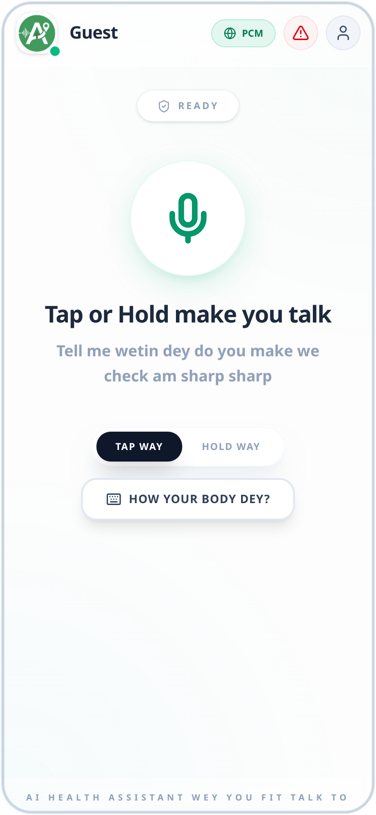
From “something is wrong” to “I know what to do next”
alavia-ai.vercel.app
5 languages
English, Pidgin, Yoruba, Hausa, Igbo
Voice-first
Speak or type, in your language
Emergency-ready
Guest access with no sign-up, and a nearest-hospital map
It checks back
Follow-ups and feedback after every assessment
Next: a Lagos pilot with partner hospitals
Notes:
Close on the line. From "something is wrong" to "I know what to do next". What is built: five languages, voice-first, a guest mode so an emergency never hits a sign-up wall, a nearest-hospital map, and follow-up check-ins. The ask is yours to state: the next step is a Lagos pilot with partner hospitals. The screen on the right is the same app in Pidgin: "How your body dey?"

