Slide 1



JWT
SUH SAECHAN
2024. 05. 12

Slide 2

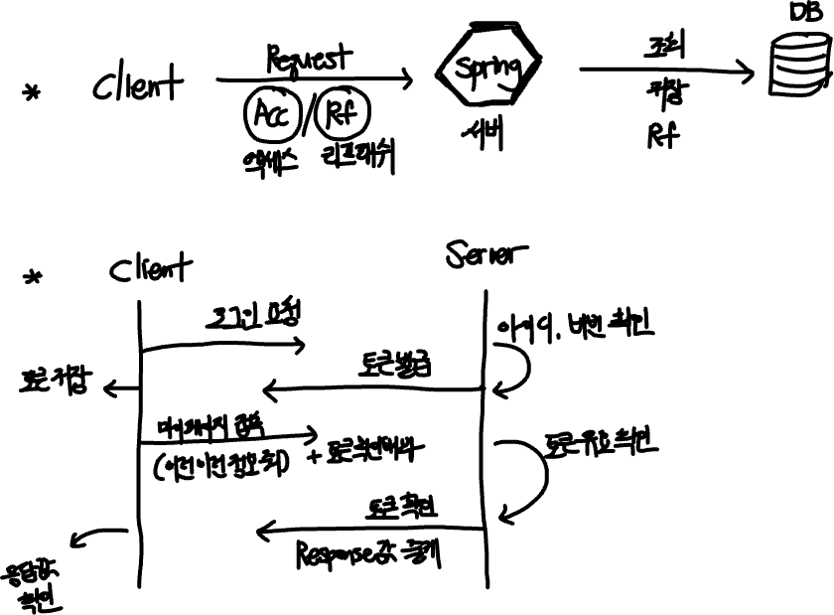
JWT

Slide 3
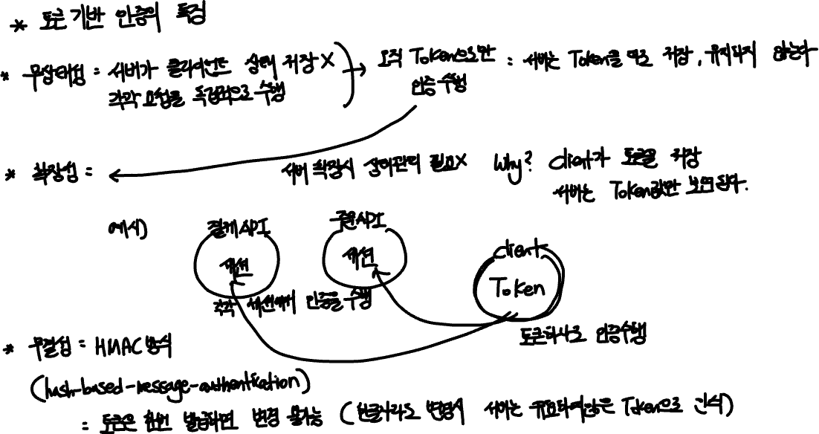
JWT

Slide 4
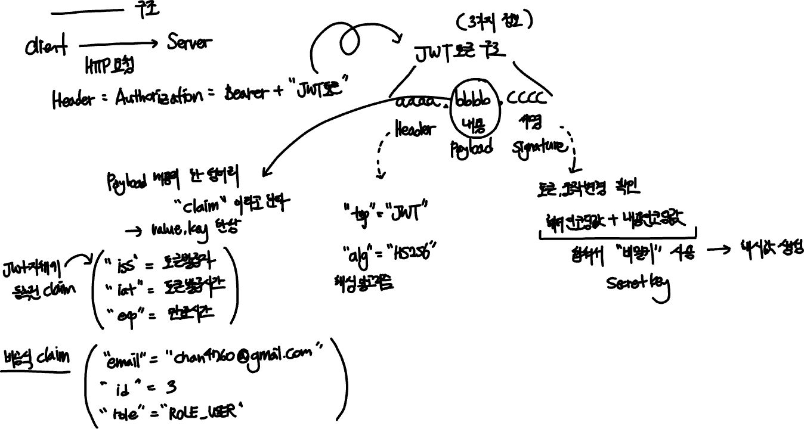
JWT

Slide 5

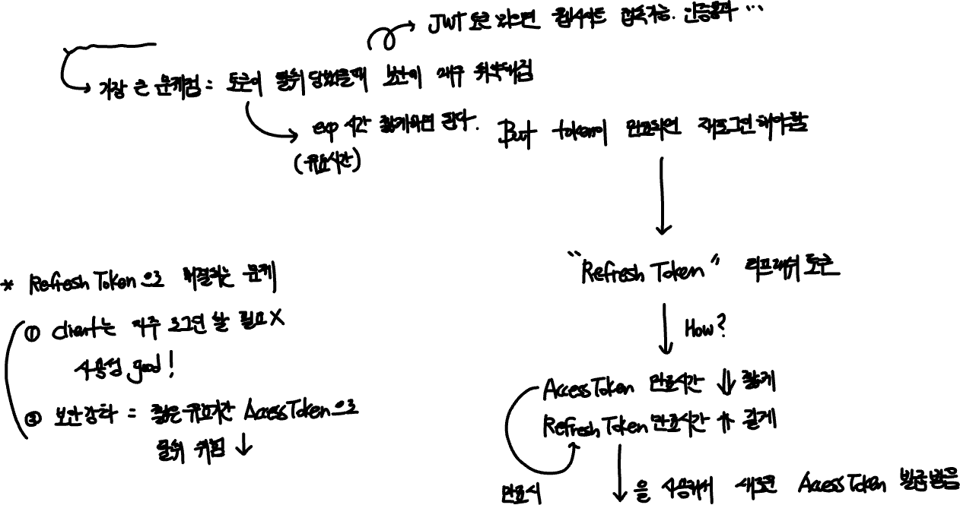

JWT

Slide 6
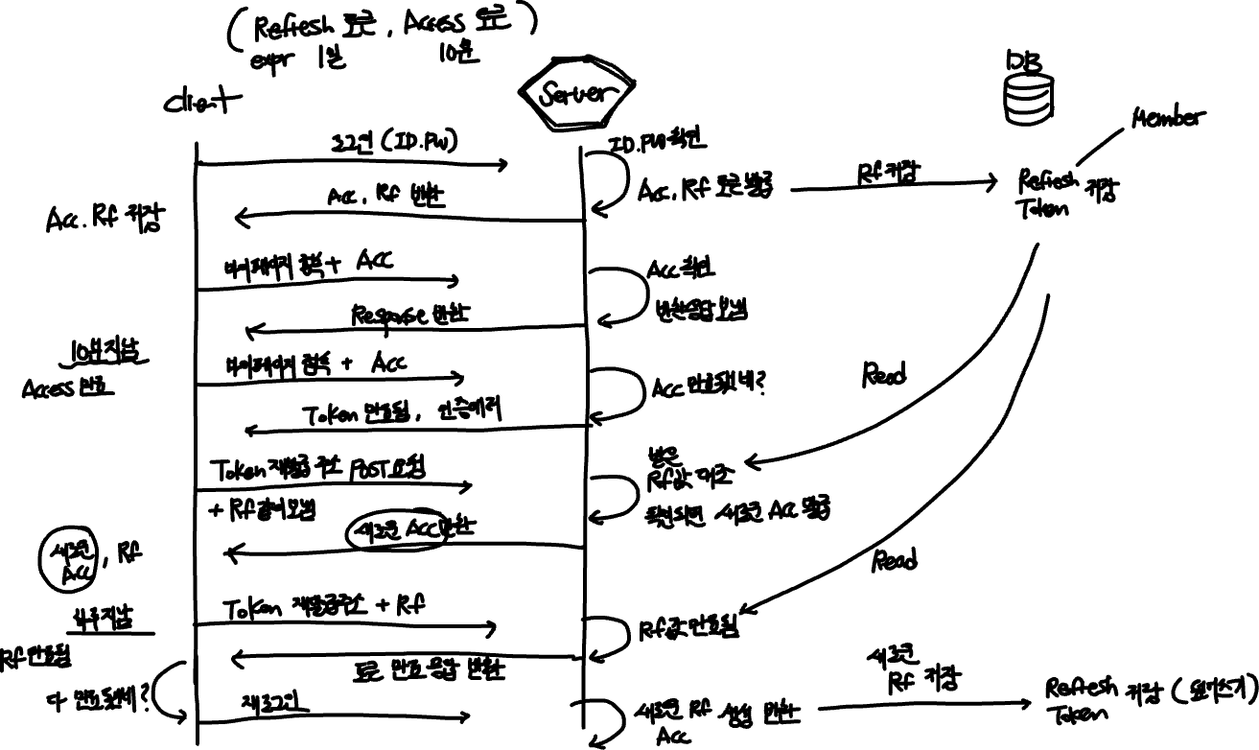
JWT

