Slide 1



Slide 2

High Level vs Low Level Programming Languages.

Slide 3

…Programming Language?

Slide 4
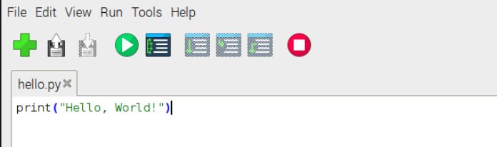
High Level Language:
User friendly and easy to understand/debug
Relatively simple syntax
easy to port to other platforms.
Disadvantage: machine takes time to process it before it reaches the hardware.
Examples of HL languages: Java, C++, and Python.

Slide 5
Now that we know what a HIGH level programming language is….

Slide 6
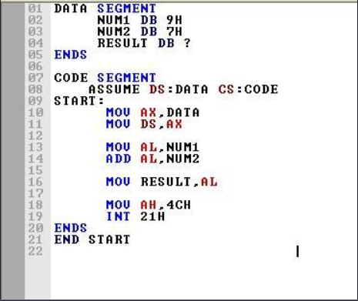
What are Low Level Languages?
not very user friendly.

Slide 7
Cannot be easily ported to other platforms.
Advantage: really fast to process and obtain the output.
Examples: Assembly and Machine Language

Slide 8

Q: Is C a high or a low level language?
High Level.

Slide 9



Slide 10
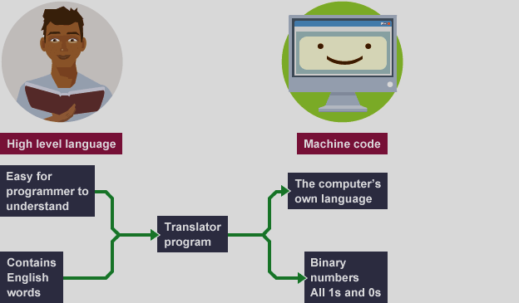
Why do they both exist?

Slide 11


Slide 12
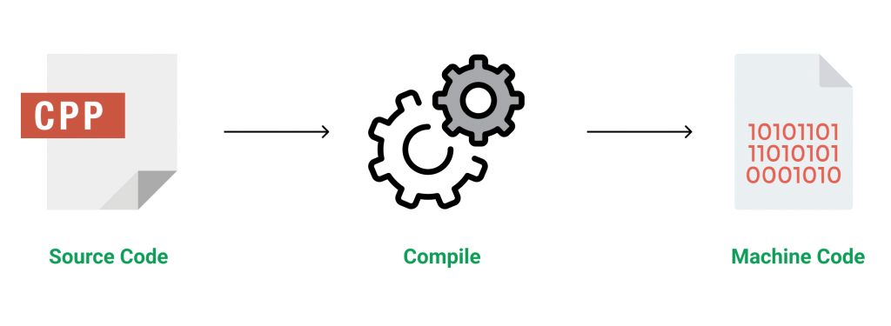

Slide 13
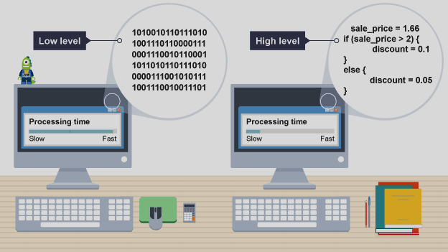

Slide 14
So what should I use?
In most cases, only a high level programming language is required
Low level is used for coding programs closely linked to hardware.

Slide 15
C++ : A High Level Programming Language.
WORA- Write Once Run Anywhere
Easy to understand
Object Oriented Programming Language
Robust and easily portable

Slide 16



Applications of C++
Google chrome
YouTube
Amazon

Slide 17

What’s the difference between C++ and Python?

Slide 18
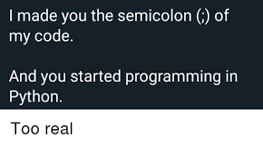
Difference 1: Syntax
C++will throw an error if you miss a semicolon at the end of the line.
E.g. cout(“Hi”) will throw an error.
Python will still work even if you do not put a semicolon.
E.g. print(“Hi”) still works.

Slide 19
Difference 2: Speed
C++ is much faster.
Python is slower.

Slide 20
Difference 3: User Friendliness
C++ is much harder to learn.
Python is easier to learn and understand.

Slide 21
Speaker : Rijuta Saraswat

