Slide 1

MINOR PROJECT – 1st PRESENTATION
Tourist Demand Forecasting for Uttarakhand
Submitted by: [Student Name 1], [Student Name 2], [Student Name 3]
Roll No.: [Roll Numbers]
Group Number :
Under the Guidance of: [Guide Name], [Designation]
Department of [Department Name]
Shivalik College of Engineering
4th Year – [Academic Session]

Slide 2
INTRODUCTION
Introduction / Overview
Uttarakhand recorded about 6.10 crore tourist visits in 2024 (Ministry of Tourism). Demand is highly seasonal: Char Dham opening and holidays (May–June), the Kanwar Yatra (July) and a second Char Dham peak in October.
Events and shocks distort it: the Haridwar Kumbh (next: Jan–Apr 2027) and COVID-19, which cut visits from 3.77 crore (2019) to 0.70 crore (2020) before demand settled at a much higher level.
This project forecasts monthly tourist visits 1–3 years ahead, so hotels, transport, the Char Dham administration and disaster teams can plan capacity and safety.
KEY POINTS
1
Domain: time-series forecasting of tourism demand (Uttarakhand + Himachal Pradesh)
2
Gap: no open month-wise forecast that handles Char Dham, Kumbh and the post-COVID shift
3
Matters: helps plan crowds, hotels, transport and safety in fragile mountain areas
4
Solution: event-aware SARIMAX + ML ensemble, with a dashboard and hotspot map
Minor Project – 1st Presentation
2

Slide 3
PROBLEM & OBJECTIVES
Problem Statement & Objectives
PROBLEM STATEMENT
Monthly tourist demand in Uttarakhand is highly seasonal and repeatedly disrupted by events (Kumbh, Char Dham season) and shocks (COVID-19), after which it shifted to a permanently higher level. Planners have no tested month-wise forecast with uncertainty ranges, and models that ignore these events give large errors.
OBJECTIVES
Build a pipeline that forecasts monthly visits 1–3 years ahead with 80% ranges
Engineer event-aware features: Kumbh, COVID, post-COVID break, seasons
1
2
Compare seasonal naive, SARIMAX, Gradient Boosting and an ensemble on a 24-month hold-out
Deliver a Streamlit dashboard with a hotspot map of Uttarakhand and Himachal Pradesh
3
4
Minor Project – 1st Presentation
3

Slide 4
LITERATURE REVIEW
Literature Review / Existing System
Author / Source | Title / Focus | Year | Key Finding / Gap
Box, Jenkins et al. | Time Series Analysis: Forecasting and Control | 2015 | Seasonal ARIMA framework; events added as regressors (basis of our SARIMAX)
Song & Li | Tourism demand forecasting – a review | 2008 | No single method is best everywhere, so several models must be compared
Song, Qiu & Park | Review of tourism demand forecasting research | 2019 | Time-series, econometric and AI methods all used; combining forecasts helps
Friedman | Gradient boosting machine | 2001 | Small trees added one by one, each fixing earlier errors; basis of our GBM
Makridakis et al. | The M4 Competition | 2020 | Combinations did well; pure ML methods did not beat statistical benchmarks
Hyndman & Athanasopoulos | Forecasting: Principles and Practice | 2021 | Test on held-out data against simple benchmarks such as seasonal naive
Gap:little open work on month-wise forecasting for Uttarakhand that models Char Dham seasonality, the Kumbh and the post-COVID break together, and extends it to destination level.
Minor Project – 1st Presentation
4

Slide 5
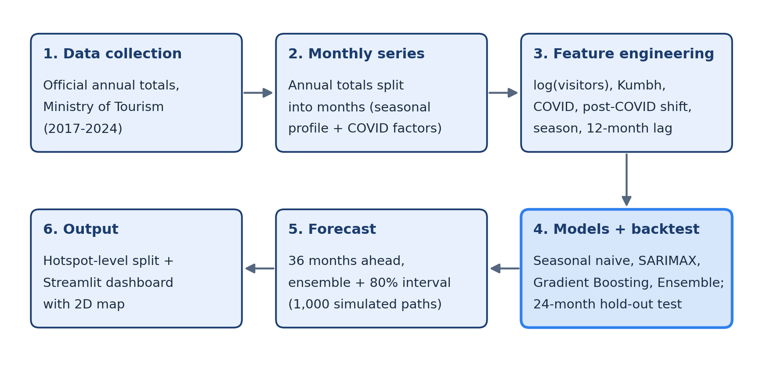
METHODOLOGY
Proposed Methodology / System Design
STEP 1
→
STEP 2
→
STEP 3
Official annual totals → monthly series
Features + 4 models, 24-month backtest
3-year forecast, hotspot map, dashboard
Minor Project – 1st Presentation
5

Slide 6
TOOLS & TIMELINE
Tools, Technologies & Work Plan
TOOLS & TECHNOLOGIES
TENTATIVE WORK PLAN
Language(s)
Python 3.12
Phase 1
Requirement analysis, literature review & data sources (done)
Libraries
pandas, statsmodels, scikit-learn
Phase 2
Pipeline, feature and evaluation design; official data collected (done)
Dashboard
Streamlit, Altair, pydeck (map)
Phase 3
Models, hotspot map, dashboard; real monthly data (in progress)
Tools / Data
VS Code; CSV files (no database)
Phase 4
Testing on real data, evaluation & report writing (planned)
Minor Project – 1st Presentation
6

Slide 7
EXPECTED OUTCOME & REFERENCES
EXPECTED OUTCOME
A tested system that forecasts Uttarakhand's monthly tourist visits 1–3 years ahead with 80% ranges, compares four models and shows results in a dashboard with a hotspot map. First results (estimated monthly data): SARIMAX error 3.2% MAPE vs 7.8% for the seasonal-naive baseline; forecast ≈ 6.19 crore visits in 2025 and 6.41 crore in the Kumbh year 2027.
REFERENCES
[1] G. E. P. Box et al., Time Series Analysis: Forecasting and Control, 5th ed., Wiley, 2015.
[2] R. J. Hyndman and G. Athanasopoulos, Forecasting: Principles and Practice, 3rd ed., OTexts, 2021.
[3] H. Song, R. T. R. Qiu and J. Park, “A review of research on tourism demand forecasting,” Annals of Tourism Research, vol. 75, 2019.
[4] S. Makridakis et al., “The M4 Competition,” International Journal of Forecasting, vol. 36, no. 1, 2020.
[5] Ministry of Tourism, Govt. of India, India Tourism Data Compendium 2025 (Table 4.1.2), 2025.
THANK YOU

