Slide 1
RFID Technology: An In-Depth Exploration

Slide 2
Sl no | Content | Page Number
1 | Abstract on RFID | 3
2 | What is RFID? | 4
3 | Uses of RFID | 5
4 | Types of RFID | 6
5 | Passive RFID | 7
6 | Active RFID | 8
7 | Semi-passive RFID | 9
8 | Working of RFID | 10
9 | Advantages of RFID | 11
10 | Disadvantages of RFID | 12
11 | Future Technology and Scope | 13
12 | Conclusion | 14

Slide 3
Abstract
Radio Frequency Identification (RFID) technology is a wireless communication system that utilizes radio waves to identify and track objects. Widely used in various industries for asset tracking, inventory management, and identification purposes, RFID offers significant improvements over traditional barcode systems. This presentation delves into the fundamentals of RFID, its types, working mechanism, advantages, disadvantages, and its potential future developments.

Slide 4
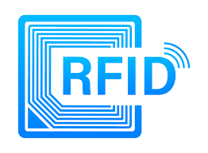
What is RFID?
RFID stands for Radio Frequency Identification. It is a technology that uses electromagnetic fields to automatically identify and track tags attached to objects. These tags contain electronically stored information, which can be read by a reader device without requiring line-of-sight, making it more versatile than barcode systems.

Slide 5
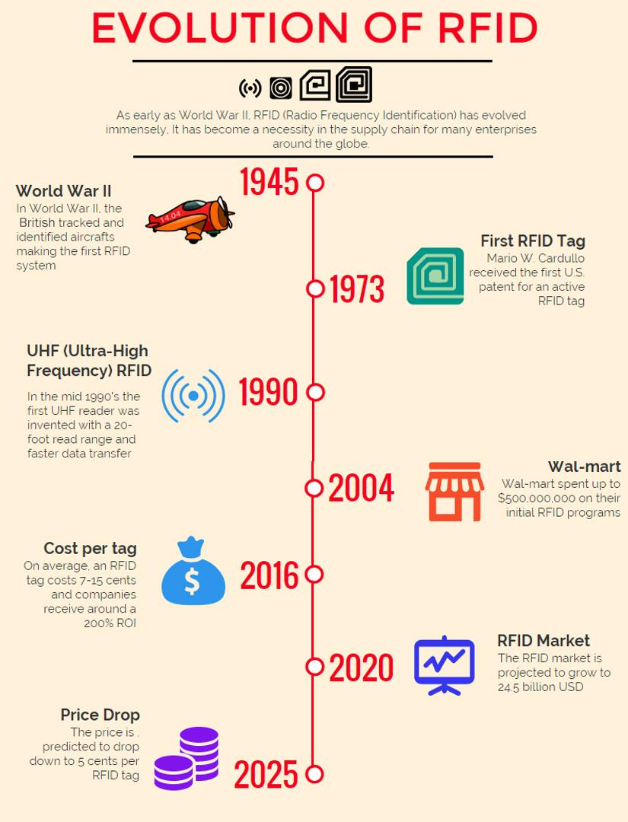

Slide 6
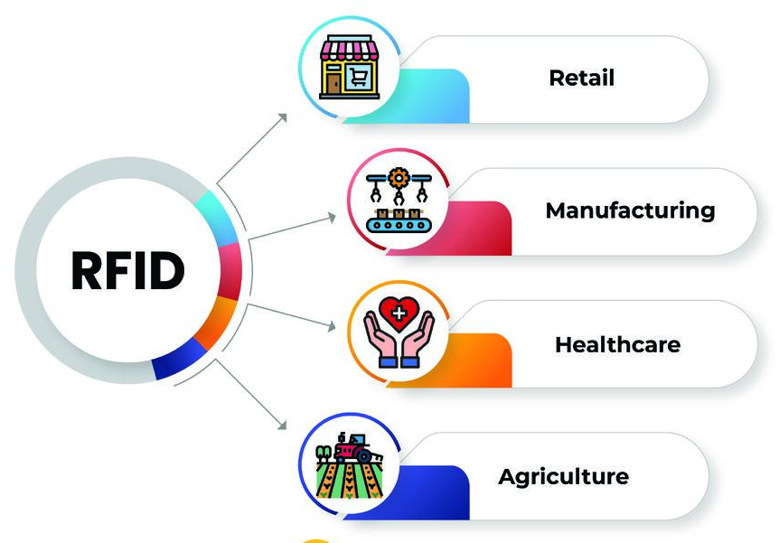
Use of RFID
Inventory and supply chain management
Asset tracking
Access control
Contactless payment systems
Identification of animals and humans
Healthcare (e.g., tracking patients and equipment)
Logistics and transportation

Slide 7
Types of RFID
RFID systems are categorized based on their power sources and operational range. The main types are:
Passive RFID
Active RFID
Semi-passive RFID

Slide 8
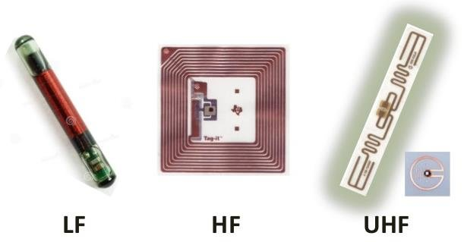
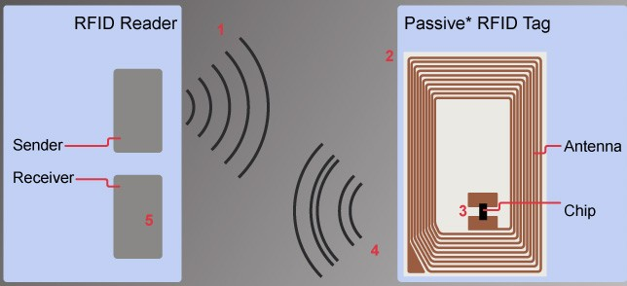
Passive RFID
Description:
No internal power source: The tags do not have a battery.
Activation: Powered by the reader’s electromagnetic field.
Range: Short-range, typically up to a few meters.
Cost: Inexpensive and small in size.
Uses:
Inventory management
Retail and anti-theft systems
Access control

Slide 9
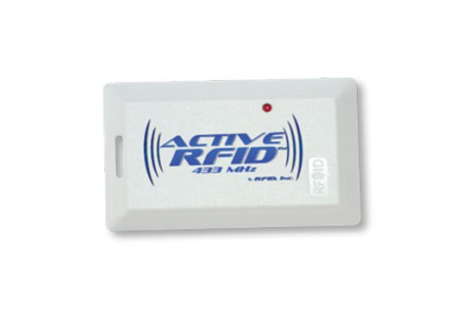
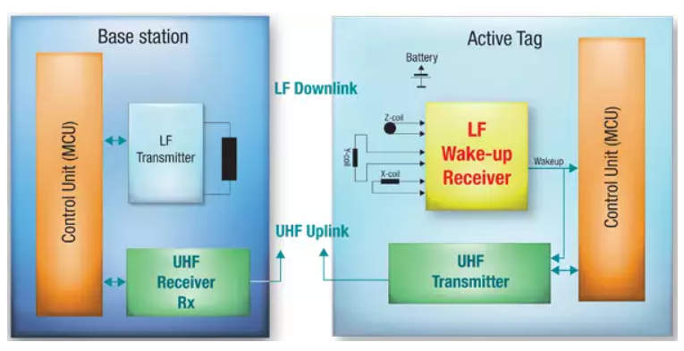
Active RFID
Description:
Internal power source: Contains a battery to power the tag and its transmission.
Range: Long-range, up to hundreds of meters.
Cost: More expensive than passive tags.
Uses:
Real-time location tracking
Asset management in large facilities
Environmental monitoring

Slide 10
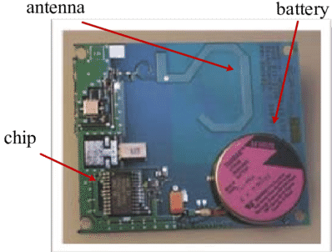
Semi-passive RFID
Description:
Partial power source: Battery-powered but relies on the reader to communicate.
Range: Intermediate range between passive and active.
Cost: Moderate cost.
Uses:
Monitoring environmental conditions like temperature and humidity
Supply chain management where intermediate range and battery life are important

Slide 11
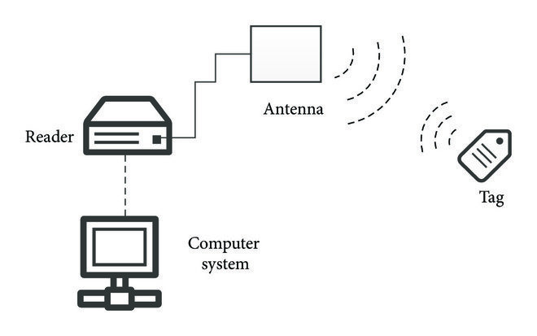
Working of RFID
Tag: Contains a microchip and antenna. Stores data and communicates with the reader.
Reader: Emits radio waves and receives signals from the tag. Can read and sometimes write data to the tag.
Antenna: Facilitates the communication between the tag and reader.
Software/System: Processes the data collected by the reader for various applications.
When a tag enters the electromagnetic zone of a reader, it detects the activation signal. The tag’s antenna draws power from the reader’s signal, allowing the microchip to transmit the information back to the reader.

Slide 12

Advantages of RFID
No line-of-sight requirement: Tags can be read without direct visibility.
Durability: RFID tags are more robust than barcodes.
Data capacity: Can store more data than traditional barcodes.
Efficiency: Speeds up data collection processes.
Automation: Enhances automation and accuracy in tracking and inventory management.

Slide 13
Disadvantages of RFID
Cost: Higher initial cost compared to barcodes.
Interference: Metal and liquids can interfere with signals.
Privacy concerns: Potential for unauthorized reading of tags.
Compatibility issues: Different RFID systems may not be compatible.

Slide 14
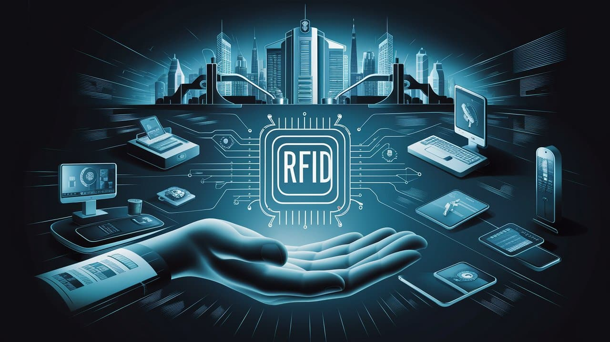
Future Technology and Scope
Enhanced data security: Improved encryption and authentication methods.
Integration with IoT: Greater synergy with Internet of Things applications.
Smaller, cheaper tags: Advances in manufacturing and materials.
Increased range and reliability: Development of new frequency bands and improved reader technology.
Wider adoption: Broader implementation in smart cities, healthcare, and logistics.

Slide 15
Conclusion
RFID technology represents a significant advancement in the field of automatic identification and data capture. Its ability to provide accurate, real-time data tracking and management has already revolutionized many industries. Despite challenges like cost and interference, ongoing technological advancements promise to enhance its capabilities and applications, positioning RFID as a cornerstone of future technological ecosystems.

Slide 16


