Slide 1

ACADEMIC PROJECT EVALUATION · REVIEW 1 & 2
Campus Library
Management System
Copy-Level Circulation with Embedded Total Quality Management (TQM)
✨ 100% Working Web Application · 64/64 Automated Tests Passing
Tech Stack: Python 3.10+ · Flask 3.1 · SQLAlchemy · SQLite/PostgreSQL · Bootstrap 5
⚡ 64 Tests Passing
🛡️ ACID Locks
Modern Digital Campus Library
Notes:
Good morning evaluators. Today I am presenting our Campus Library Management System with embedded Total Quality Management (TQM). It is a fully working web application covering both Review 1 (Setup, SRS, and Architecture) and Review 2 (Working CRUD, Circulation, and TQM).

Slide 2

📌 REVIEW 1 · PROBLEM STATEMENT
Why Traditional Campus Libraries Struggle
❌ Physical Copy Blindspots
Old systems count total books, not individual copies. When a book is lost or damaged, nobody knows which specific copy is missing.
⏳ Peak-Hour Circulation Friction
Slow manual checkouts create long student lines at the desk. Fines are calculated by hand or forgotten completely.
📉 Zero Quality Feedback Loop
Student complaints go into a void. Libraries do not use root-cause analysis (Ishikawa/5-Whys) to fix recurring service defects.
🎯 Solution: 100% Barcoded Copies & TQM Feedback
Notes:
In Review 1, we identified 3 major problems: 1) Physical copy blindspots, 2) Checkout queue delays, and 3) Missing quality loops. Our system fixes all three with copy-level barcoding, sub-second circulation, and real TQM.

Slide 3
📌 REVIEW 1 · QUALITY OBJECTIVES
Target Metrics & TQM Quality Goals
0.0% Loss
Zero Stock Discrepancy
Every single book has its own unique barcode (LIB-00001-001) tracked in real time.
< 0.5 sec
Lightning Fast Checkouts
Sub-second database-backed transactions eliminate peak-hour queue delays.
4.8 ★ / 5.0
Student Satisfaction Goal
Real Voice of Customer (VoC) ratings submitted across 6 library service areas.
100% Fixed
Closed-Loop TQM Resolution
Every complaint requires an Ishikawa Fishbone & 5-Whys root-cause fix before closing.
Notes:
Here are our 4 measurable quality objectives: 1) Zero stock loss using unique barcodes, 2) Sub-second checkouts, 3) High student satisfaction tracked empirically, and 4) 100% closed-loop root-cause problem solving.

Slide 4
📌 REVIEW 1 · USER ROLES & SCOPE
Three Isolated Roles for Seamless Operations
🎒 Student / Member
Portal: /login/student
• Search books by course & semester
• Reserve unavailable books (FIFO waitlist)
• Track active loans, due dates & fines
• Rate library service (1 to 5 stars)
• File complaints & receive alerts
🔍 Quality Manager
Portal: /quality/
• Live TQM KPI Dashboard
• Pareto 80/20 Defect Analysis
• Ishikawa (6M Fishbone) & 5-Whys
• Kaizen Action Register with deadlines
• Stage-Gated Deming PDCA cycles
🏛️ Admin / Librarian
Portal: /library/
• Issue & Return circulation desk
• Manage barcoded copy statuses
• Bulk import books via CSV (up to 10k)
• Manage student & staff accounts
• Generate CSV, Excel & PDF reports
Notes:
The system has 3 clean, isolated user roles: Students have a self-service portal to reserve books and give feedback; Quality Managers run Pareto and PDCA quality tools; and Librarians run the circulation desk and manage inventory.

Slide 5

📌 REVIEW 1 · ARCHITECTURE & DATABASE
Modular Software Architecture & Relational Design
🏗️ Modular Blueprint Architecture
• Frontend: Responsive Bootstrap 5 + Chart.js
• Blueprints: auth, catalog, quality, reports, main
• Service Layer: Atomic transactions & business logic
• ORM: SQLAlchemy 2.1 with full Foreign Keys
• Database: SQLite (local demo) / PostgreSQL (production)
• Security: CSRF protection on all forms + Werkzeug password hashing
✨ Clean separation makes adding new features easy without breaking existing code.
🗄️ 14 Normalized Database Tables
Copy-Level Tracking: 1 Book ➔ Multiple unique Barcoded Copies. Foreign keys, check constraints, and partial unique indexes prevent double loans.
Notes:
Architecturally, we use Flask Blueprints separated by domain, connected to a transaction service layer and SQLAlchemy ORM. Our database has 14 normalized tables, enforcing copy-level granularity and ACID transactional security.

Slide 6

📌 REVIEW 2 · IMPLEMENTATION MILESTONE
100% Working Web Application (Live Demonstration)
⚡ Fully Operational & Test-Verified
• Live Server: Running locally on http://127.0.0.1:5000
• /healthz Probe: Returns HTTP 200 OK with verified DB connectivity
• Zero Mockups: Every single button, form, filter, and table is tied directly to real database rows
• Multi-Theme UI: High-contrast toggle, Forest Green, Light, and Dark themes with keyboard shortcuts (/ to search)
• 64/64 Pytest Passed: All core workflows and edge cases automated and verified.
🟢 Server Status: 200 OK (Port 5000)
Notes:
Moving into Review 2: We have achieved a 100% working application running live. There are no mockups or static templates—every page connects to the live database, tested with 64 automated test cases.

Slide 7
📌 REVIEW 2 · CRUD CAPABILITIES
Comprehensive CRUD Operations in Action
📚 Catalog & Copy CRUD
• Create: Add book + auto-generate unique barcodes
• Read: Search by title, author, ISBN, course, semester
• Update: Edit title, add stock, change copy status
• Delete: Cascade guards prevent deleting loaned books
🔄 Circulation & Loan CRUD
• Create: Atomic issue assigning copy to member
• Read: Live loan register, overdues, student history
• Update: Check-in, late fine calculation, hold flip
• Delete: Audit history preserved permanently
⭐ TQM & Feedback CRUD
• Create: Submit 1–5 star ratings & formal complaints
• Read: Searchable registers with category filters
• Update: Advance status (Open ➔ In Progress ➔ Closed)
• Delete: Real-time student in-app notifications on update
👥 User & Admin CRUD
• Create: Self-registration & CLI staff provisioning
• Read: Full student directory with active loan counts
• Update: Toggle member status, reset passwords
• Delete: Instant session kill via auth_version counter
Notes:
Here are our CRUD operations across 4 main pillars: Catalog & Copies, Circulation, TQM registers, and Users. Every operation respects relational integrity and maintains full audit history.

Slide 8
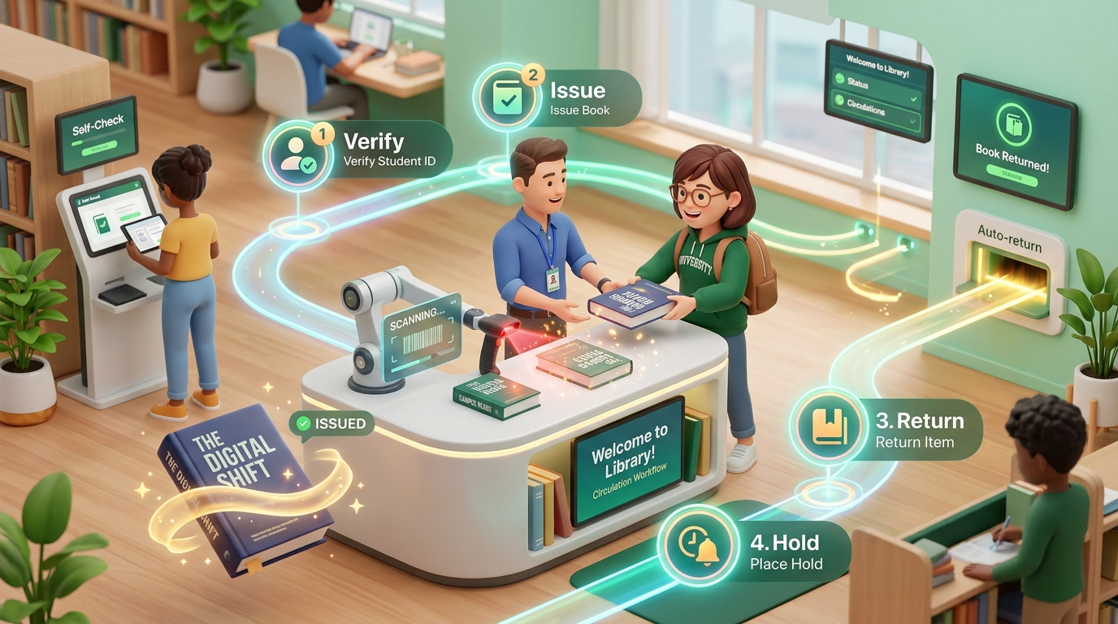
📌 REVIEW 2 · MAIN SYSTEM WORKFLOW
Circulation Pipeline: Scan, Issue, Return & Holds
STEP 01 · Atomic Issue & Duplicate Check
Staff selects member & book. Database locks the row (with_for_update), verifies no duplicate active loan, and flips copy status to 'loaned'.
STEP 02 · Check-In & Exact Late Fines
On return, system checks days late: (today - due_date). Fines are computed with exact Decimal math and recorded in the fine ledger.
STEP 03 · Automatic FIFO Hold Allocation
If a student is waiting on the waitlist, copy status flips to 'reserved' and an alert is sent for pickup. If not, copy returns to available.
Notes:
Here is our core circulation workflow. In Step 1, row locking guarantees two people cannot checkout the same book simultaneously. In Step 2, returns compute exact late fines. In Step 3, returned copies are automatically claimed by students on the waitlist.

Slide 9

📌 REVIEW 2 · TQM IMPLEMENTATION
Embedded Total Quality Management Tools
⚙️ The 4-Stage Continuous Improvement Cycle
1. Voice of the Customer (VoC):
Students submit 1 to 5 star ratings & complaints across 6 service categories.
2. Pareto 80/20 Analysis:
Database groups complaints and calculates cumulative % to isolate the vital few defects.
3. Ishikawa (6M Fishbone) & 5-Whys:
Root-cause drill-down across People, Process, Tech, Materials, Environment, Policy.
4. Stage-Gated Deming PDCA Cycles:
Plan ➔ Do ➔ Check ➔ Act with mandatory evidence at each step before standardizing.
Notes:
Our TQM engine is not static text—it is fully integrated with live tables. We collect student VoC ratings, run Pareto 80/20 analyses to find the main problems, use 6M Fishbone and 5-Whys to find the root cause, and close the loop with Deming PDCA cycles.

Slide 10
📌 REVIEW 2 · TESTING & VERIFICATION
Automated Test Suite & Export Deliverables
🏆 64 / 64
AUTOMATED TESTS PASSED
• 15 Auth & RBAC Security Tests
• 9 Circulation & Overdue Tests
• 16 Feature & CSV Import Tests
• 13 Production Config Tests
• 11 TQM & PDCA Workflow Tests
⚡ Executes in ~29 seconds with 100% pass rate!
📊 Institutional Multi-Format Exports
• CSV Exports: Universal Excel compatibility with UTF-8 BOM
• Excel (.xlsx): Styled headers, freeze-panes, and auto-filters
• PDF Reports: Vector landscape tables generated via ReportLab
• Security: Formula injection defense (prefixes ' on =, +, -, @)
🛡️ Disaster Recovery & Uptime Tools
• Online Backup CLI (backup-db): Point-in-time consistent SQLite snapshots
• Stale Token Purge (purge-expired-records): Cleans up expired reset links
• Automated Due Reminders (send-loan-reminders): Idempotent cron job
Notes:
We verified the application with 64 automated tests in Pytest covering all security and circulation routines. The system also produces professional CSV, Excel, and PDF reports, with built-in disaster recovery backup commands.

Slide 11
📌 EVALUATION DEFENSE
Key Viva Defense Answers & Future Roadmap
🛡️ Concurrency Defense
Q: How are race conditions stopped during checkout?
A: We lock rows with with_for_update() inside atomic transactions. If two users click at once, the second cleanly encounters 'already loaned' and rolls back safely.
⚙️ TQM Reality Defense
Q: Is TQM just theory or real code?
A: Fully real in code! VoC ratings feed live Pareto calculations in SQL, Ishikawa forms enforce 6M root causes, and Deming PDCA cycles gate improvements.
🔒 Session Defense
Q: How is credential tampering prevented?
A: Passwords use salted Werkzeug scrypt hashing. An auth_version column revokes all existing sessions instantly whenever a password is reset.
🚀 Future Evolution Roadmap
1. Handheld Barcode Scanner Integration ➔ 2. RFID Self-Checkout Kiosks ➔ 3. Automated SMTP Email Notifications
Notes:
In conclusion, our project fulfills every requirement of Review 1 and Review 2 with a fully functional, tested, and secure application. Thank you, and we welcome any questions from the evaluators.

