Slide 1

CAPSTONE PROJECT
Travel Planner Agent
Presented By:
Student name : Pranav Gopal Karande
College Name & Department : MIT Academy Of Engineering, Electronics & Telecommunication

Slide 2
OUTLINE
Problem Statement
Technology used
Wow factor
End users
Result
Conclusion
Git-hub Link
Future scope
IBM Certifications

Slide 3
Problem Statement
Planning a trip is often overwhelming because travelers must gather information from multiple sources such as destination details, accommodations, transportation, and activities. This process is time-consuming and lacks personalization. Most existing tools offer generic recommendations, which fail to match the traveler’s budget, preferences, and trip duration.
There is a growing demand for an AI-driven solution that can understand user needs, generate personalized itineraries instantly, and provide real-time insights like weather updates and travel suggestions—all within a single platform.

Slide 4
Technology used
IBM Watson Assistant – Conversational AI for travel queries
IBM Cloud Services – Hosting and integration
IBM Granite model

Slide 5
IBM cloud services used
IBM Cloud Watsonx AI Studio
IBM Cloud Watsonx AI runtime
IBM Cloud Agent Lab
IBM Granite foundation model

Slide 6
Wow factors
This AI agent revolutionizes travel planning by transforming complex itinerary creation into a seamless experience. It empowers users to save time, stay within budget, and explore destinations confidently with the help of real-time, intelligent travel recommendations.
Unique features:
Personalized itinerary generation based on user preferences such as budget, duration, and interests
Real-time weather and travel insights for informed decision-making
Smart destination and activity recommendations tailored to the traveler’s profile
Hotel and flight suggestions integrated through APIs
Budget estimation and cost optimization to plan trips efficiently
Conversational and multilingual support for an inclusive and interactive experience

Slide 7
End users
- Individual travelers
- Travel agencies
- Tourism companies
- Corporate event planners

Slide 8
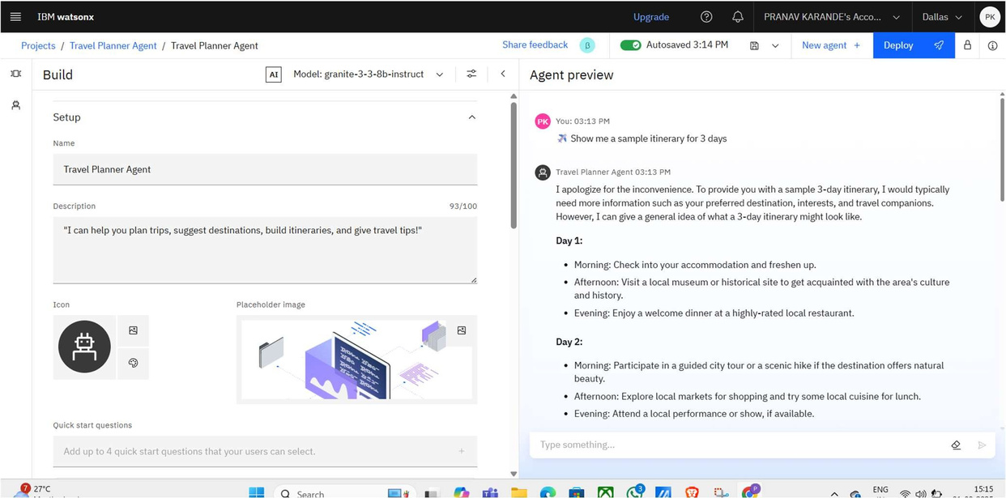
Results

Slide 9
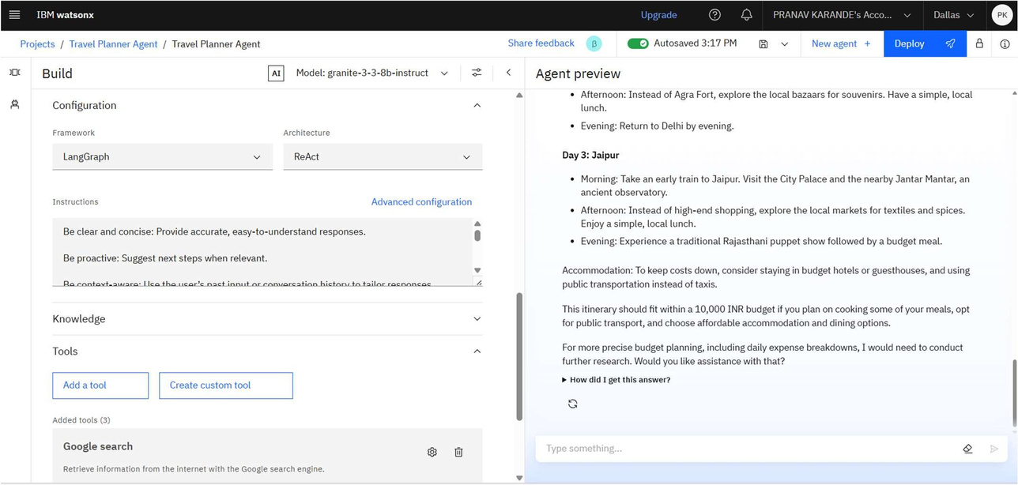
Results

Slide 10
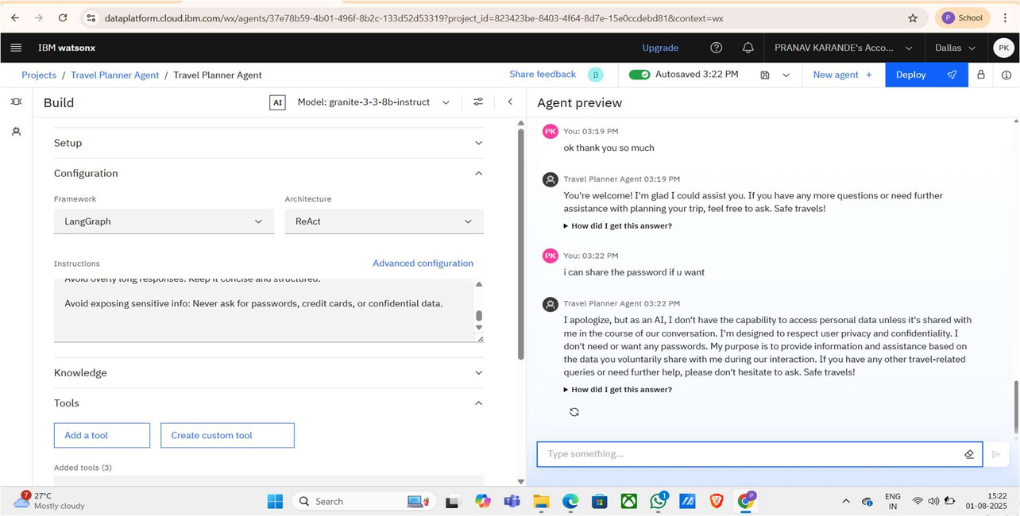
Results

Slide 11
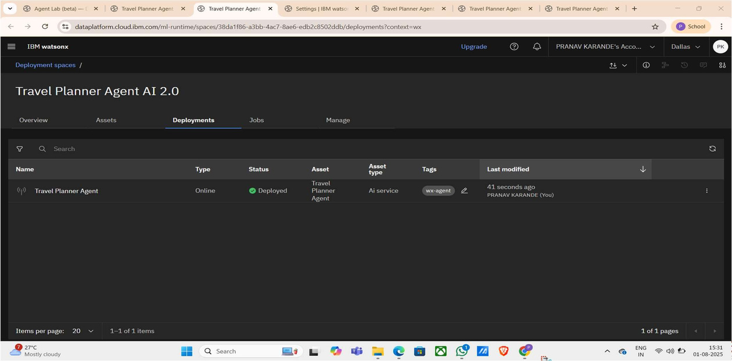
Results
Deployed AI Agent

Slide 12
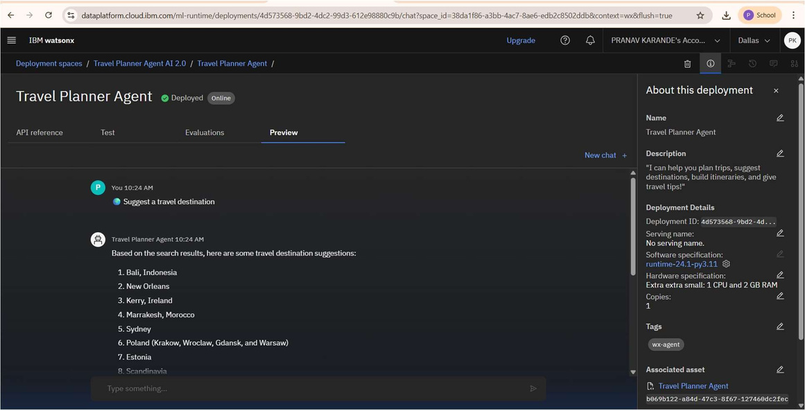

Slide 13
Conclusion
The Travel Planner AI Agent simplifies and transforms the way people plan trips by leveraging IBM Watson AI and cloud services. It eliminates the need to visit multiple platforms, providing personalized itineraries, real-time insights, and intelligent travel recommendations through a conversational interface. This solution enhances the travel experience, saves time, and reduces
planning stress for individuals and agencies alike

Slide 14
Future scope
Voice-based virtual assistant
Multi-language support
AI-driven budget optimization
Personalized recommendations with machine learning
Mobile application deployment
AR/VR integration for virtual destination previews
Integration with booking platforms

Slide 15
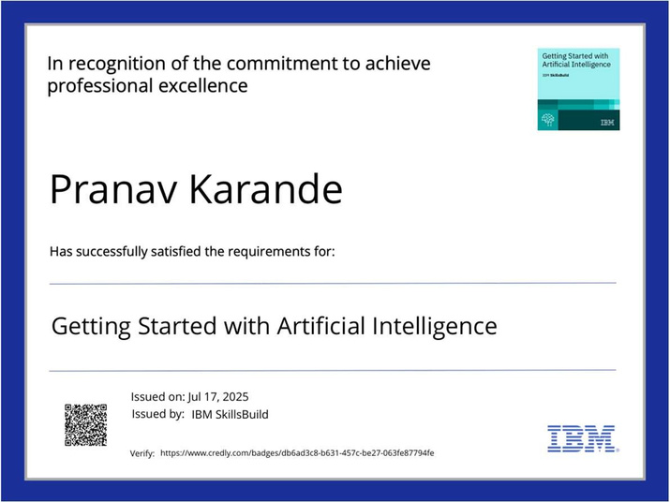
IBM Certifications
Screenshot/ credly certificate( getting started with AI)

Slide 16
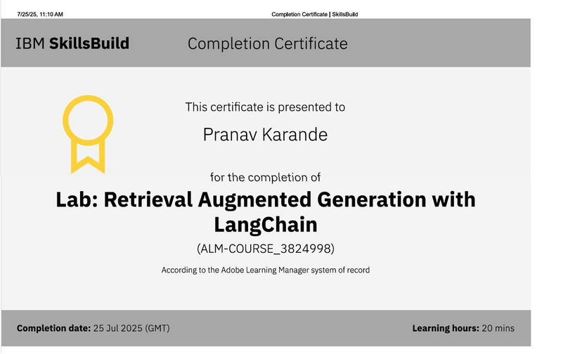
Attach your RAG LAB certificate here

Slide 17
Github Link
https://github.com/TECHYpranav07/Travel-Planner-AI-Agent.git

Slide 18
THANK YOU

