Slide 1
Fly Tipping form - Prototype

Slide 2
Research all counties in Wales
Status Button (sent, received, solving, ….) helps /us them, to track respond to and update them about their requests.
Notice letter - informs them what happens when their information is submitted.
This gives the user more confidence so they know what happens when their form is submitted , also assuring them that any of their personal information such as their name, contact number, email, is not shared to a third party unless the law requires them to do so.
Most counties have used only a page to do the form. Simple and straightforward. Allows the user to see how many questions there is
4 main questions - their name(optional), location of where the incident took place (write their postcode, which searches for their address), type of waste? / what has been fly-tipped?, if its on private land?, attach photo (max.4)
Add a progress bar, so the member of the public can see how much more they have to do
Prototype of a status bar, prototype of the postcode/address searcher.
Notes:
Isle of anglesy , Flintshire, Denbighsire, cowy, gwynedd, carmarthsire,

Slide 3
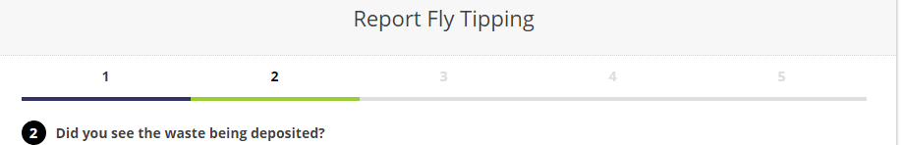
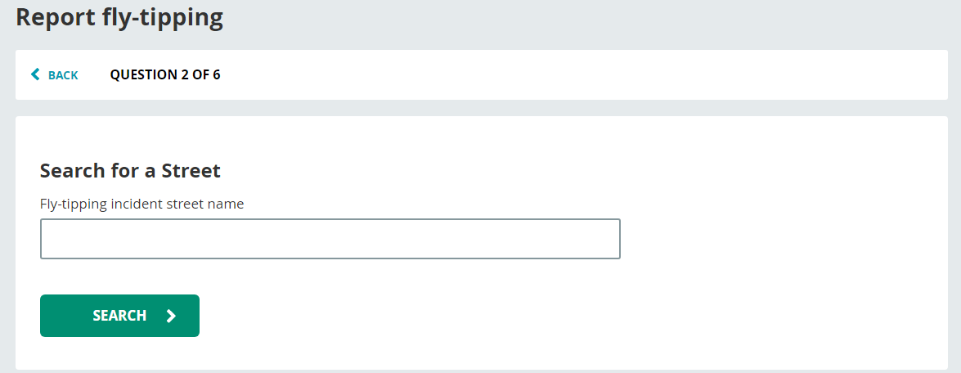
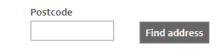
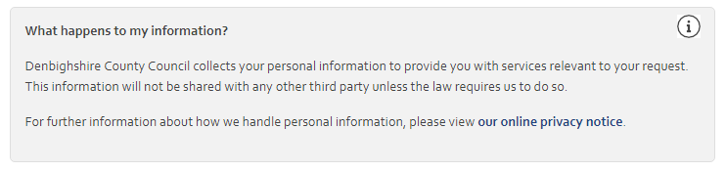

Slide 4
Report - 20 / 11 / 2018
Last week, I looked into 22 counties in Wales and wrote down any good features or techniques they’ve used and using this, I made 3 different prototypes. I came to the conclusion that the design of the web form should appear professional and simple and a maximum of 4 questions should be asked :
Ask their name (optional)
Location of the incident (asks for their postcode, which will then bring up address to that postcode, which then they can select
What has been fly-tipped? (drop down menu - household items, construction / demolition / Excavation, etc.
If its on private land? (drop down menu - Yes, No, Not Sure
Also, I thought of implementing a status bar - allowing the person who submitted the form to know what has happened to their submission, the status bar can display ‘received’, ‘in progress’, ‘solved’.
I believe we can now use this in order to create a final design.

Slide 5
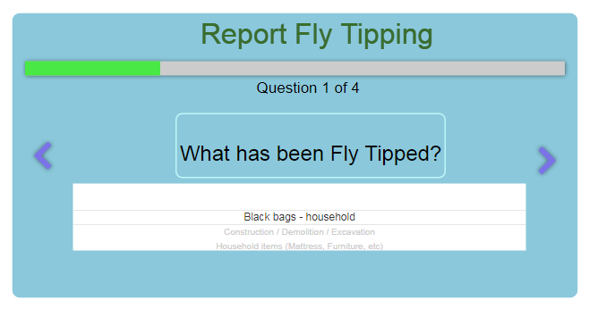
Prototype 1

Slide 6
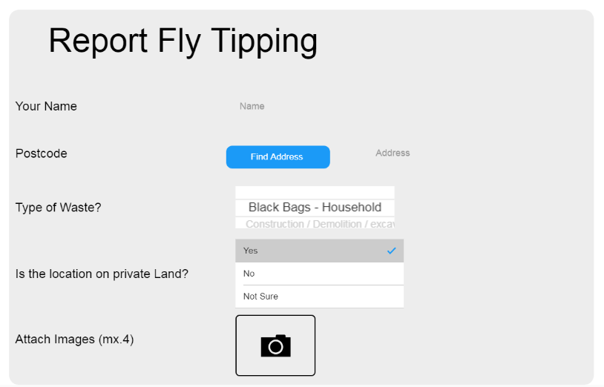
Prototype 2

Slide 7
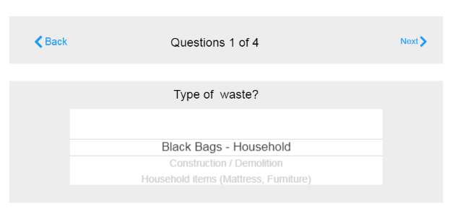
Prototype 3

Slide 8
