Slide 1
TED²
Brian Evans, Susan Tarnowski, Ricardo Alcazar and Julie Ching

Slide 2
Project Description
Educational app to help provide an interface to search the TED library and provide related materials for user to reference.

Slide 3
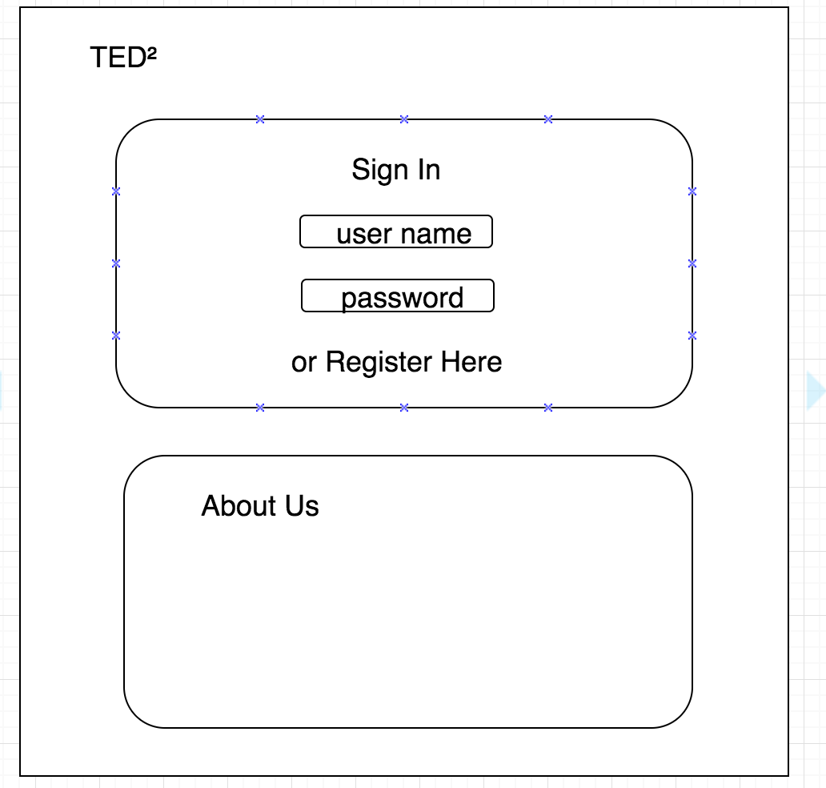
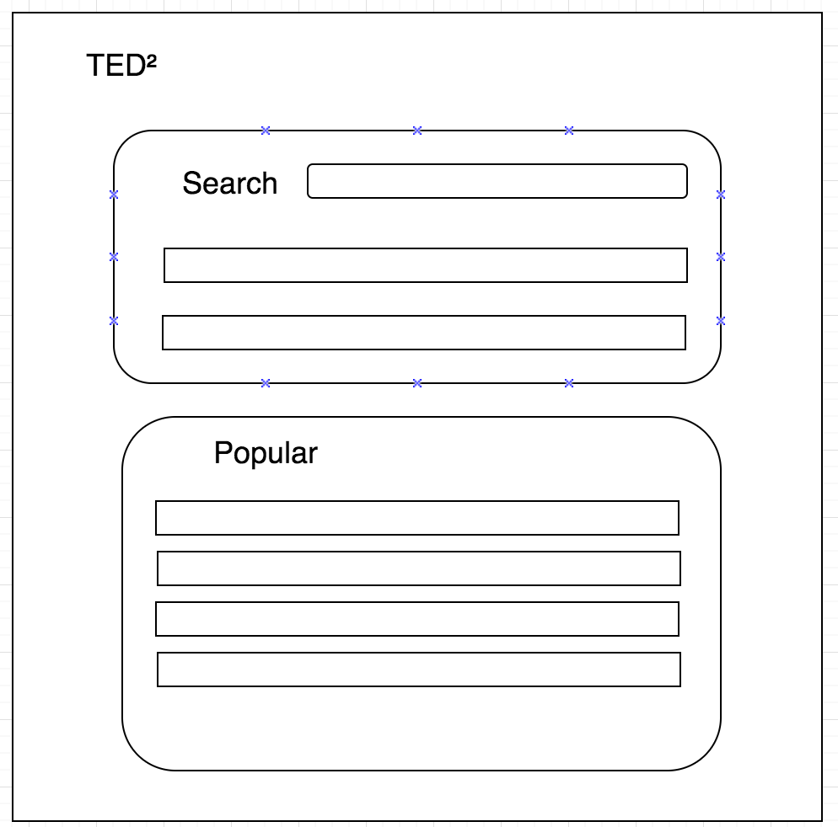
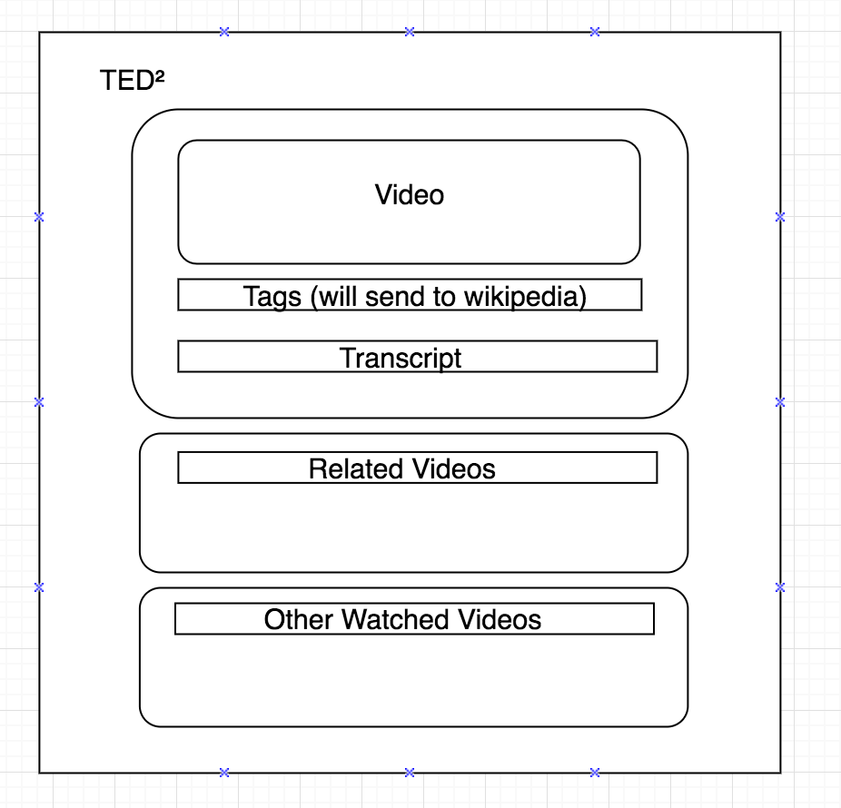
Sketch of Final Product

Slide 4
Technologies
MySQL
Express
Sequelize
Materialize CSS
Wikipedia API
TED Talk Data Set
TED Talk API

Slide 5
Rough Breakdown of Tasks
UI/UX
Brian
Julie
Backend Dev
Ricardo
Susan
Authentication (Brian)
QA/Project Management
Julie

