Slide 1

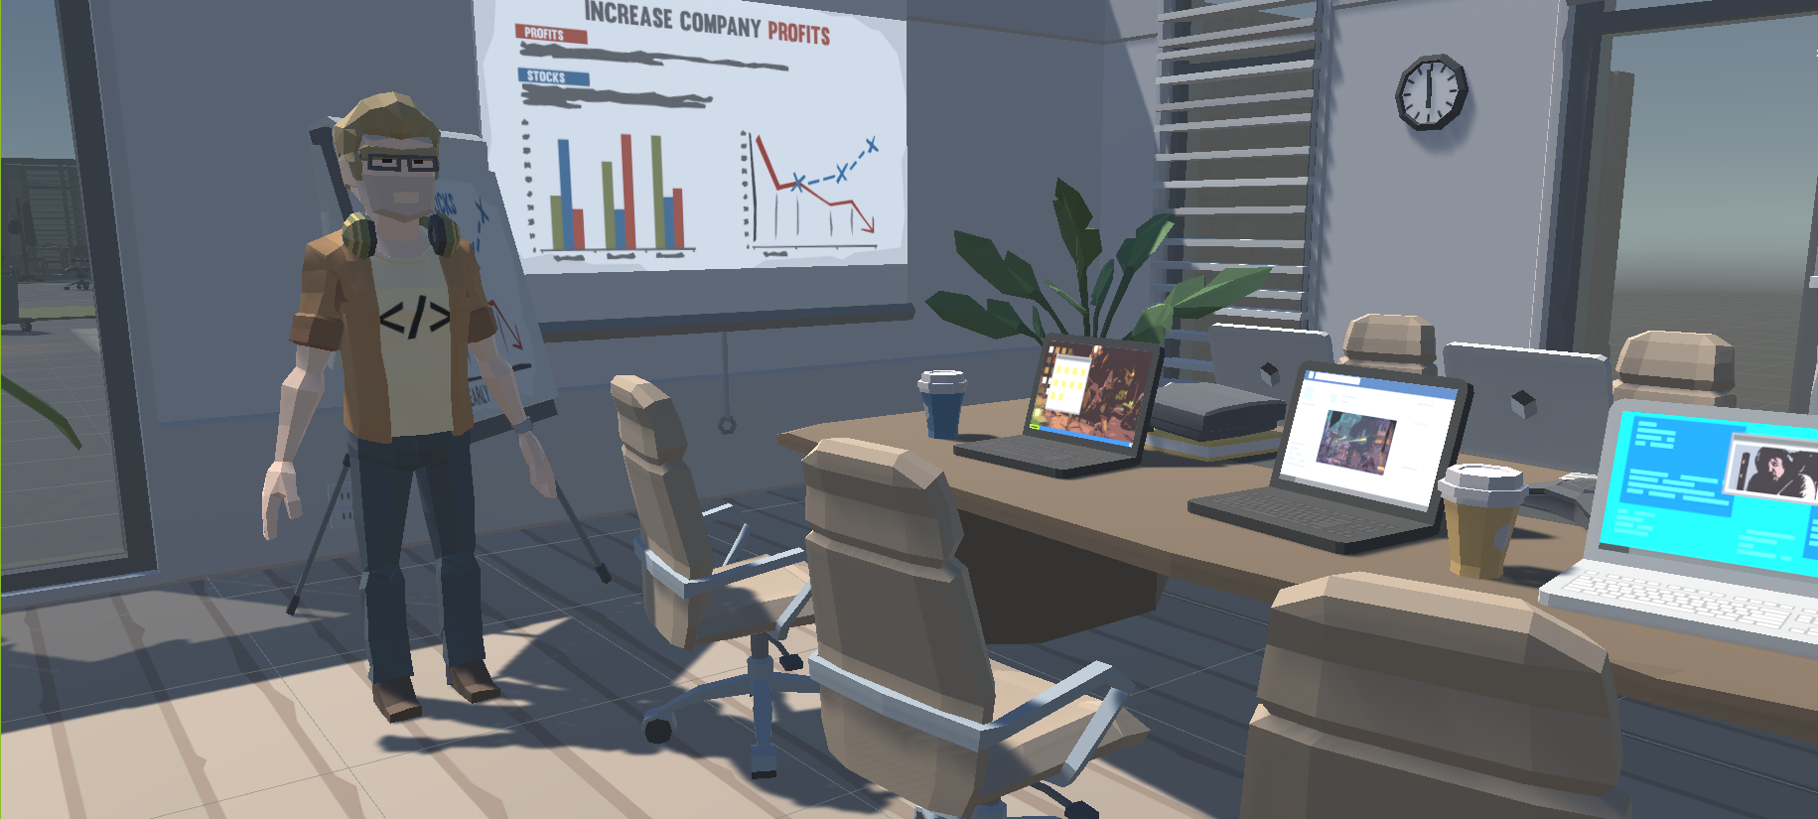
Escape From The Office
Egemen Engin Barış Sinaplı
Eyüp Bahadır Başlı Ilyas Nayle

Slide 2

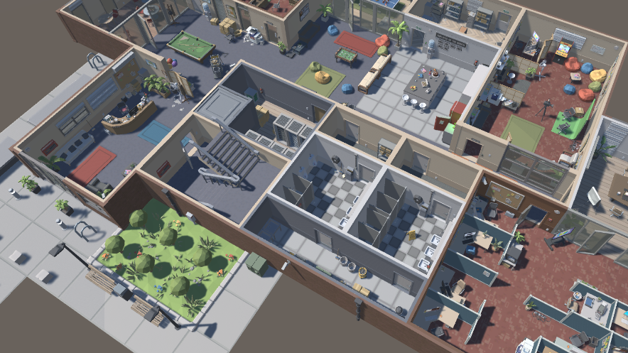



What is Escape From The Office?

Slide 3
Barış Sinaplı
Who Did What and Remaining Process
Inventory System (Item interactions, HUD, selection)
Lever System (Modeling, interaction with player)

Slide 4
Egemen Engin
Basic Character Movements(Move around, rotate and jump)
Traps
Door System
UI (Menus, panels and other elements)
Game Flow(From Beginning to End)
Level Manager(Save&Load) -> Only one gameplay scene
General Edit(Merge, branches etc) and Bug Fixes of Current Version

Slide 5
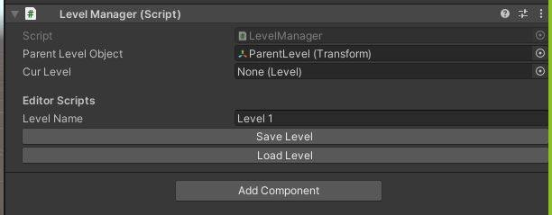

Slide 6
Eyüp Bahadır Başlı
Pressure Plate Door System
Ilyas Nayle
Character movement (Jump, Sprint, Crunch and Ground check)
Keypad password system for door (opening door).

Slide 7
To-Do
Menu and UI backgrounds will be arranged.
Some of sounds are ready but music and other sound effects will be added.
With our systems, we will prepare puzzles of levels. Also, with these puzzles and other models, we will design levels.
While working on level designs we have to work on lightning
We need to add a particle system.
We should work on animations such as doors, levers etc.
Portal system will be added.
We adjust graphic quality changes.

Slide 8
Thank you for your Attention

