Slide 1
Cmpe 316-Game Project
Notes:
Hello everybody, today we are going to introduce our shooter game named Mega Shooter Fantasy.

Slide 2
Contents
Gameplay
World design
Interactions
UI
Notes:
In this presentation we will cover 1,2,3,4. Also up to now we make 92 commits for this game.

Slide 3
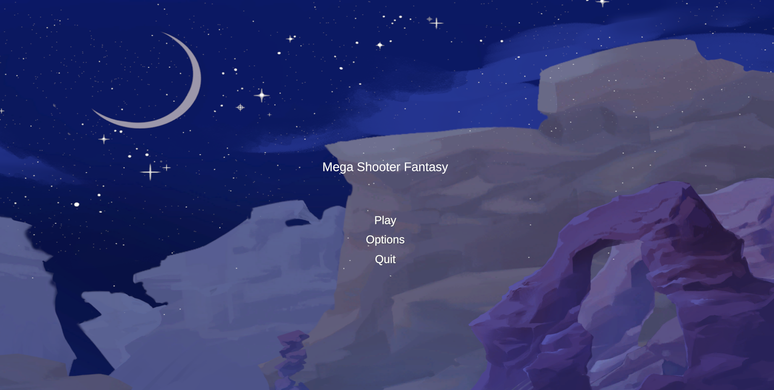
Gameplay Mechanics
Classic first person shooter game with RPG mechanics
Level System and Stats
Minimap
Inventory System -> Character Equip System.
Day-Night Cycle with Shader Graph for with intention of dynamic enemies.
Double jump for future puzzle mechanics
Notes:
Our game has many gameplay mechanics such as … User can adjust properties of the game by using options in main menu as shown. Also user can customize player’s stats by powering up these different stats.

Slide 4
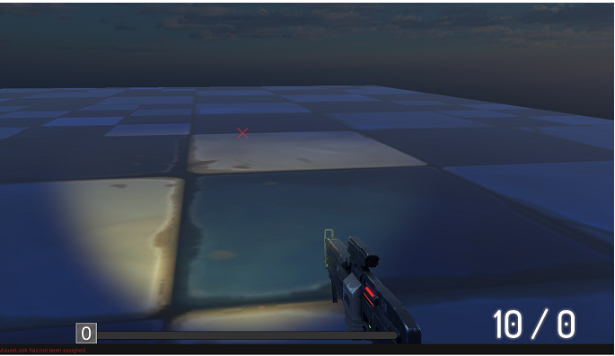
Gameplay Mechanics
Jetpack
Parachute
Sprint/Stamina
Fall damage
Flashlight
Headshot(planned)
Notes:
in the continuation, Mega Shooter Fantasy has various type of mechanics. For example we develop headshot mechanic by adding 2 colliders for enemy. Sphere collider for headshot mechanic it doubles the given damage, and other box collider for the enemy body for regular damage. In addition, user should make 2 tactics while playing game. 1 for the day time and other tactic for the night time gameplay since user’s vision will decrease in night time.

Slide 5

World Design
Terrain
Trees
Rocks
Mountains
Skybox
Notes:
Many objects used in creating game environment such as … Each element used in different biomes.

Slide 6
Interactions
Enemies
Collectible
NPC (In progress)
Notes:
User can interact with …

Slide 7
Enemies
Gives damage to player
Can die similar to player
Collectibles
Guns
Ammo Pack
NPC
Objective/Mission System
Notes:
Player fights against melee and ranged enemies. Also user interact with the dropped guns and ammo packs.

Slide 8
User Interface
Menu Layout/Start Screen
Inventory UI
Stats UI
Level Bar-Experience UI
Health/Stamina/Special Ability
Ammo UI
Enemy Stats Display in World
Notes:
In user interface design, game will show many information to user.

Slide 9
Thank you for listening
Notes:
Thanks

