Slide 1


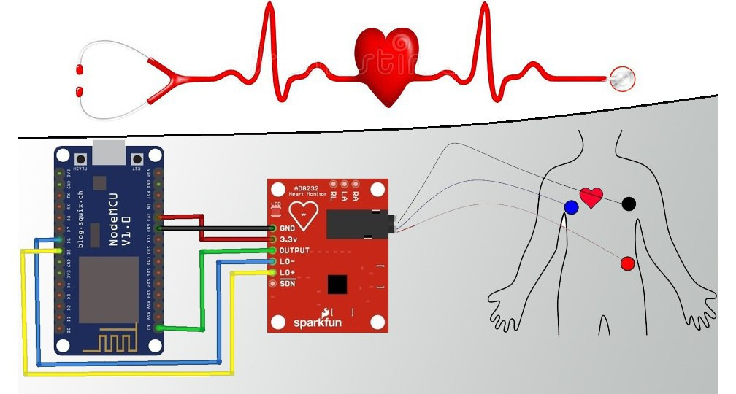
សាកលវិទ្យល័យភូមិន្ទភ្នំពេញ
Royal University of Phnom Penh
មហាវិទ្យាល័យវិស្វកម្ម
Faculty of Engineering
ដេប៉ាតឺម៉ង ទូរគមនាគមន៏​ និងអេឡិចត្រូនិច
ECG Monitoring components
ណែនាំដោយសិស្សច្បង​ រាល សុវណ្ណឌឿ
ធ្វើបទបង្ហាយដោយ ផន​ សុវណ្ណារ៉ា
ដឹកនាំដោយៈ បណ្ឌិត ថាប់ ថារឿន
1

Slide 2
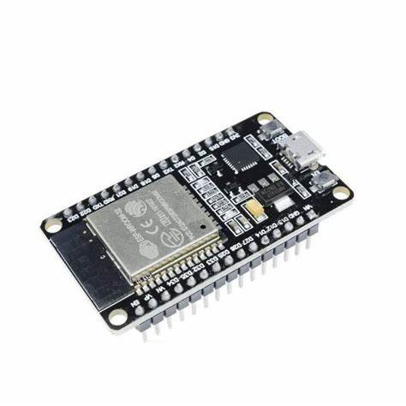
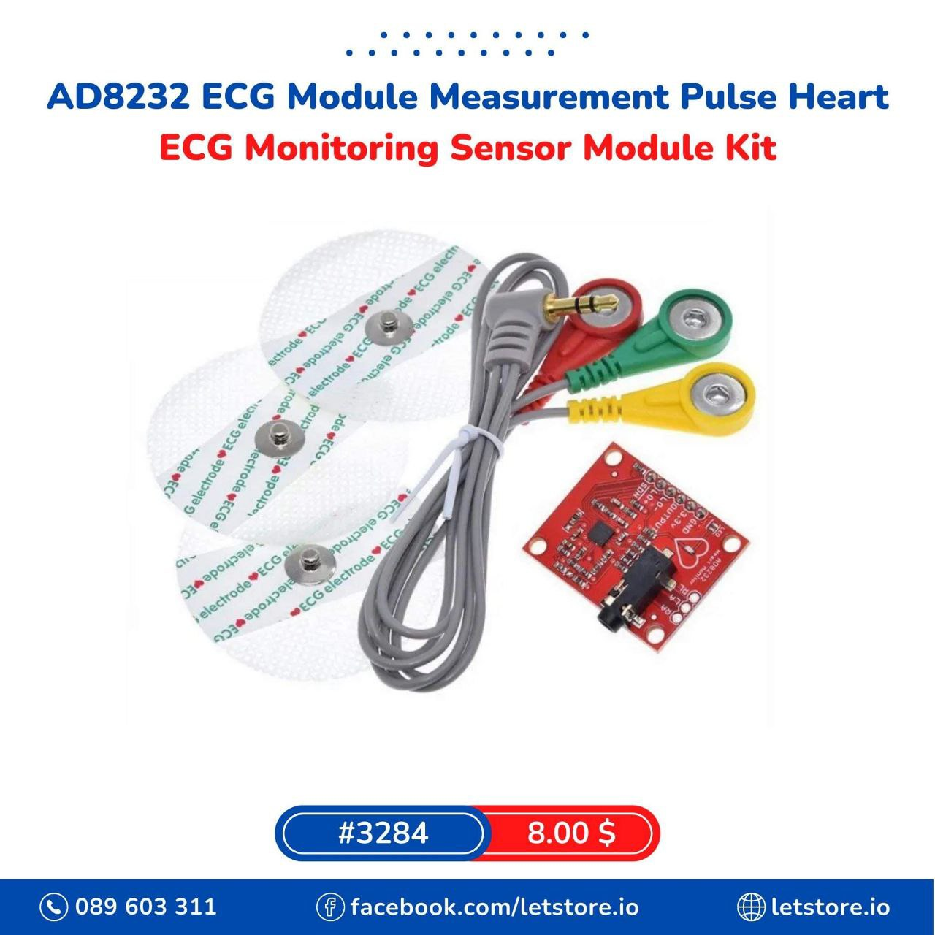
components
ESP 32 WROOM
ECG Monitoring Sensor
2

Slide 3
WROOM ESP 32
ESP WROOM 32 is a dual-core 32-bit all-powerful, universal Wi-Fi, BT (Bluetooth), BLE (Bluetooth LE) enabled MCU module that allows an extensive range of applications.
The dual-core MCU operates at 240 MHz and provides 600 DMIPS of processing capability.
3

Slide 4
Features of ESP32 Microcontroller
Hybrid Wi-FI & Bluetooth.
High level of integration.
Ultra-low-power management.
4 MB Flash.
On-board PCB antenna.
Integrated 520 KB SRAM
4

Slide 5
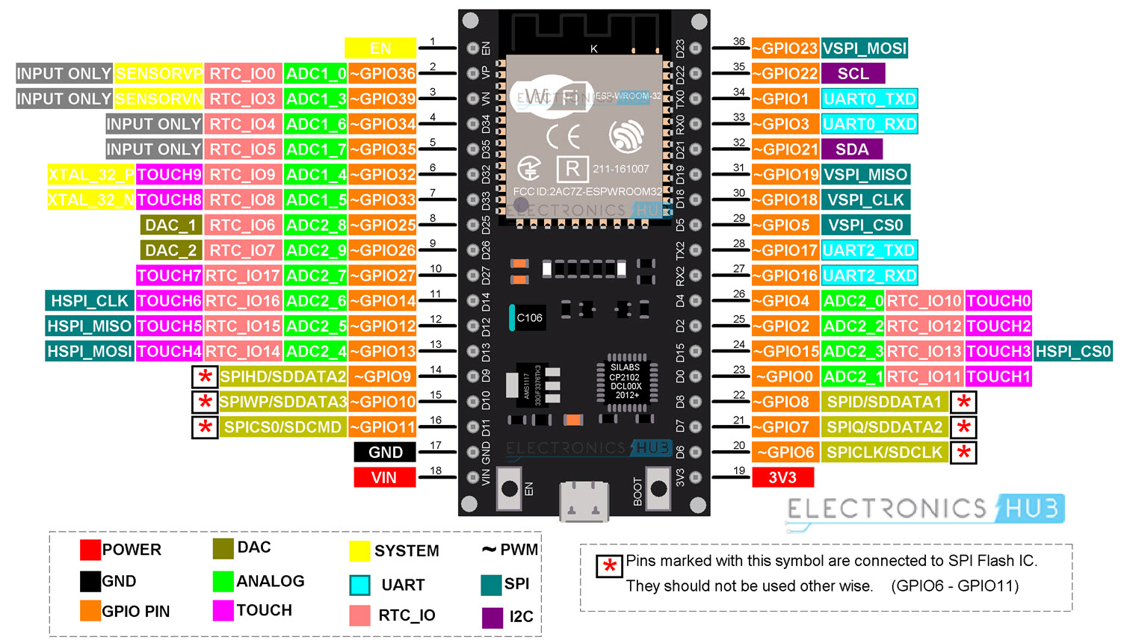
5V
5

Slide 6
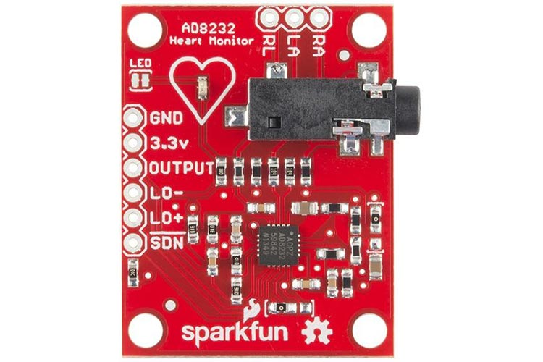
AD8232 ECG Module
The AD8232 ECG Module is a cost-effective board used to measure the electrical activity of the heart. This electrical activity can be charted as an ECG or Electrocardiogram and output as an analog reading.
6

Slide 7
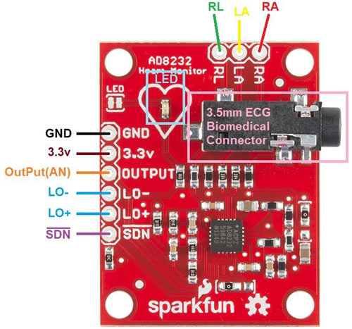
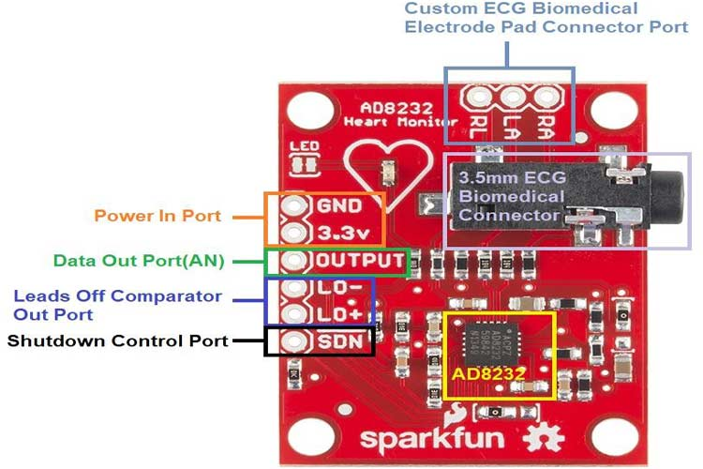
AD8232 ECG Module
7

Slide 8
Output (ADC) | Operational Amplifier Output. The fully conditioned heart rate signal is present at this output. OUT can be connected to the input of an ADC.
LO- | Leads Off Comparator Output. In dc leads off detection mode, LO− is high when the electrode to −IN is disconnected, and it is low when connected
LO+ | Leads Off Comparator Output. In dc leads off detection mode, LOD+ is high when the +IN electrode is disconnected, and it is low when connected
RA (Right Arm) | RED Biomedical electrode pad RA(input). Instrumentation Amplifier Negative Input. −IN is typically connected to the right arm (RA) electrode
LA(Left Arm) | YELLOW Biomedical electrode pad LA(input). Instrumentation Amplifier Positive Input. +IN is typically connected to the left arm (LA) electrode
RL(Right Leg) | GREEN Biomedical electrode pad RL(input). Right Leg Drive Output. Connect the driven electrode (typically, right leg) to the RLD pin.
8

Slide 9
Features of the AD8232 ECG Module
Fully integrated single-lead ECG front end
Qualified for automotive application
Single-supply operation: 2.0 V to 3.5
Fast restore feature improves filter settling
Size: 3.5cm x 3cm
9

Slide 10
4. ឯកសារយោង
1. https://components101.com/modules/ad8232-ecg-module
2.https://datasheethub.com/wroom-esp32-wifi-based-microcontroller-development-board/
10

Slide 11
Thank You
9
11

