Slide 1






TEI Simple
Power, economy, and a processing model for encoders and developers

Slide 2
TEI Simpletons
Project Investigators:
  Martin Mueller, Northwestern University
  Brian Pytlik Zillig, University of Nebraska-Lincoln
  Sebastian Rahtz, University of Oxford
Additional Project Staff:
  Magdalena Turska, DiXiT Project / University of Oxford
  James Cummings, DiXiT Project (Oxford PI) / University of Oxford
Advisory Committee:
  Pip Willcox, Bodleian Library, Oxford
  Suzanne Haaf, Deutsches Textarchiv, Berlin
  Matthias Goebel, University of Gottingen
  James Cummings, University of Oxford
And other members of the TEI-Simple mailing list and TEI Community

Slide 3
About TEI Simple
Joint project between TEI Consortium, Mellon Foundation, Northwestern University, University of Nebraska-Lincoln, and the University of Oxford
TEI Simple aims to ‘define a new highly-constrained and prescriptive subset of the Text Encoding Initiative (TEI) Guidelines suited to the representation of early modern and modern books, and a formally-defined set of processing rules which permit modern web applications to easily present and analyze the encoded texts’
All outputs are open source, all working is in the open on github https://github.com/TEIC/TEI-Simple/
All discussion is on a open mailing list: https://web.maillist.ox.ac.uk/ox/info/teisimple

Slide 4
TEI Simple: High-Level Goals
Definition of a new highly constrained and prescriptive subset of the TEI Guidelines suited to the representation of early modern and modern books. The degree of detail supported will be sufficient to encompass, at a minimum, the current practices of the TCP’s EEBO, ECCO, and Evans collections plus those of other major European initiatives such as Text Grid or the German Text Archive (DTA) and the Consortium Cahiers in France.
Developing and implementing processing model documentation for TEI Simple.
Formal mapping of the elements used by TEI Simple to the Conceptual Reference Model of the International Council of Museums (CIDOC CRM).
Definition and implementation of machine-readable descriptions of the encoding status and richness of TEI texts, providing ‘TEI Performance Indicators’, which help to document expectations for the encoded text.
Full integration of TEI Simple into the TEI Guidelines and infrastructure with ongoing maintenance by the TEI Technical Council.

Slide 5
TEI vs TEI Simple
TEI
TEI Simple
concentrates on data modelling aspects and ideological agnosticism
prefers freedom of projects to customize over rigid standardization
avoids any recommendation for output processing & publishing
TEI stylesheets often too complicated to customize
Set of existing customizations which allow maximum flexibility
usually only concerned with TEI vocabularies
concentrates on eliminating the ambiguity for the encoder
aims at increased interoperability
provides out-of-the-box mechanism for default processing
allows for [relatively] easy customization and extension
Constrained customization with lack of flexiblity
TEI Simple processing model can be applied to other vocabularies

Slide 6
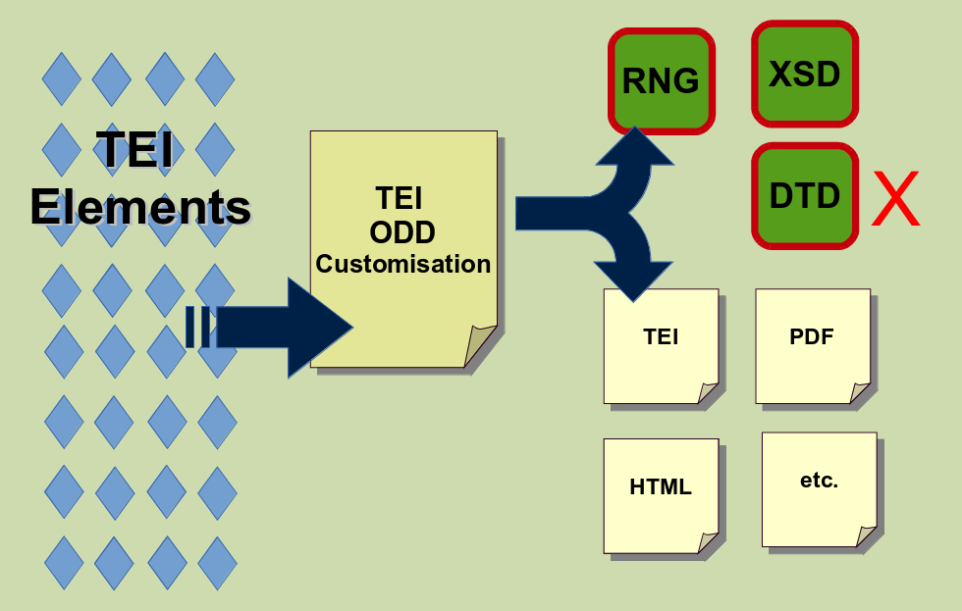
TEI Customization: A Quick Reminder

Slide 7
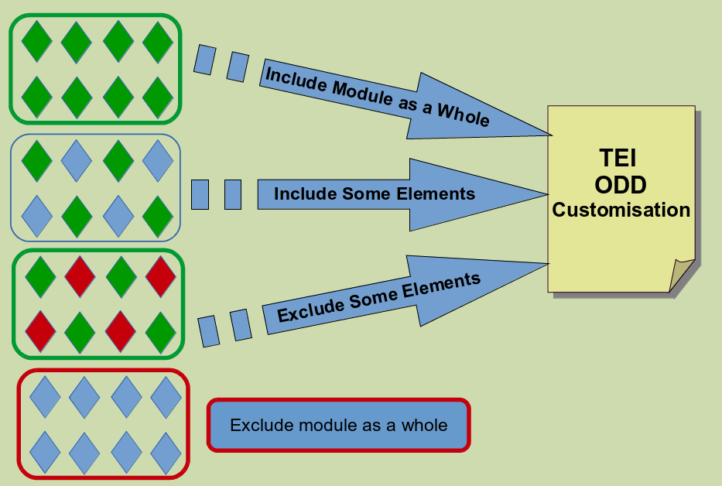
TEI Customization: A Quick Reminder

Slide 8
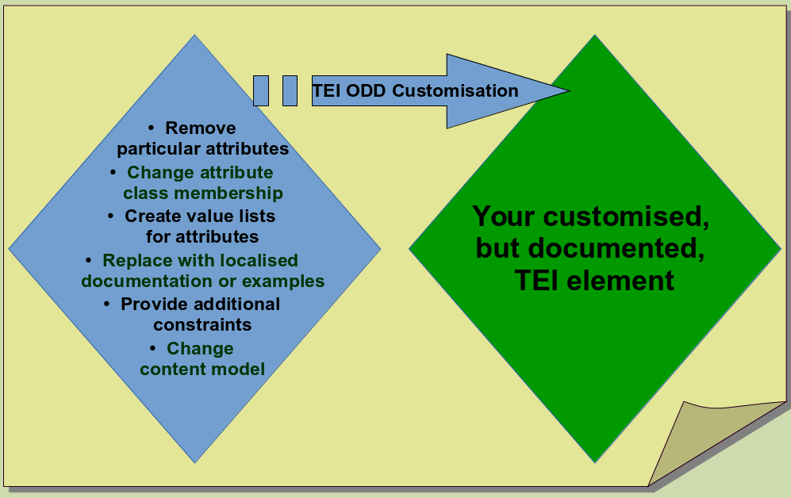
TEI Customization: A Quick Reminder
All conformant use of the TEI relies on a TEI ODD Customisation.

Slide 9
TEI Simple Subset
This subset of TEI Simple attempts to remove ambiguity for both encoders and developers.
'Simple' does not necessarily mean 'small', nor does it mean 'simplistic'
Selection of elements on TEI texts from a set of large archives or text collections:
  Text Creation Partnership: Evans, ECCO, EEBO (including the unreleased phase 2).
  Oxford Text Archive: All TEI P5 files.
  Deutsches Textarchiv.
  Documenting the American South.
  CESR.
  OBVIL: corpus critique.
Concentrates on constraining the contents of the <text> element, not metadata or facsimiles.
Subset of elements reduced the 546 (as of TEI P5 version 2.7.0) elements could be limited to 104 (at time of writing) not including <teiHeader> elements.

Slide 10
TEI Simple Constraints
Closed attribute value lists, where TEI has open ones, e.g. name/@type
Schematron constraints, e.g. for checking local URI fragment references
Uses Documented Private URI Syntax for standardized @rendition values, e.g.:
  simple:allcaps, simple:blackletter, simple:bold, simple:bottombraced, simple:boxed, simple:centre, simple:cursive, simple:display, simple:doublestrikethrough, simple:doubleunderline, simple:dropcap, simple:float, simple:hyphen, simple:inline, simple:justify, simple:italic, simple:larger, simple:left, simple:leftbraced, simple:letterspace, simple:literal, simple:normalstyle, simple:normalweight , simple:right, simple:rightbraced, simple:rotateleft, simple:rotateright, simple:smallcaps, simple:smaller, simple:strikethrough, simple:subscript, simple:superscript, simple:topbraced, simple:typewriter, simple:underline, simple:wavyunderline
And of course many elements and attribute (classes) removed

Slide 11
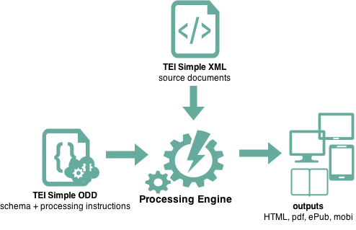
TEI Simple ODD
=
a schema
+
processing instructions for all elements
TEI Simple processing model

Slide 12
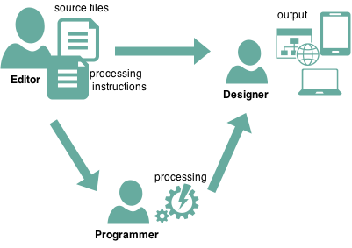
Rahtz Rationale
workflow with at least three distinct roles (not necessarily people)
Editor
Programmer
Designer
manages the text integrity,
makes the high-level output decisions:
  structural descriptions
‘should the original or corrected version be displayed by default‘, or ‘is this a block level or inline component‘
  indications of appearance
‘titles should be in italics‘
takes the editor’s specification, and the TEI text(s), and creates the input for the designer to make the final output
creates the output envelope (for example book layout using InDesign, or a web site using Drupal), making decisions about the appearance in conjunction with the editor
‘use Garamond font throughout’
‘every page must show the departmental logo’

Slide 13
simple scenarios
default
customized
editorial decisions recommended by teiSimple fit project’s needs perfectly: just use teisimple.odd
project requires customization: import and override teisimple.odd with custom processing and rendition instructions

Slide 14
Editor’s (Or TEI Assistant's) Simple Tasks
identify elements that require individual treatment
if treatment differs depending on context, identify all possible situations via XPath expressions
(eg. <head> elements inside <div type=“act”> should be treated differently than all other <head> elements)
decide which behaviour is required under given circumstances, specify parameters
(eg. If it exists use only <lem> child as 'visible by default' in critical apparatus <app> entries, provide other <rdg> as alternates)
if treatment differs depending on output type create additional models with @output as necessary
specify rendition using simple:* URI syntax

Slide 15
Editor’s (Or TEI Assistant's) Simple Skills
Familiarity with source files and XML encoding used
Ability to identify different use scenarios for their output
Extremely basic XPath fluency to specify model parameters (or an assistant)
Basic CSS knowledge for specifying output rendition (or an assitant)
In many cases the editor will work with a TEI/Xpath/CSS fluent assistant, but in other cases the editor already knows these.

Slide 16
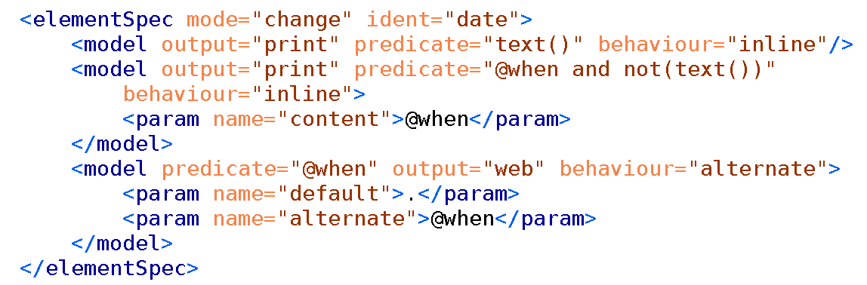
Turska Tenet
maximum expressivity to the editor
The ODD should store as much information as possible
For each element there are potentially numerous <model> instructions that specify intended processing and rendering for different outputs and in various contexts. This gives the editor, or their TEI assistant, maximum expressivity and control over output without implementation details

Slide 17
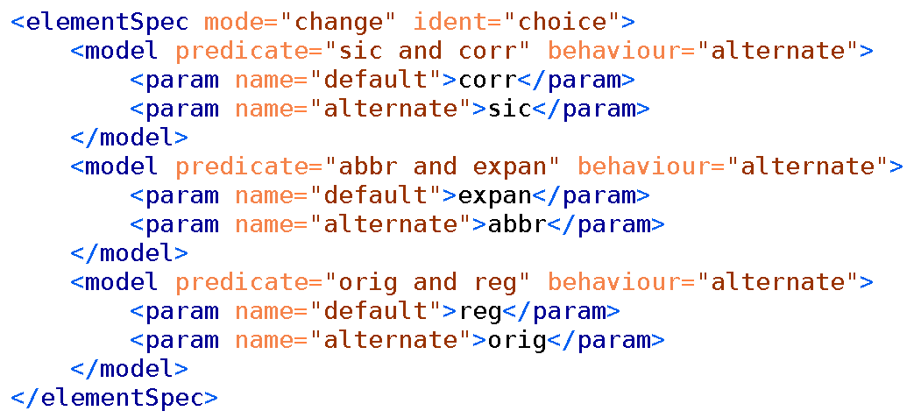
Simple Processing Model for <choice>

Slide 18
<model> Processing Model Documentation
@output specifies output in which model applies
@predicate specifies context in which model applies
@behaviour specifies behaviour from teiSimple behaviour library to apply
@useSourceRendition indication to preserve @rendition value from the source
<param> elements specify parameters for behaviour
<rendition> elements specify CSS instructions to indicate outline appearance

Slide 19
alternate (default ,alternate) | create a specialized display of alternating elements for displaying the preferred version, both at once or toggling between the two.
anchor (id) | create anchor with ID
block (content) | create a block out of the content parameter.
body (content) | create the body of a document.
break (type,label) | make a line, column, or page break according to type
cell (content) | create a table cell
cit (content,source) | show the content, with an indication of the source
document (content) | start a new output document
figure (title) | make a figure with the title as caption
glyph (content) | show a character by looking up reference
graphic (url) | if url is present, uses it to display graphic, else display a placeholder image.
heading (content) | creates a heading.
index (type) | generate list according to type
inline (content,label) | creates inline element out of content if there's something in rendition, use that formatting otherwise just show text of selected content.
link (content,target) | create hyperlink
list (content) | create a list by following content
listItem (content) | create list item
metadata (content) | create metadata section
note (content,place, marker) | create a note, according to value of place; could be margin, footnote, endnote, inline
omit | do nothing, do not process children
paragraph (content) | create a paragraph out of content.
row (content) | make table row
section (content) | create a new section of the output document
table (content) | make table
text (content) | literal text
title (content) | make document title
inline
block
…
TEI Simple
behaviours
library
handful of behaviours that achieve > 80% tasks
behaviours based on commonly used terms
if no content parameter specified, all behaviours use current element as default content

Slide 20
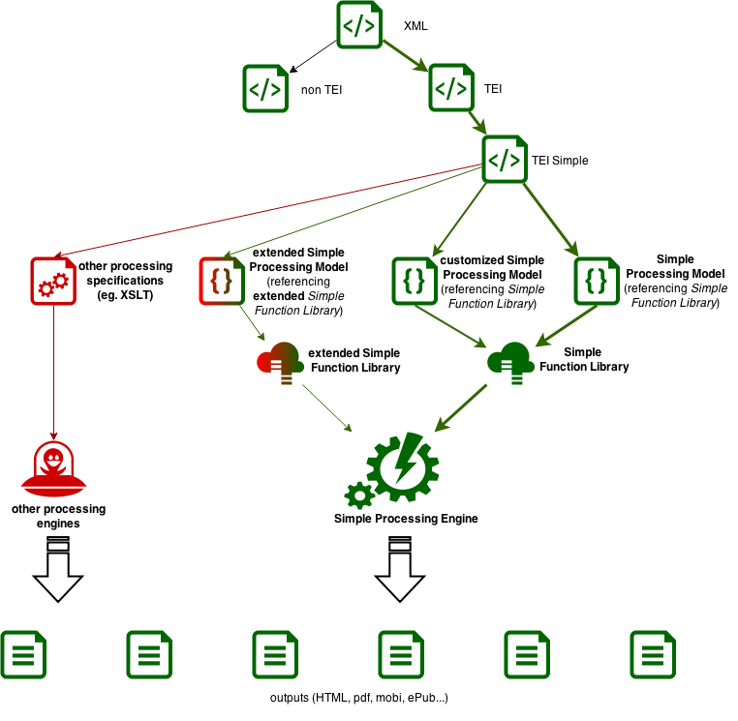
TEI Simple in a broader context

Slide 21
Implementations of Simple Processing Model documentation
As a test of development methodologies based on the processing model documentation we had developers implement it in different languages:
XSLT: implemented by Sebastian Rahtz and Magdalena Turska (University of Oxford), with significant TEI and TEI-Simple knowledge
Java: implemented by Matthew Buckett (University of Oxford), with little or no TEI knowledge
XQuery and eXist-db: implemented by Wolfgang Meier (eXist Solutions) with only minor TEI knowledge
See for example: http://showcases.exist-db.org/exist/apps/tei-simple/
Does it work?
Matthew had no problems, Wolfgang says “This saved a few thousand lines of code compared to the original app I used as a template”

Slide 22
What Now?
Documentation: While there is some (developer level) documentation, what TEI Simple needs is detailed front-facing worked examples and explanatory documentation
Integration: The TEI Technical Council has suggested some minor modifications, and these need to be incorporated before TEI Simple can become a supported customization of the TEI, and the Simple Processing Model can be integrated into the TEI Guidelines as a whole.
Expansion: TEI Simple has a relatively tight remit for works it covers. We'd be interested in people using it as base to expand for their projects (not just works by dead, white, guys!). They'll only have to extend for those bits we don't cope with.
Github: https://github.com/TEIC/TEI-Simple/
Mailing List: https://web.maillist.ox.ac.uk/ox/info/teisimple

