Slide 1
TEI Simple
Self-Documenting
Abstraction layer
For
XML Processing

Slide 2
TEI vs TEI Simple
TEI
TEI Simple
concentrates on data modelling aspects and ideological agnosticism
avoids standardization constraining individual projects
avoids any recommendation for processing & publishing
TEI stylesheets often too complicated to customize
only concerned with TEI
concentrates on eliminating the ambiguity for the encoder
aims at interoperability
provides out-of-the-box mechanism for default processing
allows for [relatively] easy customization and extension
TEI Simple processing model can be applied to other vocabularies

Slide 3
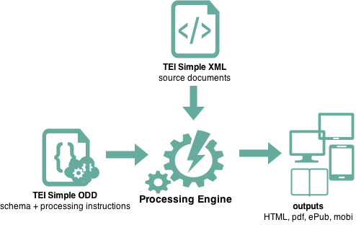
TEI Simple processing model
TEI Simple ODD
=
a schema
+
processing instructions for all elements

Slide 4
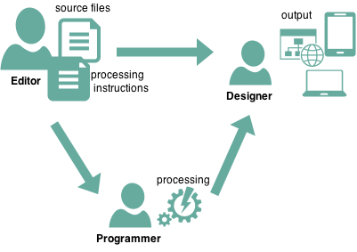
Rahtz Rationale workflow with three distinct roles
Editor
Programmer
Designer
manages the text integrity, makes the high-level output decisions:
structural descriptions
‘should the original or corrected version be displayed by default‘, or ‘is this a block level or inline component‘
indications of appearance
‘titles are in italics‘
takes the editor’s specification, and the TEI text(s), and creates the input for the designer to make the output
creates the output envelope (for example book layout using InDesign, or a web site using Drupal), making decisions about the appearance in conjunction with the editor
‘use Garamond font throughout’
‘every page must show the departmental logo’

Slide 5
simple scenarios
default
customized
editorial decisions recommended by teiSimple fit project’s needs perfectly: just use teisimple.odd
project requires customization: overwrite teisimple.odd with custom processing and rendition instructions

Slide 6
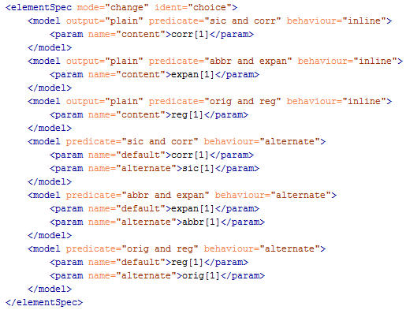
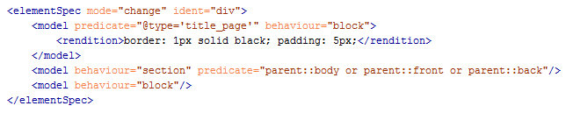
Turska Tenet maximum expressivity to the editor
ODD stores as much information as possible
for each element there are potentially numerous <model> instructions that specify intended processing and rendering for different outputs and in various contexts

Slide 7
editor’s tasks (apart from editing)
identify elements that require individual treatment
if treatment differs depending on context, identify all possible situations via XPath expressions (eg. div type=“act” headings treated differently than all other head elements)
decide which behaviour is required under given circumstances, specify parameters (eg. use only lem child as visible by default in app entries)
if treatment differs depending on output type create additional models with @output as necessary
specify rendition as CSS where required

Slide 8
model syntax
ODD extensions for TEI Simple Processing Model (PM)
model
param
rendition
modelGrp
modelSeq

Slide 9
model
@output specifies output in which model applies
@predicate specifies context in which model applies
@behaviour specifies function from teiSimple function library to apply
@useSourceRendition indication to preserve @rendition value from the source
<param> elements specify parameters for behaviour
<rendition> elements specify CSS instructions to indicate outline appearance

Slide 10
TEI Simple behaviours library
alternate (default,alternate) | create a specialized display of alternating elements for displaying the preferred version, both at once or toggling between the two.
anchor (id) | create anchor with ID
block (content) | create a block out of the content parameter.
body (content) | create the body of a document.
break (type,label) | make a line, column, or page break according to type
cell (content) | create a table cell
cit (content,source) | show the content, with an indication of the source
document (content) | start a new output document
figure (title) | make a figure with the title as caption
glyph (content) | show a character by looking up reference
graphic (url) | if url is present, uses it to display graphic, else display a placeholder image.
heading (content) | creates a heading.
index (type) | generate list according to type
inline (content,label) | creates inline element out of content if there's something in rendition, use that formatting otherwise just show text of selected content.
link (content,target) | create hyperlink
list (content) | create a list by following content
listItem (content) | create list item
metadata (content) | create metadata section
note (content,place,marker) | create a note, according to value of place; could be margin, footnote, endnote, inline
omit | do nothing, do not process children
paragraph (content) | create a paragraph out of content.
row (content) | make table row
section (content) | create a new section of the output document
table (content) | make table
text (content) | literal text
title (content) | make document title
inline
block
…
handful of functions that achieve > 80% tasks
functions based on commonly used terms
if no content parameter specified, all functions use current element as default content

Slide 11
model
there can be as many <model> statements as required, each of which can have multiple <rendition> children
set of multiple <model> statements is regarded as an alternation and only the first <model> with @predicate matching current context is applied
@behaviour specifies which one from TEI Simple function library should be applied and function parameters are specified as <param> children
within each <model> there can be set of <rendition> elements
<desc> allows for initial textual description of required processing

Slide 12
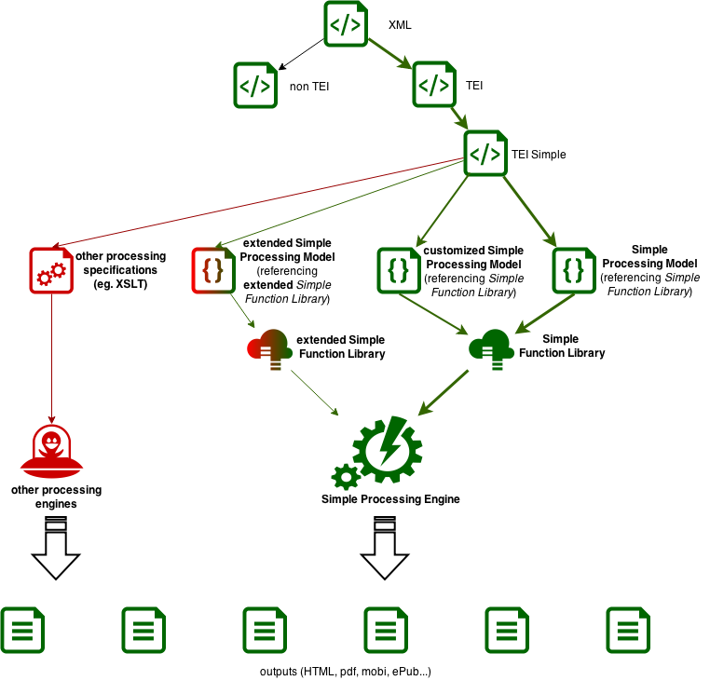
TEI Simple in a broader context

Slide 13
editor’s necessary skills
familiarity with source files and XML encoding used
ability to identify different use scenarios
relative XPath fluency to specify model parameters*
relative CSS fluency*
* possibly assisted by project’s IT support

