Slide 1


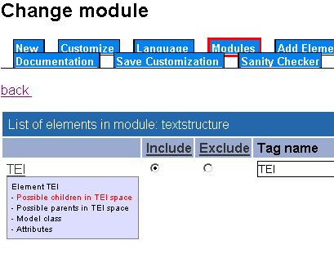
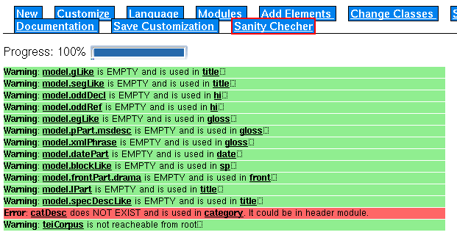
A sanity checker for TEI schemas
Bernevig Ioan, Véronika Lux Pogodalla,
Bertrand Gaiffe, Sebastian Rahtz
Institut de l’Information Scientifique et Technique, CNRS
Analyse et Traitement Informatique de la Langue Française, CNRS
Oxford University Computing Services
Overall Picture
User actions such as:
delete element
add module
etc
Flat ODD
Containing relevant
Specs
Documentation
Examples
XSLT
Schemas
DTD, RELAX NG or XSD
XSL
Transformation
XSLT
Documentation
HTML, PDF, LaTeX, etc...
Full ODD file or eXist DB
Containing:
Elements specifications
Modules specs
Class specs
Intermediate ODD
Containing relevant specs
WITHOUT documentation
or examples.
Macros are expanded.
NEW !
Sanity Checker works on this file
Sanity Checker
Checks if the TEI schema
Is coherent or not.
PROCESS
Errors and warnings
Creating your schema by including/excluding elements and modules
More information about hierarchy between elements
Checking your schema: you check your schema before generating your RELAX NG, DTD or XSD. It’s useful to see which elements are not usable.
OUTPUT
Information about schema (OK or NOT) and errors or warnings about empty classes, elements which are used and not defined, loops, elements which are not reacheable, class sequences and where all those elements are used.
Tells you what to do in order to have a correct schema, but does not perform correction.
ISSUES
The sanity checker
Attributes are not considered. What errors can attribute modification introduce?
How can we best visualize the class hierarchy?
TEI Members Meeting 2007, Maryland
Acknowledgement: This work has been supported by
Région Lorraine, France
TEI Consortium

