Slide 1

Balisage 2023 — encore presentation based on
TEI Conference and Members’ Meeting
Newcastle University
Friday, 16 September 2022
The TEI ATOP Task Force:
Syd Bauman, Martin Holmes, Helena Bermúdez Sabel, and David Maus
The TEI ATOP Task Force:
Syd Bauman, Martin Holmes, Helena Bermúdez Sabel, and David Maus

Slide 2
Gameplan
Section 1: A brief introduction to TEI, ODD, the TEI Stylesheets, and current ODD processing
Section 2: ATOP: Why it is important, how it came to be, goals
Section 3: Who, where, and how we are working
Section 4: Progress so far
Each slide has “original”, “modification”, or “balisage” in the lower left corner to indicate an original slide from the 2022-09-16 presentation, a slide from that presentation modified for this audience, or a new slide for Balisage not in that presentation. Why? Provenance!
The complete paper from the TEI 2022 conference will be published in the Journal of the Text Encoding Initiative soon.
Some of the information herein was presented at the Balisage “open mic” session last year by Helena Bermúdez Sabel.
balisage

Slide 3
The TEI is …
a markup language (currently XML-based)
  intended for modeling texts of interest to the humanities
  customizable
simultaneously a community standard and a community research effort
a research community that also has responsibility for developing and expanding the TEI
an international consortium that publishes and maintains the Guidelines
  mostly volunteer
free, both as in “beer” and as in “speech” (FLOSS for which there is no charge)
A toolchain (about which we are talking today)
Conference series (where this talk was originally presented)
Quite a few mailing lists, a journal, a wiki, 33 GitHub repos …
balisage

Slide 4
The TEI Guidelines …
Consist of a single XML document (spread out among >850 separate files) which contains:
  descriptive prose
  examples of usage
  formal declarations for components of the TEI Abstract Model:
    elements & attributes
    modules & classes
    macros & datatypes
And which is written in TEI
balisage

Slide 5
ODD (one document does it all)
Because all of the outputs (prose documentation; reference documentation; examples, possibly in multiple natural langues; plus schemas) can be generated from the one source document (of 850+ files), the “flavor” of TEI that it is written in is called ODD.
ODD is both a built-in schema language and used for customizing a language written in ODD
Thus ODD is used both for the TEI Consortium to write the TEI Guidelines, and for users to express customizations thereof
ODD is also used to define non-TEI markup languages
balisage

Slide 6
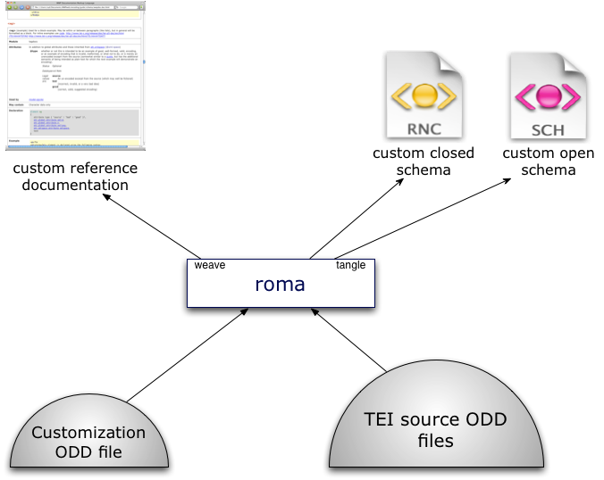
Reminder
original

Slide 7
Who, History, and Why (1)
Stylesheets bugs are hard to fix
  Note from the Council Chair report yesterday [2022-09-15] that the Council clears Guidelines issues much faster than we clear Stylesheets issues …
  … and we have a special Stylesheets group that meets (most) every month
Stylesheets have lots of bugs
  E.g., Martin & Syd would routinely found new bugs trying to fix old
modification

Slide 8
Who, History, and Why (1)
Stylesheets bugs are hard to fix
  Note from the Council Chair report yesterday [2022-09-15] that the Council clears Guidelines issues much faster than we clear Stylesheets issues …
  … and we have a special Stylesheets group that meets (most) every month
Stylesheets have lots of bugs
  E.g., Martin & Syd would routinely found new bugs trying to fix old
“I consider the Stylesheets as broken beyond repair. They work … to a certain degree[,] but they are, from my point of view, effectively unmaintainable.” — David Maus, #477, 2021-03-23
modification

Slide 9
Who, History, and Why (2)
Written by the amazing Sebastian Rahtz
Stylesheets are very impressive in what they do (and in how fast he did it)
  BUT …
  Outdated form of XSLT (basically 1.0 with a bit of 2.0)
  Poorly documented
  Extraordinarily complex
  Complex in large part because they do so much
“Sebastian was such a genius he really found it impossible to imagine
how dim the rest of us actually are.”
— Martin Holmes, TEI Conference (virtual) 2021-10
modification

Slide 10
Who, History, and Why (3)
Council feels that ODD ⇨ schemas and documentation is a core Council responsibility
  Other functions of Stylesheets are not
  After all, that is why the Stylesheets were spun off to their own repo years ago
See the charge from Council to the Task Force
original

Slide 11
Our TEIC GitHub repository
Almost all of our work is being done in a TEIC GitHub repository, https://github.com/TEIC/atop.
Repo contains (among other things):
  code
  issues & pull requests
  a glossary of terms
  documentation of goals, namespaces, error codes, etc.
  meeting minutes
modification

Slide 12
Limited Scope
Just ODD → RelaxNG & Schematron
  Not TEI Lite to ePub3
  Not DOCX to TEI
  Not ODD with processing model information to stylesheets
  Not even ODD to XSD nor DTD
ODD → documentation is a core Council activity to be handled by another group
original

Slide 13
Conventions and Consistency (1)
“consistency is the hobgoblin of little minds”
— Ralph Waldo Emerson, Self-Reliance, 1841
original

Slide 14
Conventions and Consistency (1)
“consistency is the hobgoblin of little minds”
— Ralph Waldo Emerson, Self-Reliance, 1841
Emerson was not a computer programmer
original

Slide 15
Conventions and Consistency (1)
“consistency is the hobgoblin of little minds”
— Ralph Waldo Emerson, Self-Reliance, 1841
Emerson was not a computer programmer
He did not mean “consistency is bad”, the above is taken out of context
original

Slide 16
Conventions and Consistency (1)
“consistency is the hobgoblin of little minds”
— Ralph Waldo Emerson, Self-Reliance, 1841
Emerson was not a computer programmer
He did not mean “consistency is bad”, the above is taken out of context
Emerson was not a computer programmer
original

Slide 17
Conventions and Consistency (2)
“A foolish consistency is the hobgoblin of little minds”
— Ralph Waldo Emerson, Self-Reliance, 1841
original

Slide 18
Conventions and Consistency (2)
“A foolish consistency is the hobgoblin of little minds”
— Ralph Waldo Emerson, Self-Reliance, 1841
Consistency in programming constructs is not foolish
original

Slide 19
Conventions and Consistency (2)
“A foolish consistency is the hobgoblin of little minds”
— Ralph Waldo Emerson, Self-Reliance, 1841
Consistency in programming constructs is not foolish
Besides, he was not talking about consistency in notation, or that 2+2 consistently = 4, or if one should have a consistent left margin on a printed page; the above is taken out of context
original

Slide 20
Conventions and Consistency (2)
“A foolish consistency is the hobgoblin of little minds”
— Ralph Waldo Emerson, Self-Reliance, 1841
Consistency in programming constructs is not foolish
Besides, he was not talking about consistency in notation, or that 2+2 consistently = 4, or if one should have a consistent left margin on a printed page; the above is taken out of context
Emerson was not a computer programmer
original

Slide 21
Conventions and Consistency (3)
A foolish consistency is the hobgoblin of little minds, adored by little statesmen and philosophers and divines. With consistency a great soul has simply nothing to do. He may as well concern himself with his shadow on the wall. Speak what you think now in hard words, and to-morrow speak what to-morrow thinks in hard words again, though it contradict every thing you said to-day. — “Ah, so you shall be sure to be misunderstood.” — Is it so bad, then, to be misunderstood? Pythagoras was misunderstood, and Socrates, and Jesus, and Luther, and Copernicus, and Galileo, and Newton, and every pure and wise spirit that ever took flesh. To be great is to be misunderstood.
original

Slide 22
Conventions and Consistency (4)
We have set up conventions in the hopes of consistency
  e.g., if a routine creates a node, we call a named template; if it does not, we call a function
We are using Schematron to enforce consistency:
  of parameter names ($atop:pPatternPrefix, $atop:tpFun)
  of variable names ($atop:vVersion)
  of function names (atop:unique-ident())
  in global use of @as attribute
  to require internal documentation
original

Slide 23
Software
End product will be FLOSS (of course)
End product should run in any X-environment (including oXygen)
We make use of oXygen, and end product will run in oXygen, but nothing will require oXygen
  Although for now, generation of HTML documentation may require oXygen
XSLT 3 (using XPath 3.1) only
  Even if & when XSLT 4 comes out
Saxon HE (currently Saxon 11)
jing (and trang if and when needed)
Glue will likely be in ant, or XProc, or both
modification

Slide 24
Previous Process
Current Stylesheets include over 330 XSLT files
Only ~25–33 of them are part of the process we are duplicating
The division of labor among these is, at best, confusing
Described on a TEI wiki page
original

Slide 25
Terminology
Part of the problem of the previous suite is inconsistent terminology
Thus we are trying to stick to a defined glossary of terms
original

Slide 26
Planned Process
Will not be nearly as complicated as the current suite
  In part because it does so much less
Might end up as complicated as the portion of the current suite that handles the same process …
BUT
Probably not; and
even if it does, it will be well-documented
original

Slide 27
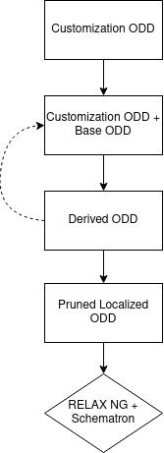
Stages
Assemble customization ODD
  Merge in references to external components, if any
  Prose may be dropped at this stage
Customization ODD + Base ODD → Derived ODD
  Keeping all internationalization information (i.e., all languages of glosses & descriptions)
Customization ODD + Derived ODD → Derived ODD
  Repeat 0 or more times as needed
Derived ODD → Pruned Localized ODD
  Removing things not needed for schema itself
  Localize by removing all but 1 language gloss & desc for each component
PLODD → RELAX NG + Schematron
  User is welcome to try to convert the RNG to DTD or XSD, but such is out of scope for ATOP
  (Remember: our goal is only generation of RELAX NG and Schematron schemas)
original

Slide 28
Validation!
We plan to validate the output of every stage
  Which means a rigorously defined derived ODD (defined by an ODD)
  Which means a rigorously defined PLODD (defined by an ODD)
This means we have to write out intermediate files
  Good for debugging, anyway
Also means we probably cannot use XPath 3.1’s transform() feature to do this all-at-once
  Snif!
Includes validation of end-output RELAX NG & Schematron
original

Slide 29
More Testing (above & beyond validation)
Building test suites as we go
Collected lots of ODDs from TEI users
Creating ODDs that test specific parts of the process
Using XSpec to test functions and named templates
May use XSpec for testing entire stages
Behavioral testing on the RELAX NG
  I.e., instance files that should be valid and instance files that should be invalid
  Thus allowing either ( blort+ ) or ( blort, blort* ) to be used to say “one or more <blort>s”
modification

Slide 30
Side effects
Our work runs into places where ODD must be more cleanly specified
No one is surprised
We are raising tickets as we go
  E.g., how a user specifies the Schematron binding is an open question
Some changes may require fixes to previous Stylesheets
original

Slide 31
Collaborative process
Collaboration operates through a process in which the successful intellectual achievements of one person arouse the intellectual passions and enthusiasms of others.
— Alexander von Humboldt (1769–1859)
original

Slide 32
Slow and steady wins the race
We are purposefully putting maintainable code over speed of output
  No major rush, the world has been making due with current Stylesheets for many years
No hard deadlines
Aspirationally would like to have
  working code for Council to start testing in summer 2023
  full release by end of 2023
Will not be upset if we do not make that aspirational deadline
(see (1) and (2) :-)
original

Slide 33
Th-th-tha-that’s all, folks
Questions?
original

