Slide 1
Differentiating ODDs
Syd Bauman, Helena Bermúdez Sabel, and Martin Holmes
(ATOP task force)
TEI Members’ Meeting, Kraków, 2025-09-18

Slide 2
Outline
How TEI ODD Works
Terminology
The original ODD conception
Problems with that:
  Non-TEI markup languages
  Current Stylesheets behaviour
  ODD chaining
Proposed solution

Slide 3
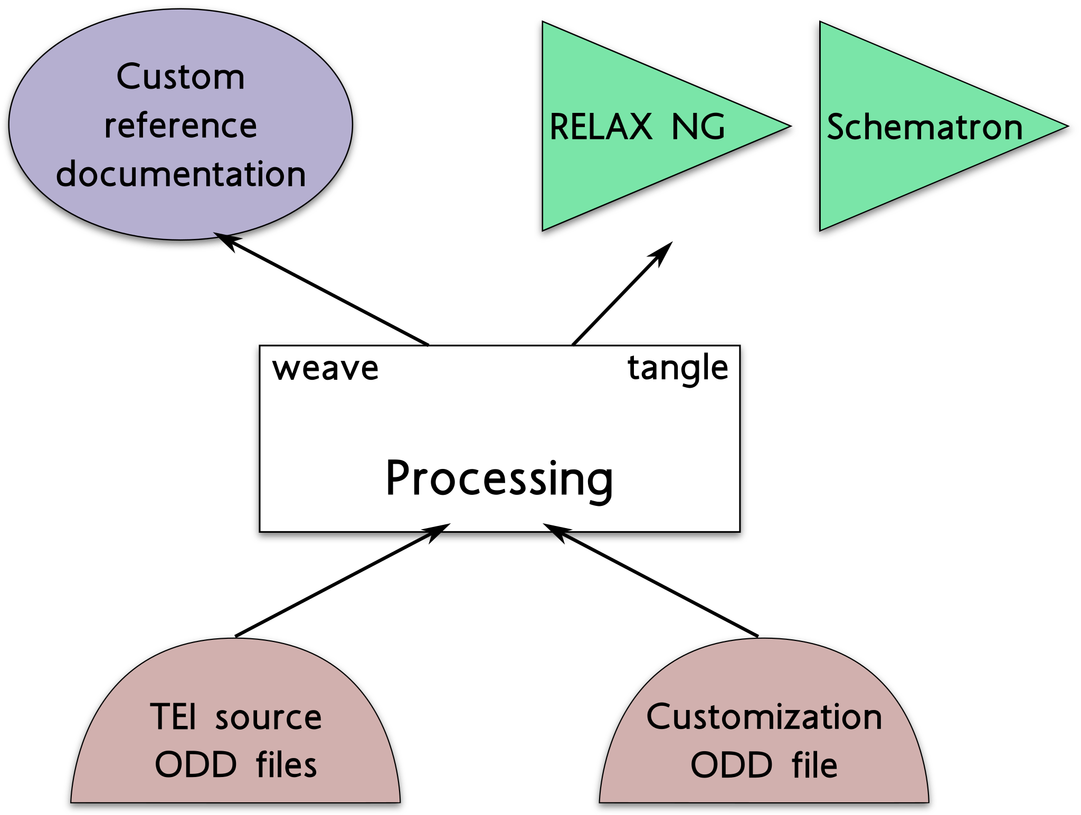
How TEI ODD Works

Slide 4
Terminology
ODD, for “one document does it all” — The TEI’s schema language that includes robust documentation and the association of output styling
Original base ODD — Normally TEI P5 (e.g., either p5.xml or p5subset.xml). Contains specifications for elements, datatypes, and macros, typically organized using classes and modules
Customization ODD — An expression of a particular schema language to be created from the specifications in its source base ODD. Typically says which parts of the base ODD are to be used (and thus which parts are to be ignored), and what additional constructs are to be added.
Derived ODD — The result of a derivation process by which a customization ODD is processed against a base ODD. A derived ODD should not have any references to any base ODDs via @source on <*Spec> elements. It may be used as the base ODD for a subsequent chained derivation step. These have been called “compiled”, “expanded”, or “processed” ODDs.
Notes:
Also contains documentation for the system being defined, and a model for intended processing, but these do not concern us here
tei_bare.odd is the “almost nothing” customization

Slide 5
Terminology
ODD, for “one document does it all” — The TEI’s schema language that includes robust documentation and the association of output styling
Original base ODD — Normally TEI P5 (e.g., either p5.xml or p5subset.xml). Contains specifications for elements, datatypes, and macros, typically organized using classes and modules
Customization ODD — An expression of a particular schema language to be created from the specifications in its source base ODD. Typically says which parts of the base ODD are to be used (and thus which parts are to be ignored), and what additional constructs are to be added.
Derived ODD — The result of a derivation process by which a customization ODD is processed against a base ODD. A derived ODD should not have any references to any base ODDs via @source on <*Spec> elements. It may be used as the base ODD for a subsequent chained derivation step. These have been called “compiled”, “expanded”, or “processed” ODDs.
Notes:
Also contains documentation for the system being defined, and a model for intended processing, but these do not concern us here
tei_bare.odd is the “almost nothing” customization

Slide 6
Terminology
ODD, for “one document does it all” — The TEI’s schema language that includes robust documentation and the association of output styling
Original base ODD — Normally TEI P5 (e.g., either p5.xml or p5subset.xml). Contains specifications for elements, datatypes, and macros, typically organized using classes and modules
Customization ODD — An expression of a particular schema language to be created from the specifications in its source base ODD. Typically says which parts of the base ODD are to be used (and thus which parts are to be ignored), and what additional constructs are to be added.
Derived ODD — The result of a derivation process by which a customization ODD is processed against a base ODD. A derived ODD should not have any references to any base ODDs via @source on <*Spec> elements. It may be used as the base ODD for a subsequent chained derivation step. These have been called “compiled”, “expanded”, or “processed” ODDs.
Notes:
Also contains documentation for the system being defined, and a model for intended processing, but these do not concern us here
tei_bare.odd is the “almost nothing” customization

Slide 7
Terminology
ODD, for “one document does it all” — The TEI’s schema language that includes robust documentation and the association of output styling
Original base ODD — Normally TEI P5 (e.g., either p5.xml or p5subset.xml). Contains specifications for elements, datatypes, and macros, typically organized using classes and modules
Customization ODD — An expression of a particular schema language to be created from the specifications in its source base ODD. Typically says which parts of the base ODD are to be used (and thus which parts are to be ignored), and what additional constructs are to be added.
Derived ODD — The result of a derivation process by which a customization ODD is processed against a base ODD. A derived ODD should not have any references to any base ODDs via @source on <*Spec> elements. It may be used as the base ODD for a subsequent chained derivation step. These have been called “compiled”, “expanded”, or “processed” ODDs.
Notes:
Also contains documentation for the system being defined, and a model for intended processing, but these do not concern us here
tei_bare.odd is the “almost nothing” customization

Slide 8
Requirement and Intended Solution
ODD processing software needs to know whether an input ODD should be read as an original base ODD or as a customization ODD
The original plan (as we understand it) was that:
A customization ODD would have a <schemaSpec> element
An original base ODD would not
Thus software should be able to differentiate based on a simple XPath
Notes:
Note: MDH never had any understanding that a base ODD would lack a <schemaSpec>; he assumed that was just an accident of the way the Guidelines were built, rather than an intentional design feature.

Slide 9
Famous Last Words
That (simple XPath) method will not work because
People have created stand-alone (i.e., non-TEI) markup languages using an ODD with a <schemaSpec>
  As long as there are no <*Ref> elements that point at TEI, it makes no difference
A derived ODD has a <schemaSpec> element, and thus looks like a customization, even though it could be a base ODD when chaining
In order to chain efficiently, we would like any ODD file (whether a base or customization ODD) to be usable as a base

Slide 10
Current Processing
<xsl:function name="atop:is-base-odd" as="xs:boolean">
<xsl:param name="pOdd" as="node()"/>
<xsl:choose>
<!--If no schemaSpec exists, it’s base (e.g. p5subset).-->
<xsl:when test="not( $pOdd/descendant::schemaSpec )">
<xsl:sequence select="true()"/>
</xsl:when>
<!--If any *Ref element child of schemaSpec has @key, we can assume that it’s a customization.-->
<xsl:when test="
some $r in $pOdd/descendant::schemaSpec/child::*[ ends-with(local-name(), 'Ref') ]
satisfies $r/@key">
<xsl:sequence select="false()"/>
</xsl:when>
<!--Any *Spec element with a mode attribute not equal to "add" means it must be a customization.-->
<xsl:when test="
some $s in $pOdd/descendant::schemaSpec/child::*[ ends-with(local-name(), 'Spec') ]
satisfies $s/@mode = ('delete', 'change', 'replace')">
<xsl:sequence select="false()"/>
</xsl:when>
<xsl:otherwise>
<xsl:sequence select="true()"/>
</xsl:otherwise>
</xsl:choose>
</xsl:function>

Slide 11
Proposed Solution
Make the @source of <schemaSpec> a required attribute
  This means that "tei:current" is no longer a default, but it is still available
Create a special-purpose value (e.g. "tei:none") for use when the ODD is a base ODD
This is not a backwards-compatible change, but in the vast majority of cases the fix would be to add source="tei:X.Y.Z" and in the remaining few source="tei:none", either of which is trivial to do.

Slide 12
Thank you! — see https://github.com/TEIC/TEI/issues/2591
Make the @source of <schemaSpec> a required attribute
  This means that "tei:current" is no longer a default, but it is still available
Create a special-purpose value (e.g. "tei:none") for use when the ODD is a base ODD
This is not a backwards-compatible change, but in the vast majority of cases the fix would be to add source="tei:X.Y.Z" and in the remaining few source="tei:none", either of which is trivial to do.
Questions?

