Slide 1


ODD ODDities
some problems with the ODD language unearthed by an attempt to write a processor
TEI / MEC Conference, 2023-09-07 11:15 Main Campus, Room B
Syd Bauman, Helena Bermúdez Sabel, and David Maus; with input and assistance from Martin Holmes

Slide 2
Gameplan
Introduction
Issues
  no duplicate definitions of the same attribute
  Schematron contexts
  tagdoc elements allowed most anywhere
  Schematron query language binding
  @generate and @expand of classes
  <interleave> (or <bag> or <box>?)
  @require vs @except
Audience discussion

Slide 3
Introduction — ODD
ODD is a TEI language for describing XML markup languages
ODD is used to describe (and thus define) TEI, MEI, and many other systems
ODD is wonderful because it allows excellent integration of detailed, structured documentation with formal specification
ODD is wonderful because it permits modification of the base language (e.g., TEI or MEI) by expressing changes in a separate customization ODD file
ODD is deficient because there is no processor that will validate against an ODD, you have to convert the ODD to something else (RELAX NG & Schematron) first
ODD is deficient because it is poorly specified — which is why we are here today

Slide 4
Introduction — ATOP
The TEI provides stylesheets (cleverly named “the Stylesheets” in a repo named “Stylesheets”) that, among lots of other things, convert ODD to RELAX NG & Schematron
Those stylesheets are very intricate, complex, perform a lot of tasks other than ODD→schema, and were written long before XSLT 3 was available
Council considers ODD→schema and ODD→documentation core mission-critical tasks
  But not the other things that the Stylesheets do
Thus TEI is creating a new utility for performing the ODD→schema task
  See paper by same authors from last year’s TEI Conference
ATOP: Another TEI ODD Processor (yes, another clever name)-:

Slide 5
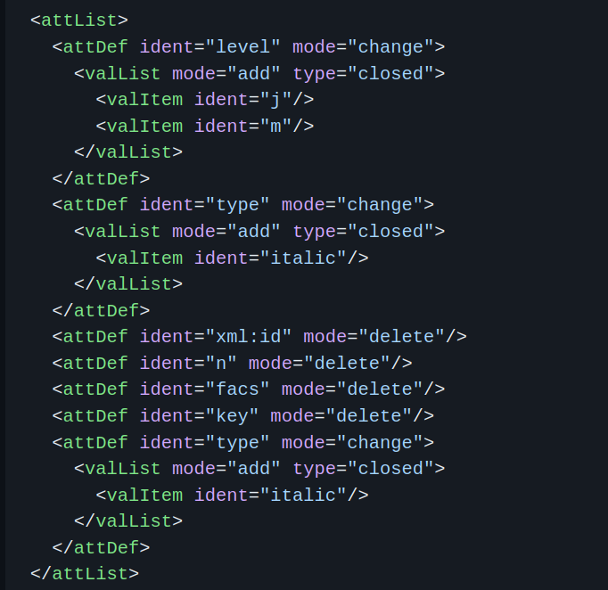
no duplicate definitions of the same attribute
Example seen in the wild

Slide 6
no duplicate definitions of the same attribute
Example seen in the wild (valid against the TEI customizations TEI Odds,
TEI All, and even TEI
Customization)

Slide 7
no duplicate definitions of the same attribute
Rationale: An XML element cannot have two attributes with the same name
Proposal: ODD schema to forbid sibling <attDef> elements with the same @ident (this therefore does not affect the combination of definitions for the same attribute throughout ODD chaining or within the same <schemaSpec>)
  Need to present guidelines about using <attList org="choice"> when wanting to customize two different attributes with the same name

Slide 8
tagdoc elements allowed most anywhere
Issue: Class model.oddDecl is a member of model.inter (which groups elements which can appear either within or between paragraph-like elements). This means that for example the element <rdg> may contain:
  classSpec constraintSpec dataSpec elementSpec macroSpec moduleSpec specDesc specGrp specGrpRef specList …
Proposal: remove model.oddDecl from model.inter BUT need to evaluate the occurrences in the Guidelines of *Spec elements in unexpected contexts like <div> and <p>

Slide 9
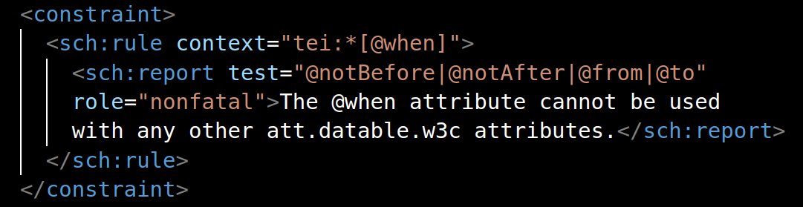
Schematron contexts
Schematron constraints depend on the definition of two XPath patterns: the context and the test.
Notes:
MDH: Is it worth noting that I abhor this specific example. I believe it should be possible to specify @when with low precision or confidence, and qualify it with @notBefore and @notAfter.

Slide 10
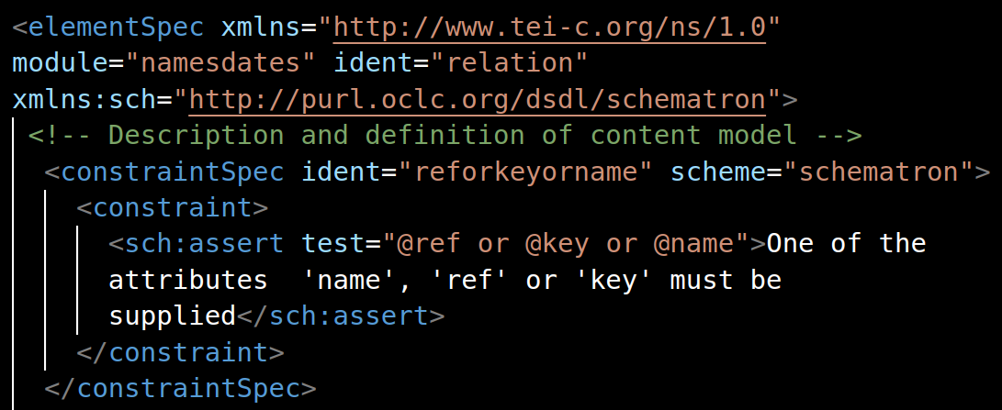
Schematron contexts
In ODD, context is not always explicitly expressed because it can be inferred

Slide 11
Schematron contexts
Issue: The TEI Guidelines do not specify how the context should be inferred when it is not explicit.
Proposal 1: Make the use of <sch:rule> with @context mandatory
Proposal 2: Depending on the ancestry, allow the inference of context in certain cases (e.g. <schemaSpec>, <elementSpec>, and <attDef>) but make an explicit context mandatory in others (e.g. <classSpec>, <macroSpec>).

Slide 12
Schematron query language binding
ISO Schematron defines the XPath version to use in expressions in terms of a query language binding.
Unless specified, ISO Schematron assumes XSLT 1.0 as the query language.
Where do we put this information?
  … and what about other ISO Schematron constructs such as diagnostics, properties, abstract patterns, …?
Solution: define a <constraintDecl> element
  Council has committed to such an element, but has not decided on exact details yet

Slide 13
@generate and @expand of classes
In an ODD content model, a <classRef> element can be used to allow all member elements of a model class.
The @expand attribute of such a <classRef> describes how members of the class should appear: As a sequence or as an alternation.
In an ODD, an element can be a member of zero or more model classes; membership is declared by a <memberOf> element.
The @generate attribute restricts how members of a class may appear: As a sequence or as an alternation.

Slide 14
@generate and @expand of classes
classRef/@expand and classSpec/@generate control how members of a model class may appear: As a sequence or as an alternation.
Alas, there is no “natural” order of class members!
Possible solutions
  Drop the @expand and @generate attributes altogether, always use an alternation of member elements?
    Council has decided (3 days ago) to drop classSpec/@generate
  Drop sequence and add interleave as a possible value?

Slide 15
<interleave> (or <bag> or <box>?)
It is useful to express the concept “each element in this set, in any order” in a content model
SGML DTDs used the & connector; RELAX NG uses the <interleave> pattern
PureODD uses <sequence preserveOrder="false">
At best, counter-intuitive
Proposal: add an <interleave> element in PureODD that corresponds to RELAX NG’s

Slide 16
@require vs @except (1)
In an ODD, the <anyElement> element is used to express the concept “you (the user of the schema) can put any element you want here”
For complex reasons that were not necessarily originally intended to be permanent, TEI Council added two attributes, @require and @except, which take as their value a (space-separated) list of namespace URIs; @except can also take fully qualified element names.
The two attributes are defined as being mutually exclusive, but …
… the prose does not mention them at all (except in the reference page), …
… and due to a bug, the TEI schema does not enforce the mutual exclusivity.

Slide 17
@require vs @except (2)
Furthermore, during the years that both attributes have been permitted by the (erroneous) TEI schemas, at least one person has come up with a use case for having both attributes on the same <anyElement>.
For example:
<anyElement
require="http://www.w3.org/1999/xhtml"
except="html:blink"/>
So now TEI Council finds itself in the odd position of allowing both attributes.
But …

Slide 18
@require vs @except (3)
What is a processor to do if the same namespace occurs on both @require and @except?
Several possible answers:
  Take the @require, it wins
  Take the @except, it wins
  Throw an error, this makes no sense

Slide 19
Discussion!

