Slide 1

TEI Conference and Members’ Meeting
Newcastle University
Friday, 16 September 2022
The TEI ATOP Task Force:
Syd Bauman, Martin Holmes, Helena Bermúdez Sabel, and David Maus
The TEI ATOP Task Force:
Syd Bauman, Martin Holmes, Helena Bermúdez Sabel, and David Maus

Slide 2
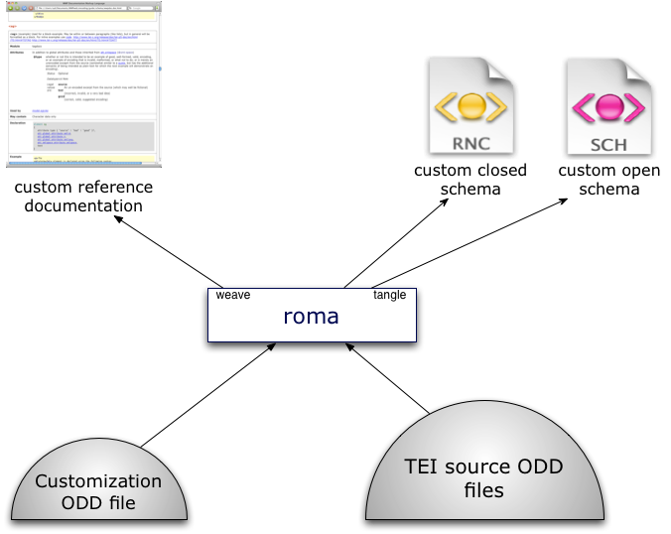
Reminder

Slide 3
Who, History, and Why (1)
Stylesheets bugs are hard to fix
  Note from Martina’s report yesterday that we clear Guidelines issues much faster than we clear Stylesheets issues
  And we have a special Stylesheets group that meets (most) every month
Stylesheets have lots of bugs
  E.g., Martin & Syd would routinely found new bugs trying to fix old

Slide 4
Who, History, and Why (1)
Stylesheets bugs are hard to fix
  Note from Martina’s report yesterday that we clear Guidelines issues much faster than we clear Stylesheets issues
  And we have a special Stylesheets group that meets (most) every month
Stylesheets have lots of bugs
  E.g., Martin & Syd would routinely found new bugs trying to fix old
“I consider the Stylesheets as broken beyond repair. They work … to a certain degree[,] but they are, from my point of view, effectively unmaintainable.” — David Maus, #477, 2021-03-23

Slide 5
Who, History, and Why (2)
Written by the amazing Sebastian Rahtz
Stylesheets are very impressive in what they do (and in how fast he did it)
  BUT …
  Outdated form of XSLT (basically 1.0 with a bit of 2.0)
  Poorly documented
  Extraordinarily complex
  Complex in large part because they do so much
“Sebastian was such a genius he really found it impossible to imagine
how dim the rest of us actually are.”
— Martin Holmes, this conference (virtual), last year

Slide 6
Who, History, and Why (3)
Council feels that ODD ⇨ schemas and documentation is a core Council responsibility
  Other functions of Stylesheets are not
  After all, that is why the Stylesheets were spun off to their own repo years ago
See the charge from Council to the Task Force

Slide 7
Our TEIC GitHub repository
Almost all of our work is being done in a TEIC GitHub repository, https://github.com/TEIC/atop.
  Main exception is this slide presentation — yet 😀
Repo contains (among other things):
  code
  issues & pull requests
  a glossary of terms
  documentation of goals, namespaces, error codes, etc.
  meeting minutes

Slide 8
Limited Scope
Just ODD → RelaxNG & Schematron
  Not TEI Lite to ePub3
  Not DOCX to TEI
  Not ODD with processing model information to stylesheets
  Not even ODD to XSD nor DTD
ODD → documentation is a core Council activity to be handled by another group

Slide 9
Conventions and Consistency (1)
“consistency is the hobgoblin of little minds”
— Ralph Waldo Emerson, Self-Reliance, 1841

Slide 10
Conventions and Consistency (1)
“consistency is the hobgoblin of little minds”
— Ralph Waldo Emerson, Self-Reliance, 1841
Emerson was not a computer programmer

Slide 11
Conventions and Consistency (1)
“consistency is the hobgoblin of little minds”
— Ralph Waldo Emerson, Self-Reliance, 1841
Emerson was not a computer programmer
He did not mean “consistency is bad”, the above is taken out of context

Slide 12
Conventions and Consistency (1)
“consistency is the hobgoblin of little minds”
— Ralph Waldo Emerson, Self-Reliance, 1841
Emerson was not a computer programmer
He did not mean “consistency is bad”, the above is taken out of context
Emerson was not a computer programmer

Slide 13
Conventions and Consistency (2)
“A foolish consistency is the hobgoblin of little minds”
— Ralph Waldo Emerson, Self-Reliance, 1841

Slide 14
Conventions and Consistency (2)
“A foolish consistency is the hobgoblin of little minds”
— Ralph Waldo Emerson, Self-Reliance, 1841
Consistency in programming constructs is not foolish

Slide 15
Conventions and Consistency (2)
“A foolish consistency is the hobgoblin of little minds”
— Ralph Waldo Emerson, Self-Reliance, 1841
Consistency in programming constructs is not foolish
Besides, he was not talking about consistency in notation, or that 2+2 consistently = 4, or if one should have a consistent left margin on a printed page; the above is taken out of context

Slide 16
Conventions and Consistency (2)
“A foolish consistency is the hobgoblin of little minds”
— Ralph Waldo Emerson, Self-Reliance, 1841
Consistency in programming constructs is not foolish
Besides, he was not talking about consistency in notation, or that 2+2 consistently = 4, or if one should have a consistent left margin on a printed page; the above is taken out of context
Emerson was not a computer programmer

Slide 17
Conventions and Consistency (3)
A foolish consistency is the hobgoblin of little minds, adored by little statesmen and philosophers and divines. With consistency a great soul has simply nothing to do. He may as well concern himself with his shadow on the wall. Speak what you think now in hard words, and to-morrow speak what to-morrow thinks in hard words again, though it contradict every thing you said to-day. — “Ah, so you shall be sure to be misunderstood.” — Is it so bad, then, to be misunderstood? Pythagoras was misunderstood, and Socrates, and Jesus, and Luther, and Copernicus, and Galileo, and Newton, and every pure and wise spirit that ever took flesh. To be great is to be misunderstood.

Slide 18
Conventions and Consistency (4)
We have set up conventions in the hopes of consistency
  e.g., if a routine creates a node, we call a named template; if it does not, we call a function
We are using Schematron to enforce consistency:
  of parameter names ($atop:pPatternPrefix, $atop:tpFun)
  of variable names ($atop:vVersion)
  of function names (atop:unique-ident())
  in global use of @as attribute
  to require internal documentation

Slide 19
Software
End product will be FLOSS (of course)
End product should run in any X-environment (including oXygen)
We make use of oXygen, and end product will run in oXygen, but nothing will require oXygen
  Although for now, generation of HTML documentation may require oXygen
XSLT 3 (using XPath 3.1) only
  Even if & when XSLT 4 comes out
Saxon HE (currently Saxon 11)
jing (and trang if and when needed)
Glue will likely be in ant or XProc (or possibly both, but we’d prefer one)

Slide 20
Previous Process
Current Stylesheets include over 330 XSLT files
Only ~25–33 of them are part of the process we are duplicating
The division of labor among these is, at best, confusing
Described on a TEI wiki page

Slide 21
Terminology
Part of the problem of the previous suite is inconsistent terminology
Thus we are trying to stick to a defined glossary of terms

Slide 22
Planned Process
Will not be nearly as complicated as the current suite
  In part because it does so much less
Might end up as complicated as the portion of the current suite that handles the same process …
BUT
Probably not; and
even if it does, it will be well-documented

Slide 23
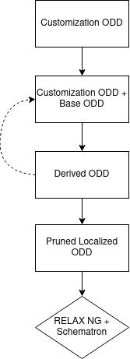
Stages
Assemble customization ODD
  Merge in references to external components, if any
  Prose may be dropped at this stage
Customization ODD + Base ODD → Derived ODD
  Keeping all internationalization information (i.e., all languages of glosses & descriptions)
Customization ODD + Derived ODD → Derived ODD
  Repeat 0 or more times as needed
Derived ODD → Pruned Localized ODD
  Removing things not needed for schema itself
  Localize by removing all but 1 language gloss & desc for each component
PLODD → RELAX NG + Schematron
  User is welcome to try to convert the RNG to DTD or XSD, but such is out of scope for ATOP
  (Remember: our goal is only generation of RELAX NG and Schematron schemas)

Slide 24
Validation!
We plan to validate the output of every stage
  Which means a rigorously defined derived ODD (defined by an ODD)
  Which means a rigorously defined PLODD (defined by an ODD)
This means we have to write out intermediate files
  Good for debugging, anyway
Also means we probably cannot use XPath 3.1’s transform() feature to do this all-at-once
  Snif!
Includes validation of end-output RELAX NG & Schematron

Slide 25
More Testing (above & beyond validation)
Building test suites as we go
Collected lots of ODDs from TEI users
Creating ODDs that test specific parts of the process
Using XSpec to test functions and named templates
May use XSpec for testing entire stages
Hoping to perform behavioral testing on the RELAX NG
  Thus allowing either ( blort+ ) or ( blort, blort* ) to be used to say “one or more <blort>s”

Slide 26
Side effects
Our work runs into places where ODD must be more cleanly specified
No one is surprised
We are raising tickets as we go
  E.g., how a user specifies the Schematron binding is an open question
Some changes may require fixes to previous Stylesheets

Slide 27
Collaborative process
Collaboration operates through a process in which the successful intellectual achievements of one person arouse the intellectual passions and enthusiasms of others.
— Alexander von Humboldt (1769–1859)

Slide 28
Slow and steady wins the race
We are purposefully putting maintainable code over speed of output
  No major rush, the world has been making due with current Stylesheets for many years
No hard deadlines
Aspirationally would like to have
  working code for Council to start testing in summer 2023
  full release by end of 2023
Will not be upset if we do not make that aspirational deadline
(see (1) and (2) :-)

Slide 29
Th-th-tha-that’s all, folks
Questions?

