Slide 1

DETECTION OF DEPRESSION RELATED POSTS IN SOCIAL MEDIA FORUM
FINAL PROJECT REVIEW
Guide:
Mrs.B.Manasa mam
Batch No 1:
M.Teja Vardhan(Y8IT103)
Y. Sai Teja(Y18IT090)
J. Ashok(L19IT125)

Slide 2
Abstract
Depression is viewed as the largest contributor to mental disability and a major reason for suicide. It has an impact on the language usage reflected in the written text. The social media users posts will be examined to detect any factors that may reveal the depression attitudes of the relevant online users. Natural Language Processing(NLP) and Machine Learning(ML) techniques will be applied to train the data and evaluate the efficiency of the models.

Slide 3
Introduction
The study has four specific contributions:
1. To examine the relationship between depression and user’s language usage.
2. To design three LIWC features for our specific research problem.
3. To evaluate the power of N-grams probabilities, LIWC and LDA as single features for performance accuracy.
4. To show the predictive power of both single and combined features with proposed classification approaches to achieve a higher performance in depression identification tasks.

Slide 4
Literature Survey
Preotiuc-Pietroi et al. [9] applied broader textual features such as LIWC, LDA and frequent 1-3 grams on the Twitter data to examine the personality of the users with self declared post-traumatic stress (PTSD) disorders.
Reece et al. [22] found out that the first stage of depression may be detectable from Twitter data several months prior to its diagnosis with 0.87 AUC of performance probability.
Eich staedt, J.C. et al. [24] study proved that it is possible to predict depression from online electronic medical records within the period up to six months achieving 0.72 AUC performance.

Slide 5
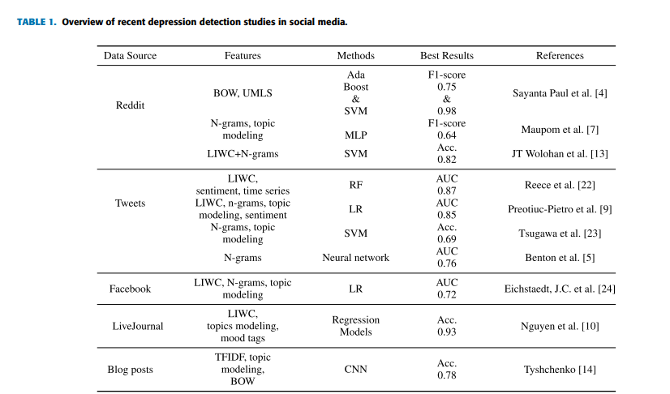

Slide 6
Datasets
Reddit dataset contains depression-indicative posts(1293) and standard posts(598).
The datasets mainly consists of the two attributes.
One is the text attribute, which contains the text from a particular Reddit user post.
Second one is the target attribute, which indicates whether the post is a depression-indicative post or standard post. It’s value is 0 if the post is normal, 1 if the post contains depression.

Slide 7
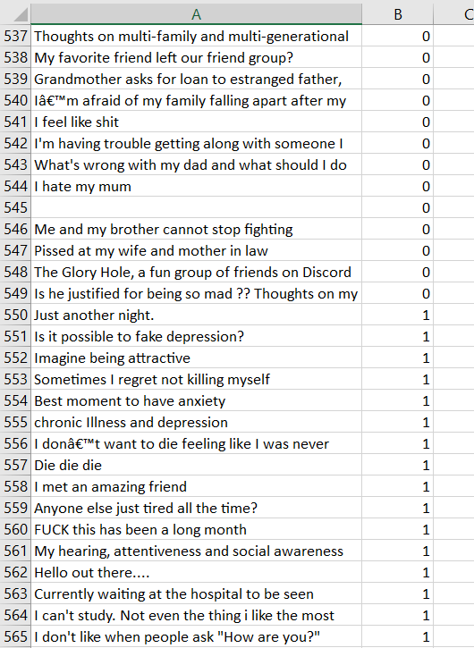
Reddit Dataset

Slide 8
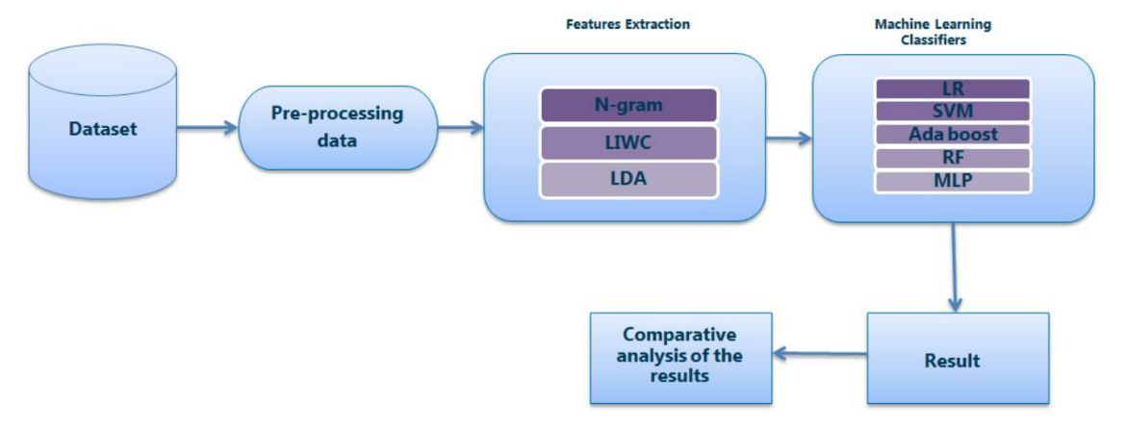
Architecture

Slide 9
Module Description
Three modules have to be implemented. They are:
Data Pre-processing:
It is the process of obtaining the clean text from the original text.
Feature Extraction:
It is the process of obtaining the relevant features related to our context from the original text.
Text Classification:
It the process of classifying the text based on some Machine Learning algorithms.

Slide 10
Data Pre-processing
Pre-processing is done in 3 steps. They are:
Removal of URL’s, Mentions and Punctuations:
Regular Expressions will be used for the removal of URL’s and mentions.
Removal of Stop words:
Stop words are the most commonly used words in a language. Generally, these words are filtered out before processing the natural language data.
Stemming:
Stemming is a process of converting the words into their root form.
For example, consider the word “studies”. Stemming returns “studi”, whereas Lemmatization returns “study”.

Slide 11
Feature Extraction
Feature Extraction is done using 3 techniques. They are:
N-grams Modeling:
It is used to calculate the probability of co-occurence of each input sequence as a unigram and bigram.
Linguistic Inquiry and Word Count(LIWC) dictionary:
It calculates the degree to which various categories of words that are used in the text.
Topic Modeling:
It is an effective tool to reduce the input of textual data feature space to a fixed number of topics.

Slide 12
N-grams Modeling
N-gram model is a type of probabilistic language model for predicting the next item in a sequence in the form of (n-1) order.
TF-IDF will be used as a numeric statistic
TF: Term Frequency
Number of times a particular word has occured in a given document.
IDF: Inverse Document Frequency:
In how many documents the given word has appeared.

Slide 13
N-grams Modeling
S1: This movie is Bad.
S2: This movie is Good.
Unigrams: Bigrams:
[ This, movie, is, [[This, movie], [movie, is],
Bad, Good] [is, Bad], [is, Good]]
Vectorising:
S1: [1,1,1,1,0] S1: [1,1,1,0]
S2: [1,1,1,0,1] S2: [1,1,0,1]

Slide 14
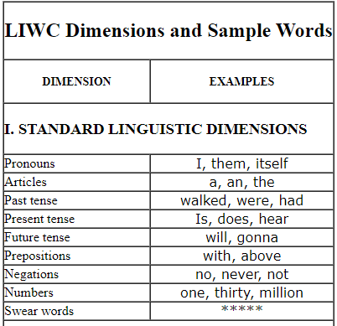
LIWC
Linguistic Inquiry and Word Count dictionary is widely used in computational linguistics as a source of features for psychological and psycholinguistic analysis.
Standard Linguistic dimension
Psychological process
Personal concerns
Spoken categories

Slide 15
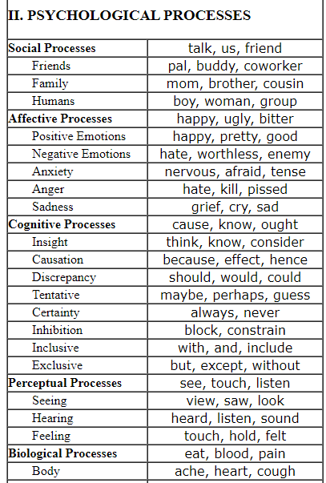
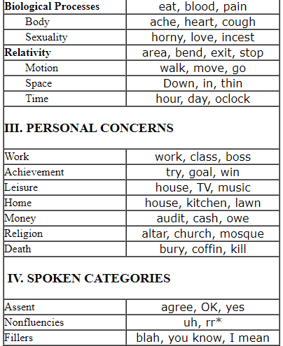
LIWC

Slide 16
LIWC
For each dictionary word, LIWC maintains a corresponding dictionary entry that defines one or more word categories.
We extract the features from different features and change every depressive and non-depressive post into numerical values.

Slide 17
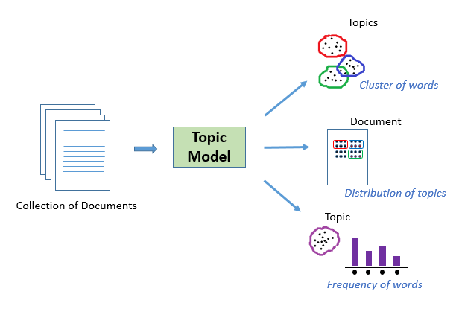
Topic Modeling
We use the Latent Dirichlet Allocation(LDA) for performing the Topic modeling.
LDA is a probabilistic generative model for deriving the underlying topics.
It is useful for finding reasonably accurate mixtures of topics within a given document.

Slide 18
Text Classification
To estimate the presence of depression, we employ classifying approaches to estimate the likelihood of depression within the users.
Five classification algorithms will be used. They are:
Logistic Regression
Support Vector Machine
Random Forest
Adaptive Boosting
Multilayer Perceptron

Slide 19
Logistic Regression
Logistic Regression estimates the probability that a data item belongs to a particular category.
The logistic function or sigmoid function will be used to model the probabilities. The sigmoid function gives output between 0 and 1 for all the input values.
The logistic function will always produce an S-shaped curve regardless of the input variable X.
The coefficients b0 and b1 are unknown, and must be estimated based on the available training data.
The probability p(x) is calculated, which yields a value of either 0 or 1.
In our case, we can assume that 1 indicates depressive post and 0 indicates non-depressive post.

Slide 20
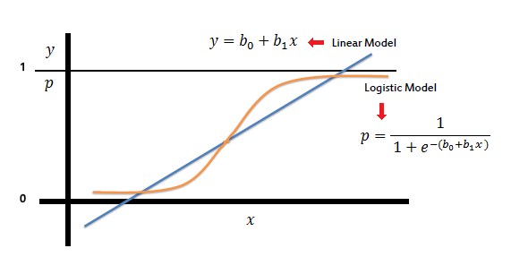
Logistic Regression

Slide 21
Logistic Regression
MERITS:
Easy to interpret.
DEMERITS:
Vulnerability for overfitting.
Works only with linearly seperable data.

Slide 22
Support Vector Machine
SVM is a discriminative classifier formally defined by a separating hyperplane.
It’s main task is to select a hyperplane with the maximum possible margin between the support vectors in the given dataset.
Hyperplane is a decision plane that separates between a set of objects having different class memberships.
Margin is the perpendicular distance between the hyperplane and the support vectors.

Slide 23
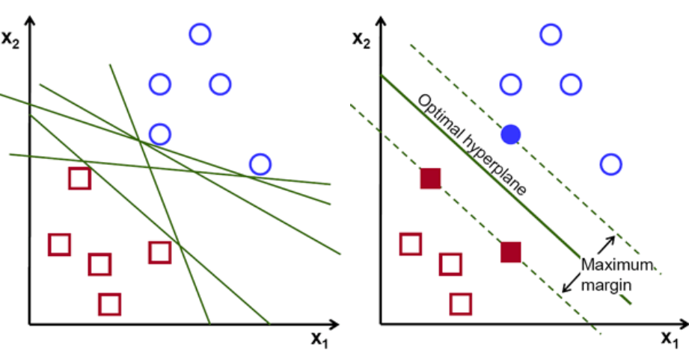
Support Vector Machine

Slide 24
Support Vector Machine
MERITS:
Good prediction in a variety of situations.
Easy to interpret results.
DEMERITS:
Computationally expensive.
Complexity is high.
Requires more memory and time for training the model.

Slide 25
Random Forest
It creates a forest with a number of decision trees.
Decision trees are created from randomly selected subset of training set.
The training algorithm of random forest is called bootstrap algorithm or bagging technique.
Aggregates the votes from different decision trees to decide the final class of the test object.

Slide 26
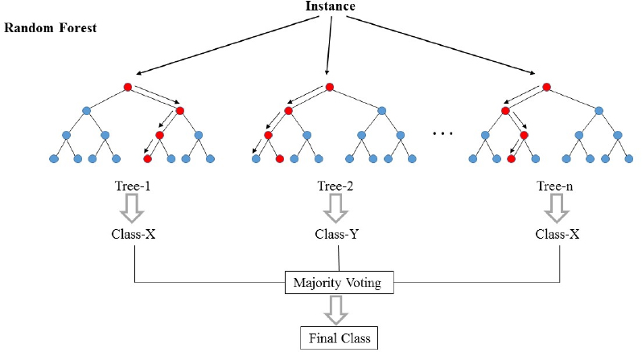
Random Forest

Slide 27
Random Forest
MERITS:
Efficient on large datasets.
Deals with high dimensional data.
DEMERITS:
Observed to be over fit with noisy classification tasks.
Large number of trees makes the algorithm slow for real-time prediction.

Slide 28
Adaptive Boosting
It is an ensemble technique that can combine many weak classifiers into one strong classifier.
The concept of adaboost is about correcting the mistakes of the previous classifiers.
The most common algorithm used with Adaboost are decision trees with one level, often called as decision stumps.

Slide 29
Adaptive Boosting
Each instance in the training dataset is initialized to a weight. A decision stump is prepared on the training data using the weighted samples.
Each decision stump makes one decision on one input variable and outputs a +1.0 or -1.0.
The training weights are updated giving more weight to incorrectly predicted instances, and less weight to correctly predicted instances.
The process continues until no further improvement can be made on the training dataset.

Slide 30
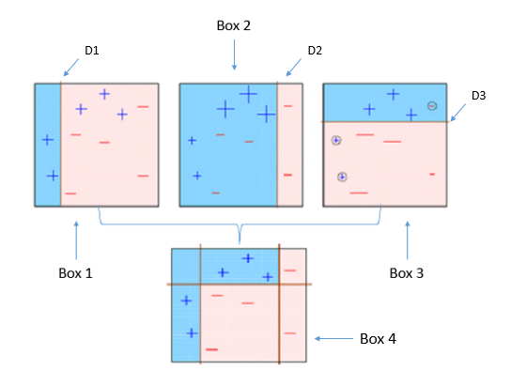
Adaptive Boosting

Slide 31
Adaptive Boosting
MERITS:
Simple to implement.
Fairly good generalization.
DEMERITS:
Sensitive to noisy data and outliers.

Slide 32
Multilayer Perceptron
Multilayer Perceptron is a feedforward artificial neural network often used for modelling complex relationships between the input and output layers.
It is characterized by one input layer, one output layer and one or more hidden layers.
Every layer should have a feed-forward loop and back propagation loop.

Slide 33
Multilayer Perceptron
Feed forward loop takes an input and generates output for making a prediction.
Back propagation loop helps in training the model by adjusting weights in the layer to lower the output loss.
In back propagation, weight update is done by using the chain rule and optimized using an optimization algorithm.
Once the training has been completed, it can be used to make predictions on test data or new data.

Slide 34
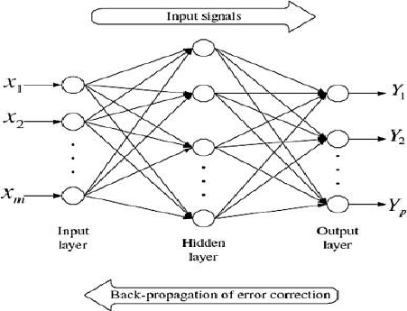
Multilayer Perceptron

Slide 35
Multilayer Perceptron
MERITS:
Powerful, can model complex functions.
Adapt to unknown situations.
DEMERITS:
Number of hidden layers is to be set by the user.

Slide 36
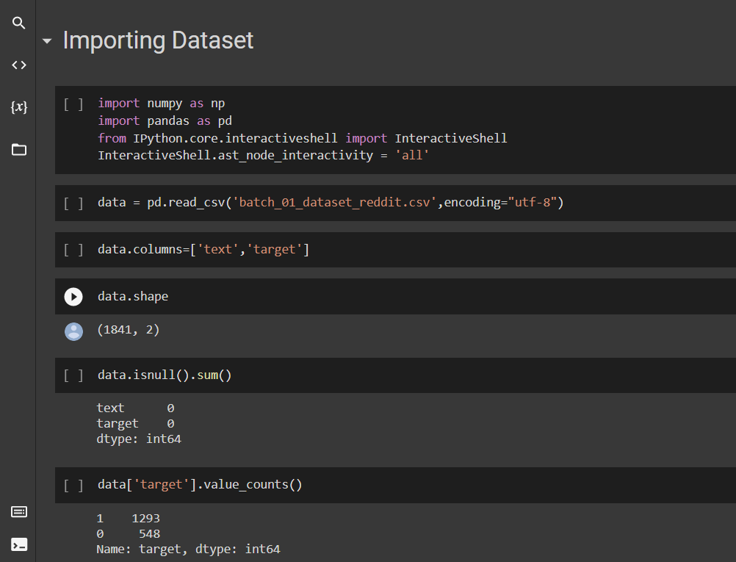
Implementation

Slide 37
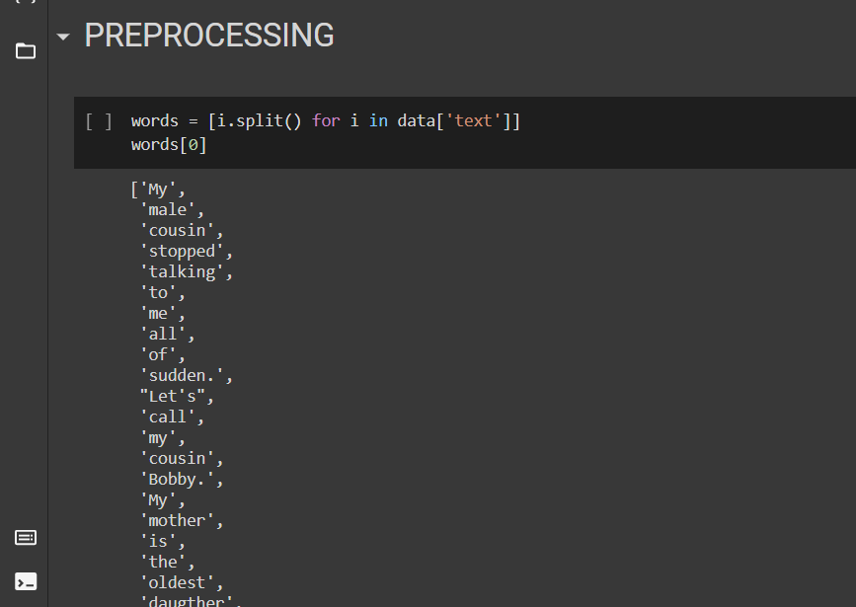
Data Pre-processing

Slide 38
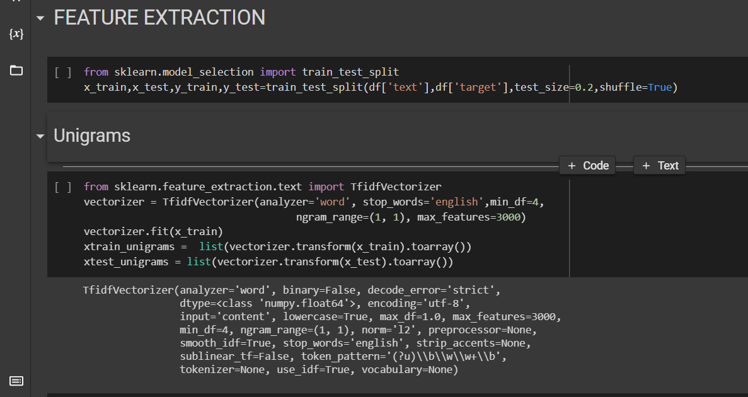
Feature Extraction

Slide 39
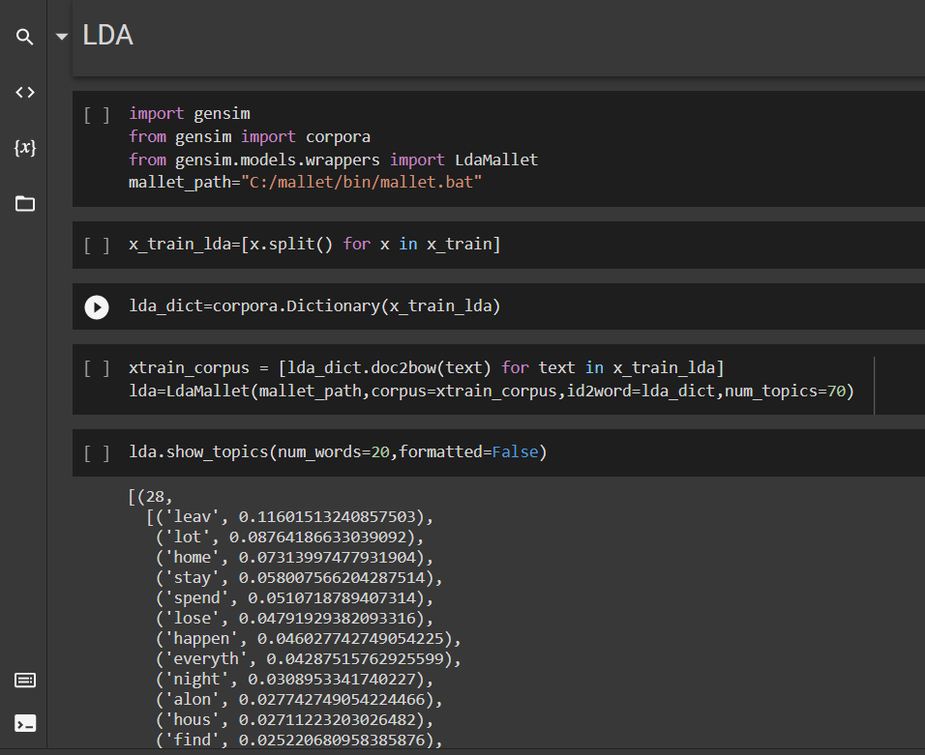
LDA

Slide 40
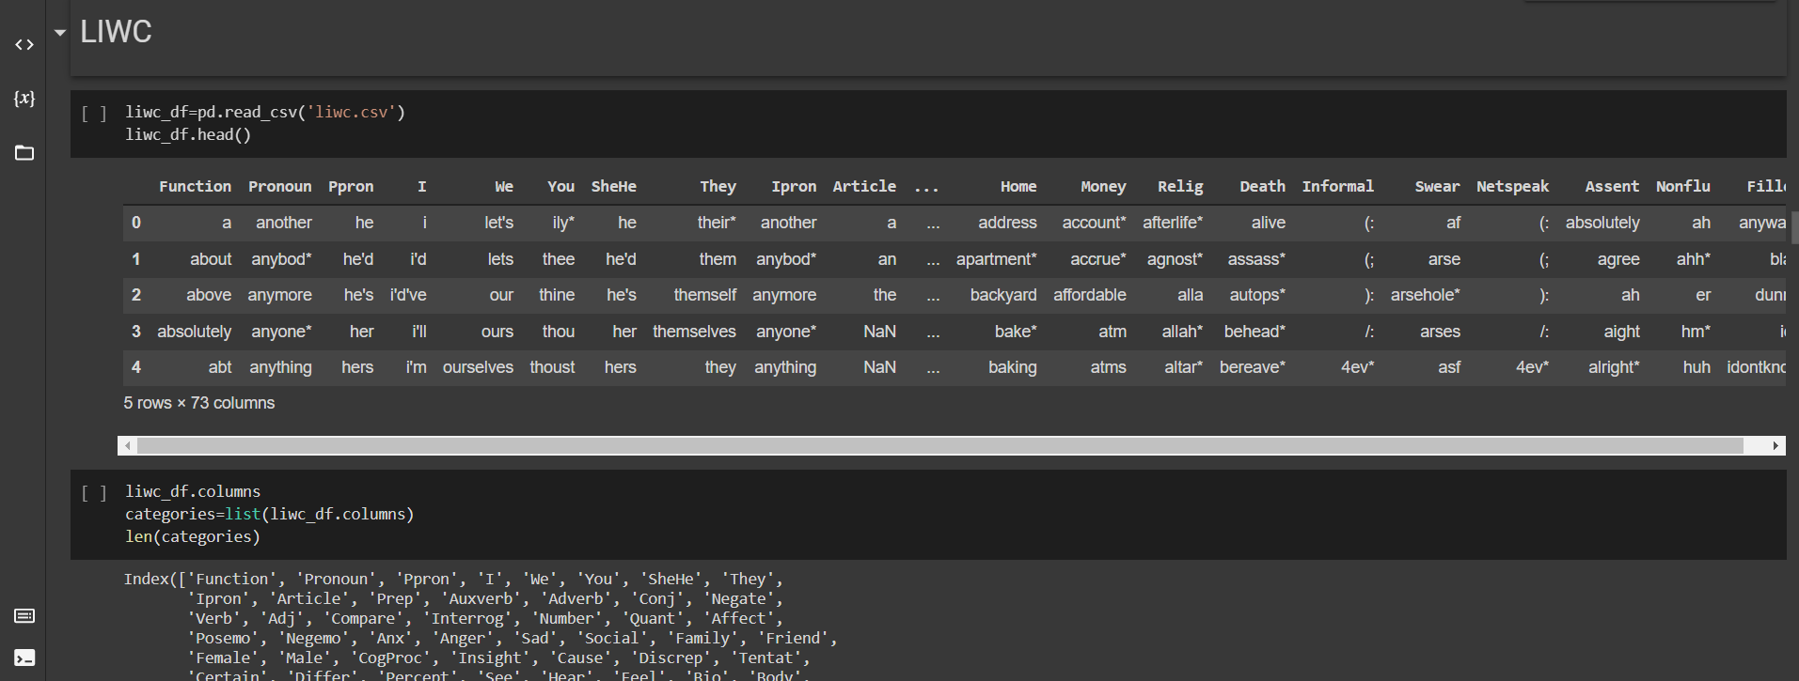
LIWC

Slide 41
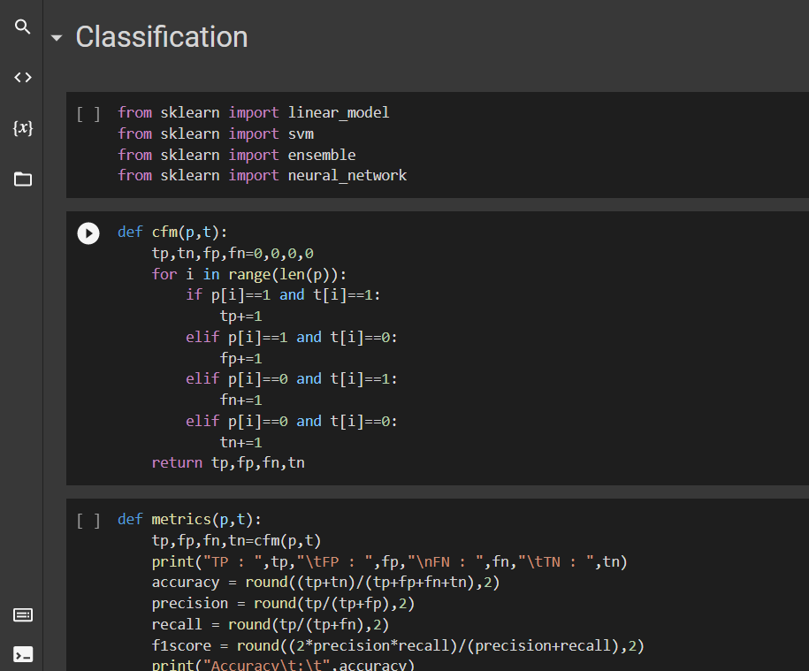
Text Classification

Slide 42
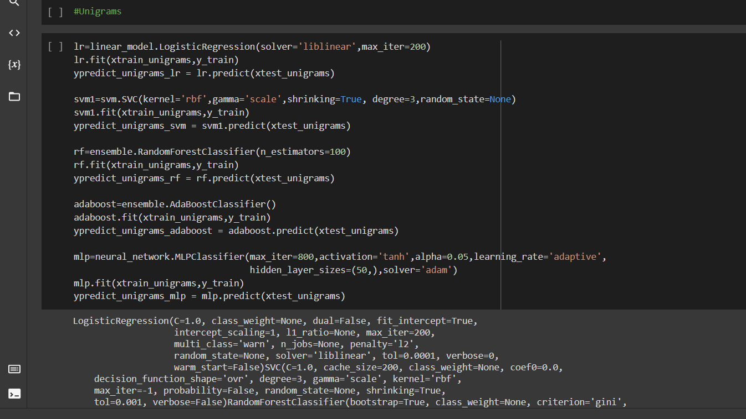
Unigram classification

Slide 43
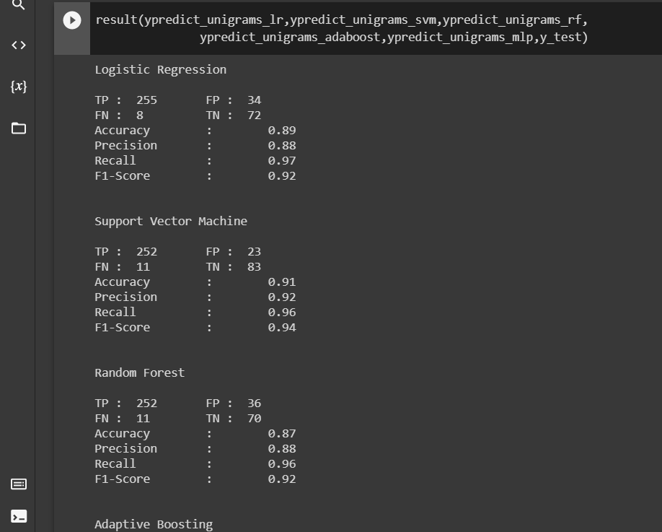
Results of UNIGRAM

Slide 44
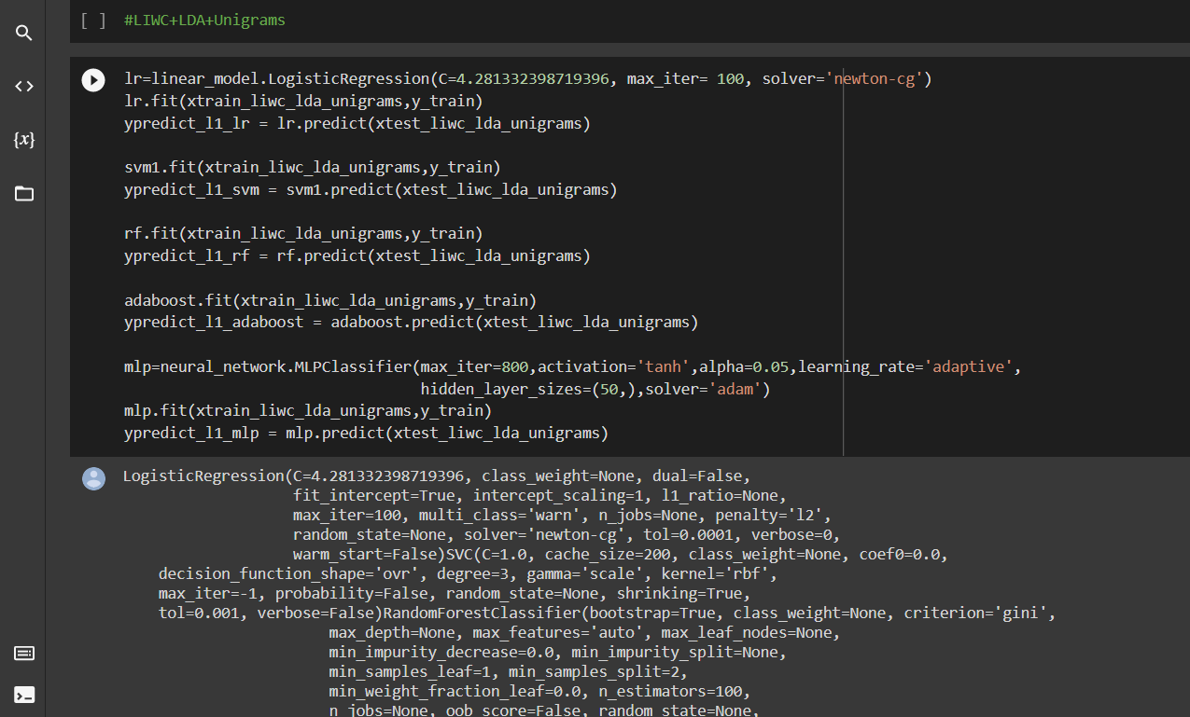
LIWC + LDA + UNIGRAM

Slide 45
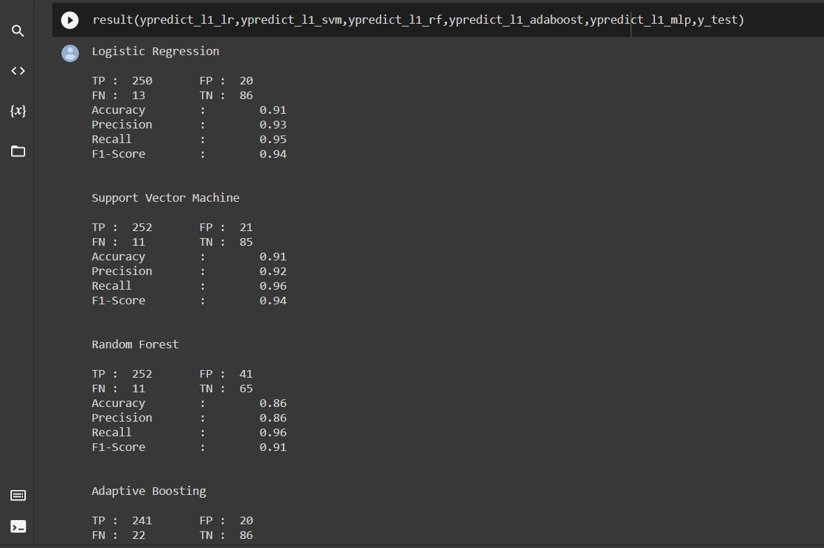
Results of LIWC+LDA+UNIGRAM

Slide 46
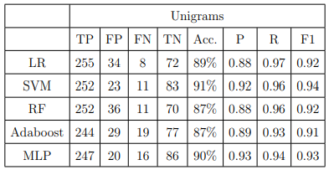
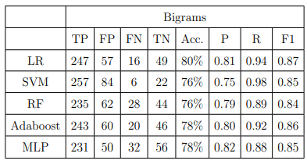
RESULTS
Unigrams result for Reddit Data
Bigrams result for Reddit Data

Slide 47
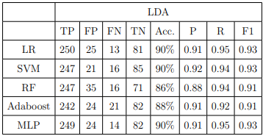
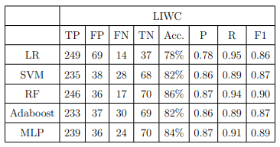
RESULTS
LDA result for Reddit data
LIWC result for Reddit data

Slide 48
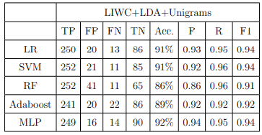
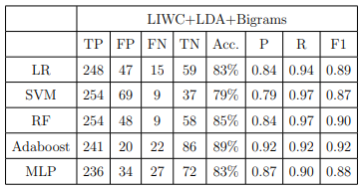
RESULTS
LIWC+LDA+Unigrams result for Reddit data
LIWC+LDA+Bigrams result for Reddit data

Slide 49
Conclusion and Future Work
The models are built which will analyze the text and determine whether the text contains depression or not.
We performed Data Pre-processing, Feature Extraction and Classification on the text.
Multiple combinations of the models are built which perform feature extraction and classification.
The best model is considered as the model which gives maximum accuracy.
Though the models have performed well, a detailed analysis on each model can be done in the future.

Slide 50
References
[2] M. J. Friedrich, ‘‘Depression is the leading cause of disability around the world,’’ JAMA, vol. 317, no. 15, p. 1517, Apr. 2017.
[4] S. Paul, S. K. Jandhyala, and T. Basu, ‘‘Early detection of signs of anorexia and depression over social media using effective machine learning frameworks,’’ in Proc. CLEF, Aug. 2018, pp. 1–9.
[6] G. Coppersmith, M. Dredze, C. Harman, and K. Hollingshead, ‘‘From ADHD to SAD: Analyzing the language of mental health on twitter through self-reported diagnoses,’’ in Proc. 2nd Workshop Comput. Linguistics Clin. Psychol. Linguistic Signal Clin. Reality, 2015, pp. 1–10.

Slide 51


