Slide 1

SQL Grocery store management
Kesarapu Teja | Ramoju Surya Nagendra

Slide 2
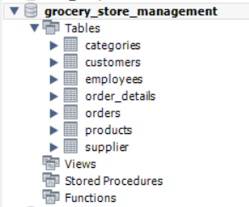
PROJECT OVERVIEW
Agenda - This project analyzes a real-world Grocery Store Management System using MySQL. The database captures transactional data across 7 interconnected tables — enabling rich business intelligence across sales, customers, products, employees, and suppliers.
Sales & Order Trends
Supplier Contribution
Database:
Analyze order volumes, revenue trends, and seasonal patterns across time periods.
Assess supplier product portfolio size, pricing, and revenue impact.
Employee Performance
Product Performance
Measure order processing efficiency and total sales handled per employee.
Rank products by revenue, quantity sold, and category-level contribution.
Customer Insights
Order Deep Dive
Identify top buyers, purchase frequency, and average order value per customer.
Understand quantity-price relationships and unit price variation per order.

Slide 3
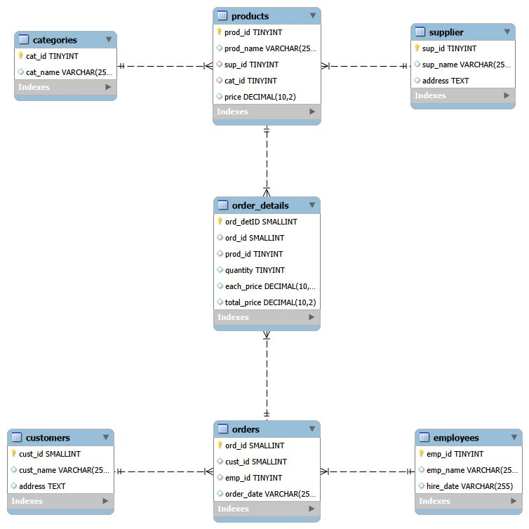
DATABASE SCHEMA & ER DIAGRAM
supplier
PK: sup_id
sup_id · sup_name · address
categories
PK: cat_id
cat_id · cat_name
employees
PK: emp_id
emp_id · emp_name · hire_date
customers
PK: cust_id
cust_id · cust_name · address
products
PK: prod_id | FK: sup_id, cat_id
prod_id · prod_name · sup_id · cat_id · price
orders
PK: ord_id | FK: cust_id, emp_id
ord_id · cust_id · emp_id · order_date
order_details
PK: ord_detID | FK: ord_id, prod_id
One-to-Many from supplier to products
One-to-Many from categories to products
One-to-Many from products to order_details
One-to-Many from orders to order_details
One-to-Many from customers to orders
One-to-Many from employees to orders
ord_detID · ord_id · prod_id · qty · price

Slide 4


Sales & Order Trends
Code
Analyzing order volumes, revenue patterns, and temporal buying behavior
PROBLEM STATEMENT
How many orders have been placed in total?
CODE EXPLANATION
Result:
Uses COUNT() aggregate function on the orders table to return the total number of order records. No grouping is needed since we want a single global count.
KEY INSIGHT
The store has processed 300 total orders, forming the baseline for all trend and performance analyses.

Slide 5
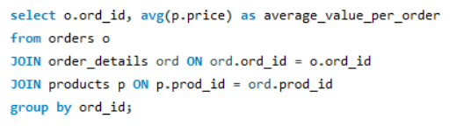
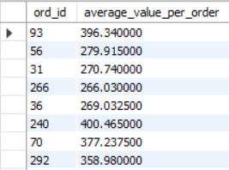
Sales & Order Trends
Code
PROBLEM STATEMENT
What is the average value per order?
CODE EXPLANATION
JOINs orders, order_details, and products tables. Groups by ord_id and uses AVG(price) to compute the mean product price per individual order across all its line items.
Result:
KEY INSIGHT
Average order value helps identify purchasing power; higher averages indicate premium product affinity or bulk buying behavior.

Slide 6

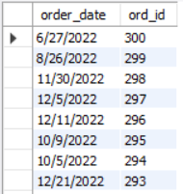
Sales & Order Trends
Code
PROBLEM STATEMENT
On which dates were the most orders placed?
CODE EXPLANATION
Retrieves order_date and ord_id from the orders table, ordering results in descending order by ord_id. This surfaces the most recent or highest-volume order dates at the top.
Result:
KEY INSIGHT
Identifying peak order dates enables targeted promotions and inventory pre-positioning for high-demand periods.

Slide 7
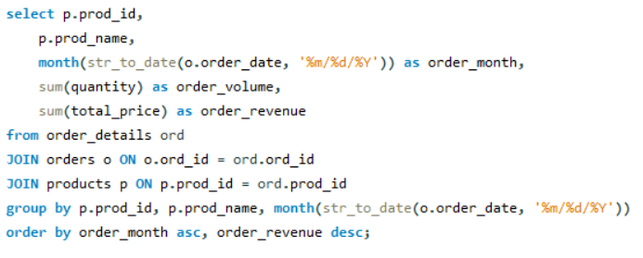
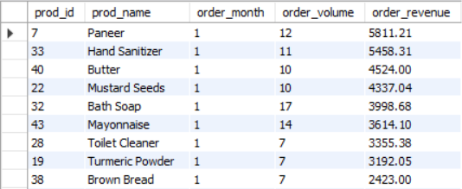
Sales & Order Trends
Code
PROBLEM STATEMENT
What are the monthly trends in order volume and revenue?
CODE EXPLANATION
Uses STR_TO_DATE to parse the varchar order_date, extracts MONTH(), then aggregates SUM(quantity) and SUM(total_price) per product per month using JOINs across order_details, orders, and products.
Result:
KEY INSIGHT
Monthly trends reveal seasonal demand spikes — critical for procurement planning and promotional budgeting.

Slide 8
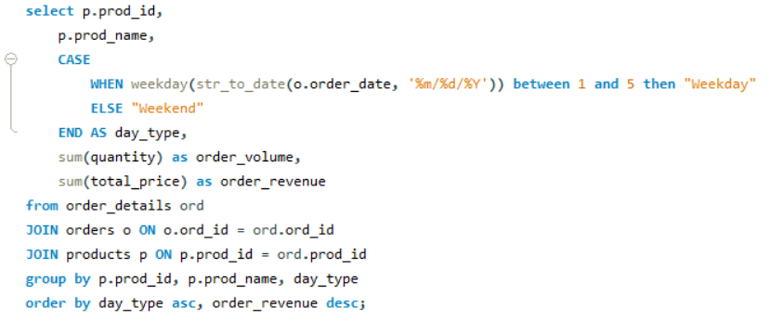
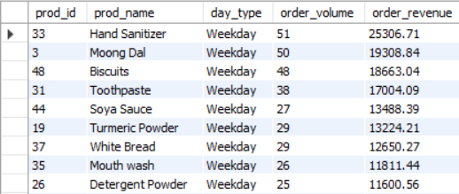
Sales & Order Trends
Code
PROBLEM STATEMENT
How do order patterns vary across weekdays and weekends?
CODE EXPLANATION
Uses WEEKDAY() on the parsed date and a CASE expression to classify orders as 'Weekday' or 'Weekend'. Aggregates volume and revenue per product per day type via triple JOIN.
Result:
KEY INSIGHT
Weekend vs weekday segmentation helps allocate staff and optimize stock replenishment cycles for peak trading days.

Slide 9


Customer Insights
Understanding customer purchasing behavior, frequency, and value contribution
PROBLEM STATEMENT
How many unique customers have placed orders?
Code
CODE EXPLANATION
Applies COUNT(DISTINCT cust_id) on the orders table to count only customers who have at least one recorded order — excluding registered customers who never purchased.
Result:
KEY INSIGHT
Unique active customers = true buyer base. Comparing this against total registered customers reveals engagement rate.

Slide 10
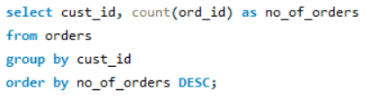
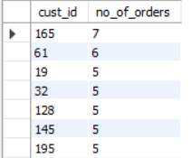
Customer Insights
Code
PROBLEM STATEMENT
Which customers have placed the highest number of orders?
CODE EXPLANATION
Groups the orders table by cust_id and counts ord_id occurrences. Results are ordered descending by order count to rank customers from most to least frequent buyers.
Result:
KEY INSIGHT
High-frequency buyers are the store's loyalty base — ideal targets for retention programs and exclusive discount offers.

Slide 11
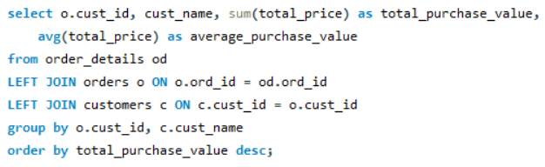
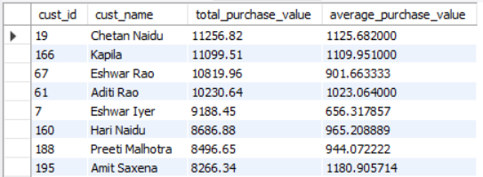
Customer Insights
Code
PROBLEM STATEMENT
What is the total and average purchase value per customer?
CODE EXPLANATION
JOINs order_details, orders, and customers to link purchase amounts to named customers. SUM(total_price) gives lifetime value; AVG(total_price) reveals typical basket size per customer.
Result:
KEY INSIGHT
Customers with high totals but low averages make many small purchases; those with high averages but few orders are premium buyers — both require different retention strategies.

Slide 12
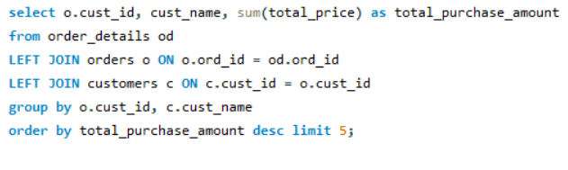
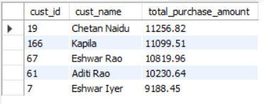
Customer Insights
Code
PROBLEM STATEMENT
Who are the top 5 customers by total purchase amount?
CODE EXPLANATION
Same join pattern as Q3 but uses LIMIT 5 to return only the five highest-spending customers ranked by SUM(total_price). Ideal for VIP identification and reporting dashboards.
Result:
KEY INSIGHT
Top 5 customers — led by Chetan Naidu (₹11,257) — collectively account for a significant share of total revenue, validating a focused VIP program.

Slide 13
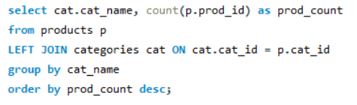
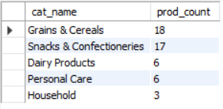
Product Performance
Code
Ranking products and categories by revenue, volume, and supplier performance
PROBLEM STATEMENT
How many products exist in each category?
CODE EXPLANATION
LEFT JOINs products to categories on cat_id and groups by cat_name, counting prod_id per group. LEFT JOIN ensures categories with zero products still appear in the result.
Result:
KEY INSIGHT
Snacks & Confectioneries holds the most SKUs, suggesting a wide variety strategy in the store's highest-revenue category.

Slide 14
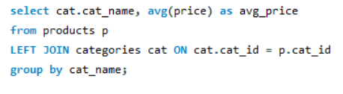
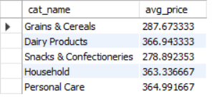
Product Performance
Code
PROBLEM STATEMENT
What is the average price of products by category?
CODE EXPLANATION
LEFT JOINs products with categories and computes AVG(price) per category group. This reveals the price positioning and tier of each product segment in the store.
Result:
KEY INSIGHT
Categories with higher average prices point to premium positioning; lower averages indicate commodity/staple segments with high volume potential.

Slide 15
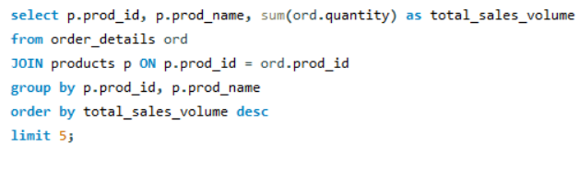
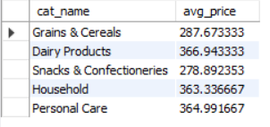
Product Performance
Code
PROBLEM STATEMENT
Which products have the highest total sales volume (by quantity)?
CODE EXPLANATION
JOINs order_details with products, groups by product, and sums quantity ordered. LIMIT 5 returns top performers. This measures physical throughput rather than revenue.
Result:
KEY INSIGHT
Volume leaders are the store's fast-moving goods — critical for safety stock, reorder thresholds, and supplier negotiation.

Slide 16
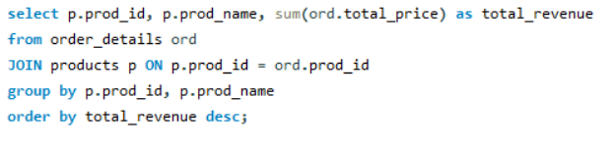
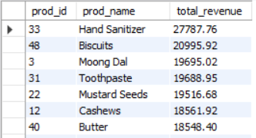
Product Performance
Code
PROBLEM STATEMENT
What is the total revenue generated by each product?
CODE EXPLANATION
Groups order_details by product ID and sums total_price to compute cumulative revenue per product. Ranking by revenue DESC highlights the store's top money-generating SKUs.
Result:
KEY INSIGHT
Hand Sanitizer is the top revenue-generating product (₹27,788), indicating strong demand for personal care items — warranting dedicated shelf space and promotions.

Slide 17
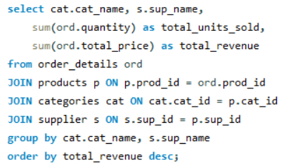
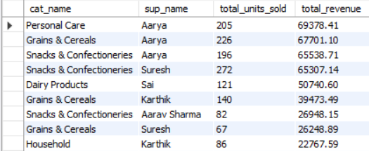
Product Performance
Code
PROBLEM STATEMENT
How do product sales vary by category and supplier?
CODE EXPLANATION
A four-table JOIN (order_details → products → categories → supplier) groups results by category and supplier, computing both total units sold and total revenue. Reveals cross-dimensional performance.
Result:
KEY INSIGHT
This cross-analysis identifies which supplier-category combinations drive the most revenue — essential for supplier performance reviews and category management.

Slide 18


Employee Performance
Code
Measuring employee order processing efficiency and revenue contribution
PROBLEM STATEMENT
How many employees have processed orders?
CODE EXPLANATION
Uses COUNT(DISTINCT emp_id) on the orders table to identify unique employees linked to at least one order. Employees in the employees table but with no orders are excluded.
Result:
KEY INSIGHT
If all 10 employees have processed orders, workload is well-distributed; disparities suggest training gaps or uneven scheduling.

Slide 19
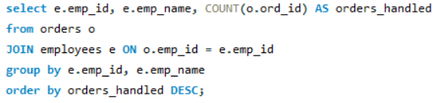
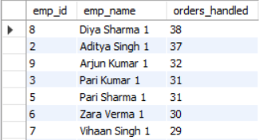
Employee Performance
Code
PROBLEM STATEMENT
Which employees have handled the most orders?
CODE EXPLANATION
JOINs orders with employees on emp_id, groups by employee, and counts ord_id. Ranking descending surfaces the most active order processors — key for workload and incentive analysis.
Result:
KEY INSIGHT
Diya Sharma leads with 38 orders handled; identifying top processors enables merit recognition and equitable task assignment across the team.

Slide 20
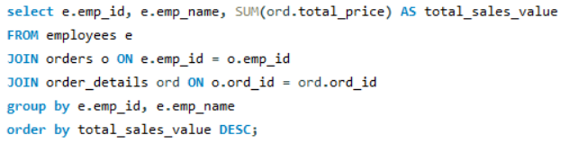
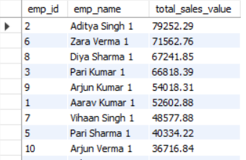
Employee Performance
Code
PROBLEM STATEMENT
What is the total sales value processed by each employee?
CODE EXPLANATION
Three-table JOIN (employees → orders → order_details) aggregates SUM(total_price) per employee. This shifts focus from order count to financial impact of each team member.
Result:
KEY INSIGHT
Aditya Singh leads total sales at ₹79,252 across 37 orders — demonstrating both volume and value efficiency as top revenue processor.

Slide 21
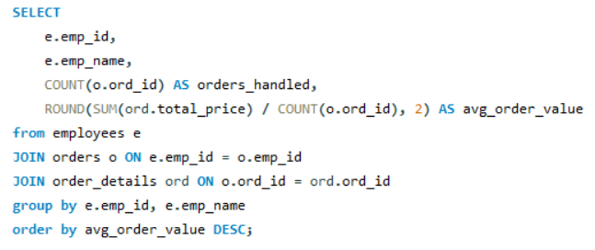
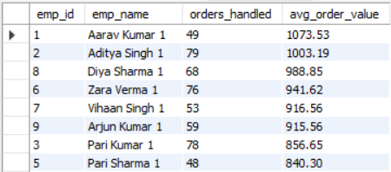
Employee Performance
Code
PROBLEM STATEMENT
What is the average order value handled per employee?
CODE EXPLANATION
Calculates avg_order_value by dividing SUM(total_price) by COUNT(ord_id) using ROUND to 2 decimals. This reveals per-order efficiency rather than raw volume — useful for comparing high-count vs high-value handlers.
Result:
KEY INSIGHT
An employee handling fewer but larger orders may serve premium customers; lower average per order with high count indicates bulk/everyday transaction processing.

Slide 22


Supplier Contribution
Code
Evaluating supplier portfolio, pricing strategy, and revenue impact
PROBLEM STATEMENT
How many suppliers are there in the database?
CODE EXPLANATION
A simple COUNT(sup_id) aggregate on the supplier table returns the total number of registered suppliers. Provides the baseline for supplier portfolio analysis.
Result:
KEY INSIGHT
With 5 suppliers serving 50 products (avg 10 products each), the store has moderate supplier diversity — reducing single-supplier dependency risk.

Slide 23
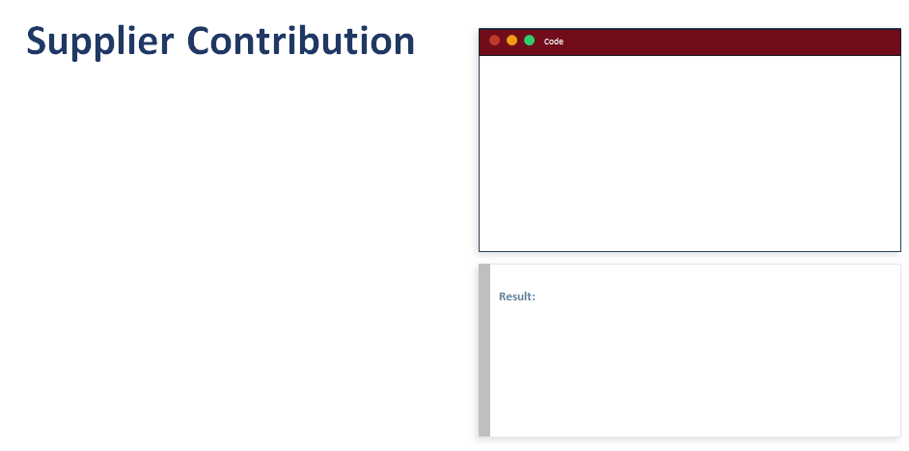
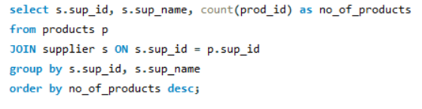
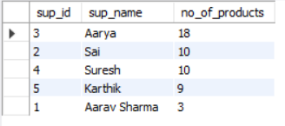
PROBLEM STATEMENT
Which supplier provides the most products?
CODE EXPLANATION
JOINs products with supplier on sup_id, groups by supplier, and counts prod_id. Ordering descending shows which vendor has the broadest product catalog supplied to the store.
KEY INSIGHT
The dominant supplier (by product count) is a strategic partner — their catalog depth gives them leverage in negotiations and their reliability is critical to store operations.

Slide 24
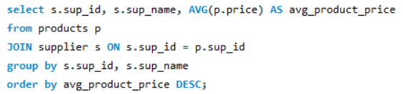
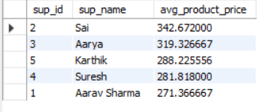
PROBLEM STATEMENT
What is the average price of products from each supplier?
CODE EXPLANATION
JOINs products with supplier and computes AVG(price) grouped by supplier. ROUND or direct AVG reveals the pricing tier of each supplier's product catalog in the store.
KEY INSIGHT
Suppliers with higher average product prices cater to premium segments; lower-priced suppliers support everyday essentials — both require different margin and stocking strategies.

Slide 25
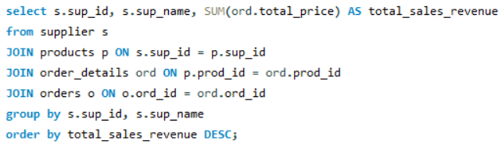
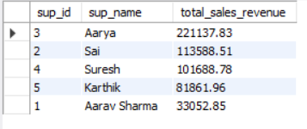
PROBLEM STATEMENT
Which suppliers contribute the most to total product sales (by revenue)?
CODE EXPLANATION
A four-table JOIN (supplier → products → order_details → orders) links each supplier's products to their sold quantities and total revenue. Groups by supplier and ranks by total_sales_revenue.
KEY INSIGHT
The highest-revenue supplier's products are the store's backbone SKUs — any supply disruption would directly impact top-line revenue and require emergency sourcing.

Slide 26

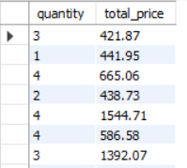
Order details
Code
Exploring quantity-price relationships and unit price variation across orders
PROBLEM STATEMENT
What is the relationship between quantity ordered and total price?
CODE EXPLANATION
Selects quantity and total_price directly from order_details without aggregation. This raw pair-wise data enables scatter-plot correlation analysis — useful for detecting non-linear pricing or discount patterns.
Result:
KEY INSIGHT
A near-linear relationship confirms consistent unit pricing across orders; deviations signal bulk discounts, pricing errors, or promotional pricing worth investigating.

Slide 27
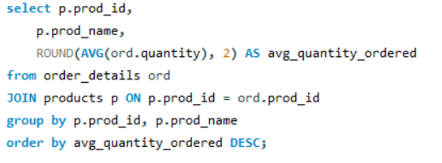
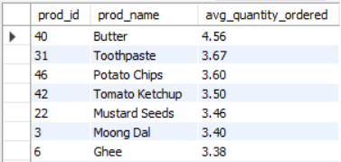
Order details
Code
PROBLEM STATEMENT
What is the average quantity ordered per product?
CODE EXPLANATION
JOINs order_details with products and computes ROUND(AVG(quantity), 2) grouped by product. This shows typical order size per SKU — essential for setting reorder quantities and packaging sizes.
Result:
KEY INSIGHT
Products with high average quantities per order are bulk staples; low averages suggest trial or impulse purchases — each needing a different replenishment strategy.

Slide 28
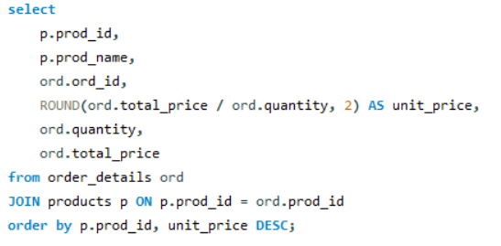
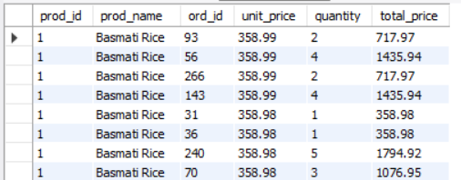
Order details
Code
PROBLEM STATEMENT
How does the unit price vary across products and orders?
CODE EXPLANATION
Derives unit_price by dividing total_price by quantity (ROUND to 2dp). Joins order_details with products to show each product's effective unit price per order — detecting variance from list price.
Result:
KEY INSIGHT
Unit price variance across orders for the same product reveals dynamic pricing, promotional discounting, or data quality issues that require pricing policy review.

Slide 29
Summary of Insights
Sales:
300 orders generating ₹5.51L total revenue with clear seasonal patterns identifiable via monthly trend analysis.
7
Tables
Customers:
Top 5 customers contribute disproportionately to revenue — Chetan Naidu leads at ₹11,257 total spend.
300
Orders
Products:
Hand Sanitizer is the #1 revenue product (₹27,788); Snacks & Confectioneries dominate category revenue at ₹1.83L.
200
Employees:
Aditya Singh leads revenue processed (₹79,252); Diya Sharma handles the most orders (38) — both excel in different dimensions.
Customers
10
Suppliers:
5 suppliers provide 50 products; revenue concentration analysis enables strategic supplier partnership decisions.
Employees

Slide 30
KEY METRICS DASHBOARD
₹5.51L
156
300
50
Total Revenue
Unique Customers
Total Orders
Products
Across all 600 order lines
Active buyer base
Avg ₹1,837 per order
Across 5 categories

Slide 31

THANK YOU

