Slide 1
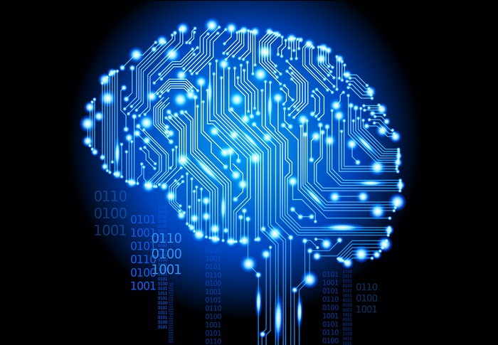
COMPUTER VISION
BY:- P.S.TEJA

Slide 2
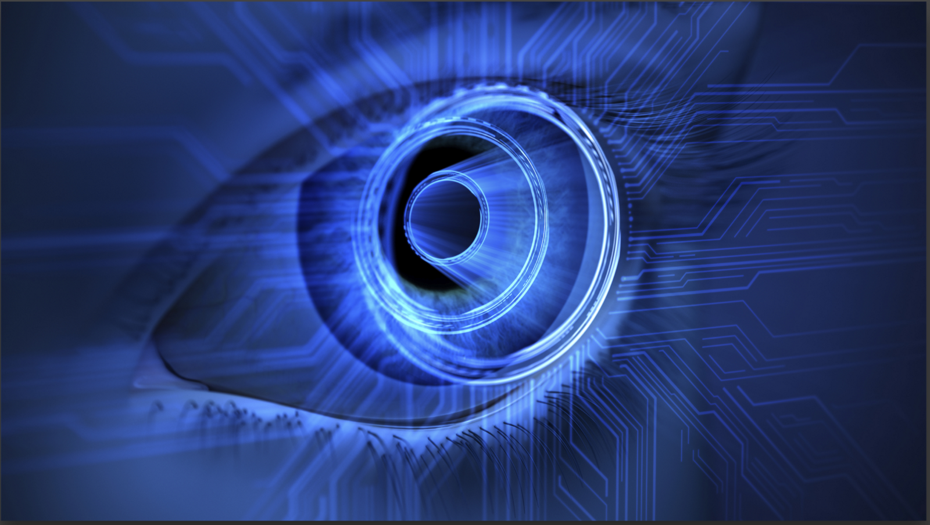
Computer vision is the science that aims to give a similar, if not better, capability to a machine or computer. Computer vision is concerned with the automatic extraction, analysis and understanding of useful information from a single image or a sequence of images.

Slide 3

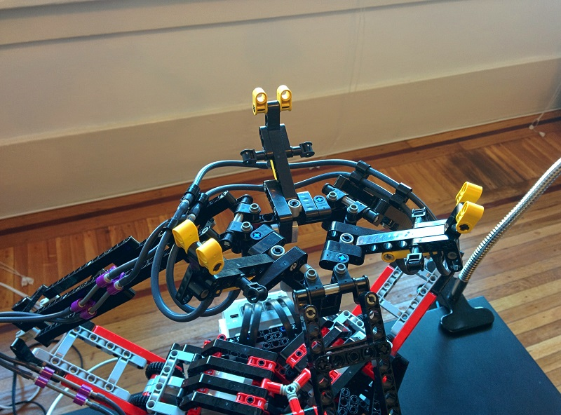
Someone across the room throws you a ball and you catch it. Simple, right?

Slide 4
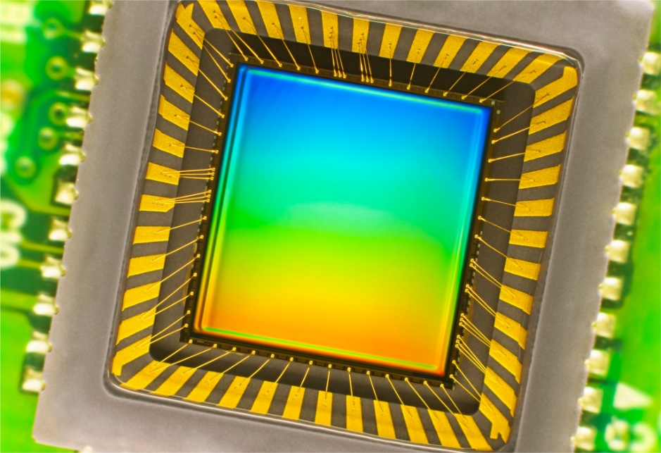
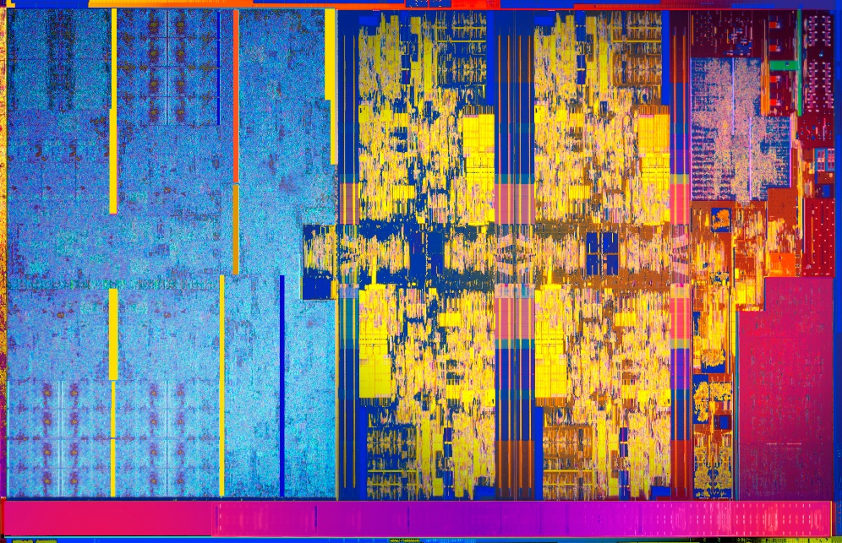
REINVENTING THE EYE.

Slide 5
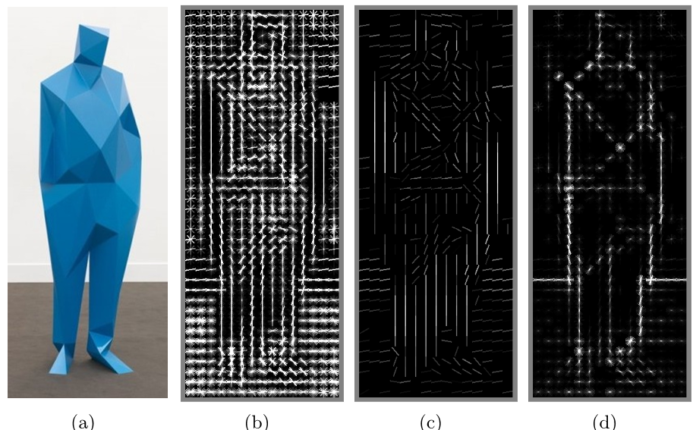
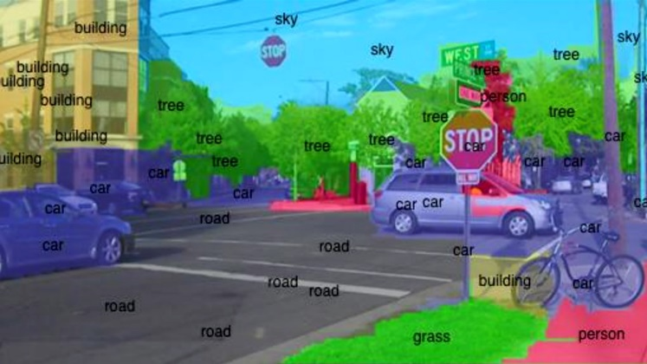
DIFFERENT APPROACHES:-

Slide 6
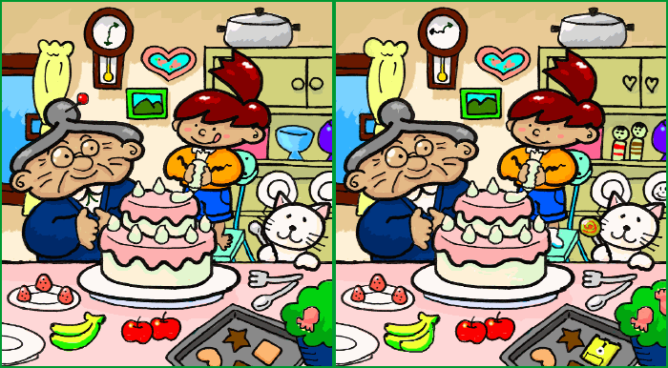
Guess you know it?

Slide 7
Some fields of computer vision:-
Learning
signal processing
Robotics
artificial intelligence.

Slide 8
Some of the Main Libraries in computer vision:-
Tensor Flow
Pytorch
Keras

Slide 9
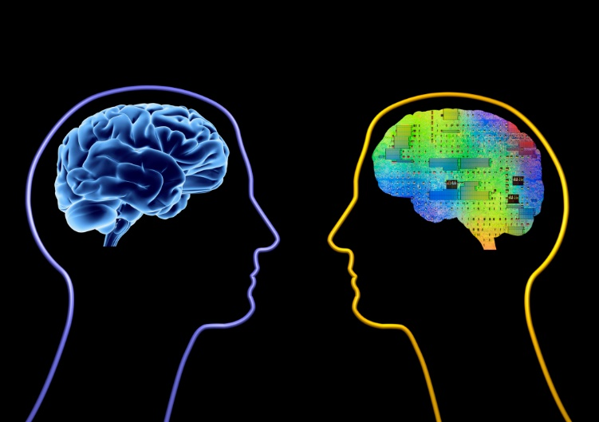
CONCLUSION:-

Slide 10


