Slide 1

Model Context Protocol (MCP)
The USB‑C for Agentic AI
Agentic AI Training
Presented by Sai Teja Polisetty

Slide 2
Learning Objectives
• Understand what MCP is and why it matters in Agentic AI
• Learn about Hosts, Clients, and Servers
• Explore local vs remote MCP setups
• Build and test your own MCP Client and Server
• Discover marketplaces and best practices
💡 MCP makes AI tools interoperable like USB‑C makes devices universal.

Slide 3
What is MCP?
• MCP = Model Context Protocol
• A standard, not a framework or tool
• Introduced by Anthropic as the 'USB‑C for AI'
• Enables LLMs to plug into tools, data, and prompts seamlessly.

Slide 4
What MCP is NOT
🚫 Not a new way to code agents
🚫 Not a framework (LangChain, LangGraph)
🚫 Not a replacement for SDKs
✅ It’s a protocol – defines how AI systems communicate with tools.

Slide 5
What MCP *Is*
• A universal connector for AI tools & agents
• Makes integration frictionless
• Standardizes how LLMs access resources
• Drives a growing ecosystem of open‑source MCP servers.
💡 MCP is the bridge between LLMs and external knowledge/tools.

Slide 6
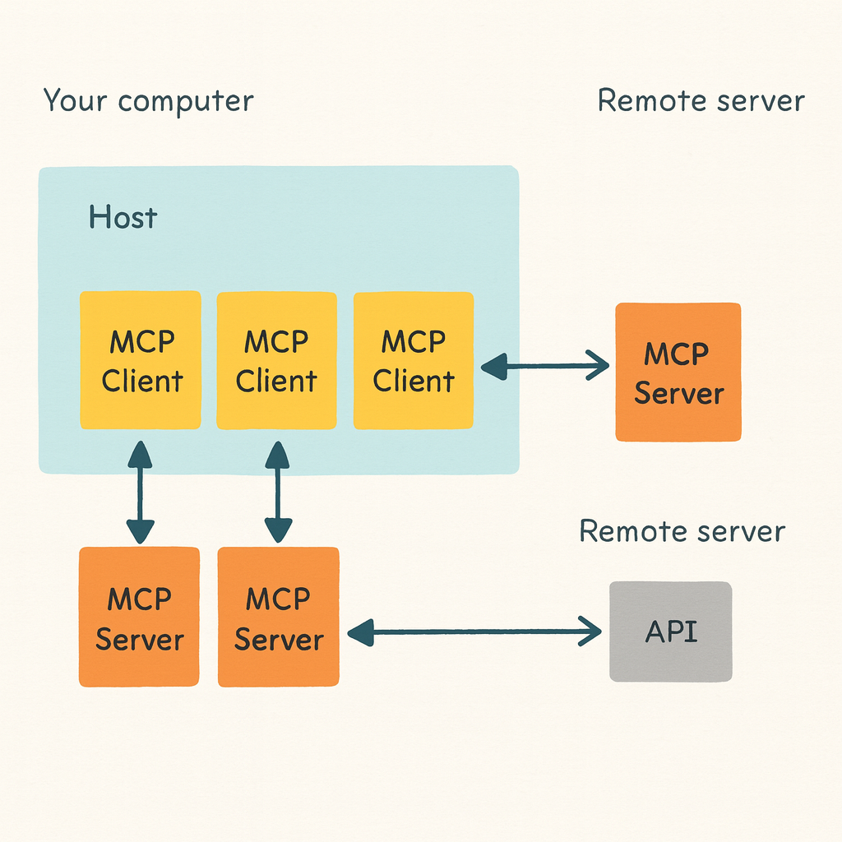
MCP Architecture
[Host / LLM App]
↓
[MCP Client]
↓
[MCP Server(s)] → Tools, APIs, Datasets,
Prompts
Examples:
• Host: Claude Desktop, OpenAI Agent
• Client: Connector between host & server
• Server: Provides tools (fetch, weather,
file access).

Slide 7
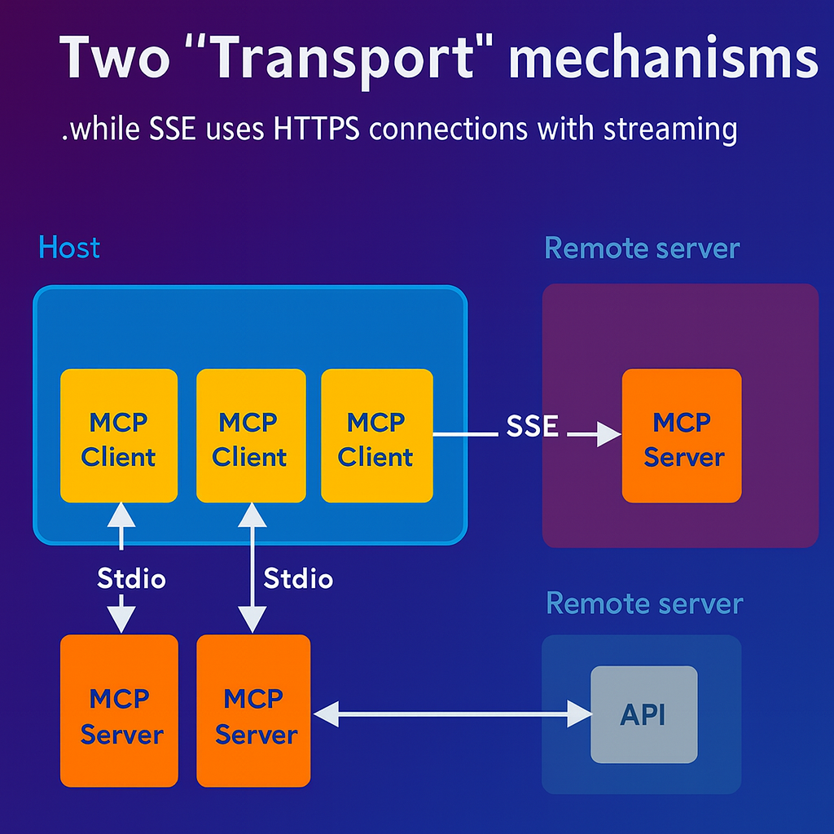
Transport Mechanisms
STDIO → For local servers
• Spawns process; uses
input/output stream
SSE → For remote servers
• HTTPS streaming for cloud MCP.
💡 Use STDIO for local dev,
SSE for remote streaming.

Slide 8
Lab 1 – Setting up MCP
Steps:
1️⃣ Create an MCP Client
2️⃣ Spawn a Server
3️⃣ Collect tools exposed by server
Python Snippet:
from mcp import Client
client = Client()
server = client.spawn_server('weather-mcp')
tools = server.get_tools()
print(tools)
💡 Tip: Use STDIO for local development; easier to debug.

Slide 9
MCP Marketplaces
Explore:
• https://mcp.so
• https://glama.ai/mcp
• https://smithery.ai/
Articles:
• Hugging Face – Top 11 MCP Libraries
• Hugging Face – Getting Started with MCP
💡 Encourage students to run Fetch or Brave MCP servers.

Slide 10
Why Build an MCP Server?
• Share your tools with others
• Plug into others’ workflows
• Learn AI plumbing & integration
• Customize tool capabilities
🚫 When not to: if only used internally, use @function_tool instead.

Slide 11
Types of MCP Servers
Local, Offline → All local tools (file reader, calculator)
Local + Internet → Local + APIs (Brave Search)
Remote MCP → Hosted (Claude Remote, Cloudflare)
💡 Choose type based on deployment scope.

Slide 12
Quick Quiz & Reflection
Q1: How is MCP different from LangChain?
Q2: Which transport suits remote servers?
Q3: Why USB‑C analogy?
Q4: What are MCP setup steps?
💬 Reflection: How can you apply MCP in your next project?

Slide 13

Thank You & Discussion
🎓 Encourage building custom MCP servers
🧩 Share mini‑projects & results
📚 Resources and GitHub templates to follow.

