Slide 1
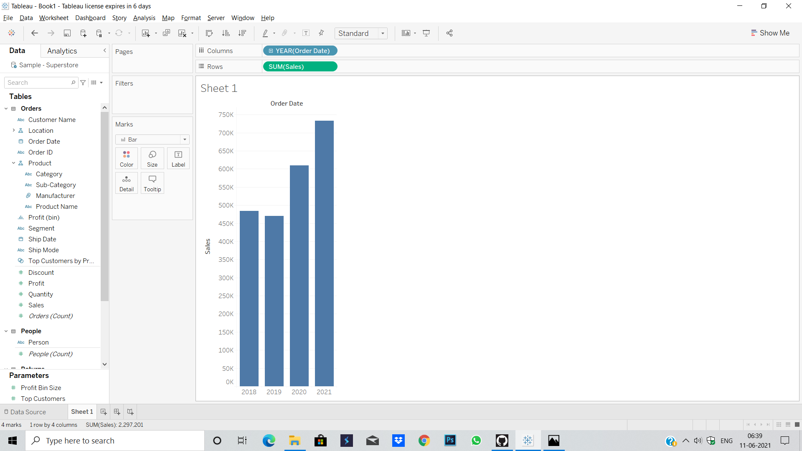
Find the sales for every year and find the highest sales and show the view in bar graph.

Slide 2
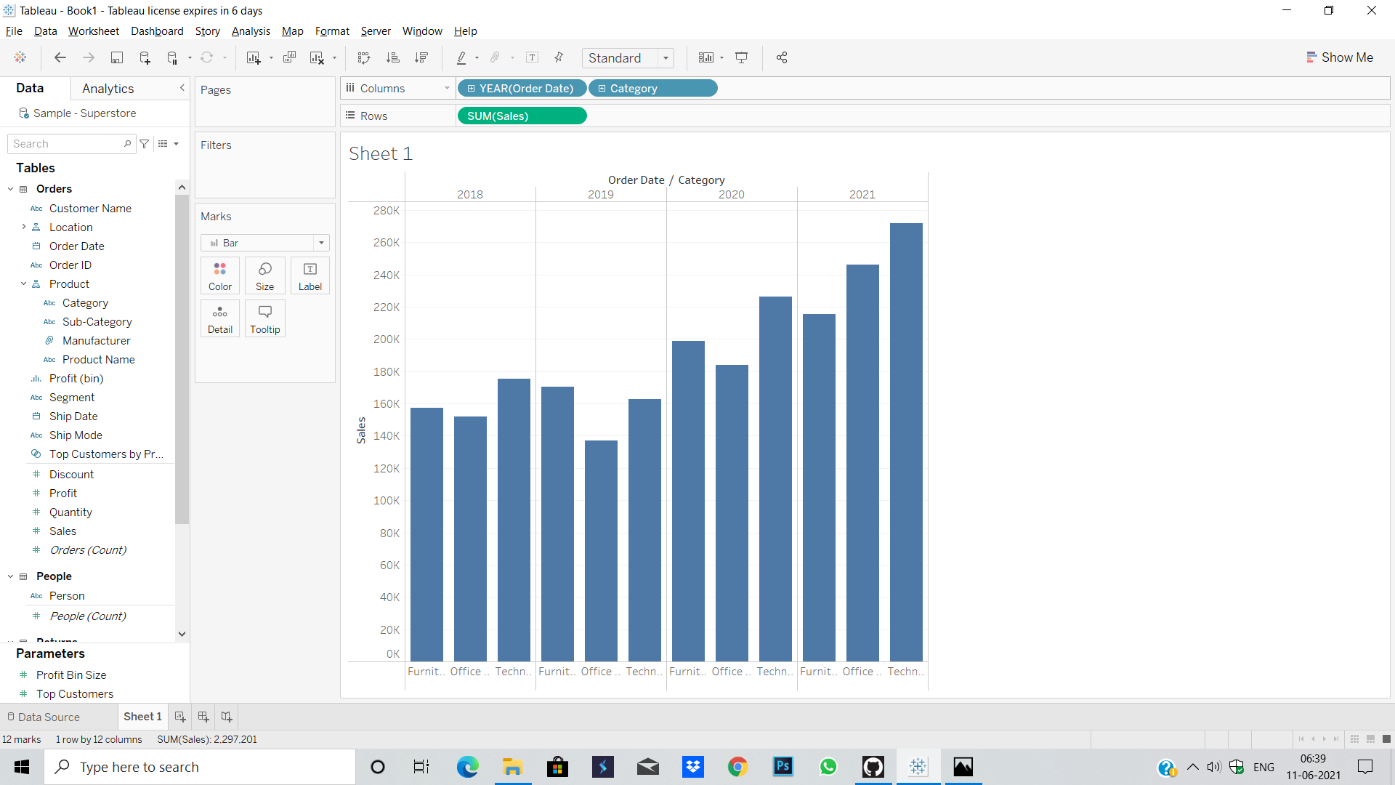
Find the category wise sales for every year.

Slide 3
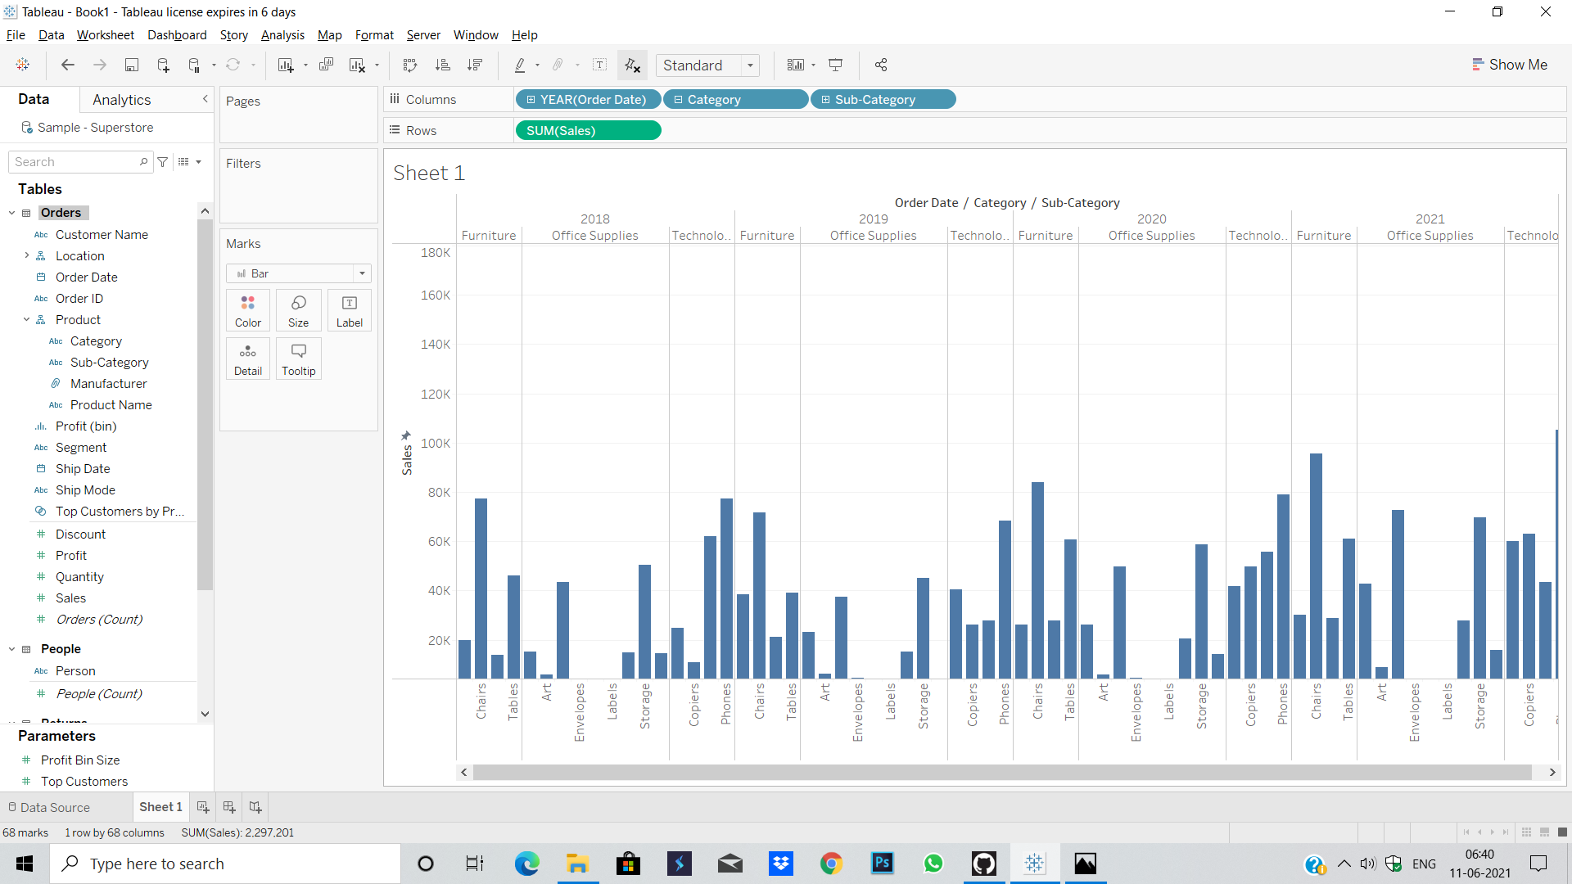
Display subcategory and find some insights from the view about max and min sales under every category.

Slide 4
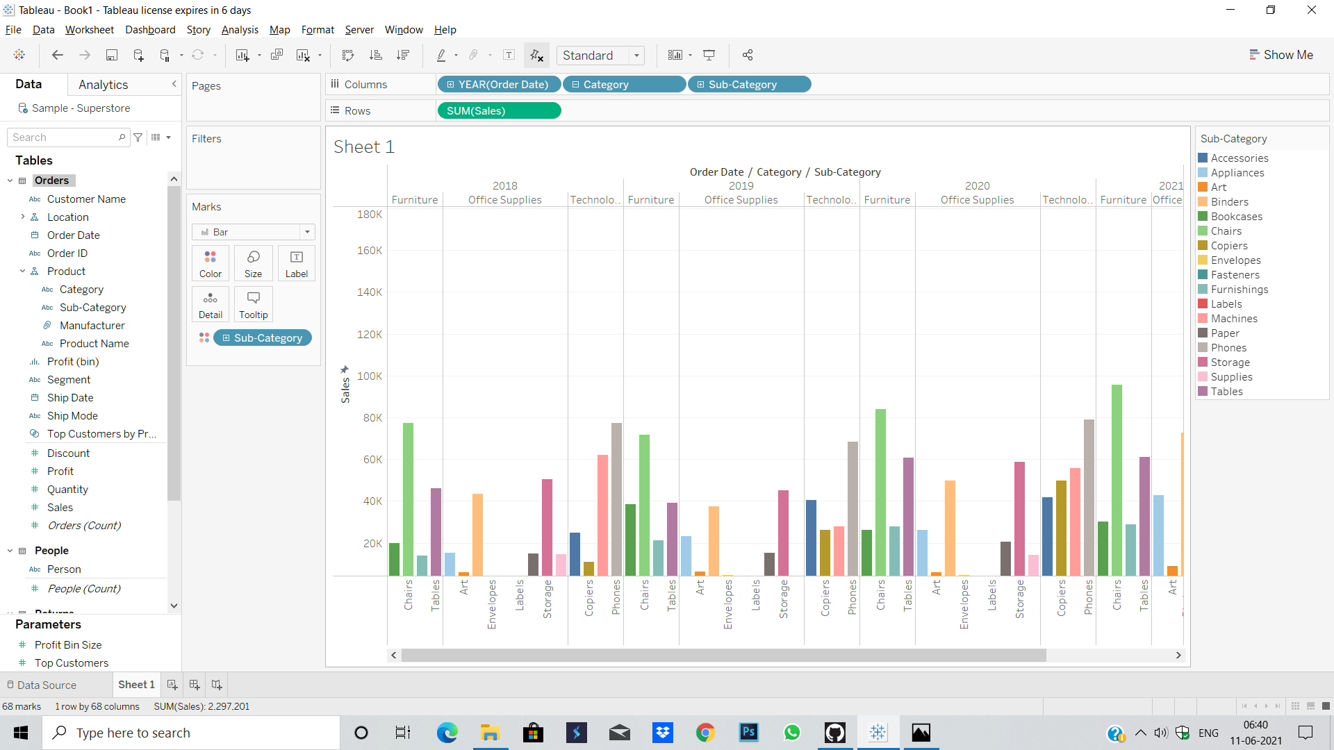
In your bar graph present subcategory under each bar of category using colour card

