Slide 1

TATYASAHEB KORE INSTITUTE OF ENGINEERING AND TECHNOLOGY, WARANANAGAR (An Autonomous Institute)
DEPARTMENT OF COMPUTER SCIENCE & ENGINEERING
2023-24

Slide 2
Department of Computer Science & Engineering Academic Year (2023-2024) A Mini Project Presentation On “CSI Connect: Empowering Excellence in Digital Innovation”
Presented By :
Name Roll No.
Samarth Ajit Sambrekar. 265
Tejas Bhagvan Shinde. 269
Vipul Suresh Shinde. 270
Guided By : Prof. B. A. Chougule.

Slide 3
Content :

Slide 4
Content :
Project title
Objective
Problem statement
Introduction
Existing system
Drawbacks/limitations/challenges in Existing System
An aim, goal, or end of actions of your project
Use-case diagram
Gantt chart
Outcome

Slide 5
Project Title :
“CSI Connect: Empowering Excellence in Digital Innovation”

Slide 6
INTRODUCTION
The Computer Society of India (CSI) grapples with significant challenges in its current digital landscape and member engagement strategies. Outdated website infrastructure, inefficient communication channels, and limited member engagement underscore the need for a comprehensive web project.
Further complications arise in event management, resource accessibility, training, and membership processes. Collaboration challenges with chapters, the imperative to stay technologically updated, and ensuring robust security and privacy measures accentuate the pressing need for a transformative web initiative.

Slide 7
Motivation: -
The web project for the Computer Society of India (CSI) is a transformative initiative, aiming to revitalize digital presence and member engagement. Motivated by the vision of creating a vibrant community, it seeks to enhance connectivity, streamline communication, and provide valuable resources.
Ultimately, the project aspires to facilitate knowledge exchange, uphold CSI's reputation, and solidify its standing as a leader in the field of computer science and technology in India.

Slide 8
Existing System: -
Physical Registration: As you mentioned, students need to visit a physical location, such as the CSI office or a designated registration center, to complete the membership registration process.
Paper Forms: The registration process likely involves filling out paper forms with personal information, contact details, and any other required details for the membership application.
Payment: If there are membership fees, students may need to make the payment in person, either in cash or through other accepted payment methods.
Documentation: Students might be required to provide certain documents as proof of identity, student status, or any other relevant information.

Slide 9
PROBLEM STATEMENT:
CSI faces challenges with an outdated website, inefficient communication channels, and limited member engagement. Event management, resource accessibility, training processes, and membership management need improvement. Collaboration with chapters, staying technologically updated, and ensuring security pose additional concerns. A comprehensive web project is essential to enhance CSI's overall effectiveness and efficiency.

Slide 10
Advantages:-
Convenience for Members
Efficiency in Processing
Reduced Errors
Cost Savings
Faster Approval and Activation
Improved Data Management
Enhanced Communication
24/7 Accessibility
Scalability
Enhanced Security
.

Slide 11
An aim of the project: -
Membership Engagement:
Foster a sense of community among students and professionals interested in computer science and information technology.
Information Dissemination:
Provide a centralized platform for disseminating information about upcoming events, workshops, seminars, and other activities organized by CSI.
Membership Registration and Management:
Streamline the membership registration process, allowing students and professionals to easily join and manage their memberships online.
Resource Hub:
Serve as a repository for educational resources, research publications, and industry-related information in the field of computer science.

Slide 12
Block Diagram
Start
Admin
students
Adds categories
Browse
Manages students using database
Register
End
Fig: CSI website

Slide 13
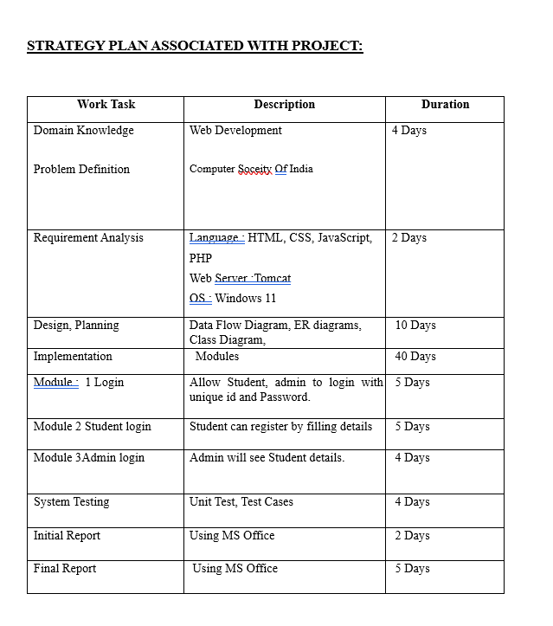

Slide 14
OUTCOME :
The anticipated outcomes of this project include an upgraded and user-friendly Computer Society of India (CSI) website, improved member engagement, streamlined communication channels, efficient event management, enhanced resource accessibility, modernized training and certification processes, optimized membership management, strengthened collaboration with chapters, and a technologically updated platform, ultimately ensuring heightened security and privacy measures. These outcomes collectively aim to elevate CSI's digital presence and reinforce its position as a leading force in the field of computer science and technology in India.

Slide 15
References :
A beginner’s guide to HTML, CSS, Javascript, and Web Graphics, by Jennifer Niederst Robbins
https://www.w3schools.com/web-development
https://www.geeksforgeeks.org/web-development

Slide 16
Thanks!

