Slide 1
Dijkstra's algorithm

Slide 2
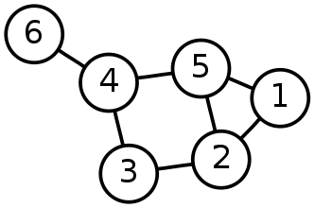
Single-Source Shortest Path Problem
Single-Source Shortest Path Problem - The problem of finding shortest paths from a source vertex v to all other vertices in the graph.

Slide 3
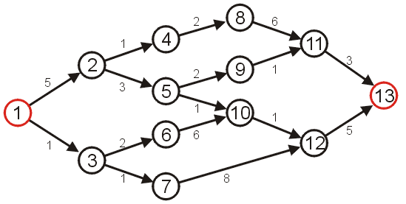
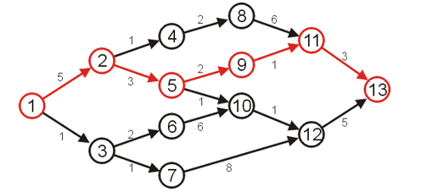
Shortest Path
Given the graph below, suppose we wish to find the shortest path from vertex 1 to vertex 13
After some consideration, we may determine that the shortest path is as follows, with length 14
Other paths exists, but they are longer

Slide 4
Dijkstra's algorithm
Dijkstra's algorithm - is a solution to the single-source shortest path problem in graph theory.
Works on both directed and undirected graphs. However, all edges must have nonnegative weights.
Approach: Greedy
Input: Weighted graph G={E,V} and source vertex v∈V, such that all edge weights are nonnegative
Output: Lengths of shortest paths (or the shortest paths themselves) from a given source vertex v∈V to all other vertices

Slide 5
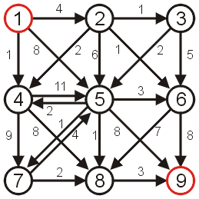
Shortest Path
Consider the following graph with positive weights and cycles.

Slide 6
Dijkstra’s Algorithm
A first attempt at solving this problem might require an array of Boolean values, all initially false, that indicate whether we have found a path from the source.
1 | F
2 | F
3 | F
4 | F
5 | F
6 | F
7 | F
8 | F
9 | F

Slide 7
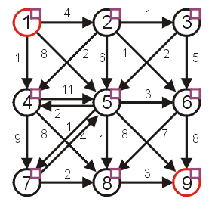
Dijkstra’s Algorithm
Graphically, we will denote this with check boxes next to each of the vertices (initially unchecked)

Slide 8
Dijkstra’s Algorithm
We will work bottom up.
Note that if the starting vertex has any adjacent edges, then there will be one vertex that is the shortest distance from the starting vertex. This is the shortest reachable vertex of the graph.
We will then try to extend any existing paths to new vertices.
Initially, we will start with the path of length 0
this is the trivial path from vertex 1 to itself

Slide 9
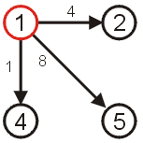
Dijkstra’s Algorithm
If we now extend this path, we should consider the paths
(1, 2) length 4
(1, 4) length 1
(1, 5) length 8
The shortest path so far is (1, 4) which is of length 1.

Slide 10
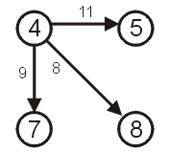
Dijkstra’s Algorithm
Thus, if we now examine vertex 4, we may deduce that there exist the following paths:
(1, 4, 5) length 12
(1, 4, 7) length 10
(1, 4, 8) length 9

Slide 11
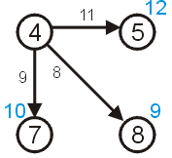
Dijkstra’s Algorithm
We need to remember that the length of that path from node 1 to node 4 is 1
Thus, we need to store the length of a path that goes through node 4:
5 of length 12
7 of length 10
8 of length 9

Slide 12
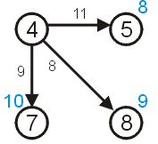
Dijkstra’s Algorithm
We have already discovered that there is a path of length 8 to vertex 5 with the path (1, 5).
Thus, we can safely ignore this longer path.

Slide 13
Dijkstra’s Algorithm
We now know that:
There exist paths from vertex 1 to vertices {2,4,5,7,8}.
We know that the shortest path from vertex 1 to vertex 4 is of length 1.
We know that the shortest path to the other vertices {2,5,7,8} is at most the length listed in the table to the right.
Vertex | Length
1 | 0
2 | 4
4 | 1
5 | 8
7 | 10
8 | 9

Slide 14
Dijkstra’s Algorithm
There cannot exist a shorter path to either of the vertices 1 or 4, since the distances can only increase at each iteration.
We consider these vertices to be visited
Vertex | Length
1 | 0
2 | 4
4 | 1
5 | 8
7 | 10
8 | 9

Slide 15
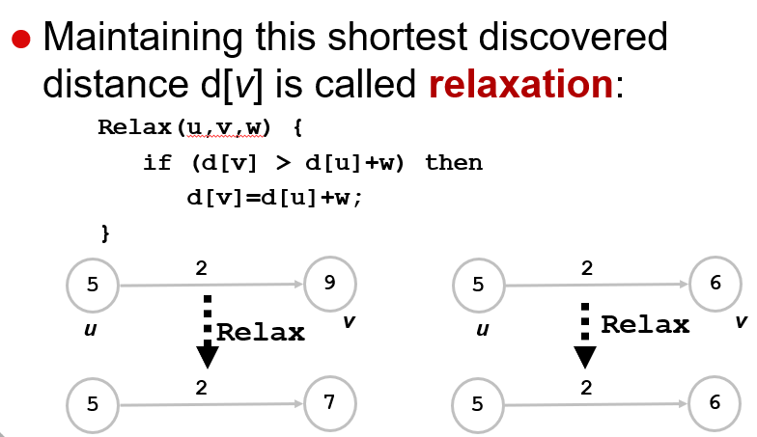
Dijkstra’s Algorithm
Dijkstra’s Algorithm

Slide 16
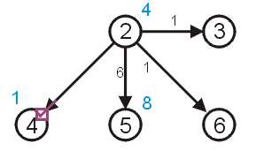
Dijkstra’s Algorithm
In Dijkstra’s algorithm, we always take the next unvisited vertex which has the current shortest path from the starting vertex in the table.
This is vertex 2

Slide 17
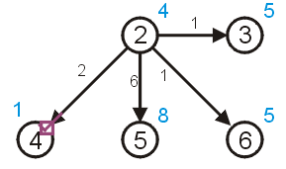
Dijkstra’s Algorithm
We can try to update the shortest paths to vertices 3 and 6 (both of length 5) however:
there already exists a path of length 8 < 10 to vertex 5 (10 = 4 + 6)
we already know the shortest path to 4 is 1

Slide 18
Dijkstra’s Algorithm
To keep track of those vertices to which no path has reached, we can assign those vertices an initial distance of either
infinity (∞ ),
a number larger than any possible path, or
a negative number
For demonstration purposes, we will use ∞

Slide 19
Dijkstra’s Algorithm
As well as finding the length of the shortest path, we’d like to find the corresponding shortest path
Each time we update the shortest distance to a particular vertex, we will keep track of the predecessor used to reach this vertex on the shortest path.

Slide 20
Dijkstra’s Algorithm
We will store a table of pointers, each initially 0
This table will be updated each time a distance is updated
1 | 0
2 | 0
3 | 0
4 | 0
5 | 0
6 | 0
7 | 0
8 | 0
9 | 0

Slide 21
Dijkstra’s Algorithm
Graphically, we will display the reference to the preceding vertex by a red arrow
if the distance to a vertex is ∞, there will be no preceding vertex
otherwise, there will be exactly one preceding vertex

Slide 22
Dijkstra’s Algorithm
Thus, for our initialization:
we set the current distance to the initial vertex as 0
for all other vertices, we set the current distance to ∞
all vertices are initially marked as unvisited
set the previous pointer for all vertices to null

Slide 23
Dijkstra’s Algorithm
Thus, we iterate:
find an unvisited vertex which has the shortest distance to it
mark it as visited
for each unvisited vertex which is adjacent to the current vertex:
add the distance to the current vertex to the weight of the connecting edge
if this is less than the current distance to that vertex, update the distance and set the parent vertex of the adjacent vertex to be the current vertex

Slide 24
Dijkstra’s Algorithm
Halting condition:
we successfully halt when the vertex we are visiting is the target vertex
if at some point, all remaining unvisited vertices have distance ∞, then no path from the starting vertex to the end vertex exits
Note: We do not halt just because we have updated the distance to the end vertex, we have to visit the target vertex.

Slide 25
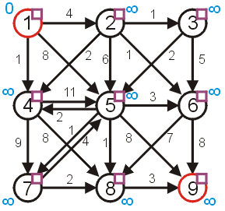
Example
Consider the graph:
the distances are appropriately initialized
all vertices are marked as being unvisited

Slide 26
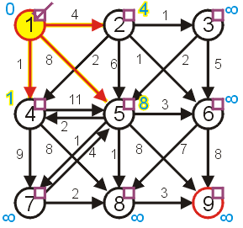
Example
Visit vertex 1 and update its neighbours, marking it as visited
the shortest paths to 2, 4, and 5 are updated

Slide 27
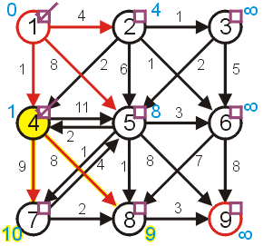
Example
The next vertex we visit is vertex 4
vertex 5 1 + 11 ≥ 8 don’t update
vertex 7 1 + 9 < ∞ update
vertex 8 1 + 8 < ∞ update

Slide 28
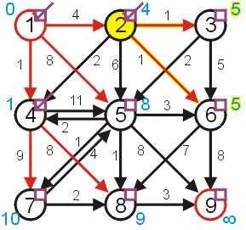
Example
Next, visit vertex 2
vertex 3 4 + 1 < ∞ update
vertex 4 already visited
vertex 5 4 + 6 ≥ 8 don’t update
vertex 6 4 + 1 < ∞ update

Slide 29
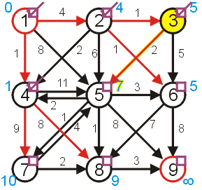
Example
Next, we have a choice of either 3 or 6
We will choose to visit 3
vertex 5 5 + 2 < 8 update
vertex 6 5 + 5 ≥ 5 don’t update

Slide 30
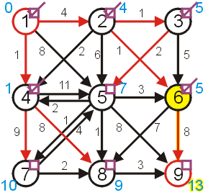
Example
We then visit 6
vertex 8 5 + 7 ≥ 9 don’t update
vertex 9 5 + 8 < ∞ update

Slide 31
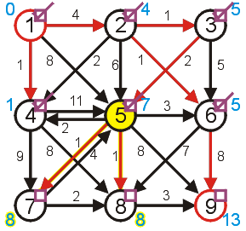
Example
Next, we finally visit vertex 5:
vertices 4 and 6 have already been visited
vertex 7 7 + 1 < 10 update
vertex 8 7 + 1 < 9 update
vertex 9 7 + 8 ≥ 13 don’t update

Slide 32
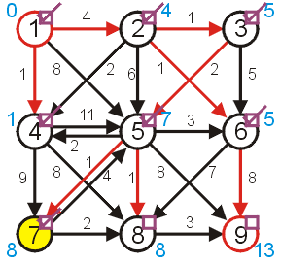
Example
Given a choice between vertices 7 and 8, we choose vertex 7
vertices 5 has already been visited
vertex 8 8 + 2 ≥ 8 don’t update

Slide 33
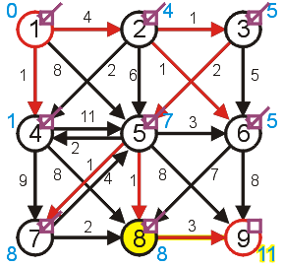
Example
Next, we visit vertex 8:
vertex 9 8 + 3 < 13 update

Slide 34
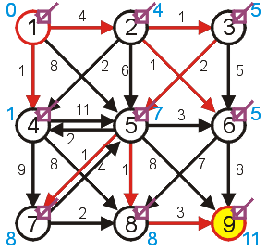
Example
Finally, we visit the end vertex
Therefore, the shortest path from 1 to 9 has length 11

Slide 35
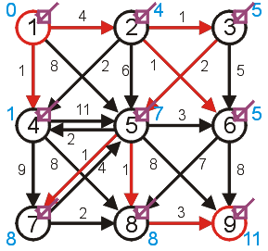
Example
We can find the shortest path by working back from the final vertex:
9, 8, 5, 3, 2, 1
Thus, the shortest path is (1, 2, 3, 5, 8, 9)

Slide 36
Dijkstra’s algorithm
d[s] ← 0
for each v ∈ V – {s}
do d[v] ← ∞
S ← ∅
Q ← V ⊳ Q is a priority queue maintaining V – S
while Q ≠ ∅
do u ← EXTRACT-MIN(Q)
S ← S ∪ {u}
for each v ∈ Adj[u]
do if d[v] > d[u] + w(u, v)
then d[v] ← d[u] + w(u, v)
p[v] ← u

Slide 37
Dijkstra’s algorithm
d[s] ← 0
for each v ∈ V – {s}
do d[v] ← ∞
S ← ∅
Q ← V ⊳ Q is a priority queue maintaining V – S
while Q ≠ ∅
do u ← EXTRACT-MIN(Q)
S ← S ∪ {u}
for each v ∈ Adj[u]
do if d[v] > d[u] + w(u, v)
then d[v] ← d[u] + w(u, v)
p[v] ← u
relaxation step
Implicit DECREASE-KEY

Slide 38
Example of Dijkstra’s algorithm
2
Graph with nonnegative edge weights:
B
D
10
A
8
1
4
7
9
3
C
E
2

Slide 39
Example of Dijkstra’s algorithm
∞
∞
Initialize:
2
B
D
10
A
8
0
1
4
7
9
3
Q:
A
B
C
D
E
C
E
2
0
∞
∞
∞
∞
∞
∞
S: {}

Slide 40
Example of Dijkstra’s algorithm
∞
∞
“A” ← EXTRACT-MIN(Q):
2
B
D
10
A
8
0
1
4
7
9
3
Q:
A
B
C
D
E
C
E
2
0
∞
∞
∞
∞
∞
∞
S: { A }

Slide 41
Example of Dijkstra’s algorithm
10
∞
Relax all edges leaving A:
2
B
D
10
A
8
0
1
4
7
9
3
Q:
A
B
C
D
E
C
E
2
0
∞
∞
∞
∞
3
∞
10
3
∞
∞
S: { A }

Slide 42
Example of Dijkstra’s algorithm
10
∞
“C” ← EXTRACT-MIN(Q):
2
B
D
10
A
8
0
1
4
7
9
3
Q:
A
B
C
D
E
C
E
2
0
∞
∞
∞
∞
3
∞
10
3
∞
∞
S: { A, C }

Slide 43
Example of Dijkstra’s algorithm
7
11
Relax all edges leaving C:
2
B
D
10
A
8
0
1
4
7
9
3
Q:
A
B
C
D
E
C
E
2
0
∞
∞
∞
∞
3
5
10
3
∞
∞
7
11
5
S: { A, C }

Slide 44
Example of Dijkstra’s algorithm
7
11
“E” ← EXTRACT-MIN(Q):
2
B
D
10
A
8
0
1
4
7
9
3
Q:
A
B
C
D
E
C
E
2
0
∞
∞
∞
∞
3
5
10
3
∞
∞
7
11
5
S: { A, C, E }

Slide 45
Example of Dijkstra’s algorithm
7
11
Relax all edges leaving E:
2
B
D
10
A
8
0
1
4
7
9
3
Q:
A
B
C
D
E
C
E
2
0
∞
∞
∞
∞
3
5
10
3
∞
∞
7
11
5
S: { A, C, E }
7
11

Slide 46
Example of Dijkstra’s algorithm
7
11
“B” ← EXTRACT-MIN(Q):
2
B
D
10
A
8
0
1
4
7
9
3
Q:
A
B
C
D
E
C
E
2
0
∞
∞
∞
∞
3
5
10
3
∞
∞
7
11
5
S: { A, C, E, B }
7
11

Slide 47
Example of Dijkstra’s algorithm
7
9
Relax all edges leaving B:
2
B
D
10
A
8
0
1
4
7
9
3
Q:
A
B
C
D
E
C
E
2
0
∞
∞
∞
∞
3
5
10
3
∞
∞
7
11
5
S: { A, C, E, B }
7
11
9

Slide 48
Example of Dijkstra’s algorithm
7
9
“D” ← EXTRACT-MIN(Q):
2
B
D
10
A
8
0
1
4
7
9
3
Q:
A
B
C
D
E
C
E
2
0
∞
∞
∞
∞
3
5
10
3
∞
∞
7
11
5
S: { A, C, E, B, D }
7
11
9

Slide 49
Summary
Given a weighted directed graph, we can find the shortest distance between two vertices by:
starting with a trivial path containing the initial vertex
growing this path by always going to the next vertex which has the shortest current path

Slide 50
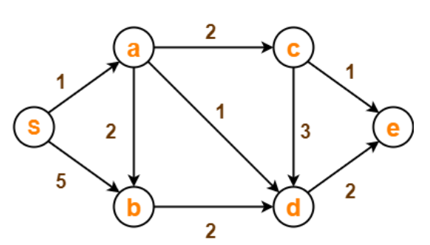
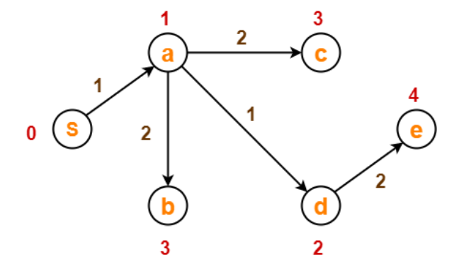
Example 2

Slide 51
Dijkstra's Algorithm - Why use it?
As mentioned, Dijkstra’s algorithm calculates the shortest path to every vertex.
However, it is about as computationally expensive to calculate the shortest path from vertex u to every vertex using Dijkstra’s as it is to calculate the shortest path to some particular vertex v.
Therefore, anytime we want to know the optimal path to some other vertex from a determined origin, we can use Dijkstra’s algorithm.

Slide 52
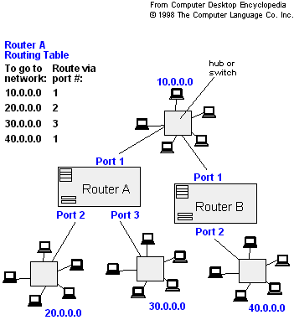
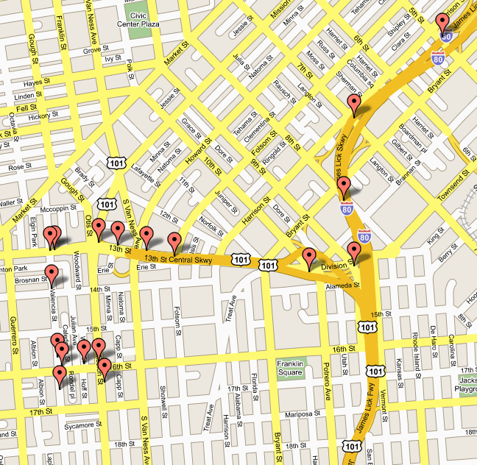
Applications of Dijkstra's Algorithm
- Traffic Information Systems are most prominent use
- Mapping (Map Quest, Google Maps)
- Routing Systems

