Slide 1

Hot-Swappable Machine Learning Model at the Edge
Submitted By:
Albin Joy | 250840130007
Tejas Desale | 250840130014
Jacob Mathew | 250840130020
Nidhi Wasule | 250840130030
Jaydeep Patil | 250840130036
Guided By:
Mr. Rhugved Rane

Slide 2
Architecture
Data acquisition
Machine Learning Model
  Training
  Deployment
  Inference
Hot Swapability
Display and Debugging
Ad-on feature : Cloud Integration transferring acquired data to cloud.

Slide 3
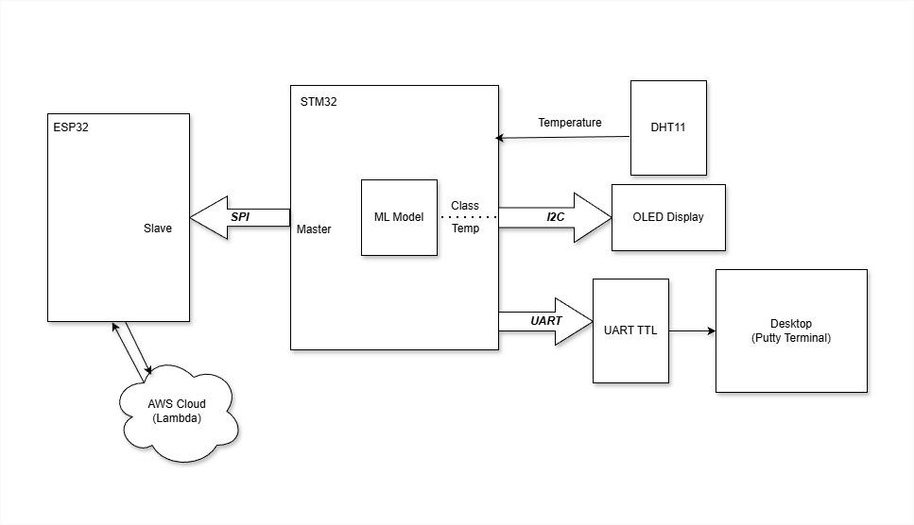
Block Diagram:
ML1
ML_1
ML2
ML_2

Slide 4
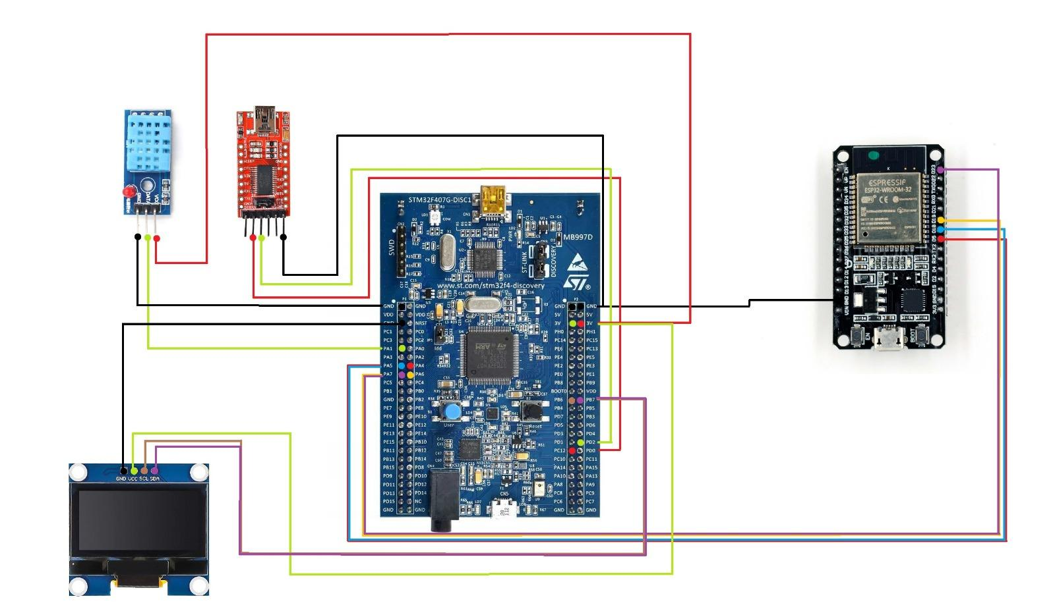
Circuit Diagram:

Slide 5
Data Acquisition
Data collected : Temperature
Sensor used :DHT11 Digital Temperature and Humidity Sensor
Protocol definition
single-wire proprietary digital protocol
Start Signal
  Request: The microcontroller pulls the data line LOW for at least 18 milliseconds. This "wakes up" the sensor.
  Release: The microcontroller pulls the line HIGH and waits for 20–40 microseconds for the sensor to respond.
Response
  It pulls the line LOW for 80 microseconds.
  It pulls the line HIGH for 80 microseconds.
Data Packet - 40 bits(5 bytes)
  Byte 1: First byte of relative humidity
  Byte 2: Second byte of relative humidity
  Byte 3: First byte of temperature
  Byte 4: Second byte of temperature
  Byte 5: Checksum byte for data validation
  Temperature (°C) = ((Byte3 << 8) | Byte 4)/10

Slide 6
Machine Learning Model
Model requirements
  Needs two models
    Model 1 - Low accuracy
    Model 2 - High accuracy
Training
  Temperature classifier developed using Tensorflow
  Uses Synthetically generated data
  Generates a .tflite file containing the model.
Deployment
  Uses X-Cube-AI as a middleware layer in STM32CubeIDE
  X-Cube-AI converts .tflite file to associated C arrays and functions
Inference
  Uses functions generated by X-Cube-AI

Slide 7
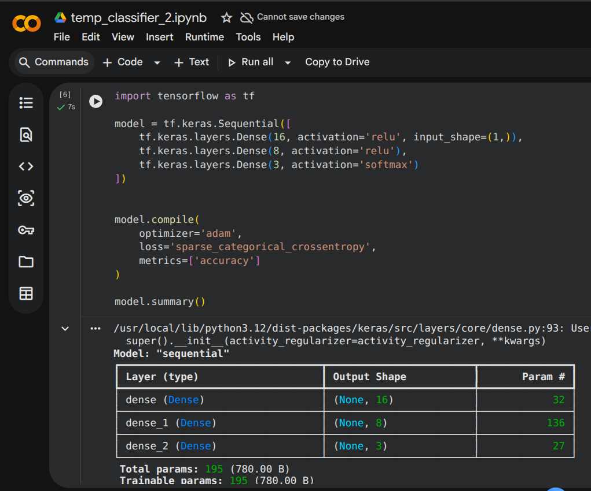
Model Design

Slide 8
Accuracies after model training:
ML Model 1 Training Set Size = 300 Accuracy=85%
ML Model 2 Training Set Size = 600 Accuracy=99%

Slide 9
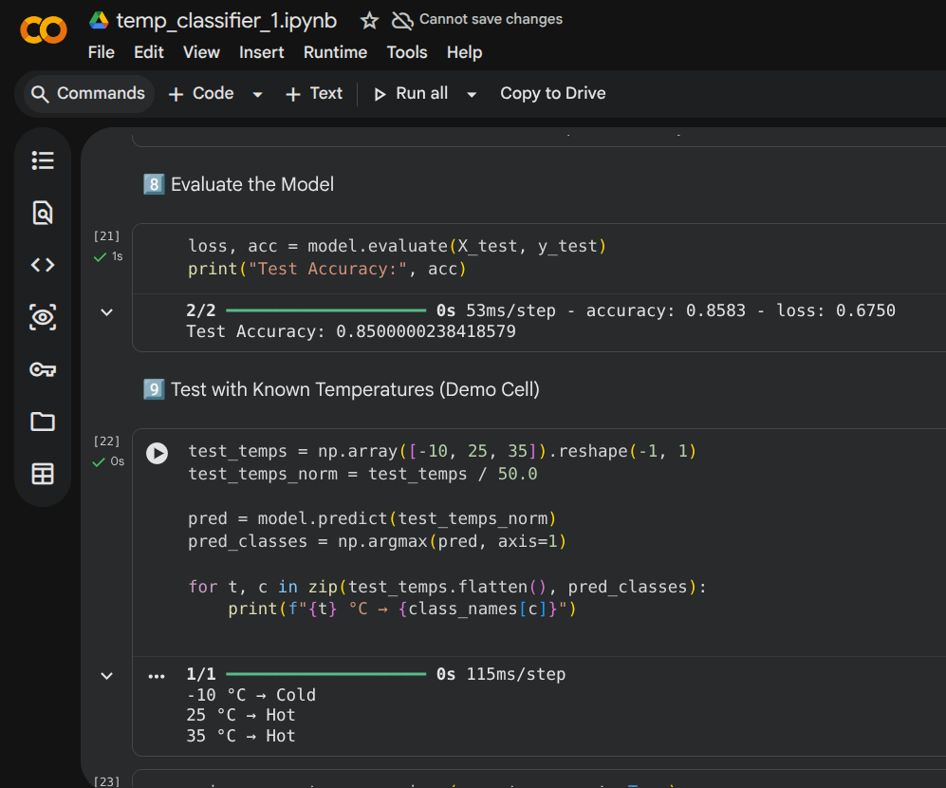
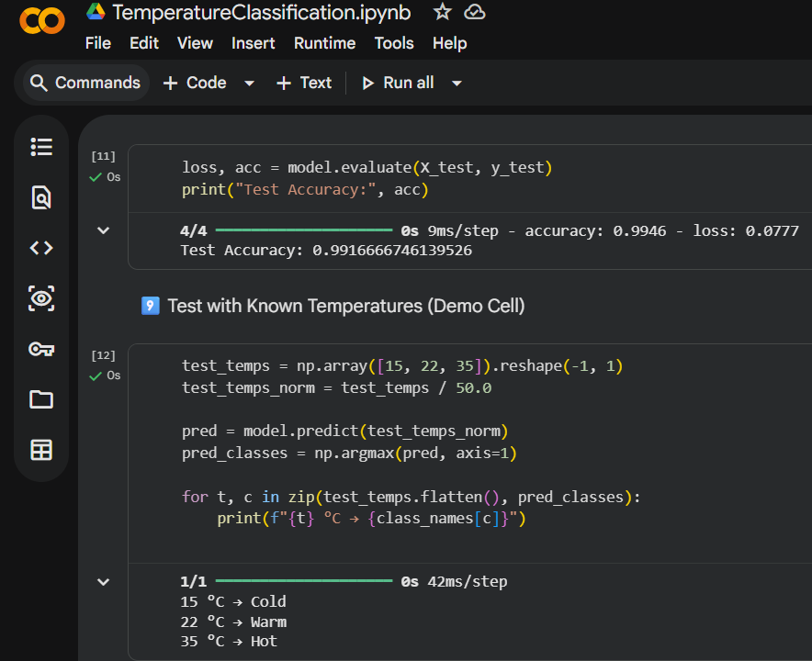
Model 1
Model 2

Slide 10
Hot-Swapability
Model swap not possible while application is running
  Model relies on generated C arrays and associated functions.
  Application lacks a dynamic linker
Model swap requires swapping between applications
=> We run 2 applications
  Application 1 - Running Model 1(Low accuracy)
  Application 2 - Running Model 2(High accuracy)
  Uses Vector Table offset Register(VTOR) register in System Control Block(SCB) for Vector Table Relocation
Application | Address
Application 1 | 0x0800 0000
Application 2 | 0x0802 0000

Slide 11
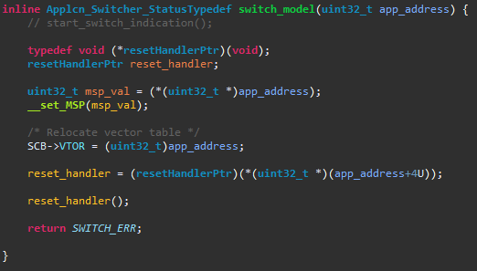
Application Switching Process
Main Stack Pointer(MSB) needs to be stored at the first memory location of the application
Vector table needs to be at an offset of app_address
reset_handler is a function pointer that points to the location of reset interrupt vector(app_address+4)

Slide 12
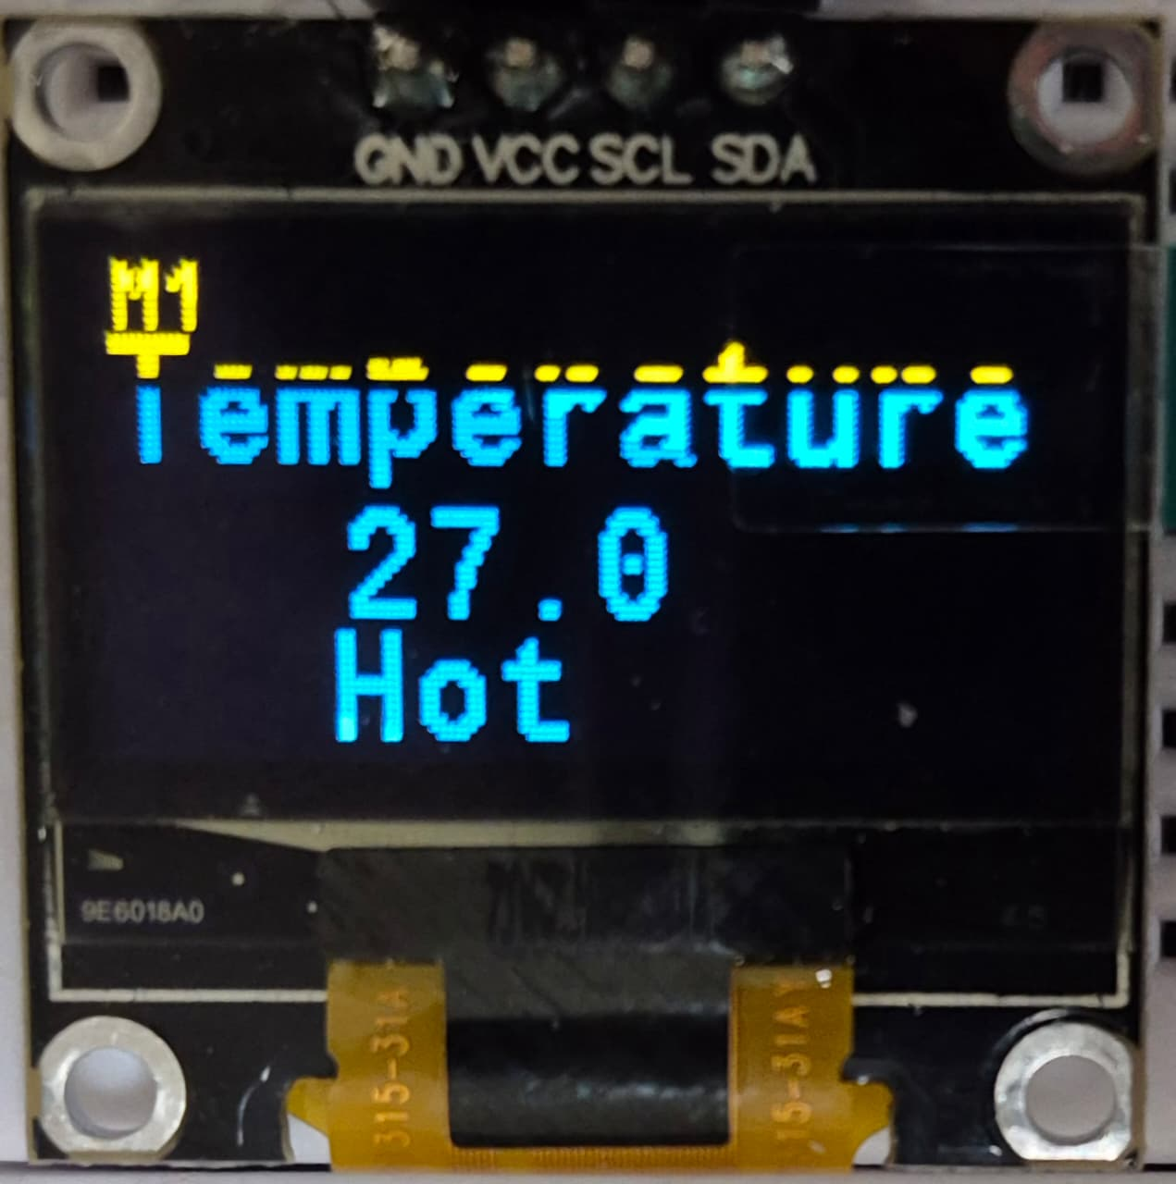
Display and Debugging
Display
0.96 inch Yellow-Blue Display Module(Driver: SSD1306)
External library: afiskon/stm32-ssd1306
Debugging
FTDI232 for UART transmission
Debug messages printed on PuTTY

Slide 13
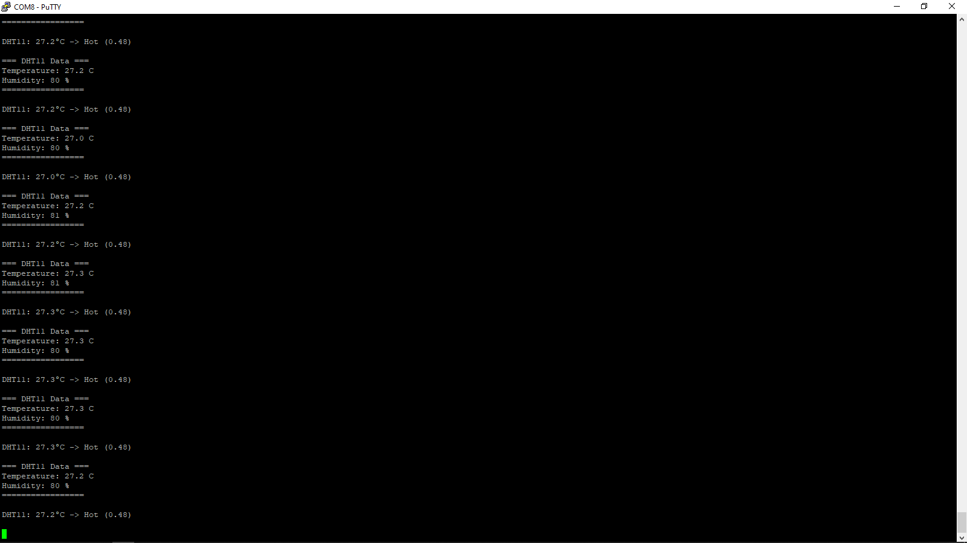
UART Logs:

Slide 14
Cloud Integration(Ad-on feature)
Transfers temperature data from STM32F407VGT6 to ESP32 Dev Module
  Uses SPI
    STM32 Discovery Module => Master
    ESP32 Dev Module => Slave
ESP32 Dev Module acts as a gateway between STM32 Discovery Board and the cloud
ESP32 Dev Module
  Connects to an Access Point with access to the internet
  Performs POST request to transfer json data to AWS API gateway
    POST /data -> ESP32 to Cloud
    Response gets printed on serial monitor
  AWS API gateway invokes a lambda function on AWS lambda

Slide 15
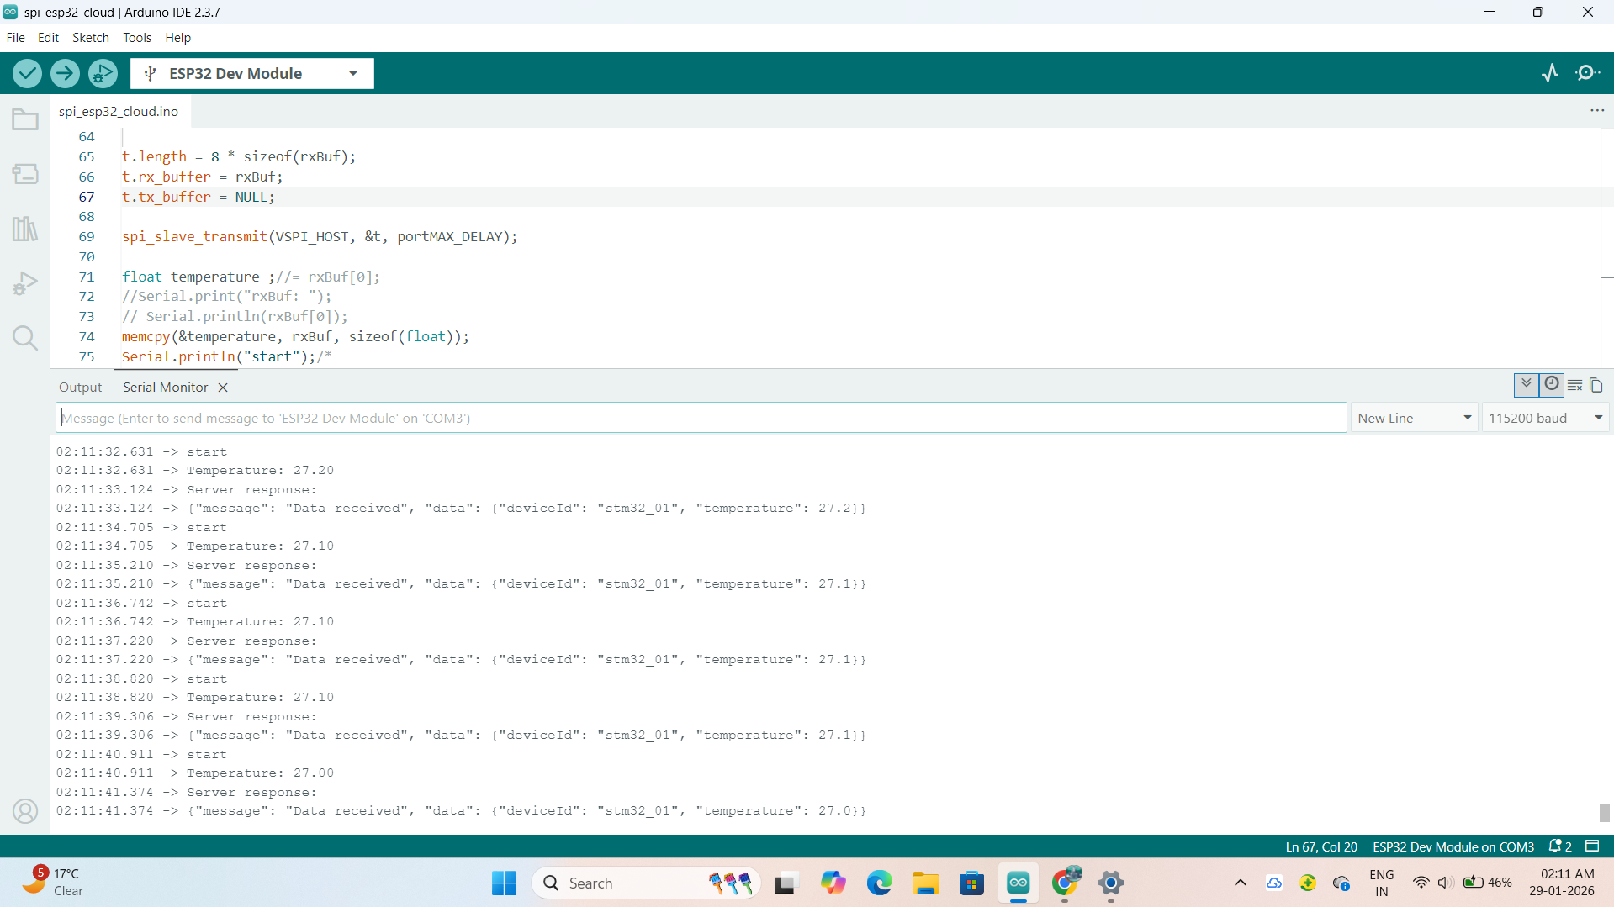
Esp32 Serial Monitor Logs:

Slide 16
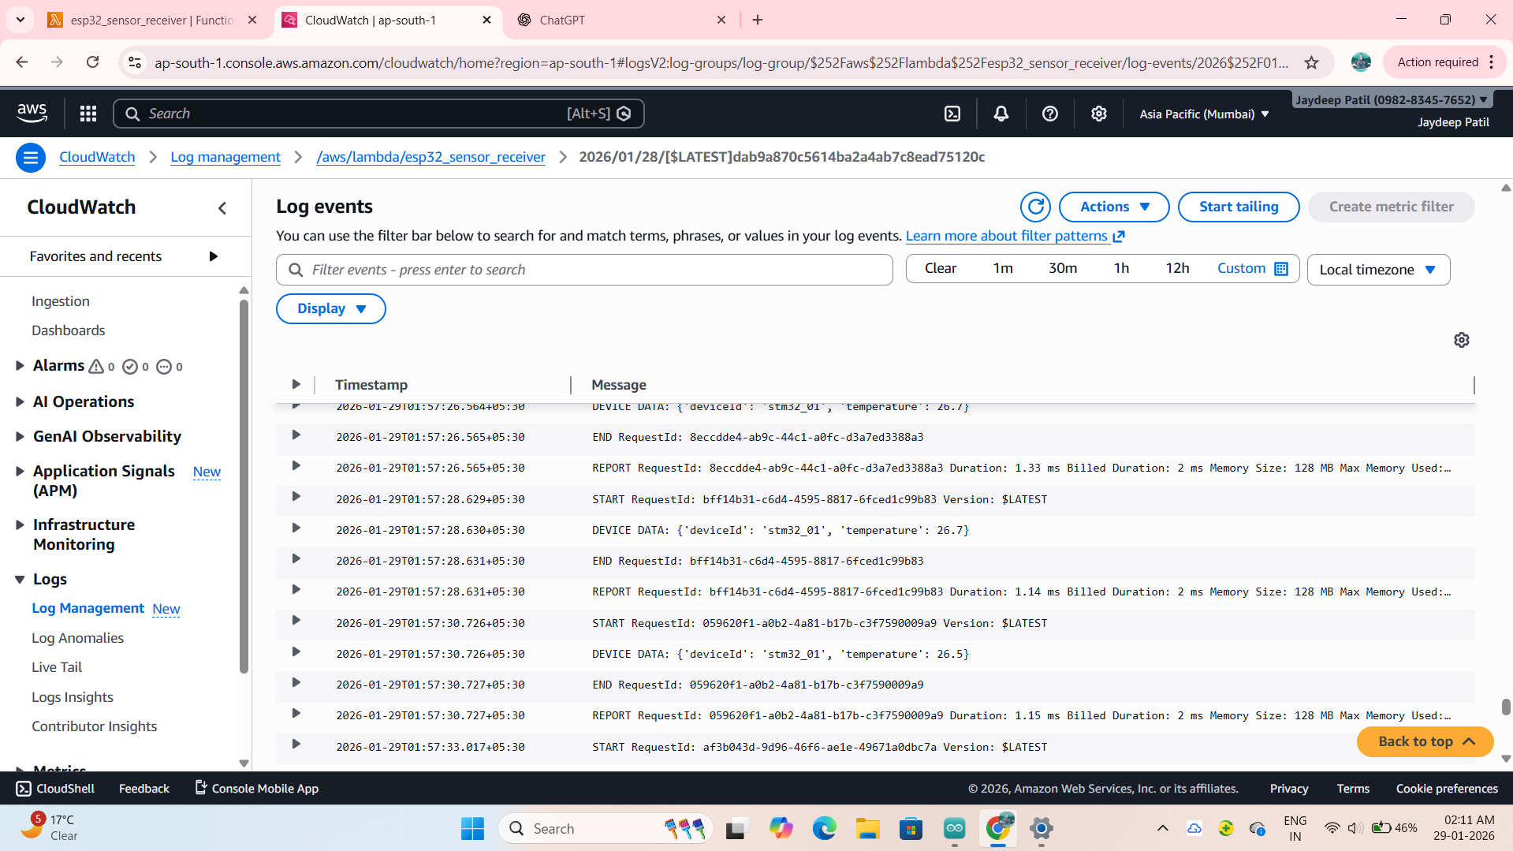
CloudWatch logs:

Slide 17
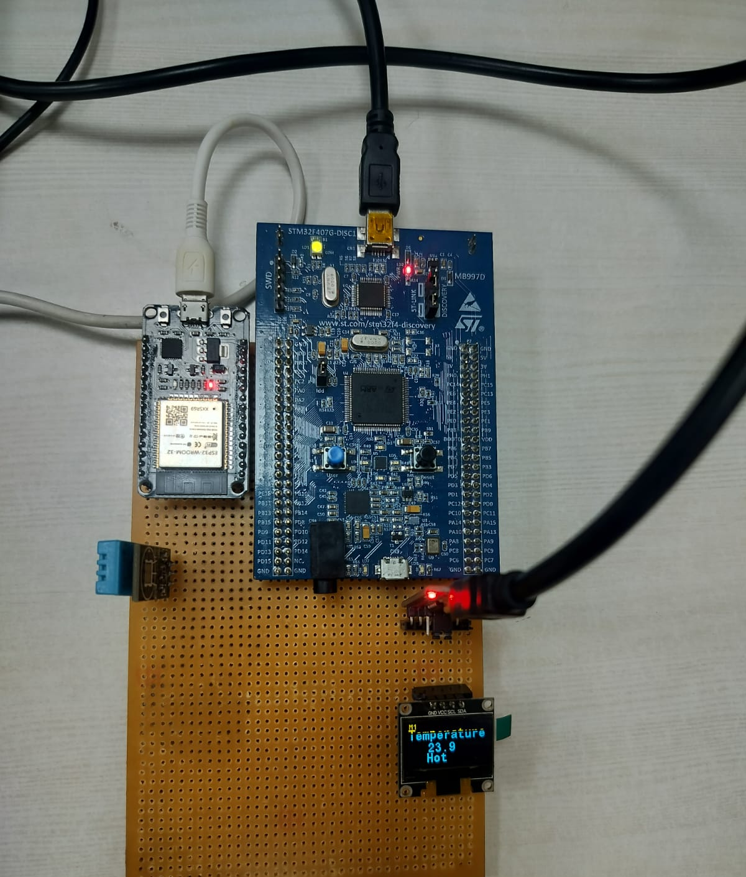
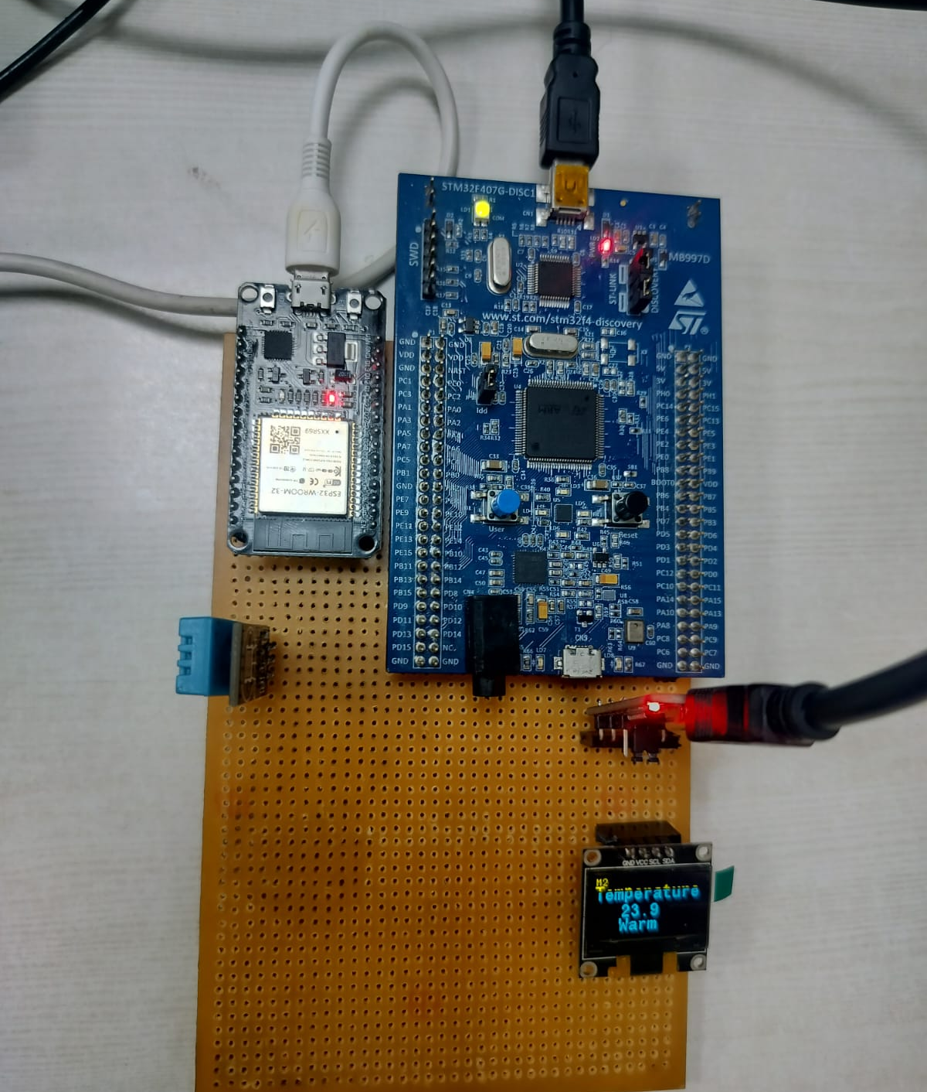
Results
MODEL 1
MODEL 2

Slide 18
Future Scope
OTA firmware update for model swapping using built-in cloud support
  Need to implement ability to receive data on STM32F407VGT6 from ESP32 Dev Module.
  Needs ability for erasing and writing to flash memory of STM32F407
  Needs the ability to verify the received firmware
  ESP32 Dev Module needs to be able to receive binary file from the cloud

Slide 19
Thank You !!!

