Slide 1

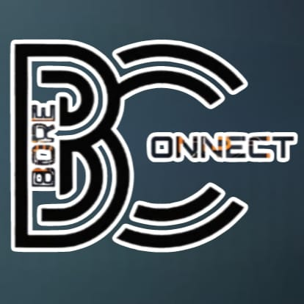

Slide 2
WHO’S WHO
Product manager:PAVANI
Developer & Tester:TEJAS
Product owner: LIKHITA
UI/UX designer:SANIA

Slide 3
The BoreConnect
“Tcp tunnel that exposes local port to a remote server”

Slide 4
ABOUT BORECONNECT
BoreConnect is a SaaS web tool which acts as a proxy between two devices, yet user-friendly solution for setting up and managing TCP and
HTTP proxies also a solution for creating secure tunnels to localhost, making it easier for developers to expose their local development servers to the internet, allowing them to bypass network restrictions, file sharing and establish communication channels.

Slide 5
Constraints
What problem are we solving?
What makes our project unique or innovative?

Slide 6
THE LOGO

Slide 7
WIREFRAME

Slide 8
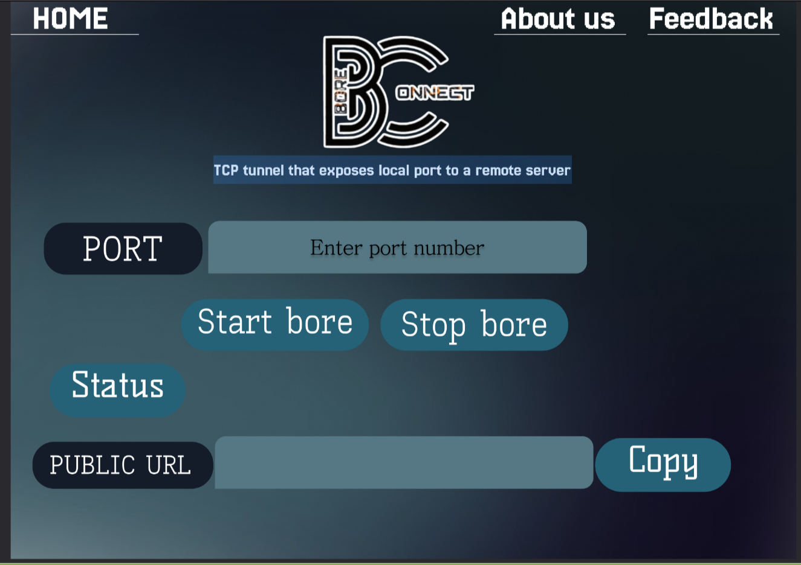

Slide 9
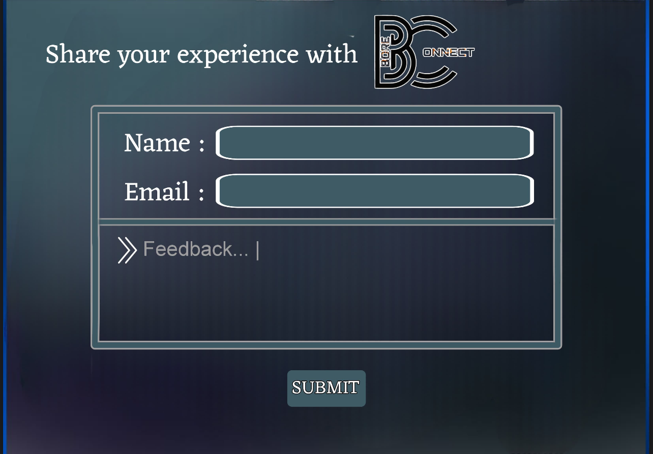
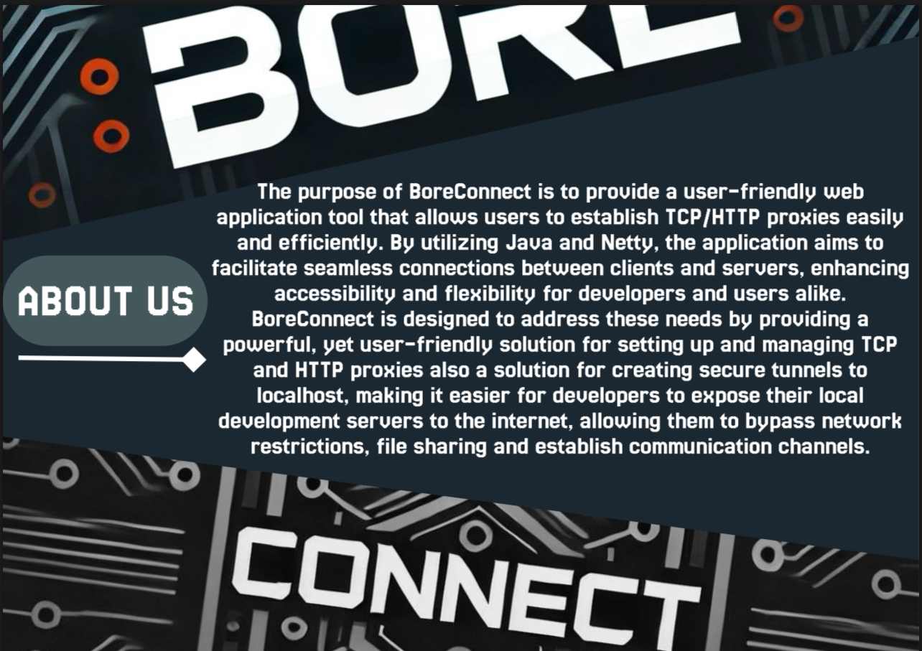

Slide 11
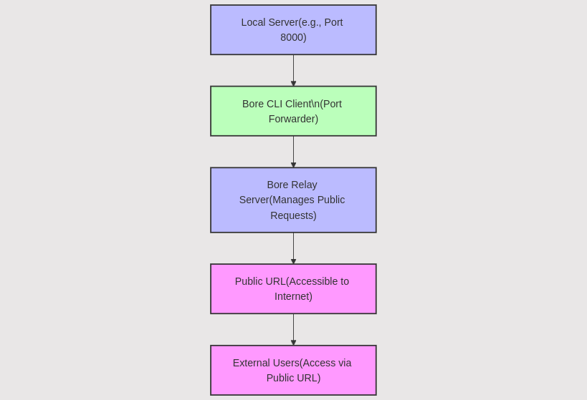
Project structure and Tech Stack
Build Tool: Gradle
Programming Language: Java
Framework: Spring Boot
Testing Tools: JUnit
UI Design: Figma
UI/UX Development: Markup languages(HTML/CSS)
under MIT LICENCE

Slide 12
HOW IT WORKS

Slide 13
What’s the potential impact of our project?

Slide 14
PRODUCT OWNER
LIKHITA L:
PRODUCT MANAGER:
PAVANI RAO V
DEVELOPER AND TESTER:
TEJAS SADASHIV JONDHALE
UI/UX DESIGNER:
M SANIA MEHEK
THANK YOU

