Slide 1

RESUME WRITING

Slide 2
What is a Resume
The answer to “What can you do for me?”
Highlights the relevant facts about you, your education, and your experience.
Makes the first impression about you.
Positions you in the mind of the employer, thus creating a value.
The interview gets you the job, the resume gets you the interview!

Slide 3
What Will a Resume Do For Me?
Helps organize your thoughts.
Enable you to assess your strengths, skills, abilities and experience - thereby preparing you for the interview process
Act as a reminder of you to the employer/interviewer after you're done interviewing
Be a basis for the interviewer to justify your hiring

Slide 4
A Resume is NOT a CV
A CV is used in academic and research-oriented job searches.
A CV is of flexible length.
A CV is a record of your academic accomplishments and credentials.
A resume is used in business, government and other types of job searches.
1 page, 2 pages max.
Should be targeted to a particular job in a particular field.

Slide 5

Research
Know Yourself
    Current Values, Interests, Skills,
      Personality Traits and Personal Priorities.
    Goal Setting.
Explore Career Opportunities
    Matching goals, transferable skills, and personal needs to a career path.
A list of potential employers.
Job descriptions from past positions.

Slide 6
Research
What kind of skills and experience required?
What can you say that demonstrates that you have made some effort to learn about the company?
What can you tell them about the contribution you are qualified to make?

Slide 7

Relevant, Clear and Concise.
No typing errors.
No misspellings.
No Abbreviations.
Do not tell a lie or mistruth.
Do not include any negative information.
Notes:
What are the Absolute, Unbreakable Rules of Resume Writing?
There are only a few absolute rules in resume writing! Almost every rule you have ever heard can be broken, if you have a compelling reason.
These rules, however, are absolutes:
No typing errors.
No misspellings.
Do not tell a lie or mistruth.
Do not include any negative information.

Slide 8

Should I Have More Than One Version of My Resume?
YES!
Create a targeted resume each time you
apply for an opportunity.
Develop a 'generic' resume to use in
online databases.

Slide 9
Use Action Verbs!
Organized Communicated Directed
Planned Created Assisted
Supported Initiated Solved
Reported Edited Analyzed
Described Developed Managed
Led Sold Designed

Slide 10

Critical Categories
Put in everything that would point out why you would be good at the job.

Slide 11
Summary
Is a concise section about what you have to offer to a prospective employer in terms of Experience, Skills, Results, Interests or you job Objective.
Example: “Fourteen years of marketing experience, proven ability in building brands.”

Slide 12
Examples
Professional musician and drama coach capable of staging plays and skits with experience producing twenty school plays.
Elementary school teacher and supervisor of student interns training colleagues in combining technology and teaching.
History and English major covering and instructing 25-30 students annually in all subjects raising their reading and math achievements by one grade level.

Slide 13

Contact Information
Name (largest font)
Address, City, PIN Code and State (spell out state)
Telephone Number
Cell Number
Email Address

Slide 14


Example
DEEPA SHANKAR 409-b, Cross Road South Extn-I New Delhi-11 Mob: 09995595959 deepas@yahoo.com | Rajesh Krishnan 580 Church Road Phone: 022-2354698 Worli, Bombay-400069 Mob: 09747123333 krish_raj@sbcglobal.net
Deepa shankar 409-b, cross Road, South Extn-I New-Delhi-11 Mob: 09995595959 | Rajesh Krishnan 580 Church Road Phone: 022-2354698 Worli, Bombay-69 Mob: 09747123333 2hotforyou@rediffmail.com

Slide 15
The Career Objective
Keep it short.
Example: “To obtain a position as an Administrative Assistant in a hospital setting.”
Remember, it is NOT essential to write a Career Objective
However, if you do write it, be absolutely clear about what you say and what you mean by it
Do not use fancy words nor write things unconnected with the job for which you are applying - For example if you are applying for a Faculty position, do no write “To reach the top level in a corporate setting”

Slide 16
Employment History
Reverse chronological order.
Divide the Relevant Experience with Work History.
Five Components:
  Job Title
  Name of Employer
  Location
  Dates of employment
  Description
Exclude
    Unaccountable gaps.
    Street address, supervisors’ names, telephone number or reason for leaving.

Slide 17
Education
List most recent education first.
Mention date of completion and University/College name.
Percentage only if I class.
Academic honours.
Don’t include High School (unless this is your highest level of education).

Slide 18
Relevant Coursework
(Optional)
This is for new graduates or current students.
This lets the employer know which courses you have already completed.
Do not list every course, only major courses or courses relevant to specific skills.

Slide 19
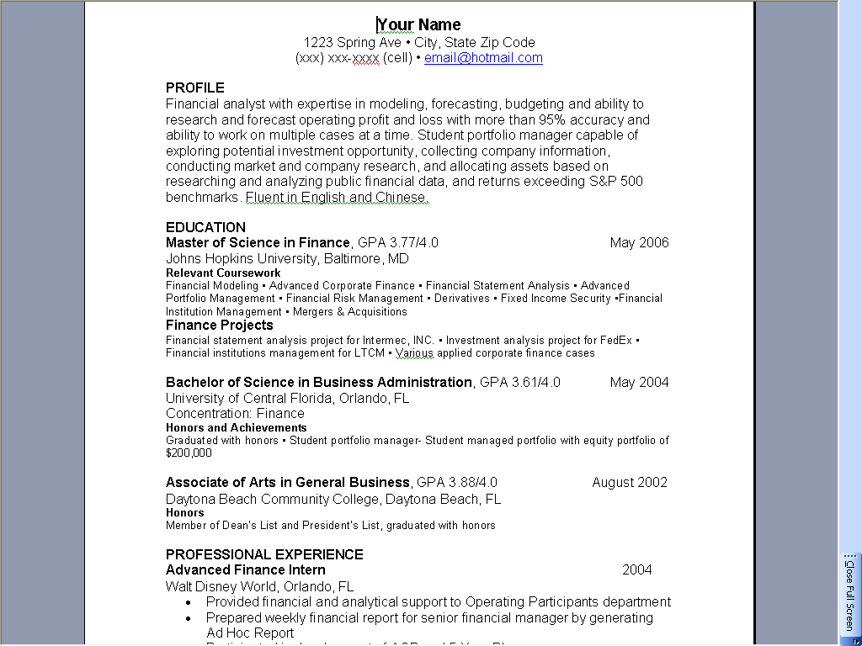
Example

Slide 20

Activities and Honors
Only if relevant to job.
  Mention scholarships, memberships etc.
  Community work, volunteer work etc.
Don’t include anything from before college.
Avoid controversial topics such as Politics, Religion etc.
For Freshers, you may mention extra-curricular activities, which would highlight your suitability to the job.

Slide 21
Significant Personal Facts
Technological Skills.
Foreign Languages
Special Skills if any

Slide 22



Hobbies and Interests
Don’t list unless
  Organized, that is, if you belong to a club or group
  Relevant to the position

Slide 23
References
Must come as a separate document using the same header on resume.
Do not send to employer unless they request it.
Between 3-5 references,
  All individuals with direct knowledge of your job abilities.
  Or a professor of main subjects.
Ask the permission of references before giving their names and numbers.

Slide 24
Do’s of Resume Writing
1 to 2 page.
Write in telegraphic style - without verbs, articles or connectives.
10 -12 font size.
Times New Roman, Arial, Bookman, Trebuchet, Lucida Sans, Garamond, Verdana etc.
Be consistent with fonts/size/bold/italics etc.
Spread out information.
Indented or bulleted statements.
Bolding, different size fonts.
Your name should be largest font on page.
Write in third person.

Slide 25
Avoid
Height, weight, place of birth, marital status, race, caste, religion and health.
Fancy Fonts, Clip art or non-traditional paper.
Don’t go for bordered paper.
Don’t fold resume, don’t stuff into envelope, don’t crumple.
The word "Resume" at the top!
Avoid Details of Travels.
Any statement that begins with "I" or "My"
Reasons for leaving previous job(s).
Picture of yourself.
Salary Information.
References.
Religious or political affiliations.

Slide 26

The Final Test
Does your resume answer these questions:
    Does it clearly and quickly communicate to employer that you can do the job?
    Do your strengths come across?
    Does everything support the job you are targeting?
    Should anything be removed?
    Does it really sell your skills?

Slide 27


Slide 28


