Slide 1




presents
team details:
datathon
2.0
Where Data Science transforms Ideas into impact
Tej Bachhav Tejas Parekh

Slide 2
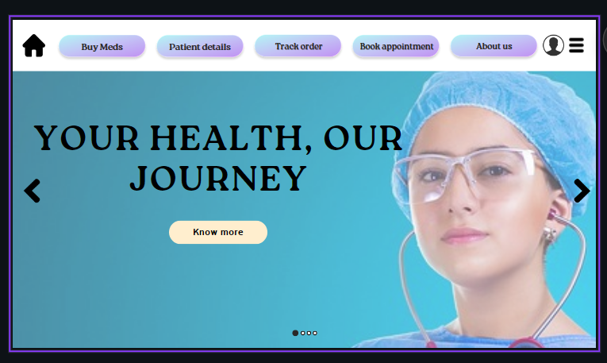

Healthcare +
Healthcare plus is a website interface, made for solving the all the problems that is faced by patients

Slide 3
Website interface
Easy to use interface
Symptoms prediction
Medicine buying option
Easy appointment booking
Reminders and scheduling

Slide 4
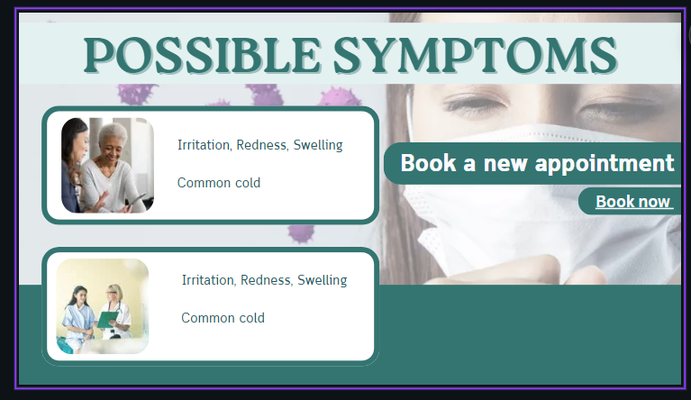
Symptoms prediction

Slide 5
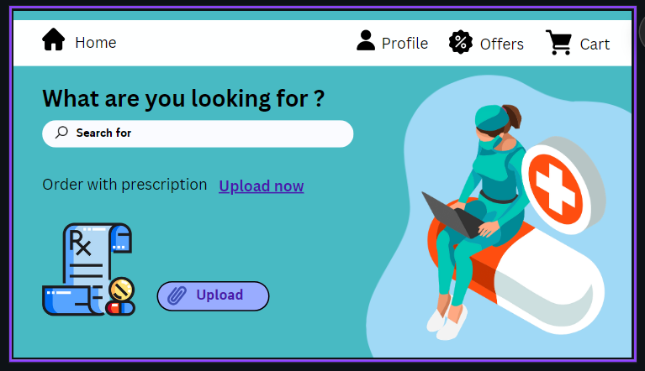
Medicine buying option

Slide 6
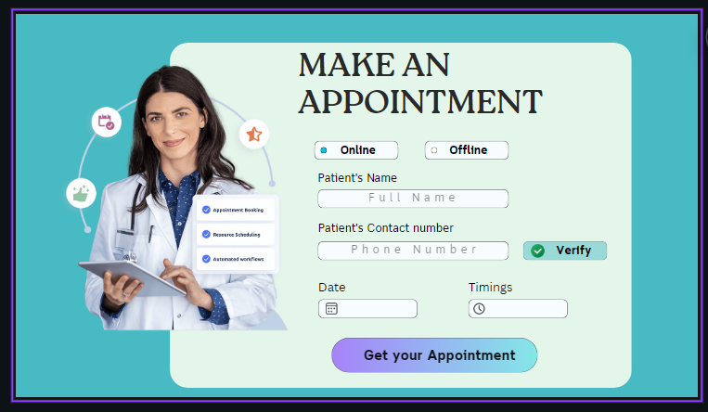
Easy appointment booking

Slide 7
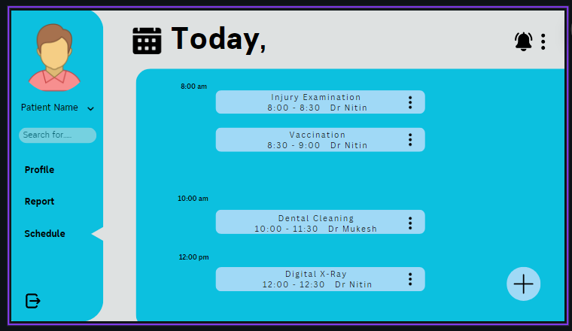
Reminders and scheduling

Slide 8
CODE:
This project is website interface and backend code for an online healthcare management app and this contains many features like identifying the diseases from symptoms and also suggests appropriate medication for the same. Next you get another opion that is it also suggests doctors accordingly and also helps in booking an appointment with the doctor as well as helps in performing transactions. if you think an appointment is unnecessary then it also helps in ordering the required medicine to your doorstep

Slide 9
Thankyou

