Slide 1
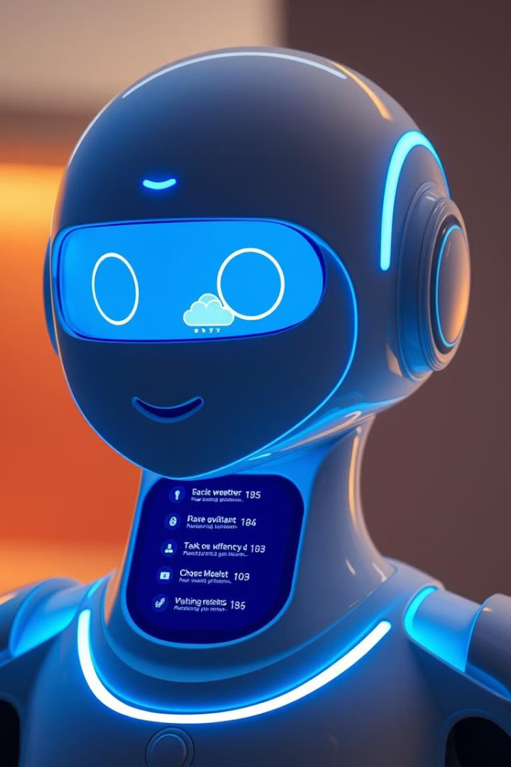
Virtual Assistant using Python
Welcome to our presentation on the development of a virtual assistant using Python. This assistant is designed to streamline daily tasks and enhance productivity using voice commands. TEAM MEMEBERS: 2200049136 2200040008 2200040003 2200049127

Slide 2
Introduction
This virtual assistant is designed to be a personalized AI assistant for daily tasks. We aim to create an intuitive and user-friendly experience.
What is it?
How does it work?
A virtual assistant using Python to perform tasks like web search, system control, weather updates, and jokes using voice commands.
The assistant listens to your commands, processes them using natural language processing, executes the task, and responds with spoken output.

Slide 3


Technologies Used
We have utilized a combination of robust technologies to bring this virtual assistant to life.
1
1. Speech Recognition
2
2. Natural Language Processing (NLP)
The assistant uses libraries like SpeechRecognition to convert spoken commands into text.
NLP libraries like NLTK and spaCy help interpret the meaning behind the commands and understand context.
3
3. Text-to-Speech
The assistant uses libraries like pyttsx3 to convert text responses back into audible speech for user feedback.

Slide 4

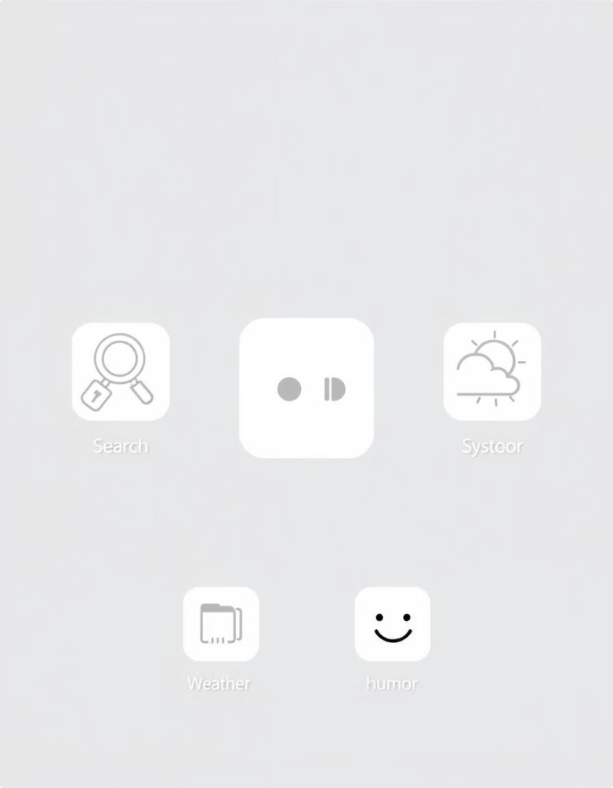
Key Functionalities
The virtual assistant is packed with a range of features, offering versatile functionality to enhance your day.
Web Search
System Control
Search the web using voice commands for quick and easy information retrieval.
Control your computer using voice commands, like opening programs or adjusting volume.
Weather Updates
Jokes and Entertainment
Get up-to-date weather information for your location with just a voice request.
Enjoy a light-hearted moment with the assistant's ability to tell jokes and provide other forms of entertainment.

Slide 5
Flowchart
Here is a visual representation of the step-by-step process the virtual assistant follows to understand and execute your commands.
User speaks a command.
1
2
The command is converted to text using speech recognition.
The text is processed using NLP to identify the intended task.
3
4
The virtual assistant executes the specified task.
The result is converted to spoken output using text-to-speech.
5
6
The assistant provides audio feedback to the user.

Slide 6
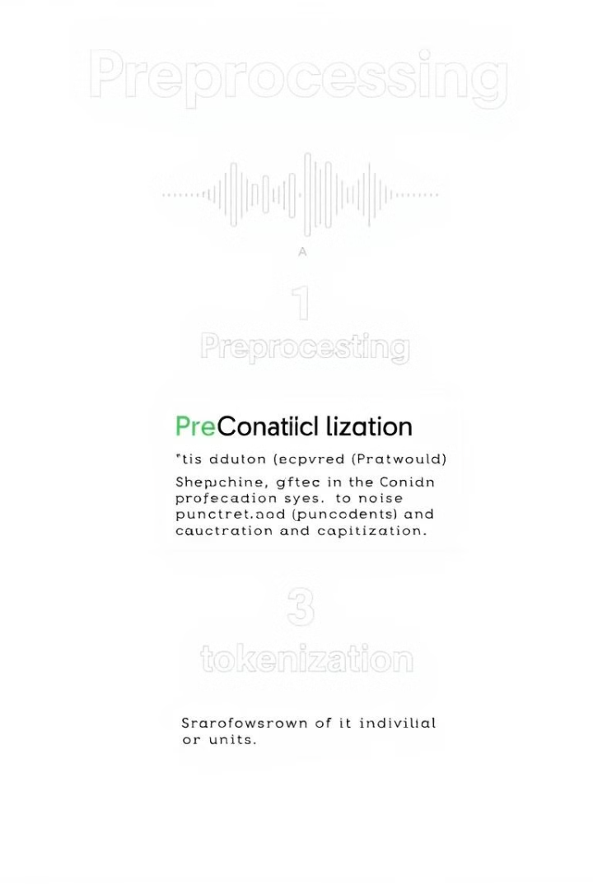



Preprocessing Steps
Before the virtual assistant can understand your commands, we perform preprocessing steps to prepare the data.
1. Noise Reduction
Remove any background noise from the recorded audio to improve the accuracy of speech recognition.
2. Punctuation and Capitalization
Add appropriate punctuation and capitalization to the transcribed text for improved NLP analysis.
3. Tokenization
Break down the text into individual words or tokens for easier processing and analysis.

Slide 7





Code Structure
The virtual assistant is organized into a modular code structure for maintainability and scalability.
1
Main Function
2
Speech Recognition
Handles audio input and converts it to text.
3
NLP Processing
Analyzes the text and identifies the intended task.
4
Task Execution
Executes the identified task based on the user's command.
5
Text-to-Speech
Converts the output of the task into spoken feedback.

Slide 8

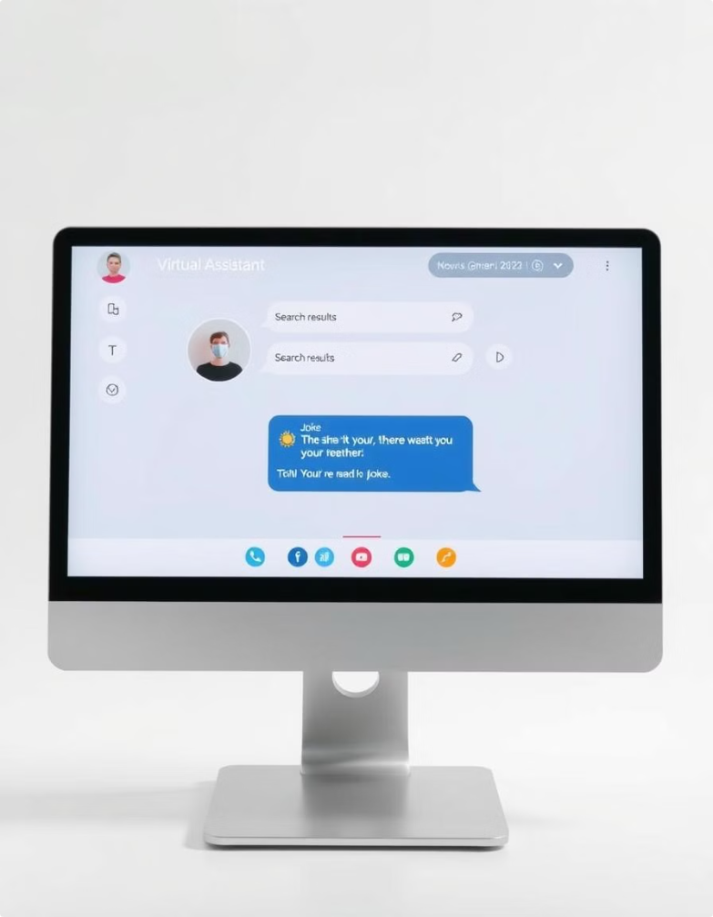
Features Demonstration
Let's see the virtual assistant in action! We will demonstrate some of its key functionalities to showcase its capabilities.
1
2
Web Search
Weather Updates
Let's see a quick web search for "latest news."
Requesting the current weather in New York City.
3
4
System Control
Jokes
Attempting to open the calculator application.
Let's see what kind of jokes the assistant can tell.

Slide 9

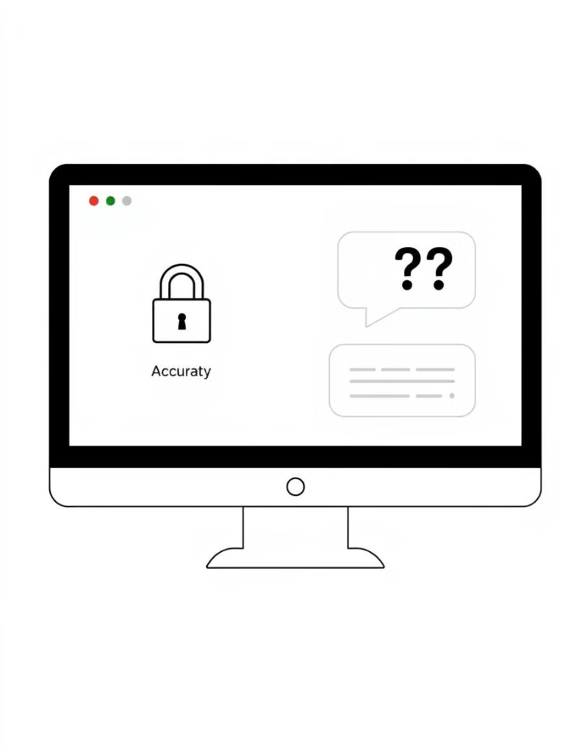



Challenges and Limitations
While we've made significant progress, there are still some challenges and limitations to address.
Accuracy
Speech recognition and NLP can struggle with accents, background noise, and complex language.
Security
Protecting user privacy and data security is crucial, especially when handling sensitive information.
Contextual Understanding
The assistant needs to improve its ability to understand complex conversations and context.

Slide 10
FUTURE ENHANCEMENT One future enhancement to consider is integrating the virtual assistant with smart home devices, allowing users to control their lights, thermostat, and other connected devices through voice commands. Additionally, exploring the possibility of incorporating AI-driven personalization to make the assistant more tailored to individual users' preferences and needs could greatly enhance the user experience. Lastly, integrating the assistant with popular messaging platforms or social media platforms could further extend its usefulness and accessibility to users.

Slide 11
APPLICATIONS
Another potential application for the virtual assistant is in the healthcare industry. By integrating with electronic health records systems and medical databases, the assistant could provide patients with personalized health information and reminders for medication schedules. Additionally, the assistant could be used in customer service settings to provide quick and efficient responses to frequently asked questions, improving customer satisfaction and reducing call wait times.
The virtual assistant could also be utilized in the education sector to provide personalized learning experiences for students. By analyzing individual learning styles and preferences, the assistant could recommend relevant educational resources and tailor instructional materials to each student's needs. Furthermore, the assistant could assist teachers in managing administrative tasks such as grading and scheduling, allowing them to focus more on instructional activities and student engagement.

Slide 12

CONCLUSION
In conclusion, the potential applications for virtual assistants are vast and not limited to just healthcare and education. They could also be used in other industries such as finance, where they can help customers with banking transactions and provide personalized financial advice. Moreover, virtual assistants can be integrated into smart homes, allowing individuals to control various devices and perform tasks through voice commands, making daily life more convenient and efficient.

Slide 13
REFERNCES:
Python Documentation: https://www.python.org/doc/
Speech Recognition Library: https://pypi.org/project/SpeechRecognition/
OpenWeatherMap API: https://openweathermap.org/
NewsAPI: https://newsapi.org/

Slide 14

THANK YOU
We appreciate your interest in our virtual assistant project. Thank you for your valuable time and feedback.

Slide 15

ANY QUERIES
This section addresses any questions you may have about the virtual assistant project.

