Slide 1

CAR PRICE PREDICTION PROJECT
BY: TEJENDRA SONI

Slide 2
OBJECTIVE:
Firstly, scraping the data from olx website of 5000 used cars from different locations
Secondly, building a machine learning model for our client
They are looking for new machine learning models from new data. We must make car price valuation model.

Slide 3
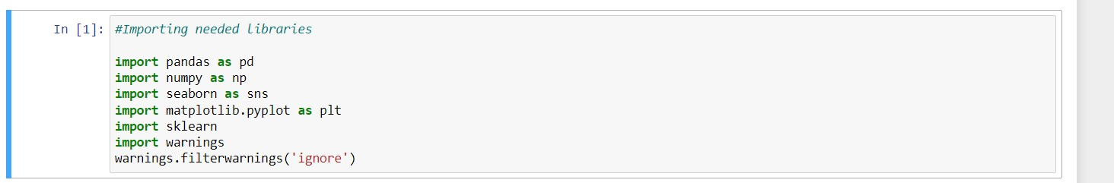
IMPORTING REQUIRED LIBRARIES AND DATABASE:

Slide 4
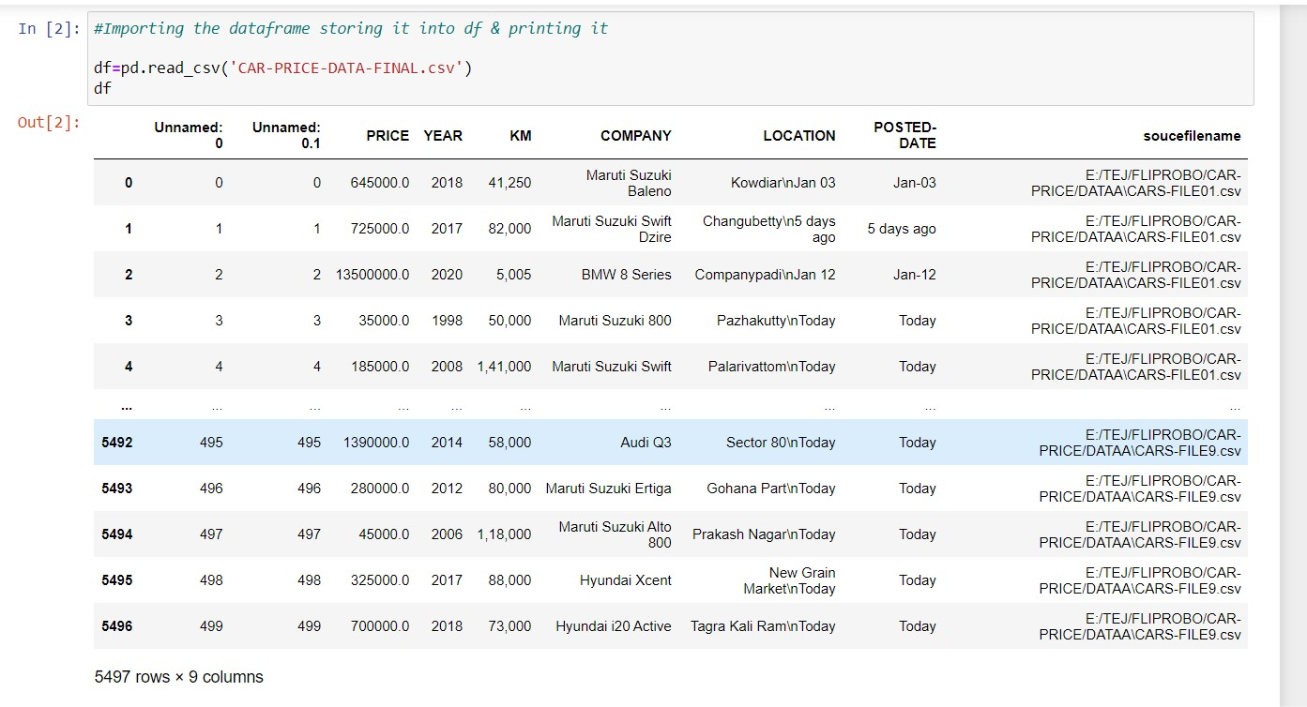
Our dataset has 5497 rows and 9 columns.

Slide 5
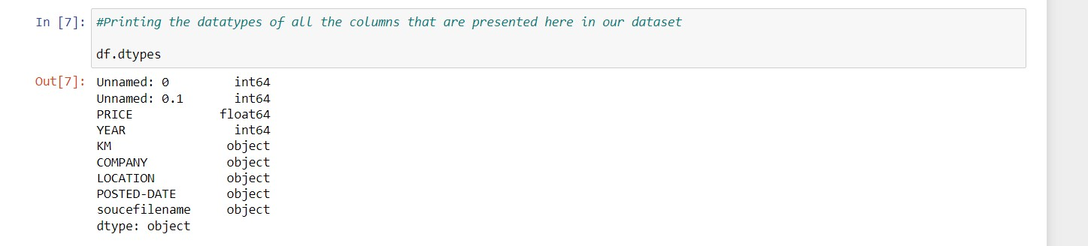
Also we can drop column Unnamed: 0 & Unnamed: 0.1 as it contains serial number only.
After dropping the columns we don’t need we can also see that there are only 2 columns are of integer type i.e. PRICE & YEAR

Slide 6
VISUALIZATIONS:

Slide 7
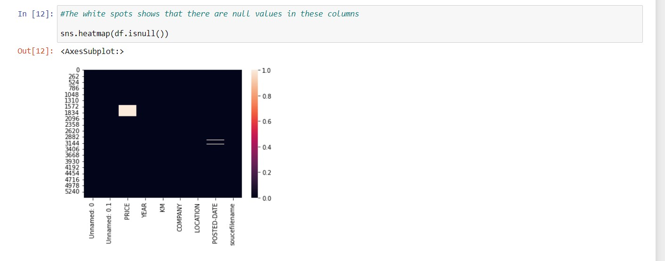
There are some null values present in our dataset showing it with the help of seaborn library & with the heatmap
All the white spots that you can see in the plot are null values shown here

Slide 8
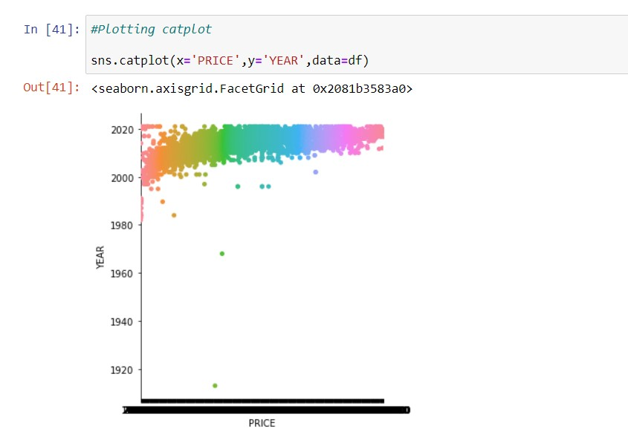
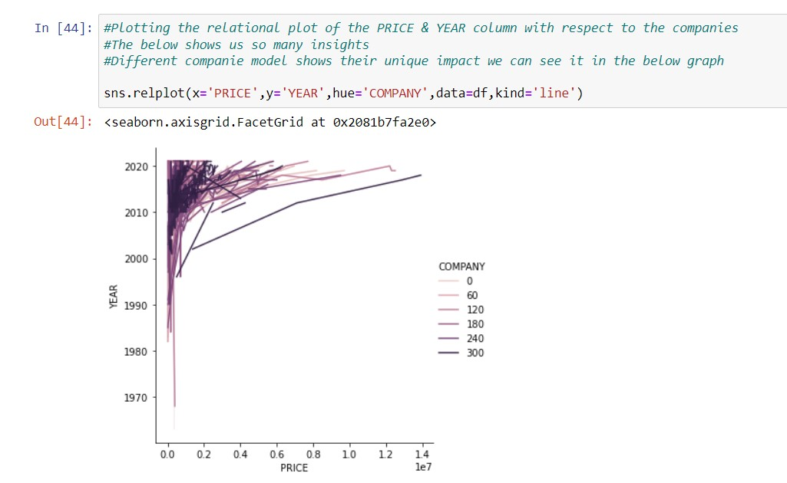
The categorical plot stats that PRICE & YEAR are in positive relationship we can here see as the year increases the Price of the cars are also increases
As a used car with low runner KM & latest as per MANUFACT-YEAR the PRICE is also increased for that
Here we have set hue=company means the plot will work with respect to company

Slide 9
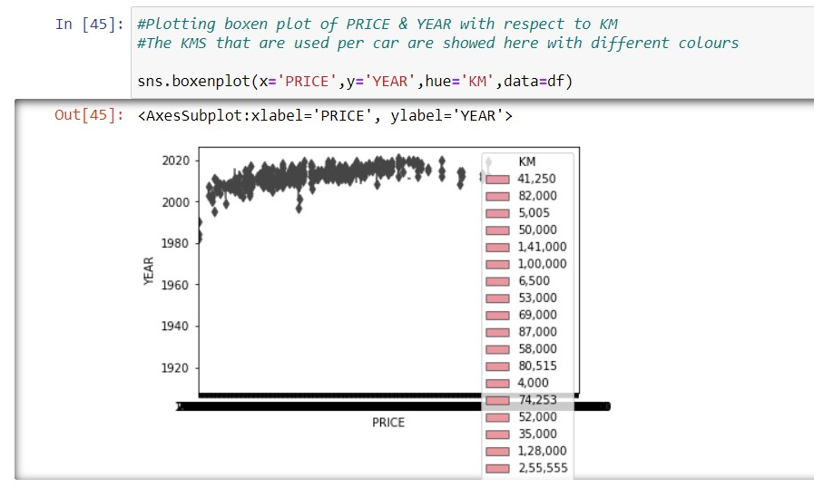
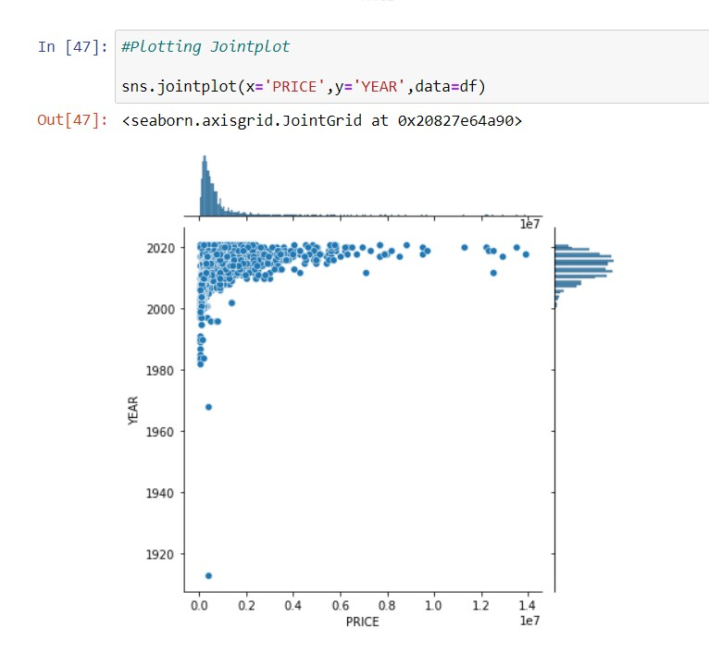
With respect to KMS also we are here plotting the boxenplot
Different lines are representing the KM runner by the cars
Plotting the joint plot of the variables

Slide 10
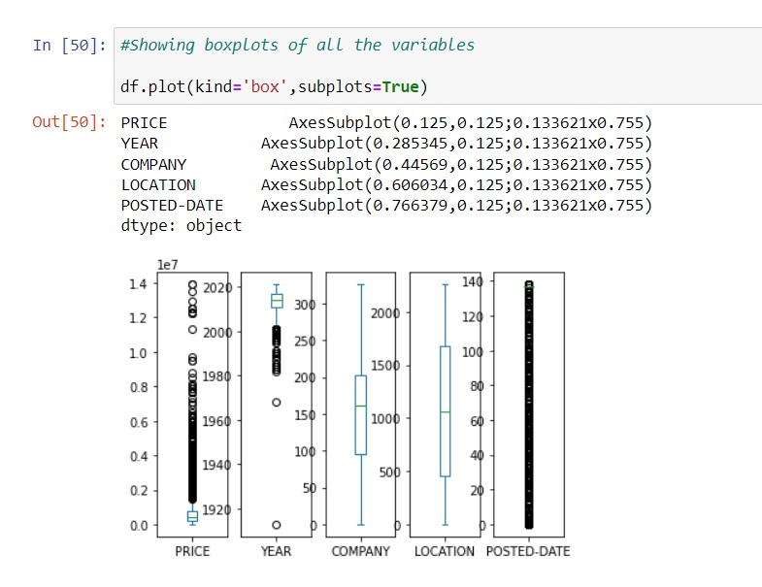
OUTLIERS:
We can see outliers in many columns, We will check them & will definitely remove them

Slide 11
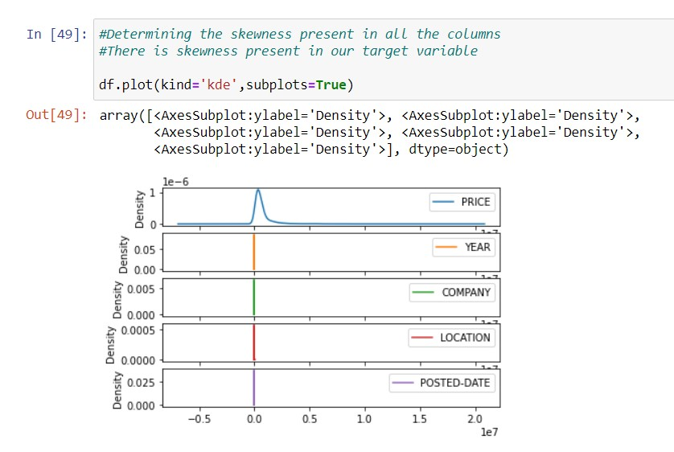
LET’S CHECK THE SKEWNESS WITH THE HELP OF DISTRIBUTION PLOT
As we can clearly see there is some skewness
present in PRICE
Also, in other columns as well

Slide 12

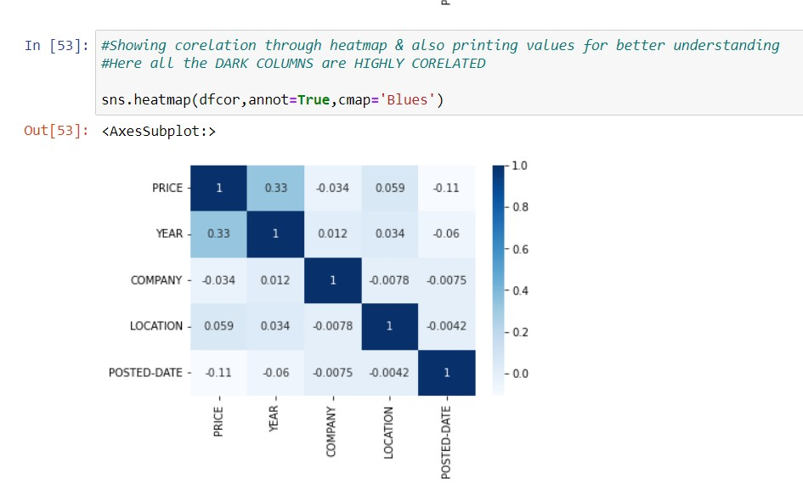
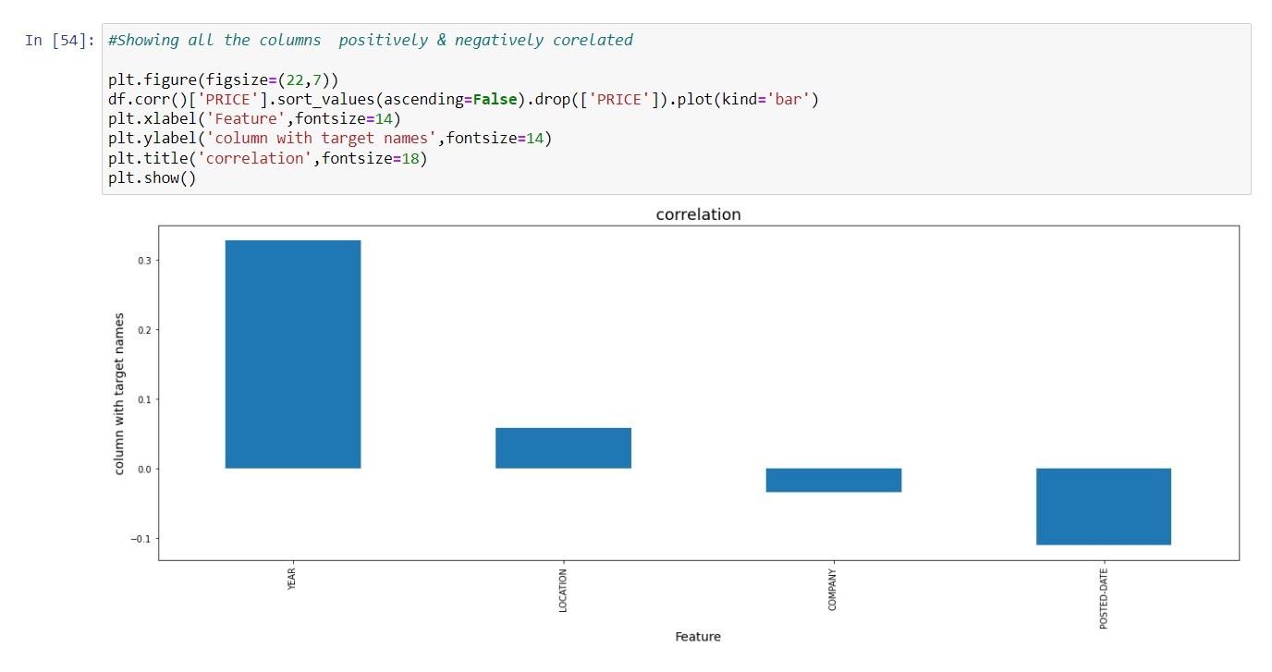
LET’S CHECK THE CORRELATION WITH THE HELP OF HEAT MAP:
All the dark blue shades show in the heatmap
Are highly co-related to each other
Only POSTED-DATE column is negatively corelated
We can see clearly in the above graph

Slide 13
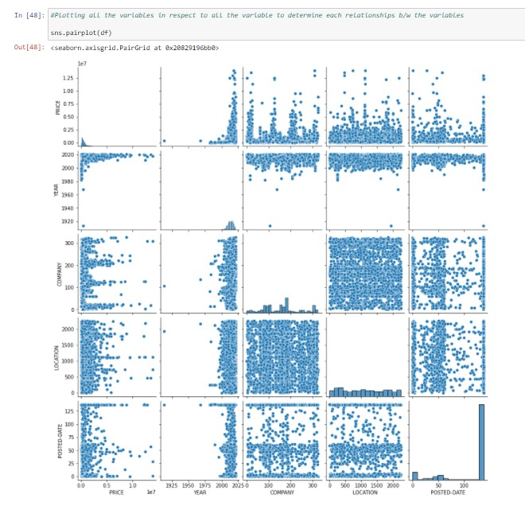
PLOTTING PAIRPLOT:

Slide 14
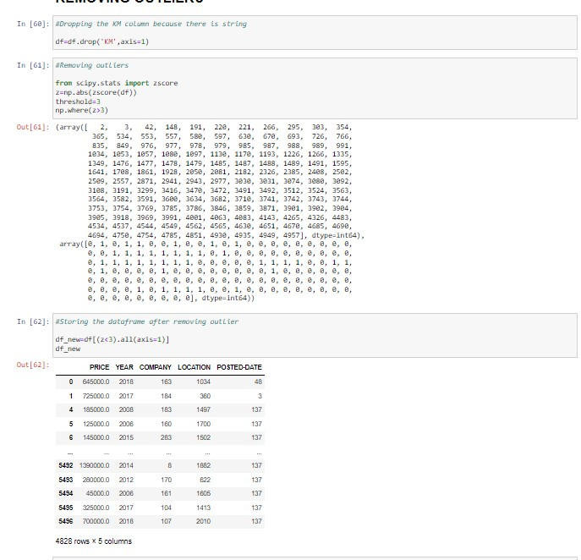
OUTLIERS TREATEMENT
Removing outliers using z-score technique
Saving the cleaned data into the new data frame
As we can see the shape has also changed to 4282 rows
& 5 columns

Slide 15
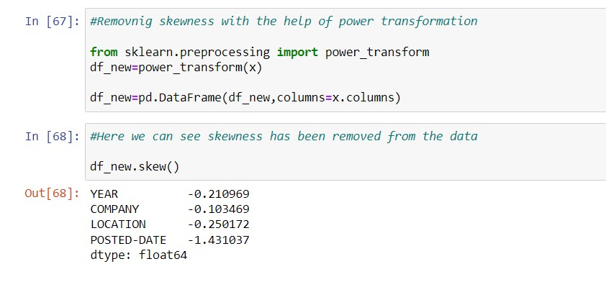
REMOVING SKEWNESS WITH POWER TRANSFORMATION
We have removed the skewness
To the maximum extent we can

Slide 16
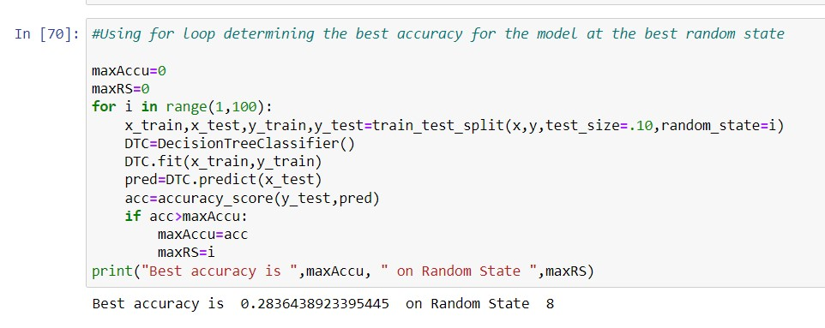
FINDING BEST RANDOM STATE:

Slide 17
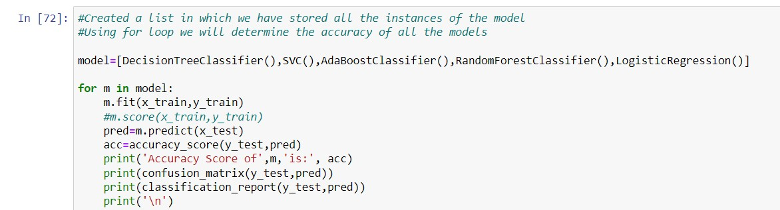
MODEL/S DEVELOPMENT AND EVALUATION:

Slide 18
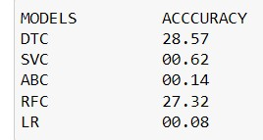
MODEL SELECTION
Here in the table, we can see that DTC model is giving
Highest accuracy among all the different present models
So, we select the DTC best for our model
But before proceeding further we will cross validate
Each of the models so that we can finally select which model
Will be the best for our dataset

Slide 19
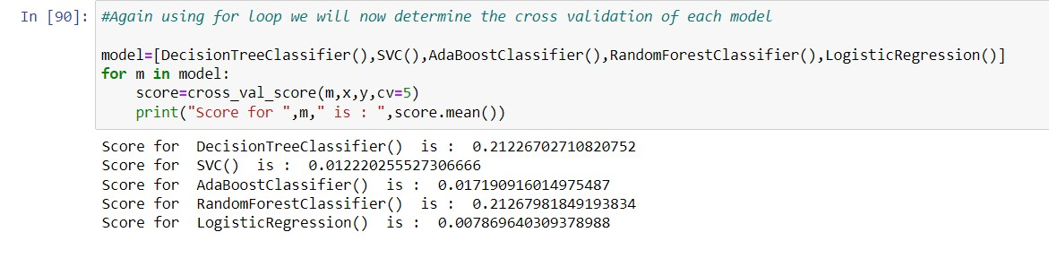
CROSS VALIDATION
After determining the cross-validation scores of the models we will now select RFC as our model
Because the RFC model shows the least difference in all the models

Slide 20
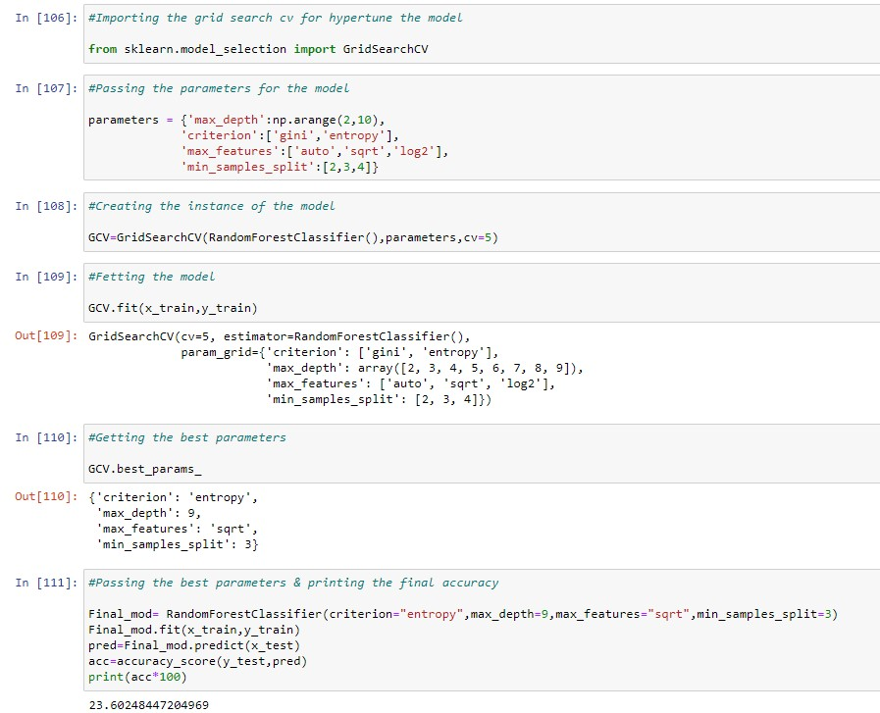
HYPER PARAMETER TUNNING:
Tunning our model to get the best accuracy of the model

Slide 21
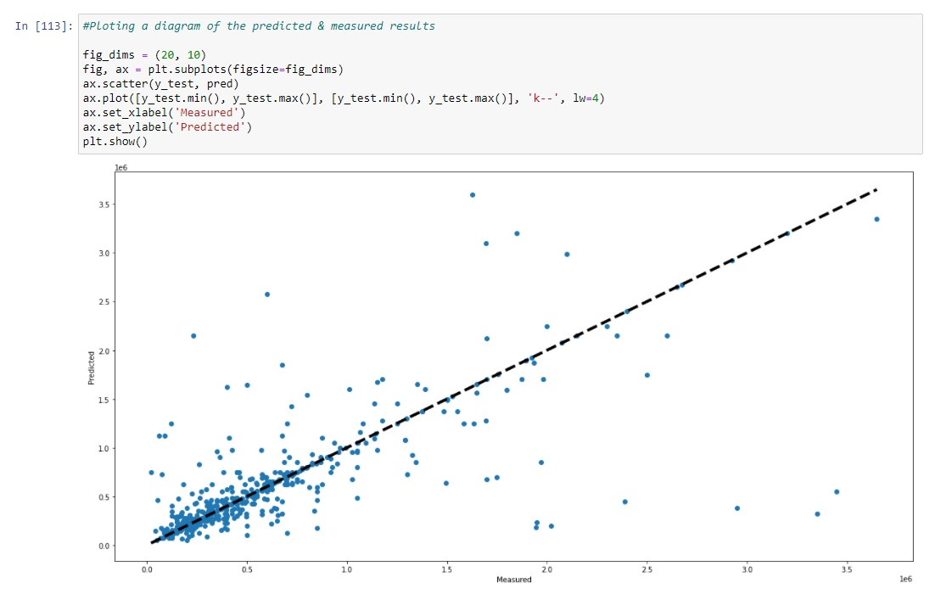
PLOTTING A GRAPH STATING THE PREDICTED & MEASURED RESULTS
The line that tries to cover the
Blues Points that is our predicted
Line Which tries to get mix with
the Measured results

Slide 22
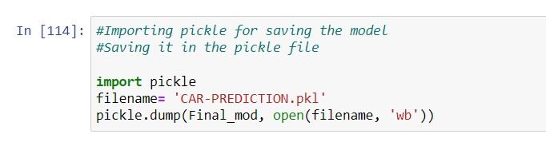
SAVING THE MODEL:
Saving the model with the help of pickle library

Slide 23
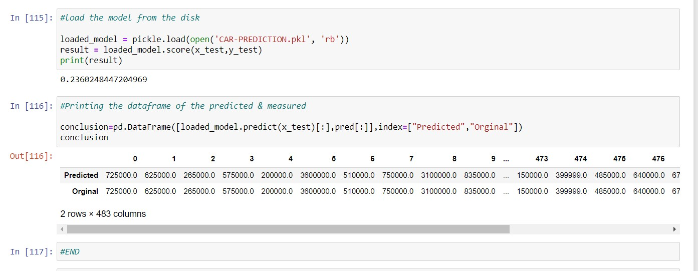
CONCLUSION
Also, making a data frame of predicted answers & measured answers & printing it

Slide 24
THANK YOU

