Slide 1
Usability Analysis of Websites with the Help of GenAI
Hackathon
2023
</
} /> [
/>
LISP Enthusiasts

Slide 2

</ Why?
Enhanced User Experience​
provide insights to improve website design and functionality
​more intuitive and user-friendly interface​
Students of Intelligent Systems​
interested in AI​
python>

Slide 3
</ Common UX Problems​
Poor navigation
Slow load times
Unresponsive design
Obsolete elements
Low contrast
} /> [
/>

Slide 4



</ Used Technologies
/> **
} /> [
Generative AI
Prompt Engineering

Slide 5
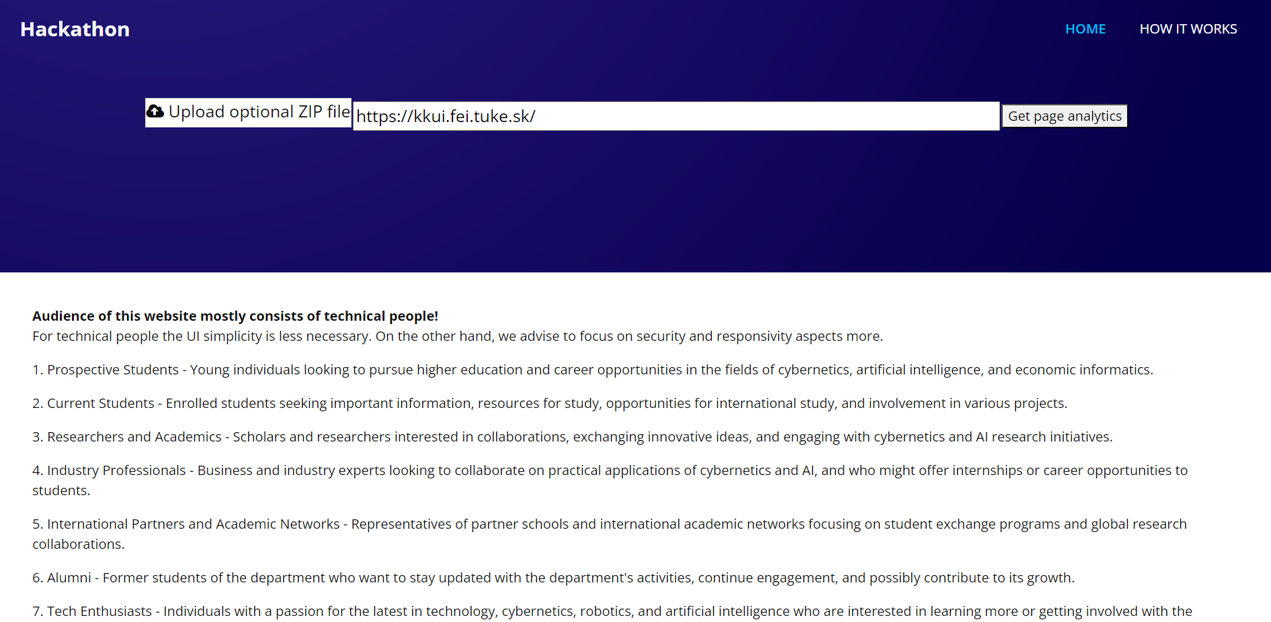

Slide 6
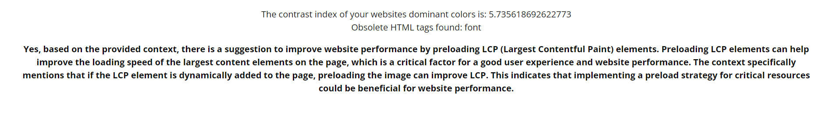

Slide 7
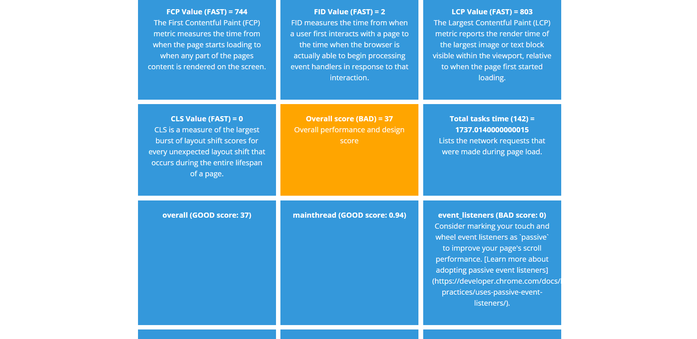

Slide 8
</ Future Plans
Automatic HTML Correction
More Personas
Cloud Integration
More Statistics
Possible paid service for automatic HTML correction (currently only statistics and comments) ​
Option for more personas categorization
Cloud integration (as paid service) - easy integration with Google
Ability to add more statistics

Slide 9
Thanks!
Hackathon
2023
</
} /> [
Do you have any questions?
/>

