Slide 1
Bits, Bytes, and Integers
Introduction to Computer Systems
2nd Lecture, Sep 10, 2026

Slide 2



Slide 3
1. The same bits can mean different values
2. Arithmetic operation discards overflowed bits
3. Eventually, bits live in memory → Endianness.

Slide 4
Today: Bits, Bytes, and Integers
Representing information as bits
Bit-level manipulations
Integers
  Representation: unsigned and signed
  Conversion, casting
  Expanding, truncating
  Addition, negation, multiplication, shifting
  Summary
Representations in memory, pointers, strings

Slide 5
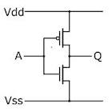
Binary Representations
Base 2 Number Representation
  Represent 4396₁₀ as 1000100101100₂
Why Computers Use Binary?
0
1
0
3.3V
2.8V
0.5V
0.0V
Binary is the most practical system to use!
Notes:
Computers weren't initially designed to use binary... rather, binary was determined to be the most practical system to use with the computers we did design.
We only use binary because we currently do not have the technology to create "switches" that can reliably hold more than two possible states. (Quantum computers aren't exactly on sale at the moment.) The binary system was chosen only because it is quite easy to distinguish the presence low/high voltage.
Different of computing and storage?? Storage can use other values.
CPU Vcore: 1.40V, even lower for some low power design, emerging technology NTC hundreds of power reudction
Bit is not the granularity, but byte is

Slide 6
Today: Bits, Bytes, and Integers
Representing information as bits
Bit-level manipulations
Integers
  Representation: unsigned and signed
  Conversion, casting
  Expanding, truncating
  Addition, negation, multiplication, shifting
  Summary
Representations in memory, pointers, strings

Slide 7
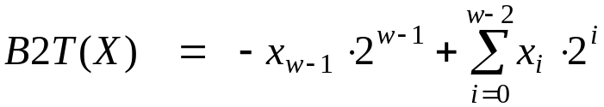
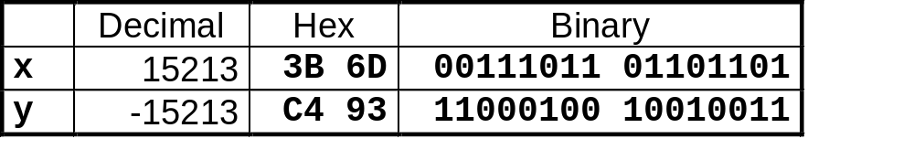
Encoding Integers
Two’s Complement
short int x = 15213;
short int y = -15213;
Sign
Bit
C short 2 bytes long
Sign Bit
  For 2’s complement, most significant bit indicates sign
    0 for nonnegative
    1 for negative
Notes:
Two’s complement

Slide 8
Two-complement: Simple Example
-16 | 8 | 4 | 2 | 1
0 | 1 | 0 | 1 | 0
10 =
8+2 = 10
-16 | 8 | 4 | 2 | 1
1 | 0 | 1 | 1 | 0
-10 =
-16+4+2 = -10

Slide 9
Negation: Complement & Increment
Claim: Following Holds for 2’s Complement
  ~x + 1 == -x
Complement
  Observation: ~x + x == 1111…111 == -1
Complete Proof?
x
1
0
0
1
1
1
0
1
+
~x
0
1
1
0
0
0
1
0
-1
1
1
1
1
1
1
1
1

Slide 10
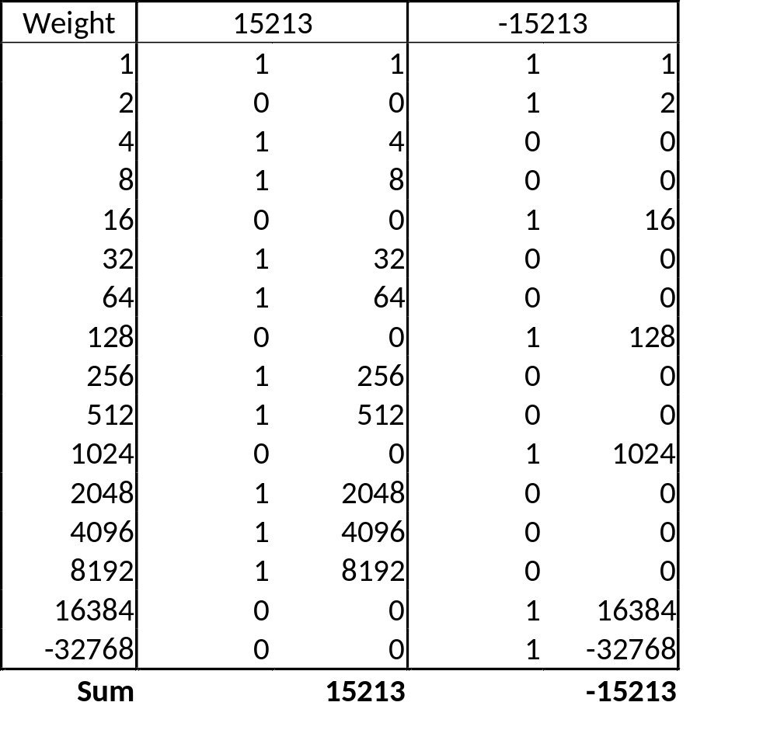
Encoding Example (Cont.)
x = 15213: 00111011 01101101
y = -15213: 11000100 10010011
Notes:
Weight is always the same !!!

Slide 11
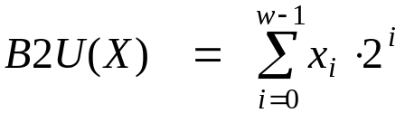
Another way to interpret binary
Unsigned
Two’s Complement
Sign
Bit

Slide 12
1. The same bits can mean different values
2. Arithmetic operation discards overflowed bits
3. Eventually, bits live in memory → Endianness.

Slide 13
Unsigned & Signed Numeric Values
X
B2U(X)
B2T(X)
0000
0
0
0001
1
1
0010
2
2
0011
3
3
0100
4
4
0101
5
5
0110
6
6
0111
7
7
1000
8
–8
1001
9
–7
1010
10
–6
1011
11
–5
1100
12
–4
1101
13
–3
1110
14
–2
1111
15
–1
Notes:
Equivalence 美[ɪ'kwɪvələns] n. 等值；相等
Uniqueness 美[jʊ'niknɪs] n. 独特性；独一无二；单值性

Slide 14
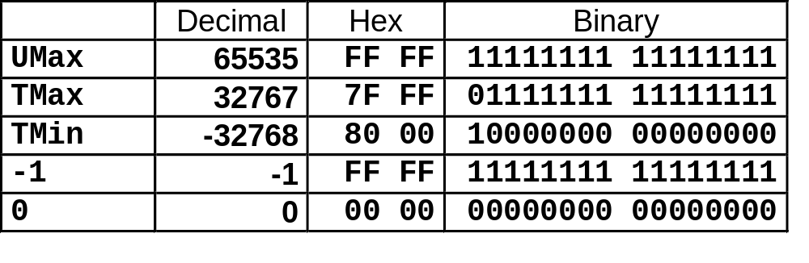
Numeric Ranges
Unsigned Values
  UMin = 0
    000…0
  UMax = 2^{w} – 1
    111…1
Two’s Complement Values
  TMin = –2^{w–1}
    100…0
  TMax = 2^{w–1} – 1
    011…1
  Minus 1
    111…1
Values for W = 16
Notes:
0 makes 2’s complement uneven

Slide 15
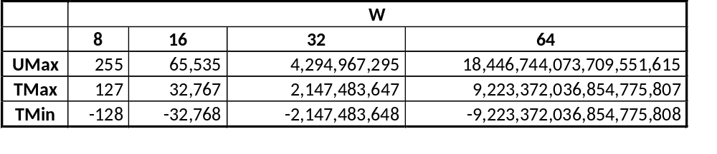
Values for Different Word Sizes
Observations
  |TMin | = TMax + 1
    Asymmetric range
  UMax = 2 * TMax + 1
C Programming
  #include <limits.h>
  Declares constants, e.g.,
    ULONG_MAX
    LONG_MAX
    LONG_MIN
  Values platform specific

Slide 16
Today: Bits, Bytes, and Integers
Representing information as bits
Bit-level manipulations
Integers
  Representation: unsigned and signed
  Conversion, casting
  Expanding, truncating
  Addition, negation, multiplication, shifting
  Summary
Representations in memory, pointers, strings

Slide 17
Mapping Between Signed & Unsigned
Mappings between unsigned and two’s complement numbers:
keep bit representations and reinterpret

Slide 18
Mapping Signed ↔ Unsigned
Bits
0000
0001
0010
0011
0100
0101
0110
0111
1000
1001
1010
1011
1100
1101
1110
1111
Signed
0
1
2
3
4
5
6
7
-8
-7
-6
-5
-4
-3
-2
-1
Unsigned
0
1
2
3
4
5
6
7
8
9
10
11
12
13
14
15

Slide 19
Mapping Signed ↔ Unsigned
Bits
0000
0001
0010
0011
0100
0101
0110
0111
1000
1001
1010
1011
1100
1101
1110
1111
Signed
0
1
2
3
4
5
6
7
-8
-7
-6
-5
-4
-3
-2
-1
Unsigned
0
1
2
3
4
5
6
7
8
9
10
11
12
13
14
15
=
+/- 16

Slide 20
Signed vs. Unsigned in C
Constants
  By default are considered to be signed integers
  Unsigned if have “U” as suffix
    0U, 4294967259U
Casting
  Explicit casting between signed & unsigned same as U2T and T2U
    int tx, ty;
    unsigned ux, uy;
    tx = (int) ux;
    uy = (unsigned) ty;
  Implicit casting also occurs via assignments and procedure calls
    tx = ux;
    uy = ty;

Slide 21
Casting Surprises
Expression Evaluation
  If there is a mix of unsigned and signed in single expression,
  signed values implicitly cast to unsigned
  Including comparison operations <, >, ==, <=, >=
  Examples for W = 32: TMIN = -2,147,483,648 , TMAX = 2,147,483,647
Constant₁ Constant₂ Relation Evaluation
  0 0U
  -1 0
  -1 0U
  2147483647 -2147483647-1
  2147483647U -2147483647-1
  -1 -2
  (unsigned)-1 -2
  2147483647 2147483648U
  2147483647 (int) 2147483648U
  0 0U == unsigned
  -1 0 < signed
  -1 0U > unsigned
  2147483647 -2147483648 > signed
  2147483647U -2147483648 < unsigned
  -1 -2 > signed
  (unsigned) -1 -2 > unsigned
  2147483647 2147483648U < unsigned
  2147483647 (int) 2147483648U > signed

Slide 22
Summary
Casting Signed ↔ Unsigned: Basic Rules
Bit pattern is maintained
But reinterpreted
Can have unexpected effects: adding or subtracting 2^{w}
Expression containing signed and unsigned int
  (signed)int is cast to unsigned!!

Slide 23
Today: Bits, Bytes, and Integers
Representing information as bits
Bit-level manipulations
Integers
  Representation: unsigned and signed
  Conversion, casting
  Expanding, truncating
  Addition, negation, multiplication, shifting
  Summary
Representations in memory, pointers, strings

Slide 24
Sign Extension
Task:
  Given w-bit signed integer x
  Convert it to w+k-bit integer with same value
Rule:
  Make k copies of sign bit:
  X ′ = x_{w–1} ,…, x_{w–1} , x_{w–1} , x_{w–2} ,…, x₀
k copies of MSB
w
X
• • •
• • •
X ′
• • •
• • •
k
w

Slide 25
Sign Extension: Simple Example
Positive number
Negative number
-16 | 8 | 4 | 2 | 1
0 | 1 | 0 | 1 | 0
-16 | 8 | 4 | 2 | 1
1 | 0 | 1 | 1 | 0
10 =
-10 =
-32 | 16 | 8 | 4 | 2 | 1
0 | 0 | 1 | 0 | 1 | 0
-32 | 16 | 8 | 4 | 2 | 1
1 | 1 | 0 | 1 | 1 | 0
10 =
-10 =

Slide 26
Sign Extension Example
short int x = 15213;
int ix = (int) x;
short int y = -15213;
int iy = (int) y;
Decimal
Hex
Binary
x
15213
3B 6D
00111011 01101101
ix
15213
00 00 3B 6D
00000000 00000000 00111011 01101101
y
-15213
C4 93
11000100 10010011
iy
-15213
FF FF C4 93
11111111 11111111 11000100 10010011
Converting from smaller to larger integer data type
C automatically performs sign extension

Slide 27
Truncation: Simple Example
No sign change
Sign change
-16 | 8 | 4 | 2 | 1
0 | 0 | 0 | 1 | 0
-16 | 8 | 4 | 2 | 1
0 | 1 | 0 | 1 | 0
2 =
10 =
 | -8 | 4 | 2 | 1
 | 0 | 0 | 1 | 0
 | -8 | 4 | 2 | 1
 | 1 | 0 | 1 | 0
2 =
-6 =
2 mod 16 = 2
10 mod 16 = 10U mod 16 = 10U = -6
-16 | 8 | 4 | 2 | 1
1 | 1 | 0 | 1 | 0
-16 | 8 | 4 | 2 | 1
1 | 0 | 1 | 1 | 0
-6 =
-10 =
 | -8 | 4 | 2 | 1
 | 1 | 0 | 1 | 0
 | -8 | 4 | 2 | 1
 | 0 | 1 | 1 | 0
-6 =
6 =
-6 mod 16 = 26U mod 16 = 10U = -6
-10 mod 16 = 22U mod 16 = 6U = 6

Slide 28
Summary:
Expanding, Truncating: Basic Rules
Expanding (e.g., short int to int)
  Unsigned: zeros added
  Signed: sign extension
  Both yield expected result
Truncating (e.g., unsigned to unsigned short)
  Unsigned/signed: bits are truncated
  Result reinterpreted
  Unsigned: mod operation
  Signed: similar to mod
Notes:
Mod operations for unsigned truncating
For negative numbers, if the remainder is positive number, than it is mod operation.

Slide 29
Today: Bits, Bytes, and Integers
Representing information as bits
Bit-level manipulations
Integers
  Representation: unsigned and signed
  Conversion, casting
  Expanding, truncating
  Addition, negation, multiplication, shifting
  Summary
Representations in memory, pointers, strings

Slide 30
Unsigned Addition
u
Operands: w bits
• • •
+
v
• • •
True Sum: w+1 bits
u + v
• • •
Discard Carry: w bits
UAdd_{w}(u , v)
• • •
Decimal
Hex
Binary
Standard Addition Function
  Ignores carry output
Implements Modular Arithmetic
  s = UAdd_{w}(u , v) = u + v mod 2^{w}
0
0
0000
1
1
0001
2
2
0010
3
3
0011
4
4
0100
5
5
0101
6
6
0110
7
7
0111
unsigned char
1110 1001
+ 1101 0101
E9
+ D5
233
+ 213
8
8
1000
9
9
1001
A
10
1010
B
11
1011
C
12
1100
D
13
1101
E
14
1110
F
15
1111

Slide 31
Unsigned Addition
u
Operands: w bits
• • •
+
v
• • •
True Sum: w+1 bits
u + v
• • •
Discard Carry: w bits
UAdd_{w}(u , v)
• • •
Decimal
Hex
Binary
Standard Addition Function
  Ignores carry output
Implements Modular Arithmetic
  s = UAdd_{w}(u , v) = u + v mod 2^{w}
0
0
0000
1
1
0001
2
2
0010
3
3
0011
4
4
0100
5
5
0101
6
6
0110
7
7
0111
unsigned char
1110 1001
+ 1101 0101
E9
+ D5
233
+ 213
8
8
1000
9
9
1001
A
10
1010
1 1011 1110
1BE
446
B
11
1011
C
12
1100
1011 1110
BE
190
D
13
1101
E
14
1110
F
15
1111

Slide 32
Two’s Complement Addition
Operands: w bits
u
• • •
+
v
• • •
True Sum: w+1 bits
u + v
• • •
Discard Carry: w bits
TAdd_{w}(u , v)
• • •
TAdd and UAdd have Identical Bit-Level Behavior
  Signed vs. unsigned addition in C:
  int s, t, u, v;
  s = (int) ((unsigned) u + (unsigned) v);
  t = u + v
  Will give s == t
1110 1001
+ 1101 0101
E9
+ D5
-23
+ -43
1 1011 1110
1BE
-66
1011 1110
BE
-66

Slide 33
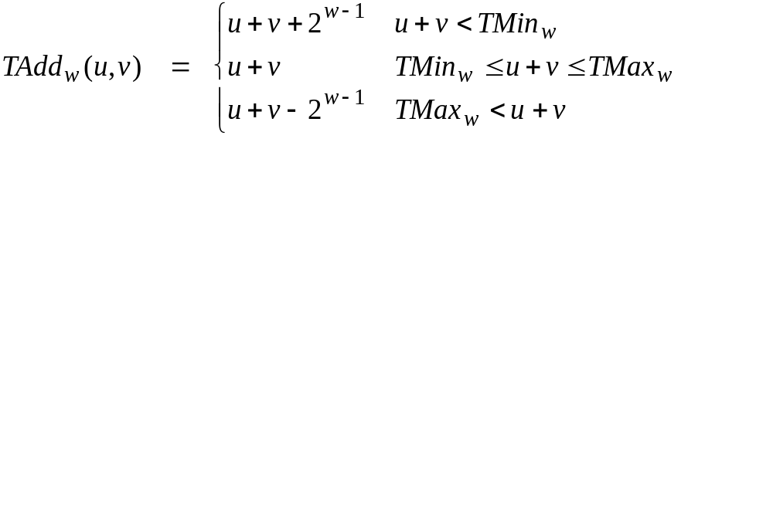
Characterizing TAdd
Positive Overflow
Functionality
  True sum requires w+1 bits
  Drop off MSB
  Treat remaining bits as 2’s comp. integer
TAdd(u , v)
> 0
v
< 0
< 0
> 0
u
Negative Overflow
2^{w}
(NegOver)
2^{w}
(PosOver)

Slide 34
Multiplication
Goal: Computing Product of w-bit numbers x, y
  Either signed or unsigned
But, exact results can be bigger than w bits
  Unsigned: up to 2w bits
    Result range: 0 ≤ x * y ≤ (2^{w} – 1) ² = 2^{2w} – 2^{w+1} + 1
  Two’s complement min (negative): Up to 2w-1 bits
    Result range: x * y ≥ (–2^{w–1})*(2^{w–1}–1) = –2^{2w–2} + 2^{w–1}
  Two’s complement max (positive): Up to 2w bits, but only for (TMin_{w})²
    Result range: x * y ≤ (–2^{w–1}) ² = 2^{2w–2}
So, maintaining exact results…
  would need to keep expanding word size with each product computed
  is done in software, if needed
    e.g., by “arbitrary precision” arithmetic packages

Slide 35
Unsigned Multiplication in C
u
• • •
Operands: w bits
*
v
• • •
True Product: 2*w bits
u · v
• • •
• • •
UMult_{w}(u , v)
Discard w bits: w bits
• • •
Standard Multiplication Function
  Ignores high order w bits
Implements Modular Arithmetic
  UMult_{w}(u , v) = u · v mod 2^{w}
1110 1001
* 1101 0101
E9
* D5
233
* 213
1100 0001 1101 1101
C1DD
49629
1101 1101
DD
221

Slide 36
Signed Multiplication in C
u
• • •
Operands: w bits
*
v
• • •
True Product: 2*w bits
u · v
• • •
• • •
TMult_{w}(u , v)
Discard w bits: w bits
• • •
Standard Multiplication Function
  Ignores high order w bits
  Some of which are different for signed vs. unsigned multiplication
  Lower bits are the same
1110 1001
* 1101 0101
E9
* D5
-23
* -43
0000 0011 1101 1101
03DD
989
1101 1101
DD
-35

Slide 37
Power-of-2 Multiply with Shift
Operation
  u << k gives u * 2^{k}
  Both signed and unsigned
Examples
  u << 3 == u * 8
  (u << 5) – (u << 3) == u * 24
  Most machines shift and add faster than multiply
    Compiler generates this code automatically
k
u
• • •
Operands: w bits
*
2^{k}
0
•••
0
1
0
•••
0
0
True Product: w+k bits
u · 2^{k}
• • •
0
•••
0
0
Discard k bits: w bits
UMult_{w}(u , 2^{k})
•••
0
•••
0
0
TMult_{w}(u , 2^{k})
Important Lesson:
Trust Your Compiler!

Slide 38
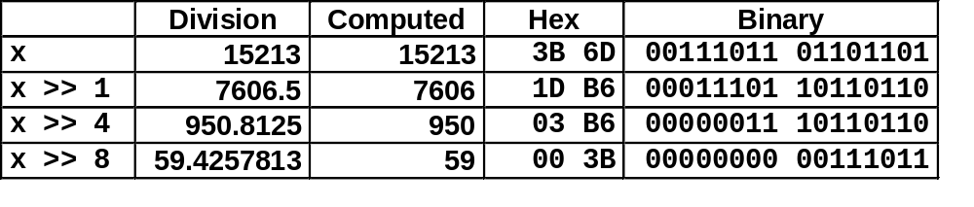
Unsigned Power-of-2 Divide with Shift
Quotient of Unsigned by Power of 2
  u >> k gives ⎣ u / 2^{k} ⎦
  Uses logical shift
k
u
•••
•••
Binary Point
Operands:
/
2^{k}
0
•••
0
1
0
•••
0
0
Division:
u / 2^{k}
0
.
0
•••
0
0
•••
•••
Result:
⎣ u / 2^{k} ⎦
0
0
•••
0
0
•••

Slide 39
Today: Bits, Bytes, and Integers
Representing information as bits
Bit-level manipulations
Integers
  Representation: unsigned and signed
  Conversion, casting
  Expanding, truncating
  Addition, negation, multiplication, shifting
  Summary
Representations in memory, pointers, strings

Slide 40
Arithmetic: Basic Rules
Addition:
  Unsigned/signed: Normal addition followed by truncate,
  same operation on bit level
  Unsigned: addition mod 2^{w}
    Mathematical addition + possible subtraction of 2^{w}
  Signed: modified addition mod 2^{w} (result in proper range)
    Mathematical addition + possible addition or subtraction of 2^{w}
Multiplication:
  Unsigned/signed: Normal multiplication followed by truncate, same operation on bit level
  Unsigned: multiplication mod 2^{w}
  Signed: modified multiplication mod 2^{w} (result in proper range)

Slide 41
Why Should I Use Unsigned?
Don’t use without understanding implications
  Easy to make mistakes
    unsigned i;
    for (i = cnt-2; i >= 0; i--)
    a[i] += a[i+1];
  Can be very subtle
    #define DELTA sizeof(int)
    int i;
    for (i = CNT; i-DELTA >= 0; i-= DELTA)
    . . .
Notes:
i>=0 is always true
Calculated as unsign

Slide 42
Counting Down with Unsigned
Proper way to use unsigned as loop index
    unsigned i;
    for (i = cnt-2; i < cnt; i--)
    a[i] += a[i+1];
See Robert Seacord, Secure Coding in C and C++
  C Standard guarantees that unsigned addition will behave like modular arithmetic
    0 – 1 → UMax
Even better
    size_t i;
    for (i = cnt-2; i < cnt; i--)
    a[i] += a[i+1];
  Data type size_t defined as unsigned value with length = word size
  Code will work even if cnt = UMax
  What if cnt is signed and < 0?
Notes:
1. When i==0, i-- -> Umax, so i>=cnt

Slide 43
Why Should I Use Unsigned? (cont.)
Do Use When Performing Modular Arithmetic
  Multiprecision arithmetic
Do Use When Using Bits to Represent Sets
  Logical right shift, no sign extension

Slide 44
Today: Bits, Bytes, and Integers
Representing information as bits
Bit-level manipulations
Integers
  Representation: unsigned and signed
  Conversion, casting
  Expanding, truncating
  Addition, negation, multiplication, shifting
  Summary
Representations in memory, pointers, strings

Slide 45
Encoding Byte Values
Byte = 8 bits
  Binary 000000002 to 111111112
  Decimal: 010 to 25510
  Hexadecimal 0016 to FF16
    Base 16 number representation
    Use characters ‘0’ to ‘9’ and ‘A’ to ‘F’
    Write FA1D37B16 in C as
      0xFA1D37B
      0xfa1d37b
Decimal
Hex
Binary
0
0
0000
1
1
0001
2
2
0010
3
3
0011
4
4
0100
5
5
0101
6
6
0110
7
7
0111
8
8
1000
9
9
1001
A
10
1010
B
11
1011
C
12
1100
D
13
1101
E
14
1110
Why 8 bit?
F
15
1111
Notes:
Why byte is 8-bit?
a byte was the number of bits used to encode a single character of text in a computer and for this reason it is the basic addressable element in many computer architectures. The size of the byte has historically been hardware dependent and no definitive standards existed that mandated the size
Q: “表示”和 “值” 的区别！
Encoding (解码）
Q2：How many bits we need to represent a digit in decimal, an example on the board
Q3: Hex is convenient for a Byte access granularity
Q4: addressing granularity, increasing vs decreasing

Slide 46
Byte-Oriented Memory Organization
00•••0
FF•••F
• • •
Programs refer to data by address
  Conceptually, envision it as a very large array of bytes
    In reality, it’s not, but can think of it that way
  An address is like an index into that array
    and, a pointer variable stores an address

Slide 47
Example Data Representations
C Data Type | Typical 32-bit | Typical 64-bit | x86-64
char | 1 | 1 | 1
short | 2 | 2 | 2
int | 4 | 4 | 4
long | 4 | 8 | 8
float | 4 | 4 | 4
double | 8 | 8 | 8
long double | − | − | 10/16
pointer | 4 | 8 | 8

Slide 48
Byte Ordering Example
Example
  Variable x has 4-byte value of 0x01234567
  Address given by &x is 0x100
Big Endian
0x100
0x101
0x102
0x103
01
01
23
23
45
45
67
67
Little Endian
0x100
0x101
0x102
0x103
67
67
45
45
23
23
01
01

Slide 49
Representing Integers
Decimal: 15213
Binary: 0011 1011 0110 1101
Hex: 3 B 6 D
int A = 15213;
long int C = 15213;
IA32, x86-64
Sun
IA32
x86-64
Sun
6D
00
3B
00
6D
6D
00
00
3B
3B
3B
00
00
6D
00
00
3B
00
00
6D
00
int B = -15213;
00
IA32, x86-64
Sun
00
00
93
FF
C4
FF
FF
C4
FF
93
Two’s complement representation

Slide 50
Byte Ordering
So, how are the bytes within a multi-byte word ordered in memory?
Conventions
  Big Endian: Sun, PPC Mac, Internet
    Least significant byte has highest address
  Little Endian: x86, ARM processors running Android, iOS, and Windows
    Least significant byte has lowest address

Slide 51
Examining Data Representations
Code to Print Byte Representation of Data
  Casting pointer to unsigned char * allows treatment as a byte array
typedef unsigned char *pointer;
void show_bytes(pointer start, int len){
int i;
for (i = 0; i < len; i++)
printf(”%p\t0x%.2x\n",start+i, start[i]);
printf("\n");
}
Printf directives:
%p: Print pointer
%x: Print Hexadecimal

Slide 52
show_bytes Execution Example
int a = 15213;
printf("int a = 15213;\n");
show_bytes((pointer) &a, sizeof(int));
Result (Linux x86-64):
int a = 15213;
0x7fffb7f71dbc 6d
0x7fffb7f71dbd 3b
0x7fffb7f71dbe 00
0x7fffb7f71dbf 00

Slide 53
Representing Pointers
int B = -15213;
int *P = &B;
Sun
IA32
x86-64
EF
FF
FB
2C
AC
28
F5
FF
3C
1B
FE
82
FD
7F
00
00
Different compilers & machines assign different locations to objects
Even get different results each time run program

Slide 54
Representing Strings
char S[6] = "18213";
Strings in C
  Represented by array of characters
  Each character encoded in ASCII format
    Standard 7-bit encoding of character set
    Character “0” has code 0x30
      Digit i has code 0x30+I
    man ascii for code table
  String should be null-terminated
    Final character = 0
Compatibility
  Byte ordering not an issue
IA32
Sun
31
38
32
31
33
00
31
38
32
31
33
00

Slide 55
Reading Byte-Reversed Listings
Disassembly
  Text representation of binary machine code
  Generated by program that reads the machine code
Example Fragment
Deciphering Numbers
  Value: 0x12ab
  Pad to 32 bits: 0x000012ab
  Split into bytes: 00 00 12 ab
  Reverse: ab 12 00 00
Address Instruction Code Assembly Rendition
8048365: 5b pop %ebx
8048366: 81 c3 ab 12 00 00 add $0x12ab,%ebx
804836c: 83 bb 28 00 00 00 00 cmpl $0x0,0x28(%ebx)

Slide 56
Summary
Representing information as bits
Bit-level manipulations
Integers
  Representation: unsigned and signed
  Conversion, casting
  Expanding, truncating
  Addition, negation, multiplication, shifting
Representations in memory, pointers, strings
Summary

Slide 57


Integer C Puzzles
x < 0 ⇒ ((x*2) < 0)
ux >= 0
x & 7 == 7 ⇒ (x<<30) < 0
ux > -1
x > y ⇒ -x < -y
x * x >= 0
x > 0 && y > 0 ⇒ x + y > 0
x >= 0 ⇒ -x <= 0
x <= 0 ⇒ -x >= 0
(x|-x)>>31 == -1
ux >> 3 == ux/8
x >> 3 == x/8
x & (x-1) != 0
Initialization
int x = foo();
int y = bar();
unsigned ux = x;
unsigned uy = y;

Slide 58
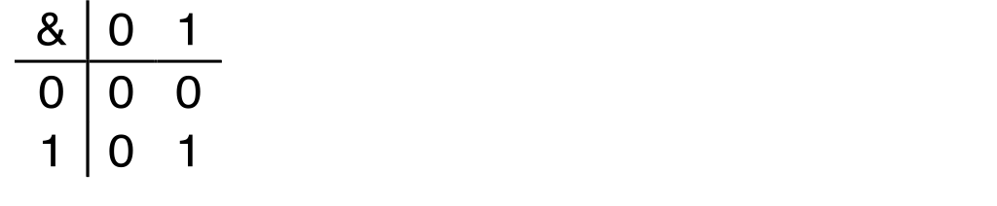
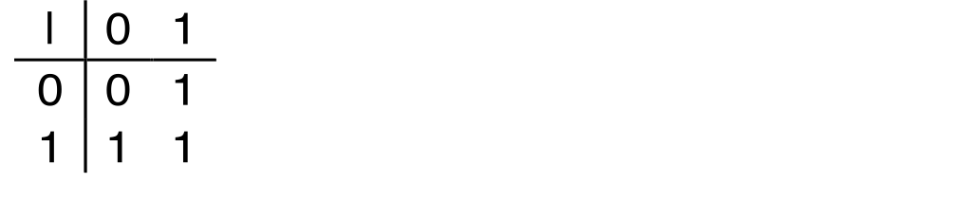
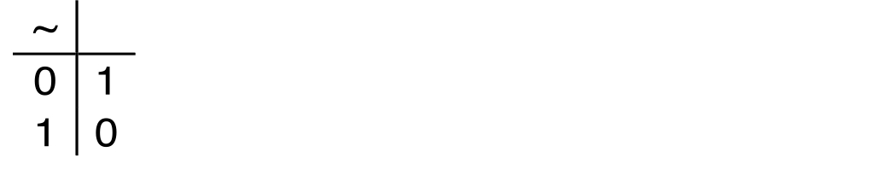
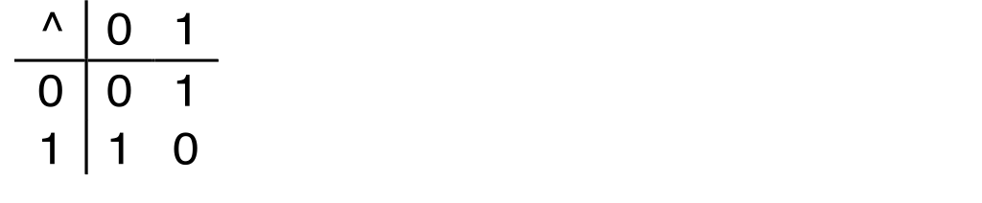
Boolean Algebra
Developed by George Boole in 19th Century
  Algebraic representation of logic
    Encode “True” as 1 and “False” as 0
And
A&B = 1 when both A=1 and B=1
Or
A|B = 1 when either A=1 or B=1
Not
~A = 1 when A=0
Exclusive-Or (Xor)
A^B = 1 when either A=1 or B=1, but not both

Slide 59
General Boolean Algebras
Operate on Bit Vectors
  Operations applied bitwise
All of the Properties of Boolean Algebra Apply
01101001
& 01010101
01000001
01101001
| 01010101
01111101
01101001
^ 01010101
00111100
~ 01010101
10101010
01000001
01111101
00111100
10101010
Notes:
Q: Bit operations in C programming. Difference between bit and logic operation
How to swap A and B with ^

Slide 60
Shift Operations
Left Shift: x << y
  Shift bit-vector x left y positions
      Throw away extra bits on left
    Fill with 0’s on right
Right Shift: x >> y
  Shift bit-vector x right y positions
    Throw away extra bits on right
  Logical shift
    Fill with 0’s on left
  Arithmetic shift
    Replicate most significant bit on left
Undefined Behavior
  Shift amount < 0 or ≥ word size
Argument x
01100010
<< 3
00010000
00010000
00010000
Log. >> 2
00011000
00011000
00011000
Arith. >> 2
00011000
00011000
00011000
Argument x
10100010
<< 3
00010000
00010000
00010000
Log. >> 2
00101000
00101000
00101000
Arith. >> 2
11101000
11101000
11101000

Slide 61
Contrast: Logic Operations in C
Contrast to Logical Operators
  &&, ||, !
    View 0 as “False”
    Anything nonzero as “True”
    Always return 0 or 1
    Early termination
Examples (char data type)
  !0x41 ➙ 0x00
  !0x00 ➙ 0x01
  !!0x41 ➙ 0x01
  0x69 && 0x55 ➙ 0x01
  0x69 || 0x55 ➙ 0x01
Watch out for && vs. & (and || vs. |)…
one of the more common oopsies in
C programming

