Slide 1
Machine-Level Programming I: Basics
Introduction to Computer Systems
4th Lecture, Sep. 18, 2025
Instructors:
Class 1: Chen Xiangqun, Liu Xianhua
Class 2: Guan Xuetao
Class 3: Lu Junlin

Slide 2
Today: Machine Programming I: Basics
History of Intel processors and architectures
C, assembly, machine code
Assembly Basics: Registers, operands, move
Arithmetic & logical operations

Slide 3
Intel x86 Processors
Dominate laptop/desktop/server market
Evolutionary design
  Backwards compatible up until 8086, introduced in 1978
  Added more features as time goes on
    Now 3 volumes, about 5,000 pages of documentation
Complex instruction set computer (CISC)
  Many different instructions with many different formats
    But, only small subset encountered with Linux programs
  Hard to match performance of Reduced Instruction Set Computers (RISC)
  But, Intel has done just that!
    In terms of speed. Less so for low power.

Slide 4
Intel x86 Evolution: Milestones
Name Date Transistors MHz
8086 1978 29K 5-10
  First 16-bit Intel processor. Basis for IBM PC & DOS
  1MB address space
386 1985 275K 16-33
  First 32 bit Intel processor , referred to as IA32
  Added “flat addressing”, capable of running Unix
Pentium 4E 2004 125M 2800-3800
  First 64-bit Intel x86 processor, referred to as x86-64
Core 2 2006 291M 1060-3333
  First multi-core Intel processor
Core i7 2008 731M 1600-4400
  Four cores

Slide 5
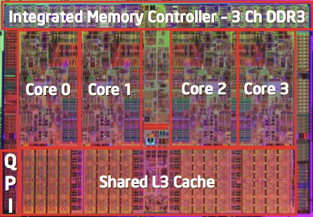
Intel x86 Processors, cont.
Machine Evolution
  386 1985 0.3M
  Pentium 1993 3.1M
  Pentium/MMX 1997 4.5M
  Pentium Pro 1995 6.5M
  Pentium 4 2000 42M
  Core 2 Duo 2006 291M
  Core i7 2008 731M
  Core i7 Skylake 2015 1.9B
  Xeon Skylake-SP 2017 8B
Added Features
  Instructions to support multimedia operations
  Instructions to enable more efficient conditional operations
  Transition from 32 bits to 64 bits
  More cores

Slide 6
Intel x86 Processors, cont.
Past Generations
  1st Pentium Pro 1995 600 nm
  1st Pentium III 1999 250 nm
  1st Pentium 4 2000 180 nm
  1st Core 2 Duo 2006 65 nm
Recent & Upcoming Generations
  Nehalem 2008 45 nm
  Sandy Bridge 2011 32 nm
  Ivy Bridge 2012 22 nm
  Haswell 2013 22 nm
  Broadwell 2014 14 nm
  Skylake 2015 14 nm
  Kaby Lake 2016 14 nm
  Coffee Lake 2017 14 nm
  Cannon Lake 2018 10 nm
  Ice Lake 2019 10 nm
  Tiger Lake 2020 10 nm
Process technology
Process technology dimension
= width of narrowest wires
(10 nm ≈ 100 atoms wide)

Slide 7
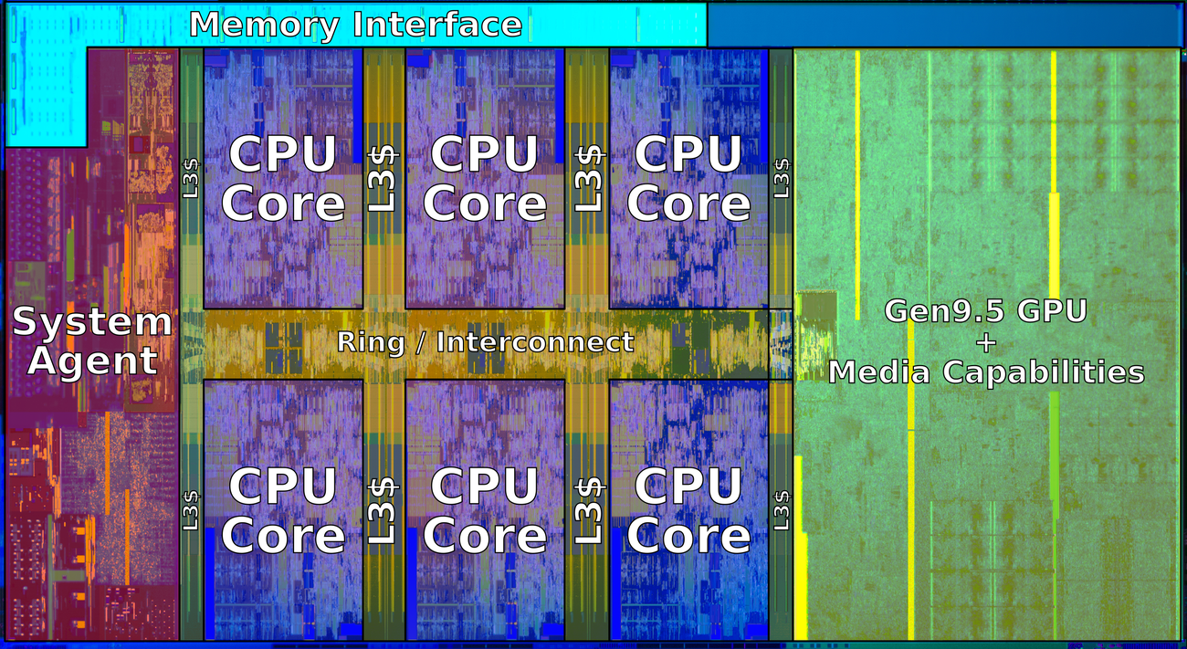
2018 State of the Art: Coffee Lake
Mobile Model: Core i7
  2.2-3.2 GHz
  45 W
Server Model: Xeon E
  Integrated graphics
  Multi-socket enabled
  3.3-3.8 GHz
  80-95 W
Desktop Model: Core i7
  Integrated graphics
  2.4-4.0 GHz
  35-95 W

Slide 8
x86 Clones: Advanced Micro Devices (AMD)
Historically
  AMD has followed just behind Intel
  A little bit slower, a lot cheaper
Then
  Recruited top circuit designers from Digital Equipment Corp. and other downward trending companies
  Built Opteron: tough competitor to Pentium 4
  Developed x86-64, their own extension to 64 bits
Recent Years
  Intel got its act together
    1995-2011: Lead semiconductor “fab” in world
    2018: #2 largest by $$ (#1 is Samsung)
    2019: reclaimed #1
  AMD fell behind
    Relies on external semiconductor manufacturer GlobalFoundaries
    ca. 2019 CPUs (e.g., Ryzen) are competitive again
Notes:
2022年财富500强，Intel营收790亿美元排145位，利润198亿；三星2400亿美元，排18位，利润342亿；
2021财年，AMD营收164亿美元（2018年64亿美元），台积电营收568亿美元（2018年342亿）
2022.9.19市值：Intel 1200亿美元；AMD 1235亿美元；台积电4000亿美元

Slide 9
Intel’s 64-Bit History
2001: Intel Attempts Radical Shift from IA32 to IA64
  Totally different architecture (Itanium)
  Executes IA32 code only as legacy
  Performance disappointing
2003: AMD Steps in with Evolutionary Solution
  x86-64 (now called “AMD64”)
Intel Felt Obligated to Focus on IA64
  Hard to admit mistake or that AMD is better
2004: Intel Announces EM64T extension to IA32
  Extended Memory 64-bit Technology
  Almost identical to x86-64!
All but low-end x86 processors support x86-64
  But, lots of code still runs in 32-bit mode

Slide 10
Our Coverage
IA32
  The traditional x86
  For this course: RIP, Fall 2016
x86-64
  The standard
  Server> gcc hello.c
  Server> gcc –m64 hello.c
Presentation
  Book covers x86-64
  Web aside on IA32
  We will only cover x86-64

Slide 11



Slide 12
Today: Machine Programming I: Basics
History of Intel processors and architectures
C, assembly, machine code
Assembly Basics: Registers, operands, move
Arithmetic & logical operations

Slide 13
Definitions
Architecture (or ISA: instruction set architecture)
  What software views the machine
  Instructions
  Registers + Memory
Example ISAs:
  X86: Used by Intel and AMD CPUs
  ARM: Used in almost all mobile phones
  RISC-V: New open-source ISA
Microarchitecture: Implementation of the architecture
  The internals' of the hardware
  Examples: cache sizes and core frequency

Slide 14
Assembly/Machine Code View
CPU
Memory
Registers
Addresses
Data
Data
PC
Condition
Codes
Programmer-Visible State
  Registers
    Fast
    Heavily used program data
  Condition codes
    Used for conditional branching
  PC: The program counter
    Address of next instruction
  Memory
    low
    Byte addressable array

Slide 15
An overview of Assembly
C Code
  Store value t where designated by dest
Assembly
  Move 8-byte value to memory
Machine Code
*dest = t;
movq %rax, (%rbx)
0x40059e: 48 89 03

Slide 16
Today: Machine Programming I: Basics
History of Intel processors and architectures
C, assembly, machine code
Assembly Basics: Registers, operands, move
Arithmetic & logical operations

Slide 17
x86-64 Integer Registers
%rax
%r8
%rbx
%r9
%rcx
%r10
%rdx
%r11
%rsi
%r12
%rdi
%r13
%rsp
%r14
%rbp
%r15
%rsp reserved for special use
All 64 bits: 8-bytes

Slide 18
Moving Data
%rax
%rcx
Moving Data
  movq Source, Dest:
Operand Types
  Immediate: Constant integer data
    Example: $0x400, $-533
    Like C constant, but prefixed with ‘$’
    Can be 1, 2, or 4 bytes
  Register: One of 16 general-purpose registers
    Example: %rax, %r13
  Memory: 8 bytes of memory at the given address
    Simplest example: (%rax)
    Various other “address modes”
%rdx
%rbx
%rsi
%rdi
%rsp
%rbp
%rN

Slide 19
movq Operand Combinations
Source
Dest
Src,Dest
C Analog
Reg
movq $0x4,%rax
temp = 0x4;
Imm
Mem
movq $-147,(%rax)
*p = -147;
Reg
movq %rax,%rdx
temp2 = temp1;
movq
Reg
Mem
movq %rax,(%rdx)
*p = temp;
Mem
Reg
movq (%rax),%rdx
temp = *p;
Cannot do memory-memory transfer with a single instruction??

Slide 20
Simple Memory Addressing Modes
Normal (R) Mem[Reg[R]]
  Register R specifies memory address
  Aha! Pointer dereferencing in C
  movq (%rcx),%rax
Displacement D(R) Mem[Reg[R]+D]
  Register R specifies start of memory region
  Constant displacement D specifies offset
  movq 8(%rbp),%rdx

Slide 21
Example of Simple Addressing Modes
void swap
(long *xp, long *yp)
{
long t0 = *xp;
long t1 = *yp;
*xp = t1;
*yp = t0;
}
swap:
movq (%rdi), %rax
movq (%rsi), %rdx
movq %rdx, (%rdi)
movq %rax, (%rsi)
ret

Slide 22
Understanding Swap()
Memory
void swap
(long *xp, long *yp)
{
long t0 = *xp;
long t1 = *yp;
*xp = t1;
*yp = t0;
}
Registers
%rdi
%rsi
%rax
%rdx
Register Value
%rdi xp
%rsi yp
%rax t0
%rdx t1
swap:
movq (%rdi), %rax # t0 = *xp
movq (%rsi), %rdx # t1 = *yp
movq %rdx, (%rdi) # *xp = t1
movq %rax, (%rsi) # *yp = t0
ret

Slide 23
Understanding Swap()
Memory
Registers
Address
123
0x120
%rdi
0x120
0x118
%rsi
0x100
0x110
%rax
0x108
%rdx
456
0x100
swap:
movq (%rdi), %rax # t0 = *xp
movq (%rsi), %rdx # t1 = *yp
movq %rdx, (%rdi) # *xp = t1
movq %rax, (%rsi) # *yp = t0
ret

Slide 24
Understanding Swap()
Memory
Registers
Address
123
0x120
%rdi
0x120
0x118
%rsi
0x100
0x110
%rax
123
0x108
%rdx
456
0x100
swap:
movq (%rdi), %rax # t0 = *xp
movq (%rsi), %rdx # t1 = *yp
movq %rdx, (%rdi) # *xp = t1
movq %rax, (%rsi) # *yp = t0
ret

Slide 25
Understanding Swap()
Memory
Registers
Address
123
0x120
%rdi
0x120
0x118
%rsi
0x100
0x110
%rax
123
0x108
%rdx
456
456
0x100
swap:
movq (%rdi), %rax # t0 = *xp
movq (%rsi), %rdx # t1 = *yp
movq %rdx, (%rdi) # *xp = t1
movq %rax, (%rsi) # *yp = t0
ret

Slide 26
Understanding Swap()
Memory
Registers
Address
456
0x120
%rdi
0x120
0x118
%rsi
0x100
0x110
%rax
123
0x108
%rdx
456
456
0x100
swap:
movq (%rdi), %rax # t0 = *xp
movq (%rsi), %rdx # t1 = *yp
movq %rdx, (%rdi) # *xp = t1
movq %rax, (%rsi) # *yp = t0
ret

Slide 27
Understanding Swap()
Memory
Registers
Address
456
0x120
%rdi
0x120
0x118
%rsi
0x100
0x110
%rax
123
0x108
%rdx
456
123
0x100
swap:
movq (%rdi), %rax # t0 = *xp
movq (%rsi), %rdx # t1 = *yp
movq %rdx, (%rdi) # *xp = t1
movq %rax, (%rsi) # *yp = t0
ret

Slide 28
Simple Memory Addressing Modes
Normal (R) Mem[Reg[R]]
  Register R specifies memory address
  Aha! Pointer dereferencing in C
  movq (%rcx),%rax
Displacement D(R) Mem[Reg[R]+D]
  Register R specifies start of memory region
  Constant displacement D specifies offset
  movq 8(%rbp),%rdx

Slide 29
Complete Memory Addressing Modes
Most General Form
D(Rb,Ri,S) Mem[Reg[Rb]+S*Reg[Ri]+ D]
  D: Constant “displacement”
  Rb: Base register
  Ri: Index register
  S: Scale: 1, 2, 4, or 8 (why these numbers?)
Special Cases
(Rb,Ri) Mem[Reg[Rb]+Reg[Ri]]
D(Rb,Ri) Mem[Reg[Rb]+Reg[Ri]+D]
(Rb,Ri,S) Mem[Reg[Rb]+S*Reg[Ri]]

Slide 30
Address Computation Examples
Carnegie Mellon
%rdx | 0xf000
%rcx | 0x0100
Expression | Address Computation | Address
0x8(%rdx)
(%rdx,%rcx)
(%rdx,%rcx,4)
0x80(,%rdx,2)
Expression | Address Computation | Address
0x8(%rdx)
(%rdx,%rcx)
(%rdx,%rcx,4)
0x80(,%rdx,2)
0xf000 + 0x8
0xf008
0xf000 + 0x100
0xf100
0xf000 + 4*0x100
0xf400
2*0xf000 + 0x80
0x1e080
Notes:
0xf000 + 0x8 = 0xf008
0xf000 + 0x0100 = 0xf100
0xf000 + 4*0x0100 = 0xf400
2*0xf000 + 0x80 = 0x1d080

Slide 31
Today: Machine Programming I: Basics
History of Intel processors and architectures
C, assembly, machine code
Assembly Basics: Registers, operands, move
Arithmetic & logical operations

Slide 32
Address Computation Instruction
Carnegie Mellon
leaq Src, Dst
  Src is address mode expression, dst is one of the 16 registers.
  Set Dst to address denoted by expression
Uses
  Computing memory addresses
    E.g., translation of p = &x[i];
  Computing arithmetic expressions of the form x + k*y
    k = 1, 2, 4, or 8
Example
long m12(long x)
{
return x*12;
}
Converted to ASM by compiler:
leaq (%rdi,%rdi,2), %rax # t <- x+x*2
salq $2, %rax # return t<<2

Slide 33
Some Arithmetic Operations
Carnegie Mellon
Two Operand Instructions:
  Format Computation
    addq Src,Dest Dest = Dest + Src
    subq Src,Dest Dest = Dest − Src
    imulq Src,Dest Dest = Dest * Src
    salq Src,Dest Dest = Dest << Src Also called shlq
    sarq Src,Dest Dest = Dest >> Src Arithmetic
    shrq Src,Dest Dest = Dest >> Src Logical
    xorq Src,Dest Dest = Dest ^ Src
    andq Src,Dest Dest = Dest & Src
    orq Src,Dest Dest = Dest | Src

Slide 34
Some Arithmetic Operations
Carnegie Mellon
One Operand Instructions
    incq Dest Dest = Dest + 1
    decq Dest Dest = Dest − 1
    negq Dest Dest = − Dest
    notq Dest Dest = ~Dest
See book for more instructions

Slide 35
Understanding Arithmetic Expression Example
Carnegie Mellon
arith:
leaq (%rdi,%rsi), %rax # t1
addq %rdx, %rax # t2
leaq (%rsi,%rsi,2), %rdx
salq $4, %rdx # t4
leaq 4(%rdi,%rdx), %rcx # t5
imulq %rcx, %rax # rval
ret
long arith
(long x, long y, long z)
{
long t1 = x+y;
long t2 = z+t1;
long t3 = x+4;
long t4 = y * 48;
long t5 = t3 + t4;
long rval = t2 * t5;
return rval;
}
Register | Use(s)
%rdi | Argument x
%rsi | Argument y
%rdx | Argument z,t4
%rax | t1, t2, rval
%rdx | t4
%rcx | t5

Slide 36
Turning C into Object Code
  Code in files p1.c p2.c
  Compile with command: gcc p1.c p2.c -o test
    Put resulting binary in file test
text
C program (p1.c p2.c)
Compiler (gcc -S)
text
Asm program (p1.s p2.s)
Assembler (gcc or as)
binary
Object program (p1.o p2.o)
Linker (gcc or ld)
binary
Executable program (p)
Notes:
-Og: In GCC 4.8, a new general optimization level, -Og, has been introduced. It addresses the need for fast compilation and a superior debugging experience while providing a reasonable level of runtime performance. Overall experience for development should be better than the default optimization level -O0. Note that -Og does not imply -g, it simply disables optimizations that may interfere with debugging.
-Og是指进行不影响-g的一些简单优化，但不是打开-g。

Slide 37
Compiling Into Assembly
C Code (sum.c)
Generated x86-64 Assembly
long plus(long x, long y);
void sumstore(long x, long y,
long *dest)
{
long t = plus(x, y);
*dest = t;
}
sumstore:
pushq %rbx
movq %rdx, %rbx
call plus
movq %rax, (%rbx)
popq %rbx
ret
Obtain (on our server machine) with command
  gcc –S sum.c
Produces file sum.s
Warning: Likely get very different results due to different versions of gcc and different compiler settings.

Slide 38
What it really looks like
.globl sumstore
.type sumstore, @function
sumstore:
.LFB35:
.cfi_startproc
pushq %rbx
.cfi_def_cfa_offset 16
.cfi_offset 3, -16
movq %rdx, %rbx
call plus
movq %rax, (%rbx)
popq %rbx
.cfi_def_cfa_offset 8
ret
.cfi_endproc
.LFE35:
.size sumstore, .-sumstore

Slide 39
What it really looks like
Things that look weird and are preceded by a ‘.’ are generally directives.
.globl sumstore
.type sumstore, @function
sumstore:
.LFB35:
.cfi_startproc
pushq %rbx
.cfi_def_cfa_offset 16
.cfi_offset 3, -16
movq %rdx, %rbx
call plus
movq %rax, (%rbx)
popq %rbx
.cfi_def_cfa_offset 8
ret
.cfi_endproc
.LFE35:
.size sumstore, .-sumstore
sumstore:
pushq %rbx
movq %rdx, %rbx
call plus
movq %rax, (%rbx)
popq %rbx
ret

Slide 40
Machine Code
Code for sumstore
Assembler
  Translates .s into .o
  Binary encoding of each instruction
0x0400595:
0x53
0x48
0x89
0xd3
0xe8
0xf2
0xff
0xff
0xff
0x48
0x89
0x03
0x5b
0xc3
  Total of 14 bytes
  Each instruction 1, 3, or 5 bytes
  Starts at address 0x0400595

Slide 41
Disassembling Machine Code
Disassembled
0000000000400595 <sumstore>:
400595: 53 push %rbx
400596: 48 89 d3 mov %rdx,%rbx
400599: e8 f2 ff ff ff callq 400590 <plus>
40059e: 48 89 03 mov %rax,(%rbx)
4005a1: 5b pop %rbx
4005a2: c3 retq
Disassembler
  objdump –d –M suffix sum
  Useful tool for examining machine code
  Can be run on either a.out (complete executable) or .o file

Slide 42
x86-64 Integer Registers
%rax
%r8
%eax
%r8d
%rbx
%r9
%ebx
%r9d
%rcx
%r10
%ecx
%r10d
%rdx
%r11
%edx
%r11d
%rsi
%r12
%esi
%r12d
%rdi
%r13
%edi
%r13d
%rsp
%r14
%esp
%r14d
%rbp
%r15
%ebp
%r15d

Slide 43
Some History: IA32 Registers
Origin
(mostly obsolete)
%eax
%ax
%ah
%al
accumulate
%ecx
%cx
%ch
%cl
counter
%edx
%dx
%dh
%dl
data
general purpose
%ebx
%bx
%bh
%bl
base
%esi
source
index
%si
%edi
destination
index
%di
%esp
stack
pointer
%sp
%ebp
base
pointer
%bp
16-bit virtual registers
(backwards compatibility)

