Slide 1
TELOS Talks Formal Verification
Yonghao Zou, Xiangcan Xu
2026.05.22

Slide 2
TELOS Talks
Exactly One Year since the first TELOS talks!
Topic
Fuzzing – Yonghao, 2025.05.22
Introduction to ML Sys – Zehua, 2025.06.06
Rust in Depth – Junyang, 2025.06.13
Scheduling & eBPF 101 – Zonghao, 2025.06.27
Coding Agent – Zhe, 2026.05.08
Formal Verification – Yonghao, Xiangcan, 2026.05.22
Something didn’t happen...
Drawing Figures – Junyang
User interrupt – Ran
More...

Slide 3
Formal Verification
Basics ~30min
Propositions
Rules
Predicates
SAT Solving
Basic SMT
Hoare Logic
Case Study ~20min
CortenMM – Xiangcan
FS – Yonghao
Advanced Topics (Maybe next time...)

Slide 4
Formal Verification
At first glance
We have a function min, and we want to verify it
To prove it, we can say “min” satisfies the spec
Isn’t it just writing the same program twice? – Sometimes, yes!
In most cases, we only care about partial correctness
spec can be simpler or more complex, depending on what you want to prove
fn min(x: int, y: int) -> int
{
if x <= y { x }
else { y }
}
spec fn min(x: int, y: int) -> int
{
if x <= y { x }
else { y }
}
spec fn min(x: int, y: int) -> (r: int)
ensures r <= x && r <= y

Slide 5
Basics
Propositions
A proposition is a claim that is either true or false
Examples
“The sky is blue.”
“5>3”
“The program never crashes.”
“n+1>n”
Not propositions
“Is it raining?”
“x>0”
“Turn left.”
“What does f return?”

Slide 6
Propositions
Important/common propositions
Safety
What is the safety of a lock?
"The lock is never held by two threads."
Correctness
What is the correctness of a payment?
"The payment is never debited twice."
Liveness
What is the liveness of a server?
"Every request eventually gets a response."
Functional
What is the functional property of a function?
"abs(x) returns a non-negative value."

Slide 7
Propositions
Quiz
Which of these are propositions?
1. "If you press the button, the light turns on."
2. "What does this function return?"
3. "The buffer never overflows."
4. "n + 1 > n"
5. "Turn left at the intersection."
Notes:
√ × √ √ ×

Slide 8
Propositions
Logic connectives
NOT, AND, OR, IMPLIES, IFF
Symbols
Symbol | Name | Reads as | True when...
¬P | NOT | negation | P is false
P ∧ Q | AND | conjunction | both true
P ∨ Q | OR | disjunction | at least one true
P → Q | IMPLIES | implication | P false, OR both true
P ↔ Q | IFF | biconditional | both have the same value

Slide 9
Propositions
Truth table
P | Q | P → Q
T | T | T
T | F | F
F | T | T
F | F | T

Slide 10
Propositions
Quiz
What’s the answer when P = true, Q = false
1. ¬P
2. P ∧ Q
3. P ∨ Q
4. P → Q
5. Q → P
6. ¬Q → P

Slide 11
Rules
Rules
How do we solve the problems?
We will follow a set of rules, each rule will claim how to transform a certain problem
We will then assemble these rules to solve a bigger problem
For example, we can define WTF rule
What the talk is this? -> What a FANTASTIC talk is this!
You see “What the ...?”
You say: “What a FANTASTIC ...!”

Slide 12
Rules
The four equivalences
Question: Modus Tollens of: BufferFull → WriteBlocked
Double negation
¬¬P ≡ P
De Morgan
¬(P ∧ Q) ≡ ¬P ∨ ¬Q
¬(P ∨ Q) ≡ ¬P ∧ ¬Q
Modus Tollens
(P → Q) ≡ (¬Q → ¬P)
Modus Ponens
(P → Q) ≡ (¬P ∨ Q)

Slide 13
Predicates
Predicates are propositions with variables
Functions that return bool
Safe(s), Valid(p), InBounds(i, arr)
Quantifiers: Universal and existential
Forall ∀, exists ∃
∀x. P(x): For every x, P(x) holds
∃x. P(x): There exists some x for which P(x) holds

Slide 14
Predicates
Examples
Safety claims: ∀s. reachable(s) → ¬crash(s)
Liveness: ∀req. ∃t. respondsBy(req, t)
Negate ∀x. P(x) → Q(x)
∃x. P(x) ∧ ¬Q(x)

Slide 15
Predicates
Quiz
1. Negate: ∀x. Safe(x)
2. Negate: ∃t. Crashed(t)
1. ∃x. ¬Safe(x)
2. ∀t. ¬Crashed(t)

Slide 16
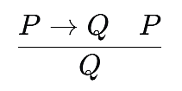
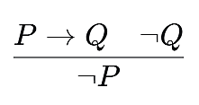
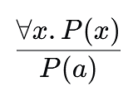
Proofs
Proof
A chain of inference steps from assumptions to a conclusion/goal.
Rules
Modus Ponens, Modus Tollens, Universal Instantiation.
Three strategies
Direct, contrapositive (MT), contradiction

Slide 17
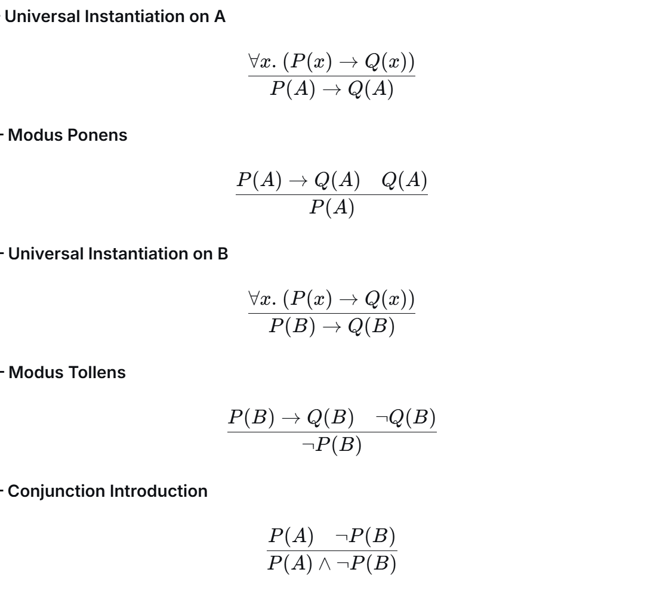
Proofs
Assumptions
All programmers can write recursive functions. P -> Q
A can write recursive functions.
B cannot write recursive functions.
Goal
A is a programmer. P(A)
B is not a programmer. Not P(B)

Slide 18
SAT
Boolean satisfiability
Given a Boolean formula, is there an assignment making it true?
If there is: SAT
If no assignment works: UNSAT
Every verification question can be turned into a SAT question.
Example
(A ∨ B) ∧ (¬A ∨ B)
A ∧ ¬A
Question: Is SAT a hard problem?

Slide 19
SAT
CNF: conjunctive normal form
A standard form for SAT in most cases
AND of ORs
Each OR-clause is built from literals (variables or negated variables).
Example:
(A ∨ B) ∧ (¬A ∨ C ∨ ¬D) ∧ (B ∨ ¬C)

Slide 20
SAT
From verification to SAT – A typical workflow
Goal: Buffer never overflows
Negate: Buffer DOES overflow
Solver:
SAT means?
Bugs!
UNSAT means?
No bug!

Slide 21
SAT Solver
DPLL
Unit propagation
If a clause has one unassigned literal left and others are false, that literal is forced.
Pure literal elimination
If a variable appears only positively (or only negatively), assign it that way.
Branching
Pick a variable, try one value; if that branch fails, backtrack and try the other.
A naïve solver will do the three steps continuously
Modern solvers add Conflict-Driven Clause Learning (CDCL)

Slide 22
SAT Solver
(A ∨ B) ∧ (¬A ∨ C) ∧ (¬C ∨ D) ∧ (¬B ∨ ¬D)
(A ∨ B) ∧ (¬A ∨ C) ∧ (B ∨ ¬C)
1. Decide A = T
no unit, no pure — branch
2. (A ∨ B) satisfied
drop
3. (¬A ∨ C) → (C)
unit → C = T
4. (¬C ∨ D) → (D)
unit → D = T
5. (¬B ∨ ¬D) → (¬B)
unit → B = F
6. No clauses left
SAT. A = T, B = F, C = T, D = T ✓
1. B = T
eliminate
...

Slide 23
SAT
Encoding
Turn constraints into CNF, one clause at a time.
Common patterns
At least one of A, B, C
(A ∨ B ∨ C)
At most one of A, B, C
(¬A ∨ ¬B) ∧ (¬A ∨ ¬C) ∧ (¬B ∨ ¬C)
Exactly one
at-least-one ∧ at-most-one
(A ∧ B) → C
(¬A ∨ ¬B ∨ C)
A ↔ B
(¬A ∨ B) ∧ (¬B ∨ A)

Slide 24
SMT
Beyond pure Boolean
Real programs have integers, arrays, bitvectors, strings.
Satisfiability Modulo Theories
SAT plus arithmetic, arrays, and more
Tool: Z3
Algorithm: DPLL(T), SAT + Theory

Slide 25
SMT
Major theories
Theory | Reasons about | Example
LIA | Linear integer arithmetic | 2x + 3y = 12
LRA | Linear real arithmetic | 0.5x + y ≤ 1.0
BV | Bitvectors | (x << 2) & 0xFF == 0
Arrays | read/write arrays | read(write(a, i, 5), i) = 5
UF | Uninterpreted functions | f(a) = f(b) → a = b ?
Str | Strings | len(s) > 0 ∧ contains(s, "ab")

Slide 26
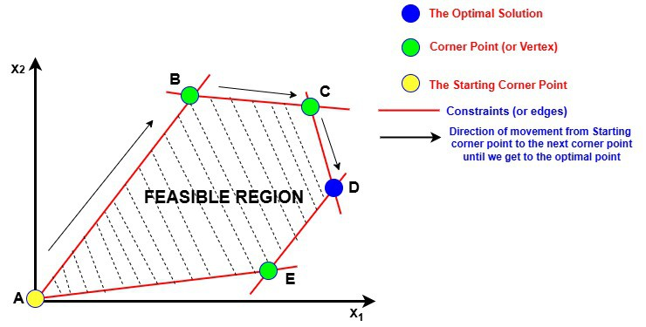
SMT
LIA theory – Linear programing problem
Algorithm: Simplex
If we got a rational solution, what should we do?
Branching
If you remember, we have read a paper in our reading group (COpter)

Slide 27
SMT
Quick Z3
Syntax: SMT-LIB
Prefix notation: (+ x y) -> x + y
Keywords: declare, assert, let, check-sat, ...
(declare-const x Int) ; integer variable
(declare-const y Int)
(assert (> x 0)) ; x > 0
(assert (= (+ x y) 10)) ; x + y = 10
(check-sat) ; SAT or UNSAT?
(get-model) ; if SAT, show witness

Slide 28
SMT
Quick Z3
What verification tools usually do?
Translate the program and proofs to Z3 queries
You can write your own one - Delphi
function abs(x: Int) returns r: Int
if x < 0 then r := -x
else r := x
(assert (or (and (< x 0) (= r (- x)))
(and (>= x 0) (= r x)))) ; program
(assert (not (>= r 0))) ; negated property
(check-sat) ; → unsat ✓

Slide 29
Hoare Logic
Reasoning about real programs
Loops, branches, and assignments
So, WTF is it?
{ P } C { Q }

Slide 30
Hoare Logic
{ P } C { Q }
If P holds before C and C terminates, Q holds after.
Total correctness: [P] C [Q] — same, plus C is guaranteed to terminate.
P: Precondition, holds before C
C: Code we execute
Q: Postcondition, holds after C

Slide 31
Hoare Logic
True or false?
A. { x = 3 } y := x + 2 { y = 5 }
B. { x > 0 } x := x - 1 { x > 0 }
C. { true } x := 7 { x = 7 }
D. { false } x := 0 { x = 999 }
E. { x ≥ 0 } y := x * x { y ≥ 0 }

Slide 32
Hoare Logic
Rule – Assignment rule (backwards assignment axiom)
Q with every occurrence of x replaced by e
For an assignment, its P should at least be Q[e/x], which is the weakest precondition
{ Q[e/x] } x := e { Q }
{ ??? } x := x + 1 { x > 5 }
Q[x+1 / x] = (x + 1) > 5 ≡ x > 4
Precondition: { x > 4 }

Slide 33
Hoare Logic
More examples
{ ??? } x := 5 { x = 5 }
Q[5 / x] = 5 = 5 ≡ true
Precondition: { true }
{ ??? } y := x * 2 { y > 10 }
Q[x*2 / y] = x * 2 > 10 ≡ x > 5
Precondition: { x > 5 }

Slide 34
Hoare Logic
Quiz
A. { ??? } x := 7 { x > 5 }
B. { ??? } x := x + 1 { x = 10 }
C. { ??? } y := x × 2 { y > 0 }

Slide 35
Hoare Logic
Rule - Sequencing
{ P } C₁ { R } { R } C₂ { Q }
{ P } C₁ ; C₂ { Q }

Slide 36
Hoare Logic
Example
Prove: { x = 5 } y := x + 1 ; z := y * 2 { z = 12 }
Step 1
z := y * 2 with Q = (z = 12). Apply rule → R must satisfy y * 2 = 12 ≡ y = 6.
Step 2
y := x + 1 with Q = (y = 6). Apply rule → P must satisfy x + 1 = 6 ≡ x = 5.
Step 3
Given precondition is x = 5 — matches. Triple verified ✓

Slide 37
Hoare Logic
Quiz - Find R and the weakest P
A. { ??? } x := x + 1 ; y := x * 2 { y = 10 }
B. { ??? } y := x ; y := y + 1 { y = 5 }

Slide 38
Hoare Logic
Rule - Conditional
{ P ∧ b } C₁ { Q } { P ∧ ¬b } C₂ { Q }
{ P } if b then C₁ else C₂ { Q }

Slide 39
Hoare Logic
Verifying abs(x)
{ true }
if x > 0 then y := x else y := -x
{ y ≥ 0 }
True branch
{ true ∧ x > 0 } y := x { y ≥ 0 }.
Need: x ≥ 0. True since x > 0. ✓
False branch
{ true ∧ x ≤ 0 } y := -x { y ≥ 0 }.
Need: -x ≥ 0 ≡ x ≤ 0. ✓

Slide 40
Hoare Logic
Rule – Loop invariants
A property that holds before the loop and after every iteration
Three obligations
Establish
Preserve
Conclude
Writing loop invariants is hard and creative!

Slide 41
Hoare Logic
Loop invariants
{ I ∧ b } C { I }
{ I } while b do C { I ∧ ¬b }

Slide 42
Hoare Logic
Example
Choose the invariant
I ≡ s = i*(i+1)/2 ∧ 0 ≤ i ≤ n
{ n ≥ 0 }
i := 0;
s := 0;
while i < n do
i := i + 1;
s := s + i
{ s = n*(n+1)/2 }

Slide 43
Hoare Logic
Example
I ≡ s = i*(i+1)/2 ∧ 0 ≤ i ≤ n
Establish: does I hold before the loop?
i = 0, s = 0
{ n ≥ 0 }
i := 0;
s := 0;
while i < n do
i := i + 1;
s := s + i
{ s = n*(n+1)/2 }

Slide 44
Hoare Logic
Example
I ≡ s = i*(i+1)/2 ∧ 0 ≤ i ≤ n
Preserve: does I hold after one iteration?
What math theory is this?
{ n ≥ 0 }
i := 0;
s := 0;
while i < n do
i := i + 1;
s := s + i
{ s = n*(n+1)/2 }
Before iteration: s = i*(i+1)/2, i < n.
After i := i+1: i' = i+1, and s = i*(i+1)/2 = (i'-1)*i'/2.
After s := s + i: s' = s + i' = (i'-1)*i'/2 + i' = i'(i'-1+2)/2 = i'(i'+1)/2 ✓
Also i' = i+1 ≤ n (since i < n) ✓

Slide 45
Hoare Logic
Example
I ≡ s = i*(i+1)/2 ∧ 0 ≤ i ≤ n
Conclude: does I hold after the loop?
does I ∧ ¬(i < n) give us s = n*(n+1)/2?
{ n ≥ 0 }
i := 0;
s := 0;
while i < n do
i := i + 1;
s := s + i
{ s = n*(n+1)/2 }

Slide 46
Hoare Logic
Quiz
{ n ≥ 0 }
i := 0;
p := 1;
while i < n do
p := p * 2;
i := i + 1
{ p = 2^n }

Slide 47
Recap
Basics
Propositions
Rules
Predicates
SAT Solving
Basic SMT
Hoare Logic

Slide 48
Tools
Solver
Z3, CVC5, Yices
Semi-automated verifiers – for real world programs
Verus for Rust
Dafny – compiles to different languages like Go and Java
Frama-C for C with annotations
Tpot – for C with C specs
Interactive proof assistants – for complex theory proofs and systems
Coq, Lean, Isabelle/HOL
Model checkers – for state-machine problems in protocols/algo
TLA+, SPIN, CBMC

Slide 49
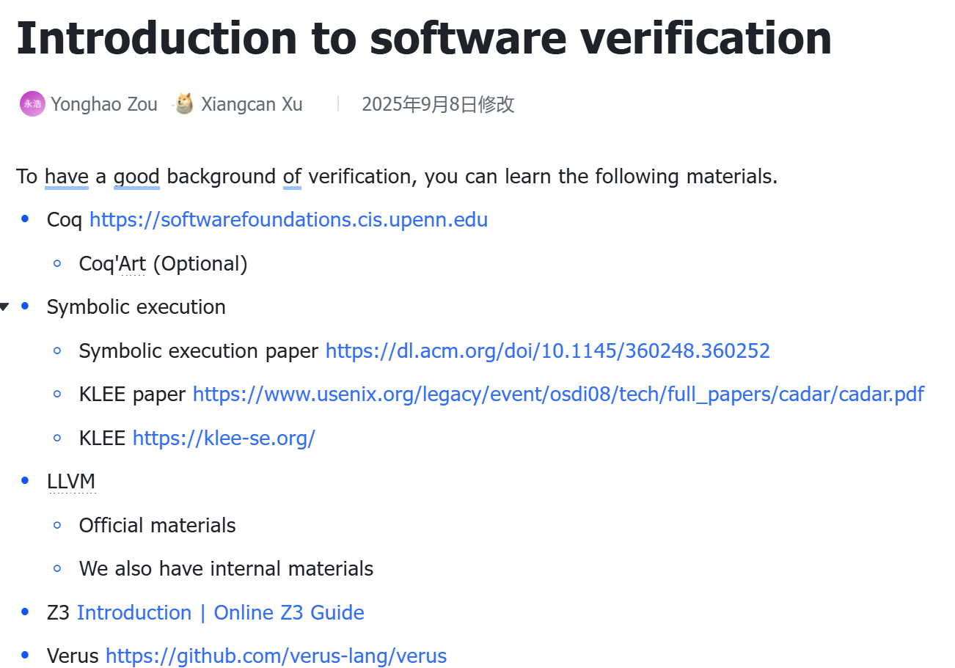
Materials
Introduction to software verification on Feishu

Slide 50
Case Study - CortenMM
Welcome Xiangcan

Slide 51
Case Study – File System
Find the right way to model outside systems
For a file system, what should we model?
Block device
Disk write(block_id, v)
Disk read(block_id, v)
Disk flush()
For the file system, what should we prove?
Functional
Concurrency
Crash consistency – maintain the metadata structure

Slide 52
Case Study - File System
Block device
Asynchronous disk
Real disks have a volatile write buffer. write() adds to it. sync() flushes it.
A crash loses the buffer. After a crash, each sector could hold any pending value.
{ a ↦ [0] }
write(a, 10)
{ a ↦ [0, 10] }
write(a, 11)
{ a ↦ [0, 10, 11] }
// read(a) returns 11 — the last element
{ a ↦ [0] }
write(a, 10); write(a, 11);
sync()
{ a ↦ [11] }

Slide 53
Case Study - File System
Block device
It could “crash.” – Losing power, forcing reboot, …
What can survive a crash?
Answer: OR
{ a ↦ [0] }
write(a, 10)
{ a ↦ [0, 10] }
CRASH: a ↦ [0] or a ↦ [10]

Slide 54
Case Study - File System
Crash Hoare Logic (FSCQ)
{ P } C { Q } CRASH { R }
{ a ↦ [v₀] }
write(a, v)
{ a ↦ [v₀, v] }
CRASH:
{ a ↦ [v₀] or a ↦ [v₀, v] }

Slide 55
Case Study - File System
How can we solve the crash consistency?
Logging/Journaling
Soft updates
…

Slide 56
Case Study - File System
Imagine we only use 2 blocks on a device, A and B
Invariants
A == B
Can we do that easily?
write(A, v);
write(B, v);
flush();

Slide 57
Case Study - File System
Imagine we only use 2 blocks on a device, A and B
Journaling
Entries
Commit block
Apply
When a crash occurs, recovery
recovery():
r = read(COMMIT)
if r then: // log was committed before crash
write(A, v) // re-apply each log entry
write(B, v)
sync()
write(COMMIT, 0) // clear the commit marker

Slide 58
Case Study - File System
Imagine we only use 2 blocks on a device, A and B
Journaling
What’s the real spec then? See journal_example.rs
pub open spec fn journal_recoverable (state: Map<int, BlockView>) -> bool {
let committed = spec_read_committed(state);
let journal_len = spec_read_journal_len(state);
if committed && journal_len > 0 {
// Committed entries exist → replaying must produce data_consistent
let replayed = spec_replay_entries(state, journal_len);
data_consistent(replayed)
} else {
// No committed entries → data must be consistent now
data_consistent(state)
}
}

Slide 59
Thanks!

