Slide 1
The Memory Hierarchy
Introduction to Computer Systems
12th Lecture

Slide 2
来点CSAPP笑话
Q：为什么CSAPP把最困难的内容放到课程开始，而把简单的内容放到后面？
A：因为作者们深刻理解了浮点数的舍入误差，这样可以最小化课程的总难度。

Slide 3
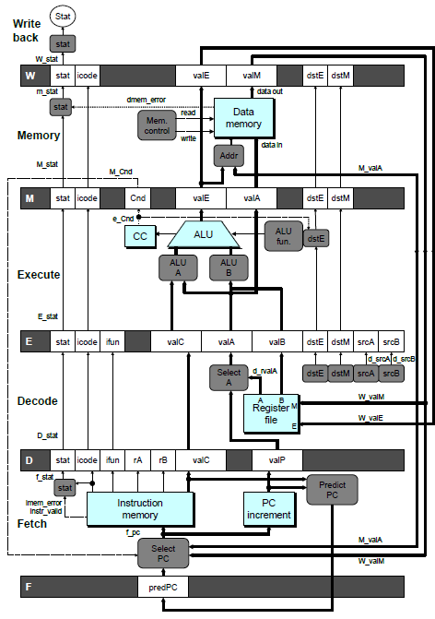
DDR5 memory access latency: avg. 70 ns
Modern CPU clock length: 0.3ns
How can the access to DRAM be done
in one cycle?

Slide 4
Today
Program exhibits locality
Cache exploits locality (more in the next lecture)
Faster storage devices stores less data and are more expensive, and vice versa.

Slide 5
Locality
The locality Principle: Programs tend to use data and instructions with addresses near or equal to those they have used recently
Temporal locality:
  Recently referenced items are likely
  to be referenced again in the near future
Spatial locality:
  Items with nearby addresses tend
  to be referenced close together in time

Slide 6
Locality Example
sum = 0;
for (i = 0; i < n; i++)
sum += a[i];
return sum;
Data references
  Reference array elements in succession: accessing a[i] means e.g., a[i-1], and a[i+1] are likely to be referenced
  Reference variable sum each iteration.
Instruction references
  Reference instructions in sequence.
  Cycle through loop repeatedly.
Spatial locality
Temporal locality
Spatial locality
Temporal locality

Slide 7
Qualitative Estimates of Locality
Claim: Being able to look at code and get a qualitative sense of its locality is a key skill for a professional programmer.
Question: Does this function have good locality with respect to array a?
int sum_array_rows(int a[M][N])
{
int i, j, sum = 0;
for (i = 0; i < M; i++)
for (j = 0; j < N; j++)
sum += a[i][j];
return sum;
}

Slide 8
Locality Example
Question: Does this function have good locality with respect to array a?
int sum_array_cols(int a[M][N])
{
int i, j, sum = 0;
for (j = 0; j < N; j++)
for (i = 0; i < M; i++)
sum += a[i][j];
return sum;
}
Answer: no, unless…
M is very small

Slide 9
Locality Example
Question: Can you permute the loops so that the function scans the 3-d array a with a stride-1 reference pattern (and thus has good spatial locality)?
int sum_array_3d(int a[M][N][N])
{
int i, j, k, sum = 0;
for (i = 0; i < M; i++)
for (j = 0; j < N; j++)
for (k = 0; k < N; k++)
sum += a[k][i][j];
return sum;
}
Answer: make j the inner loop

Slide 10
How to write a program with poor locality in instruction accesses?

Slide 11
Is locality only applicable to program? Can we have some other examples of locality?

Slide 12
System design principles: how to optimize
Optimizing a system layer requires exploiting the properties of the layer above it and the layer below it.
Suppose that we would like to optimize an OS
The layer above it: program, which often exhibits locality
The layer below it: hardware, which is amenable to pipelining.

Slide 13
Today
Program exhibits locality
Cache exploits locality (more in the next lecture)
Faster storage devices stores less data and are more expensive, and vice versa.

Slide 14
Caches
Cache: A smaller, faster storage device that stores frequently accessed data in a larger, slower device.
Why does caching work?
  Because of locality, programs often access a subset of key data given a time interval.
  Cache can just store this subset of key data.
Big Idea (Ideal): Most data stores in the cheap, slow storage, but that access at the rate of the fast storage.

Slide 15
General Cache Concepts
Cache
8
4
9
14
10
3
4
10
Underlying
device
0
1
2
3
The underlying devices are divided into multiple blocks.
4
4
5
6
7
8
9
10
10
11
12
13
14
15

Slide 16
General Cache Concepts: Hit
Request: 14
Data in block b is needed
Block b is in cache:
Hit!
Cache
8
9
14
3
14
How does this exploit locality?
Memory
0
1
2
3
4
5
6
7
8
9
10
11
12
13
14
15

Slide 17
General Cache Concepts: Miss
Request: 12
Data in block b is needed
Block b is not in cache:
Miss!
Cache
8
9
14
3
12
Block b is fetched from
memory
12
Request: 12
Block b is stored in cache
Placement policy:
determines where b goes
(more next lecture)
Replacement policy:
determines which block
gets evicted (victim)
Memory
0
1
2
3
4
5
6
7
8
9
10
11
12
12
13
14
15

Slide 18
General Caching Concepts:
Types of Cache Misses
Cold (compulsory) miss
  Cold misses occur because the cache is empty.
Conflict miss (more next lecture)
    Due to block mapping between the caching and the underlying device.
    E.g. Cache block N, stores the block % 4, referencing blocks 0, 8, 0, 8, 0, 8, ... would miss every time.
Capacity miss
  Occurs when the set of active cache blocks (working set) is larger than the cache.
What to do with different kinds of misses in the system?

Slide 19
Memory Hierarchy
L0:
Regs
Each layer caches the data of the next layer!
Smaller,
faster,
and
costlier
(per byte)
storage
devices
L1:
L1 cache
(SRAM)
The two memory modules in the processor figure actually refer to the L1 cache.
L2:
L2 cache
(SRAM)
L3:
L3 cache
(SRAM)
Larger,
slower,
and
cheaper
(per byte)
storage
devices
L4:
Main memory
(DRAM)
L5:
Local secondary storage
(local disks)
L6:
Remote secondary storage
(e.g., Web servers)

Slide 20
Examples of Caching in the Mem. Hierarchy
Cache Type
What is Cached?
Where is it Cached?
Latency (cycles)
Managed By
Registers
4-8 bytes words
CPU core
0 → <1
Compiler
TLB
Address translations
On-Chip TLB
0 → > <1
Hardware MMU
L1 cache
64-byte blocks
On-Chip L1
4
Hardware
L2 cache
64-byte blocks
On-Chip L2
10
Hardware
Virtual Memory
4-KB pages
Main memory
100
Hardware + OS
Buffer cache
Parts of files
Main memory
100
OS
Disk cache
Disk sectors
Disk controller
100,000
Disk firmware
Network buffer cache
Parts of files
Local disk
10,000,000
NFS client
Browser cache
Web pages
Local disk
10,000,000
Web browser
Web cache
Web pages
Remote server disks
1,000,000,000
Web proxy server

Slide 21
Examples of Caching in the Mem. Hierarchy
Cache Type
Where is it?
Latency (cycles)
Managed By
Registers
CPU core
1
Compiler
L1 cache
CPU core
4
Hardware
L2 cache
CPU core
15
Hardware
L3 cache
CPU core
50
Hardware
Memory
Main memory
100
OS
Disk cache
Disk controller
150,000
Disk firmware
Network file systems cache
Local disk
15,000,000
NFS client
Web cache
Remote serves
300,000,000
Web proxy server

Slide 22
来点CSAPP笑话
学生：老师，我发现 CSAPP 课件里有错误。
老师：很好！学习计算机系统就是要有质疑精神。
学生：所以这道考试题的答案是不是也应该修改？
老师：学习计算机系统的另一个重要原则，是尊重接口规范。

Slide 23
Why the main memory is slow?
Reason #1: the medium

Slide 24
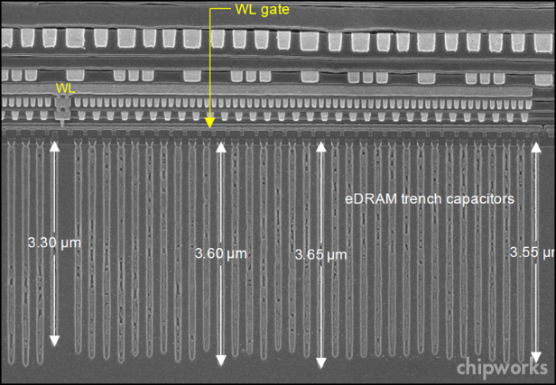
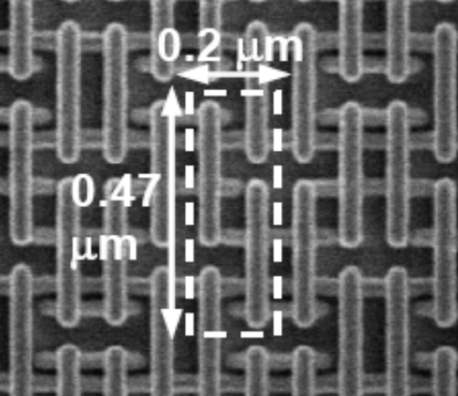
RAM Technologies
DRAM
Implementing the main memory
Must refresh state periodically
SRAM
Implementing cache
Holds state indefinitely (as long as power-on)

Slide 25
SRAM vs DRAM Summary
Trans. Access Needs Needs
per bit time refresh? ECC? Cost Applications
SRAM 6 or 8 1x No Yes 100x Cache
DRAM 1 10x Yes Yes 1x Main memories,
frame buffers
ECC: Error correction code
Both SRAM and DRAM reach their limits with semiconductor technology
  DRAM scaling limited by need for minimum capacitance
    Aspect ratio limits how deep can make capacitor
    DRAM cell cannot be made smaller, because then it stops to store data reliably

Slide 26
Enhanced DRAMs
Basic DRAM cell has not changed since its invention in 1966.
  Commercialized by Intel in 1970.
DRAM cores with better interface logic and faster I/O :
  Synchronous DRAM (SDRAM)
    Sends one bit per cycle (rising or falling)
    Uses a conventional clock signal instead of asynchronous control
    Allows reuse of the row addresses (e.g., RAS, CAS, CAS, CAS)
  Double data-rate synchronous DRAM (DDR SDRAM)
    Sends two bits per cycle (rising and falling)
    Different types distinguished by size of small prefetch buffer:
      DDR (2 bits), DDR2 (4 bits), DDR3 (8 bits), DDR4 (16 bits)
    By 2010, standard for most server and desktop systems
    Intel Core i7 supports DDR3 and DDR4 SDRAM

Slide 27
Conventional DRAM Organization
d x w DRAM:
  dw total bits organized as d supercells of size w bits
16 x 8 DRAM chip
cols
Memory
controller
0
1
2
3
2 bits
/
0
addr
1
rows
2
supercell
(2,1)
(to/from CPU)
3
8 bits
/
data
Internal row buffer

Slide 28
Reading DRAM Supercell (2,1)
Step 1(a): Row access strobe (RAS) selects row 2.
Step 1(b): Row 2 copied from DRAM array to row buffer.
16 x 8 DRAM chip
Cols
Memory
controller
RAS = 2
0
1
2
3
2
/
0
addr
1
Rows
2
8
/
3
data
Internal row buffer

Slide 29
Reading DRAM Supercell (2,1)
Step 2(a): Column access strobe (CAS) selects column 1.
Step 2(b): Supercell (2,1) copied from buffer to data lines, and eventually back to the CPU.
16 x 8 DRAM chip
Cols
Memory
controller
CAS = 1
0
1
2
3
2
/
0
addr
To CPU
1
Rows
2
supercell
(2,1)
3
8
/
data
supercell
(2,1)
Internal row buffer

Slide 30
Memory Modules
addr (row = i, col = j)
: supercell (i,j)
DRAM 0
64 MB
memory module
consisting of
eight 8Mx8 DRAMs
DRAM 7
bits
56-63
bits
48-55
bits
40-47
bits
32-39
bits
24-31
bits
16-23
bits
8-15
bits
0-7
63
63
56
56
55
55
48
48
47
47
40
40
39
39
32
32
31
31
24
24
23
23
16
16
15
15
8
8
7
7
0
0
Memory
controller
64-bit word main memory address A
64-bit word

Slide 31
Why the main memory is slow?
Reason #2: the bus

Slide 32
Traditional Bus Structure Connecting
CPU and Memory
A bus is a collection of parallel wires that carry address, data, and control signals.
Buses are typically shared by multiple devices.
CPU chip
Register file
ALU
System bus
Memory bus
Main
memory
Bus interface
I/O
bridge

Slide 33
Memory Read Transaction (1)
CPU places address A on the memory bus.
Register file
Load operation: movq A, %rax
ALU
%rax
Main memory
I/O bridge
A
0
Bus interface
x
A

Slide 34
Memory Read Transaction (2)
Main memory reads A from the memory bus, retrieves word x, and places it on the bus.
Register file
Load operation: movq A, %rax
ALU
%rax
Main memory
I/O bridge
x
0
Bus interface
x
A

Slide 35
Memory Read Transaction (3)
CPU read word x from the bus and copies it into register %rax.
Register file
Load operation: movq A, %rax
ALU
%rax
x
Main memory
I/O bridge
0
Bus interface
x
A

Slide 36
Memory Write Transaction (1)
CPU places address A on bus. Main memory reads it and waits for the corresponding data word to arrive.
Register file
Store operation: movq %rax, A
ALU
%rax
y
Main memory
I/O bridge
A
0
Bus interface
A

Slide 37
Memory Write Transaction (2)
CPU places data word y on the bus.
Register file
Store operation: movq %rax, A
ALU
%rax
y
Main memory
I/O bridge
0
y
Bus interface
A

Slide 38
Memory Write Transaction (3)
Main memory reads data word y from the bus and stores it at address A.
Register file
Store operation: movq %rax, A
ALU
%rax
y
main memory
I/O bridge
0
Bus interface
y
A

Slide 39
Why disks are slow?

Slide 40
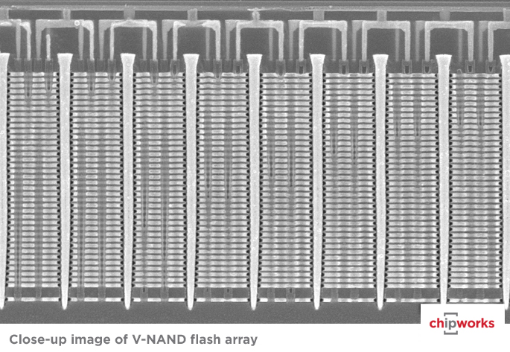
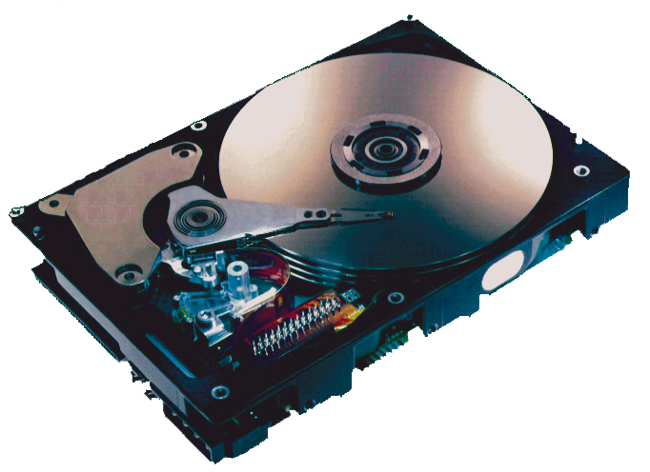
Storage Technologies
HDD: hard disk drive
Store on magnetic medium
SSD: solid state drive
Non-volatile (Flash) Memory

Slide 41
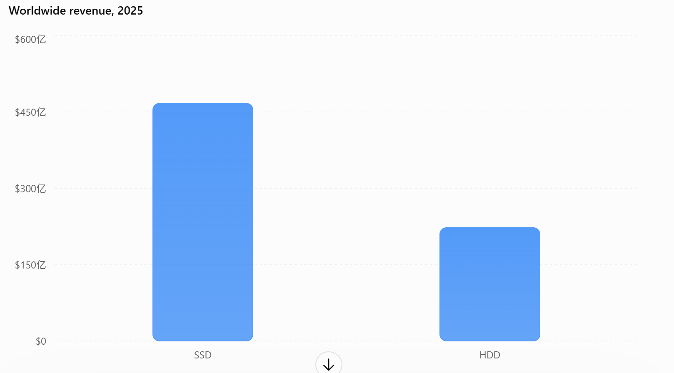
Comments: SSD actually dominates

Slide 42
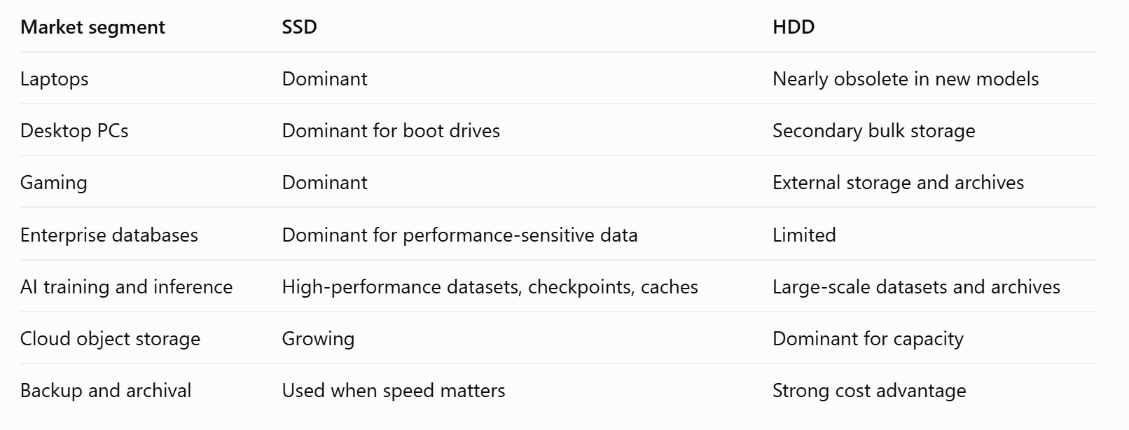
Comments: SSD actually dominates

Slide 43
来点CSAPP笑话
学生：“老师，都 2026 年了，为什么 CSAPP 课件中的数据还停留在 2015 年？”
老师：“这是为了让你们更好地理解局部性。”
学生：“什么局部性？”
老师：“时间局部性。CSAPP 的作者认为，2015 年的数据将来还会经常被访问。”

Slide 44
Why disks are slow?
Reason #1: the medium itself

Slide 45
What’s Inside A Disk Drive?
Spindle
Arm
Platters
Actuator
Electronics
(including a
processor
and memory!)
SCSI
connector
Image courtesy of Seagate Technology

Slide 46
Disk Geometry (Muliple-Platter View)
Disks consist of platters, each with two surfaces.
Surface 0
Platter 0
Surface 1
Surface 2
Platter 1
Surface 3
Surface 4
Platter 2
Surface 5
Spindle
Notes:
Cylinder： 柱面

Slide 47
Disk Geometry
Each surface consists of concentric rings called tracks.
Tracks
Surface
Track k
Spindle
Sectors
Notes:
Sector 扇区

Slide 48
Disk Operation (Single-Platter View)
The disk surface
spins at a fixed
rotational rate
The read/write head
is attached to the end
of the arm and flies over
the disk surface on
a thin cushion of air.
spindle
spindle
spindle
spindle
spindle
seek: by moving radially, the arm can position the read/write head over any track.

Slide 49
Disk Operation (Multi-Platter View)
Read/write heads
move in unison
from cylinder to cylinder
Arm
Spindle

Slide 50
Disk Access
Head in position above a track
Notes:
Goal:
Show the inefficeincy of current disk requests.
Conveyed Ideas:
Rotational latency is wasted time that can be used to service tasks
Background Information:
None.
Slide Background:
None.
Kill text and arrows

Slide 51
Disk Access
Rotation is counter-clockwise
Notes:
Goal:
Show the inefficeincy of current disk requests.
Conveyed Ideas:
Rotational latency is wasted time that can be used to service tasks
Background Information:
None.
Slide Background:
None.
Kill text and arrows

Slide 52
Disk Access – Read
About to read blue sector
Notes:
Goal:
Show the inefficeincy of current disk requests.
Conveyed Ideas:
Rotational latency is wasted time that can be used to service tasks
Background Information:
None.
Slide Background:
None.
Kill text and arrows

Slide 53
Disk Access – Read
After BLUE read
After reading blue sector
Notes:
Goal:
Show the inefficeincy of current disk requests.
Conveyed Ideas:
Rotational latency is wasted time that can be used to service tasks
Background Information:
None.
Slide Background:
None.
Kill text and arrows

Slide 54
Disk Access – Read
After BLUE read
Red request scheduled next
Notes:
Goal:
Show the inefficeincy of current disk requests.
Conveyed Ideas:
Rotational latency is wasted time that can be used to service tasks
Background Information:
None.
Slide Background:
None.
Kill text and arrows

Slide 55
Disk Access – Seek
After BLUE read
Seek for RED
Seek to red’s track
Notes:
Goal:
Show the inefficeincy of current disk requests.
Conveyed Ideas:
Rotational latency is wasted time that can be used to service tasks
Background Information:
None.
Slide Background:
None.
Kill text and arrows

Slide 56
Disk Access – Rotational Latency
After BLUE read
Seek for RED
Rotational latency
Wait for red sector to rotate around
Notes:
Goal:
Show the inefficeincy of current disk requests.
Conveyed Ideas:
Rotational latency is wasted time that can be used to service tasks
Background Information:
None.
Slide Background:
None.
Kill text and arrows

Slide 57
Disk Access – Read
After BLUE read
Seek for RED
Rotational latency
After RED read
Complete read of red
Notes:
Goal:
Show the inefficeincy of current disk requests.
Conveyed Ideas:
Rotational latency is wasted time that can be used to service tasks
Background Information:
None.
Slide Background:
None.
Kill text and arrows

Slide 58
Disk Access – Service Time Components
After BLUE read
Seek for RED
Rotational latency
After RED read
Data transfer
Seek
Rotational
latency
Data transfer
Notes:
Goal:
Show the inefficeincy of current disk requests.
Conveyed Ideas:
Rotational latency is wasted time that can be used to service tasks
Background Information:
None.
Slide Background:
None.
Kill text and arrows

Slide 59
Disk Access Time
Average time to access some target sector approximated by:
  T_{access} = T_{avg seek} + T_{avg rotation} + T_{avg transfer}
Seek time (T_{avg seek})
  Time to position heads over cylinder containing target sector.
  Typical T_{avg seek} is 3—9 ms
Rotational latency (T_{avg rotation})
  Time waiting for first bit of target sector to pass under the head.
  Typical rotational rate = 7,200 RPMs
  T_{avg rotation} = 1/2 x 1/RPMs x 60 sec/1 min = 4.17ms.
Transfer time (T_{avg transfer})
  Time to read the bits in the target sector.
  T_{avg transfer} = 1/RPM x 1/(avg # sectors/track) x 60 secs/1 min
time for one rotation (in minutes)
fraction of a rotation to be read

Slide 60
Disk Access Time Example
Given:
  Rotational rate = 7,200 RPM
  Average seek time = 9 ms
  Avg # sectors/track = 400
Derived:
  T_{avg rotation} = 1/2 x (60 secs/7200 RPM) x 1000 ms/sec = 4.17 ms
  T_{avg transfer} = 60/7200 x 1/400 x 1000 ms/sec = 0.02 ms
  T_{access} = 9 ms + 4.17 ms + 0.02 ms
Important points:
  Access time dominated by seek time and rotational latency.
  First bit in a sector is the most expensive, the rest are free.
  SRAM access time is about 4 ns/doubleword, DRAM about 60 ns
    Disk is about 40,000 times slower than SRAM,
    2,500 times slower than DRAM.

Slide 61
Why disks are slow?
Reason #2: the I/O bus

Slide 62
I/O Bus
CPU chip
Register file
ALU
System bus
Memory bus
Main
memory
Bus interface
I/O
bridge
I/O bus
Expansion slots for
other devices such
as network adapters.
USB
controller
Graphics
adapter
Disk
controller
Mouse
Keyboard
Monitor
Disk

Slide 63
Reading a Disk Sector (1)
CPU chip
CPU initiates a disk read by writing a command, logical block number, and destination memory address to a port (address) associated with disk controller.
Register file
ALU
Main
memory
Bus interface
I/O bus
USB
controller
Graphics
adapter
Disk
controller
mouse
keyboard
Monitor
Disk

Slide 64
Reading a Disk Sector (2)
CPU chip
Disk controller reads the sector and performs a direct memory access (DMA) transfer into main memory.
Register file
ALU
Main
memory
Bus interface
I/O bus
USB
controller
Graphics
adapter
Disk
controller
Mouse
Keyboard
Monitor
Disk

Slide 65
Reading a Disk Sector (3)
CPU chip
When the DMA transfer completes, the disk controller notifies the CPU with an interrupt (i.e., asserts a special “interrupt” pin on the CPU)
Register file
ALU
Main
memory
Bus interface
I/O bus
USB
controller
Graphics
adapter
Disk
controller
Mouse
Keyboard
Monitor
Disk

Slide 66
来点CSAPP笑话
学生：“CSAPP 的作者一定深刻掌握了空间局部性。”
老师：“为什么？”
学生：“他们解释一个概念的时候，总是假设我已经理解了其它相关的十个概念。”

Slide 67
Disk Capacity
Capacity: maximum number of bits that can be stored.
  Often in gigabytes (GB), where 1 GB = 10⁹ Bytes.
Capacity is determined by these technology factors:
  Recording density (bits/in): number of bits that can be squeezed into a 1 inch segment of a track.
  Track density (tracks/in): number of tracks that can be squeezed into a 1 inch radial segment.
  Areal density (bits/in2): product of
  recording and track density.
Tracks

Slide 68
Recording zones
Modern disks partition tracks into disjoint subsets called recording zones
  Each track in a zone has the same number of sectors, determined by the circumference of innermost track.
  Each zone has a different number of sectors/track, outer zones have more sectors/track than inner zones.
  So we use average number of sectors/track when computing capacity.
…
Spindle

Slide 69
Computing Disk Capacity
Capacity = (# bytes/sector) x (avg. # sectors/track) x
(# tracks/surface) x (# surfaces/platter) x
(# platters/disk)
Example:
  512 bytes/sector
  300 sectors/track (on average)
  20,000 tracks/surface
  2 surfaces/platter
  5 platters/disk
Capacity = 512 x 300 x 20000 x 2 x 5
= 30,720,000,000
= 30.72 GB

Slide 70
Solid State Disks (SSDs)
I/O bus
Requests to read and
write logical disk blocks
Solid State Disk (SSD)
Flash
translation layer
Flash memory
Block 0
Block B-1
…
…
…
Page 0
Page 1
Page P-1
Page 0
Page 1
Page P-1
Pages: 512KB to 4KB, Blocks: 32 to 128 pages
Data read in units of pages.
Data written only after its block has been erased

Slide 71
SSD Performance Characteristics
Benchmark of Samsung 940 EVO Plus
Benchmark of Micron 9650
Sequential access faster than random access
Random writes are somewhat slower
  Erasing a block takes a long time (~1 ms).
  Modifying a block page requires all other pages to be copied to new block.
  Optimization: flash translation layer allows accumulating series of small writes before doing block write.
https://ssd.userbenchmark.com/SpeedTest/711305/Samsung-SSD-970-EVO-Plus-250GB
Sequential read throughput 2,126 MB/s Sequential write tput 1,880 MB/s
Random read throughput 140 MB/s Random write tput 59 MB/s
Sequential read throughput 2,8000 MB/s Sequential write tput 14000 MB/s
Random read throughput 2,2500 MB/s Random write tput 3690 MB/s

Slide 72
SSD Tradeoffs vs Rotating Disks
Advantages
  No moving parts → No seeking, and rotational overhead, less power
Disadvantages
  Have the potential to wear out
    Mitigated by “wear leveling logic” in flash translation layer
  In 2019, about 4 times more expensive per byte
    And, relative cost will keep dropping
Applications
  In 2019, MP3 players, smart phones, laptops
  In 2026, dominates in desktops and servers

Slide 73
Comments: the SSD wear out
Not as bad as you thought
  Only affects write, not read
  Even for write: Samsung 990 PRO SSD: 600 TBW (terabytes written).
  That's equivalent to writing 100 GB per day for about
  16 years.
An HDD is likely to fall after 16 years as well: the mechanical parts can wear out

Slide 74
The CPU-Memory Gap, i.e., the memory wall
The gap widens between DRAM, disk, and CPU speeds.
Disk
SSD
DRAM
CPU

Slide 75
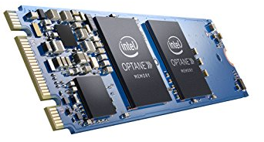
Nonvolatile Memories
DRAM and SRAM are volatile memories
  Lose information if powered off.
Nonvolatile memories retain value even if powered off
  Read-only memory (ROM): programmed during production
  Programmable ROM (PROM): can be programmed once
  Eraseable PROM (EPROM): can be bulk erased (UV, X-Ray)
  Electrically eraseable PROM (EEPROM): electronic erase capability
  Flash memory: EEPROMs. with partial (block-level) erase capability
    Wears out after about 100,000 erasings
  3D XPoint (Intel Optane) & emerging NVMs
    New materials
Uses for Nonvolatile Memories
  Firmware programs stored in a ROM (BIOS, controllers for disks, network cards, graphics accelerators, security subsystems,…)
  Solid state disks (replace rotating disks in thumb drives, smart phones, mp3 players, tablets, laptops,…)
  Disk caches

Slide 76
来点CSAPP笑话
一个读者愤怒地问CSAPP的作者 “为什么你们的书又长又难读”？
CSAPP的作者说“这正说明我们深刻地理解了系统底层原理：容量大的设备访问速度自然就慢了！”

Slide 77
Supplemental slides

Slide 78
Storage Trends
SRAM
Metric 1985 1990 1995 2000 2005 2010 2015 2015:1985
$/MB 2,900 320 256 100 75 60 25 116
access (ns) 150 35 15 3 2 1.5 1.3 115
DRAM
Metric 1985 1990 1995 2000 2005 2010 2015 2015:1985
$/MB 880 100 30 1 0.1 0.06 0.02 44,000
access (ns) 200 100 70 60 50 40 20 10
typical size (MB) 0.256 4 16 64 2,000 8,000 16.000 62,500
Disk
Metric 1985 1990 1995 2000 2005 2010 2015 2015:1985
$/GB 100,000 8,000 300 10 5 0.3 0.03 3,333,333
access (ms) 75 28 10 8 5 3 3 25
typical size (GB) 0.01 0.16 1 20 160 1,500 3,000 300,000

Slide 79
CPU Clock Rates
Inflection point in computer history
when designers hit the “Power Wall”
1985 1990 1995 2003 2005 2010 2015 2015:1985
CPU 80286 80386 Pentium P-4 Core 2 Core i7(n) Core i7(h)
Clock
rate (MHz) 6 20 150 3,300 2,000 2,500 3,000 500
Cycle
time (ns) 166 50 6 0.30 0.50 0.4 0.33 500
Cores 1 1 1 1 2 4 4 4
Effective
cycle 166 50 6 0.30 0.25 0.10 0.08 2,075
time (ns)
(n) Nehalem processor
(h) Haswell processor

