Slide 1
Exceptional Control Flow:
Exceptions and Processes
Introduction to Computer Systems
16th Lecture, Nov. 9, 2026
Instructors:
Class 1: Chen Xiangqun, Liu Xianhua
Class 2: Guan Xuetao
Class 3: Lu Junlin
Class 4: Zhou Diyu

Slide 2
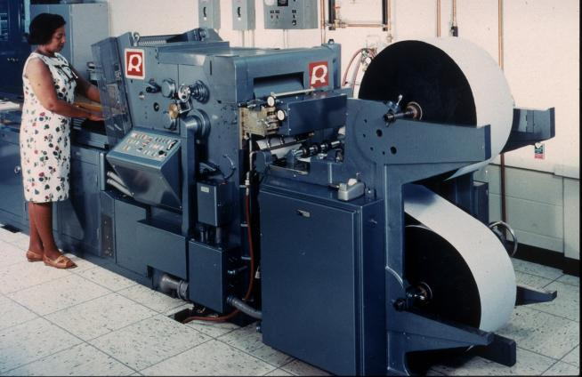
Printers Used to Catch on Fire

Slide 3
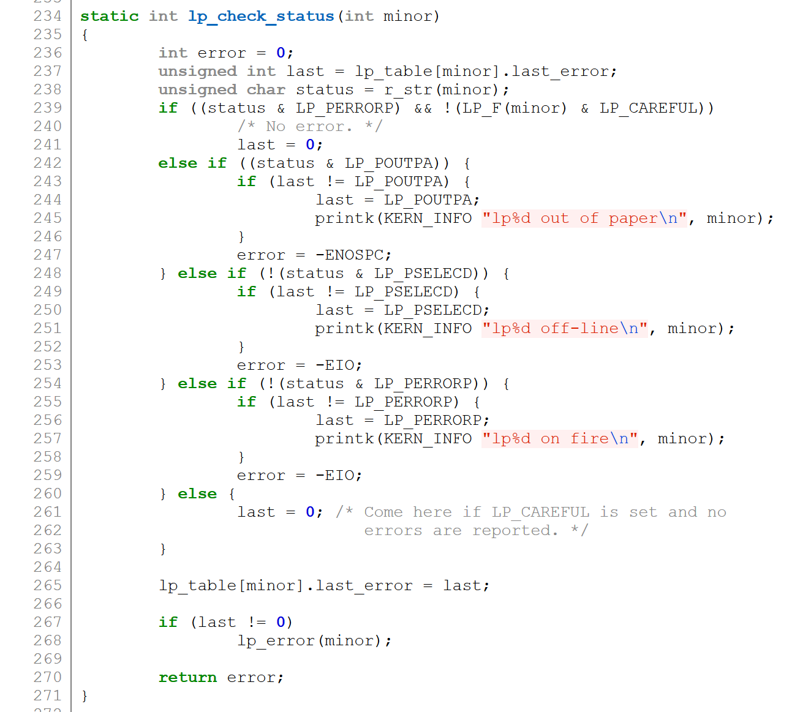
Highly Exceptional Control Flow
https://git.kernel.org/pub/scm/linux/kernel/git/torvalds/linux.git/tree/drivers/char/lp.c?h=v5.0-rc3

Slide 4
Today
Exceptional Control Flow
Exceptions
Processes
Process Control

Slide 5
Control Flow
Processors do only one thing:
  From startup to shutdown, a CPU simply reads and executes (interprets) a sequence of instructions, one at a time
  This sequence is the CPU’s control flow (or flow of control)
Program control flow
<startup>
inst₁
inst₂
inst₃
…
inst_{n}
<shutdown>
Time

Slide 6
Altering the Control Flow
Insufficient for a useful system:
Difficult to react to changes not intended by a program
  Integer Instruction divides by zero
  Data arrives from a disk or a network adapter
  User hits Ctrl-C at the keyboard
  System timer expires
System needs mechanisms for “exceptional control flow”

Slide 7
Exceptional Control Flow
Exists at all levels of a computer system
Low level mechanisms
  1. Exceptions
    Change in control flow in response to a system event
    It is mostly a hardware mechanism, which the OS configures
Higher level mechanisms
  2. Process context switch (later courses)
  3. Signals (later courses)
  4. Nonlocal jumps: setjmp() and longjmp()

Slide 8
Today
Exceptional Control Flow
Exceptions
Processes
Process Control

Slide 9
Exceptions
An exception is a transfer of control to the OS kernel in response to some event (i.e., change in processor state)
  Examples of events: Divide by 0, arithmetic overflow, page fault, I/O request completes, typing Ctrl-C
User code
Kernel code
Event
I_current
Exception
I_next
Exception processing
by exception handler
Return to I_current
Return to I_next
Kill the program
…

Slide 10
来点CSAPP笑话
处理器遇到异常之后，有三种可能：
第一，重新执行当前指令。
第二，跳过当前指令，继续执行。
第三，直接终止程序。
同学们学 CSAPP 的时候也有三种选择：
第一，没读懂，问了一下AI，再读一遍。
第二，没读懂，问了一下AI，弄懂了，不需要再读一次
第三，不读了，退课。

Slide 11
Exception Tables
Exception
numbers
Code for
exception handler 0
Each type of event has a
unique exception number k
k = index into exception table
(a.k.a. interrupt vector)
Handler k is called each time
exception k occurs
Exception
Table
Code for
exception handler 1
0
1
Code for
exception handler 2
2
...
n-1
...
Code for
exception handler n-1

Slide 12
(partial) Taxonomy
ECF
Asynchronous
Synchronous
Interrupts
Traps
Faults
Aborts

Slide 13
Asynchronous Exceptions (Interrupts)
Caused by events external to the processor
  Indicated by setting the processor’s interrupt pin
  Handler returns to “next” instruction
Examples:
  Timer interrupt
    Every few ms, an external timer chip triggers an interrupt
    Used by the kernel to support context switching (later)
  I/O interrupt from external device
  Hitting Ctrl-C at the keyboard
  Arrival of a packet from a network
  Arrival of data from a disk

Slide 14
Synchronous Exceptions
Caused by events that occur as a result of executing an instruction:
  Traps
    Examples: system calls, breakpoint traps, special instructions
    Returns control to “next” instruction
  Faults
    Unintentional but possibly recoverable
    Examples: page faults (recoverable), protection faults (unrecoverable), floating point exceptions
    Either re-executes faulting (“current”) instruction or kills the current program
  Aborts
    Unintentional and unrecoverable
    Examples: illegal instruction, parity error, machine check
    Kills the current program

Slide 15
System Calls
Each x86-64 system call has a unique ID number
Examples:
Number | Name | Description
0 | read | Read file
1 | write | Write file
2 | open | Open file
3 | close | Close file
4 | stat | Get info about file
57 | fork | Create process
59 | execve | Execute a program
60 | _exit | Terminate process
62 | kill | Send signal to process

Slide 16
System Call Example: Opening File
User calls: open(filename, options)
Calls __open function, which invokes a special instruction syscall
00000000000e5d70 <__open>:
...
e5d79: b8 02 00 00 00 mov $0x2,%eax # open is syscall #2
e5d7e: 0f 05 syscall # Return value in %rax
e5d80: 48 3d 01 f0 ff ff cmp $0xfffffffffffff001,%rax
...
e5dfa: c3 retq
User code
Kernel code
%rax contains syscall number
Other arguments in %rdi, %rsi, %rdx, %r10, %r8, %r9
Return value in %rax
Normally, negative value is an error
syscall
Exception
cmp
Open file
Returns

Slide 17
System Call Example: Opening File
Almost like a function call
Transfer of control
On return, executes next instruction
Passes arguments using calling convention
Gets result in %rax
One Important exception!
Executed by Kernel
Different set of privileges
And other differences:
  E.g., “address” of “function” is in %rax
User calls: open(filename, options)
Calls __open function, which invokes system call instruction syscall
00000000000e5d70 <__open>:
...
e5d79: b8 02 00 00 00 mov $0x2,%eax # open is syscall #2
e5d7e: 0f 05 syscall # Return value in %rax
e5d80: 48 3d 01 f0 ff ff cmp $0xfffffffffffff001,%rax
...
e5dfa: c3 retq
User code
Kernel code
%rax contains syscall number
Other arguments in %rdi, %rsi, %rdx, %r10, %r8, %r9
Return value in %rax
Normally, negative value is an error
syscall
Exception
cmp
Open file
Returns

Slide 18
Fault Example: Page Fault
int a[1000];
main ()
{
a[500] = 13;
}
User writes to memory location
That portion (page) of user’s memory
is not loaded.
80483b7: c7 05 10 9d 04 08 0d movl $0xd,0x8049d10
User code
Kernel code
Exception: page fault
movl
Copy page from disk to memory
Return and reexecute movl
Page handler must load page into physical memory
Returns to faulting instruction
Successful on second try

Slide 19
Fault Example: Invalid Memory Reference
int a[1000];
main ()
{
a[5000] = 13;
}
80483b7: c7 05 60 e3 04 08 0d movl $0xd,0x804e360
User code
Kernel code
Exception: page fault
movl
Detect invalid address
Signal process
Sends SIGSEGV signal to user process
User process exits with “segmentation fault”

Slide 20
Today
Exceptional Control Flow
Exceptions
Processes
Process Control

Slide 21
Recommend material
Operating systems: three easy pieces
https://pages.cs.wisc.edu/~remzi/OSTEP/cpu-intro.pdf
https://pages.cs.wisc.edu/~remzi/OSTEP/cpu-api.pdf

Slide 22
Processes
Definition: A process is an instance of a running program.
Process provides each program with two key abstractions:
  Exclusive use of the CPU
    Each program seems to have exclusive use of the CPU
    Provided by kernel mechanism called context switching
  Exclusive use of the main memory
    Each program seems to have exclusive use of main memory.
    Provided by kernel mechanism called virtual memory
Memory
Stack
Heap
Data
Code
CPU
Registers

Slide 23
来点CSAPP笑话
操作系统给每个进程提供两大幻觉：
第一，它觉得自己独占 CPU。
第二，它觉得自己独占内存。
CSAPP 的作者也有两大幻觉：
第一，读者的时间是无限的
第二，读者的记忆也是无限的

Slide 24
Multiprocessing: The Illusion
Memory
Memory
Memory
Stack
Stack
Stack
Heap
Heap
…
Heap
Data
Data
Data
Code
Code
Code
CPU
CPU
CPU
Registers
Registers
Registers
Computer runs many processes simultaneously
  Applications for one or more users
    Web browsers, email clients, editors, …
  Background tasks
    Monitoring network & I/O devices

Slide 25
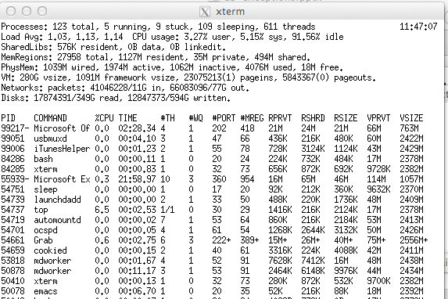
Multiprocessing Example
Running program “top” on Mac
  System has 123 processes, 5 of which are active
  Identified by Process ID (PID)

Slide 26
Multiprocessing: The (Traditional) Reality
Memory
Stack
Stack
Stack
Heap
Heap
…
Heap
Data
Data
Data
Code
Code
Code
Saved registers
Saved registers
CPU
Registers
Single processor executes multiple processes concurrently
  Process executions interleaved (multitasking)
  Address spaces managed by virtual memory system (later in course)
  Register values for nonexecuting processes saved in memory

Slide 27
Multiprocessing: The (Traditional) Reality
Memory
Stack
Stack
Stack
Heap
Heap
…
Heap
Data
Data
Data
Code
Code
Code
Saved registers
Saved registers
Saved registers
CPU
Registers
Save current registers in memory

Slide 28
Multiprocessing: The (Traditional) Reality
Memory
Stack
Stack
Stack
Heap
Heap
…
Heap
Data
Data
Data
Code
Code
Code
Saved registers
Saved registers
CPU
Registers
Schedule next process for execution

Slide 29
Multiprocessing: The (Traditional) Reality
Memory
Stack
Stack
Stack
Heap
Heap
…
Heap
Data
Data
Data
Code
Code
Code
Saved registers
Saved registers
Saved registers
CPU
Registers
Load saved registers and switch address space (context switch)

Slide 30
Multiprocessing: The (Modern) Reality
Memory
Stack
Stack
Stack
Heap
Heap
…
Heap
Data
Data
Data
Code
Code
Code
Saved registers
CPU
CPU
Multicore processors
  Share main memory (and last-level caches)
  Each can execute a separate process
  Context switch within a processor
Registers
Registers

Slide 31
Concurrent Processes
Each process is a logical control flow.
Two processes run concurrently (are concurrent) if their flows overlap in time
Otherwise, they are sequential
Examples (running on single core):
  Concurrent: A & B, A & C
  Sequential: B & C
Process A
Process B
Process C
Time

Slide 32
User View of Concurrent Processes
Control flows for concurrent processes are physically disjoint in time
However, we can think of concurrent processes as running in parallel with each other
Process A
Process B
Process C
Time

Slide 33
Context Switching
Processes are managed by a shared chunk of memory-resident OS code called the kernel
  Important: the kernel normally is not a separate process, but rather runs as part of some existing process.
Control flow passes from one process to another via a context switch
Process A
Process B
user code
kernel code
context switch
Time
user code
kernel code
context switch
user code

Slide 34
Today
Exceptional Control Flow
Exceptions
Processes
Process Control

Slide 35
Obtaining Process IDs
pid_t getpid(void)
  Returns PID of current process
pid_t getppid(void)
  Returns PID of parent process

Slide 36
Creating and Terminating Processes
From a programmer’s perspective, we can think of a process as being in one of three states
Running
  Process is ready to run: either executing, or waiting to be executed and will eventually be scheduled (i.e., chosen to execute) by the kernel
Stopped
  Process is not ready to run: its execution is suspended and will not be scheduled until further notice (next lecture when we study signals)
Terminated
  Process is stopped permanently

Slide 37
Creating Processes
Parent process creates a new running child process by calling fork
int fork(void)
  Returns 0 to the child process, child’s PID to parent process
  Child is almost identical to parent:
    Child gets the same program state (i.e., memory and register state) from the parent
    Child and parent receives a different return value from the fork.
    Child has a different PID than the parent
fork is interesting (and often confusing)

Slide 38
Conceptual View of fork
Memory
Memory
parent
child
Stack
➔
Stack
Stack
Heap
Heap
Heap
Data
Data
Data
Code
Code
Code
Saved registers
Saved registers
Saved registers
CPU
CPU
Registers
Registers
Make complete copy of execution state
  Designate one as parent and one as child

Slide 39
fork Example
fork.c
int main(int argc, char** argv)
{
int x = 1, ret = 0;
printf(“init: pid = %d: x=%d\n", getpid(), x);
ret = fork();
if (ret == 0) { /* Child */
printf("child : pid = %d, x=%d\n",
getpid(), ++x);
return 0;
}
/* Parent */
printf("parent: pid = %d, x=%d\n", getpid(), --x);
return 0;
}
linux> ./fork
init: pid = 29146, x =1
parent: pid = 29146, x=0
child : pid = 29147, x=2
linux> ./fork
init: pid = 29146, x =1
child : pid = 29147, x=2
parent: pid = 29146, x=0

Slide 40
Making fork More Nondeterministic
Problem
  Linux scheduler does not create much run-to-run variance
    E.g., does fork return to child first, or to parent?
Solution
  Create custom version of library routine that inserts random delays along different branches
    E.g., for parent and child in fork
  Use runtime interpositioning to have program use special version of library code
Notes:
Linux 的调度器在多次运行之间几乎不会产生太大的差异。
这会“隐藏”掉那些在非确定性程序中可能出现的竞态条件（race condition）。
通过修改或“替换”系统库函数（例如 fork()），在函数执行路径中随机插入延迟，就可以人为地增加不同运行之间的时序差异。
这样就能更容易暴露竞态条件：如果程序有潜在的并发问题，不同延迟可能导致不同的错误表现。

Slide 41
Variable delay fork
/* fork wrapper function */
pid_t fork(void) {
initialize();
int parent_delay = choose_delay();
int child_delay = choose_delay();
pid_t parent_pid = getpid();
pid_t child_pid_or_zero = real_fork();
if (child_pid_or_zero > 0) {
/* Parent */
if (verbose) {
printf(
"Fork. Child pid=%d, delay = %dms. Parent pid=%d, delay = %dms\n",
child_pid_or_zero, child_delay,
parent_pid, parent_delay);
fflush(stdout);
}
ms_sleep(parent_delay);
} else {
/* Child */
ms_sleep(child_delay);
}
return child_pid_or_zero;
}
myfork.c
Notes:
Enable with:
setenv LD_PRELOAD ./myfork.so
Can turn on/off verbose printing with:
setenv VERBOSE 1
unsetenv VERBOSE

Slide 42
forkx2 Example
int main(int argc, char** argv)
{
pid_t pid;
int x = 1;
pid = fork();
if (pid == 0) { /* Child */
printf("child : x=%d\n", ++x);
printf("child : x=%d\n", ++x);
return 0;
}
/* Parent */
printf("parent: x=%d\n", --x);
printf("parent: x=%d\n", --x);
return 0;
}
linux> ./forkx2
parent: x=0
parent: x=-1
child : x=2
child : x=3

Slide 43
Modeling fork with Process Graphs
A process graph is a useful tool for capturing the partial ordering of statements in a concurrent program:
  Each vertex is the execution of a statement
  a -> b means a happens before b
  Edges can be labeled with the current value of variables
Any topological sort of the graph corresponds to a feasible total ordering.
  Total ordering of vertices where all edges point from left to right

Slide 44
Process Graph Example
int main(int argc, char** argv)
{
pid_t pid;
int x = 1;
pid = fork();
if (pid == 0) { /* Child */
printf("child : x=%d\n", ++x);
return 0;
}
/* Parent */
printf("parent: x=%d\n", --x);
return 0;
}
child: x=2
Child
printf
exit
x==1
parent: x=0
Parent
main
fork
printf
exit
fork.c

Slide 45
Interpreting Process Graphs
Original graph:
Relabled graph:
child: x=2
printf
exit
x==1
parent: x=0
main
fork
printf
exit
Feasible ordering:
e
f
a
b
e
c
f
d
a
b
c
d
Infeasible ordering:
a
b
f
c
e
d

Slide 46
fork Example: Two consecutive forks
Bye
void fork2()
{
printf("L0\n");
fork();
printf("L1\n");
fork();
printf("Bye\n");
}
printf
L1
Bye
printf
fork
printf
Bye
printf
L0
L1
Bye
forks.c
printf
fork
printf
fork
printf
Feasible output:
L0
L1
Bye
Bye
L1
Bye
Bye
Infeasible output:
L0
Bye
L1
Bye
L1
Bye
Bye
Notes:
Run ./forks 2
(Similarly for other examples)

Slide 47
fork Example: Nested forks in parent
void fork4()
{
printf("L0\n");
if (fork() != 0) {
printf("L1\n");
if (fork() != 0) {
printf("L2\n");
}
}
printf("Bye\n");
}
Bye
Bye
printf
printf
L0
L1
L2
Bye
printf
fork
printf
fork
printf
printf
forks.c
Feasible output:
L0
L1
Bye
Bye
L2
Bye
Infeasible output:
L0
Bye
L1
Bye
Bye
L2

Slide 48
fork Example: Nested forks in children
void fork5()
{
printf("L0\n");
if (fork() == 0) {
printf("L1\n");
if (fork() == 0) {
printf("L2\n");
}
}
printf("Bye\n");
}
L2
Bye
printf
printf
L1
Bye
printf
fork
printf
L0
Bye
printf
fork
printf
Feasible output:
L0
Bye
L1
L2
Bye
Bye
Infeasible output:
L0
Bye
L1
Bye
Bye
L2
forks.c

Slide 49
execve: Loading and Running Programs
int execve(char *filename, char *argv[], char *envp[])
Loads and runs in the current process:
  Executable file filename
  …with argument list argv
    By convention argv[0]==filename
  …and environment variable list envp
    “name=value” strings (e.g., USER=droh)
    getenv, putenv, printenv
Overwrites code, data, and stack
  Retains PID (open files and signal context)

Slide 50
execve: Loading and Running Programs
int execve(char *filename, char *argv[], char *envp[])
Loads and runs in the current process:
  Executable file filename
Overwrites code, data, and stack
  Retains PID (open files and signal context)
if ((pid = fork()) == 0) { /* Child runs program */
if (execve(myargv[0], myargv, environ) < 0) {
printf("%s: Command not found.\n", myargv[0]);
exit(1);
}
}

Slide 51
execve Example
Execute "/bin/ls –lt /usr/include" in child process using current environment:
envp[n] = NULL
envp[n-1]
"PWD=/usr/droh"
…
envp[0]
"USER=droh"
environ
myargv[argc] = NULL
(argc == 3)
myargv[2]
"/usr/include"
myargv[1]
"-lt"
myargv
myargv[0]
"/bin/ls"

Slide 52
Structure of the stack when a new program starts
Null-terminated
environment variable strings
Bottom of stack
Null-terminated
command-line arg strings
envp[n] == NULL
envp[n-1]
environ
(global var)
...
envp[0]
argv[argc] = NULL
envp
(in %rdx)
argv[argc-1]
...
argv
(in %rsi)
argv[0]
argc
(in %rdi)
Stack frame for
libc_start_main
Top of stack
Future stack frame for
main

Slide 53
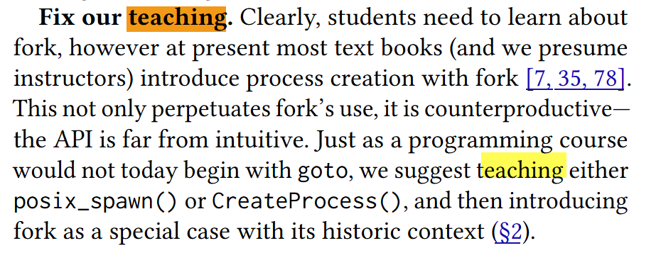
Why fork is outdated
https://www.microsoft.com/en-us/research/wp-content/uploads/2019/04/fork-hotos19.pdf

Slide 54
Terminating Processes
Process becomes terminated for one of three reasons:
  Receiving a signal whose default action is to terminate (next lecture)
  Returning from the main routine
  Calling the exit function
void exit(int status)
  Terminates with an exit status of status
  Convention: normal return status is 0, nonzero on error
  Another way to explicitly set the exit status is to return an integer value from the main routine
exit is called once but never returns.

Slide 55
Reaping Child Processes
Idea
  When process terminates, it still consumes system resources
    Examples: Exit status, various OS tables
  Called a “zombie”
    Living corpse, half alive and half dead
Reaping
  Performed by parent on terminated child (using wait or waitpid)
  Parent is given exit status information
  Kernel then deletes zombie child process
What if parent doesn’t reap?
  If any parent terminates without reaping a child, then the orphaned child should be reaped by init process (pid == 1)
  So, only need explicit reaping in long-running processes
    e.g., shells and servers

Slide 56
Zombie
Example
void fork7() {
if (fork() == 0) {
/* Child */
printf("Terminating Child, PID = %d\n", getpid());
exit(0);
} else {
printf("Running Parent, PID = %d\n", getpid());
while (1)
; /* Infinite loop */
}
}
linux> ./forks 7 &
[1] 6639
Running Parent, PID = 6639
Terminating Child, PID = 6640
linux> ps
PID TTY TIME CMD
6585 ttyp9 00:00:00 tcsh
6639 ttyp9 00:00:03 forks
6640 ttyp9 00:00:00 forks <defunct>
6641 ttyp9 00:00:00 ps
linux> ./forks 7 &
[1] 6639
Running Parent, PID = 6639
Terminating Child, PID = 6640
linux> ./forks 7 &
[1] 6639
Running Parent, PID = 6639
Terminating Child, PID = 6640
linux> ps
PID TTY TIME CMD
6585 ttyp9 00:00:00 tcsh
6639 ttyp9 00:00:03 forks
6640 ttyp9 00:00:00 forks <defunct>
6641 ttyp9 00:00:00 ps
linux> kill 6639
[1] Terminated
linux> ps
PID TTY TIME CMD
6585 ttyp9 00:00:00 tcsh
6642 ttyp9 00:00:00 ps
forks.c
ps shows child process as “defunct” (i.e., a zombie)
Killing parent allows child to be reaped by init

Slide 57
Non- terminating
Child Example
void fork8()
{
if (fork() == 0) {
/* Child */
printf("Running Child, PID = %d\n",
getpid());
while (1)
; /* Infinite loop */
} else {
printf("Terminating Parent, PID = %d\n",
getpid());
exit(0);
}
}
linux> ./forks 8
Terminating Parent, PID = 6675
Running Child, PID = 6676
forks.c
linux> ./forks 8
Terminating Parent, PID = 6675
Running Child, PID = 6676
linux> ps
PID TTY TIME CMD
6585 ttyp9 00:00:00 tcsh
6676 ttyp9 00:00:06 forks
6677 ttyp9 00:00:00 ps
linux> ./forks 8
Terminating Parent, PID = 6675
Running Child, PID = 6676
linux> ps
PID TTY TIME CMD
6585 ttyp9 00:00:00 tcsh
6676 ttyp9 00:00:06 forks
6677 ttyp9 00:00:00 ps
linux> kill 6676
linux> ps
PID TTY TIME CMD
6585 ttyp9 00:00:00 tcsh
6678 ttyp9 00:00:00 ps
Child process still active even though parent has terminated
Must kill child explicitly, or else will keep running indefinitely

Slide 58
wait: Synchronizing with Children
Parent reaps a child by calling the wait function
int wait(int *child_status)
  Suspends itself until one of its children terminates
Parent Process
Kernel code
syscall
Exception
…
Returns

Slide 59
wait: Synchronizing with Children
Parent reaps a child by calling the wait function
int wait(int *child_status)
  Suspends itself until one of its children terminates
  Return value is the pid of the child process that terminated
  If child_status != NULL, *(child_status) will be set to a value that indicates reason the child terminated:
    Checked using macros defined in wait.h
      WIFEXITED, WEXITSTATUS, WIFSIGNALED, WTERMSIG, WIFSTOPPED, WSTOPSIG, WIFCONTINUED
      See textbook for details

Slide 60
wait: Synchronizing with Children
void fork9() {
int child_status;
if (fork() == 0) {
printf("HC: hello from child\n");
exit(0);
} else {
printf("HP: hello from parent\n");
wait(&child_status);
printf("CT: child has terminated\n");
}
printf("Bye\n");
}
HC
exit
printf
CT
Bye
HP
fork
printf
wait
printf
forks.c
Feasible output:
HC
HP
CT
Bye
Feasible output(s):
HC HP
HP HC
CT CT
Bye Bye
Infeasible output:
HP
CT
Bye
HC

Slide 61
Another wait Example
If multiple children completed, will take in arbitrary order
Can use macros WIFEXITED and WEXITSTATUS to get information about exit status
void fork10() {
pid_t pid[N];
int i, child_status;
for (i = 0; i < N; i++)
if ((pid[i] = fork()) == 0) {
exit(100+i); /* Child */
}
for (i = 0; i < N; i++) { /* Parent */
pid_t wpid = wait(&child_status);
if (WIFEXITED(child_status))
printf("Child %d terminated with exit status %d\n",
wpid, WEXITSTATUS(child_status));
else
printf("Child %d terminate abnormally\n", wpid);
}
}
forks.c
Notes:
Will consistently terminate in order, even with random delays.
But, can turn off delays on parent with
setenv PARENT 0
Then see variations in termination order

Slide 62
waitpid: Waiting for a Specific Process
pid_t waitpid(pid_t pid, int *status, int options)
  Suspends current process until specific process terminates
  Various options (see textbook)
void fork11() {
pid_t pid[N];
int i;
int child_status;
for (i = 0; i < N; i++)
if ((pid[i] = fork()) == 0)
exit(100+i); /* Child */
for (i = N-1; i >= 0; i--) {
pid_t wpid = waitpid(pid[i], &child_status, 0);
if (WIFEXITED(child_status))
printf("Child %d terminated with exit status %d\n",
wpid, WEXITSTATUS(child_status));
else
printf("Child %d terminate abnormally\n", wpid);
}
}
forks.c
Notes:
Will always terminate in reverse order

Slide 63
System Call Error Handling
On error, Linux system-level functions typically return -1 and set global variable errno to indicate cause.
Hard and fast rule:
  You must check the return status of every system-level function
  Only exception is the handful of functions that return void
Example:
if ((pid = fork()) < 0) {
fprintf(stderr, "fork error: %s\n", strerror(errno));
exit(-1);
}

Slide 64
Error-reporting functions
Can simplify somewhat using an error-reporting function:
But, must think about application. Not alway appropriate to exit when something goes wrong.
void unix_error(char *msg) /* Unix-style error */
{
fprintf(stderr, "%s: %s\n", msg, strerror(errno));
exit(-1);
}
if ((pid = fork()) < 0)
unix_error("fork error");
Note: csapp.c exits with 0.

Slide 65
Error-handling Wrappers
We simplify the code we present to you even further by using Stevens-style error-handling wrappers:
NOT what you generally want to do in a real application
pid_t Fork(void)
{
pid_t pid;
if ((pid = fork()) < 0)
unix_error("Fork error");
return pid;
}
pid = Fork();

Slide 66
Summary
Exceptions
  Events that require nonstandard control flow
  Generated externally (interrupts) or internally (traps and faults)
Processes
  At any given time, system has multiple active processes
  Only one can execute at a time on any single core
  Each process appears to have total control of
  processor + private memory space

Slide 67
Summary (cont.)
Spawning processes
  Call fork
  One call, two returns
Process completion
  Call exit
  One call, no return
Reaping and waiting for processes
  Call wait or waitpid
Loading and running programs
  Call execve (or variant)
  One call, (normally) no return

