Slide 1
Detecting Parkinson’s Disease
Thijme Langelaar
Simon Coopmans
Sanne Westerveld
Martijn van Haren

Slide 2
Rationale

Slide 3
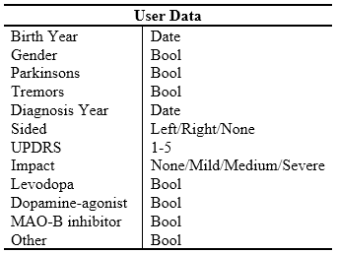
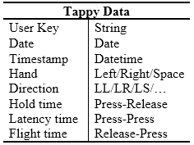
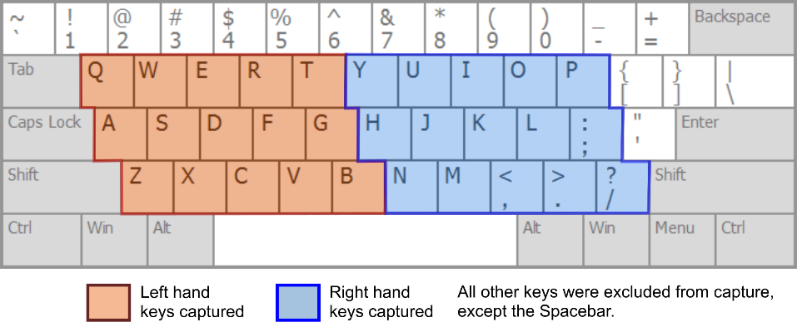
Dataset
$$Hold Time×Hand\left(3\right)=3 features$$
$$Time \left(3\right) ×Direction (9)=27 features$$
Tasks
Building a classification model that differentiates Mild from Healthy
Determine the effect of medication on the results of the model

Slide 4
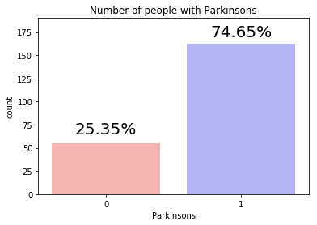
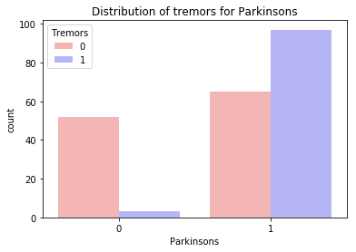
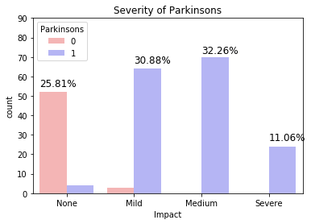
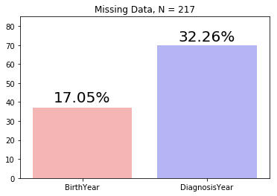
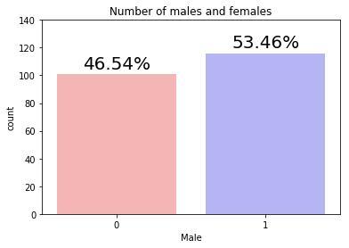
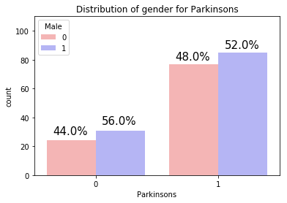
Exploratory Data Analysis: User Data

Slide 5
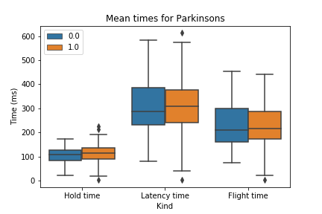
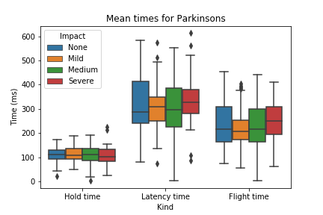
Exploratory Data Analysis: Tappy Data

Slide 6
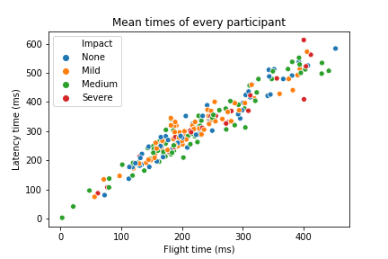
Machine Learning
“Given Tappydata, does this user suffer from Mild Parkinson?”
Labeled data: Supervised Learning
Target variable: Parkinsons (boolean) → Classification
Features: mean(HandTime,LatencyTime,FlightTime)
Hold time x Hand
Times x Direction
Time of the day?

