Slide 1
Detecting Parkinson’s Disease
Thijme Langelaar
Simon Coopmans
Sanne Westerveld
Martijn van Haren

Slide 2

Rationale
6.000.000+ Parkinson’s patients worldwide¹
Prevalence is rising with age (1903 per 100.000 people for 80+)^{1,2}
Increasing life expectancy → increasing number of patients
No definitive test^{3,2}
→Too often the wrong diagnosis^{2,4,6}
Dependent on who’s performing^{4,6}
1.Pringsheim et al, 2014; 2.Adams, 2017; 3.Jankovic, 2008; 4.Pagan, 2012; 6.Pradhan et al, 2010

Slide 3

Rationale
No definitive test^{3,2}
→Too often the wrong diagnosis^{2,4,6}
Dependent on who’s performing^{4,6}
Solution:
Using machine learning in early detection
→ Subtle changes in fine motor control⁵
Distinguish between healthy people and patients
→ Type data as alternative/tool
2.Adams, 2017; 3.Jankovic, 2008; 4.Pagan, 2012; 5.Dahdal et al, 2016; 6.Pradhan et al, 2010

Slide 4
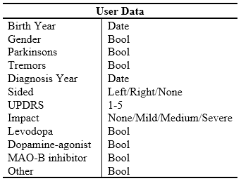
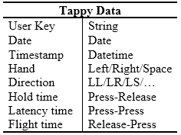
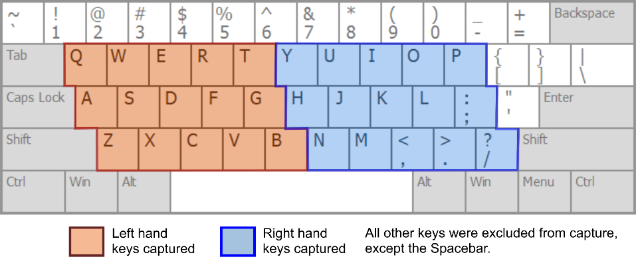
Dataset
$$Hold Time×Hand\left(3\right)=3 features$$
$$Time \left(3\right) ×Direction (9)=27 features$$
Tasks
Building a classification model that differentiates Mild from Healthy
Determine the effect of medication on the results of the model

Slide 5
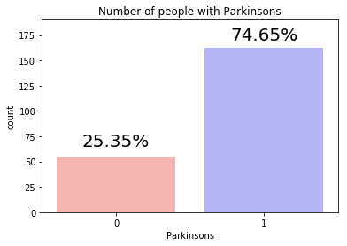
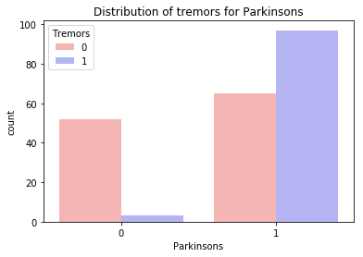
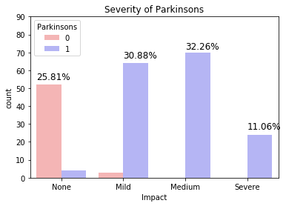
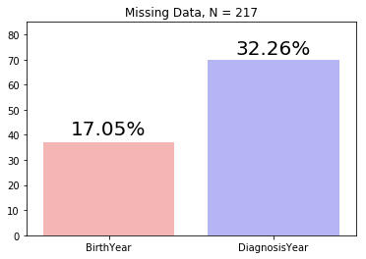
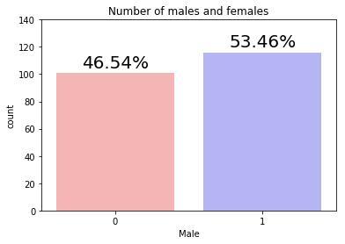
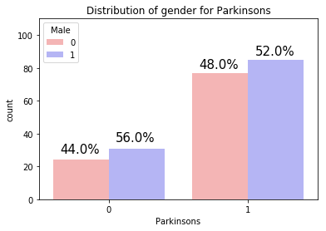
Exploratory Data Analysis: User Data

Slide 6
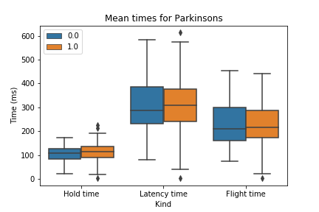
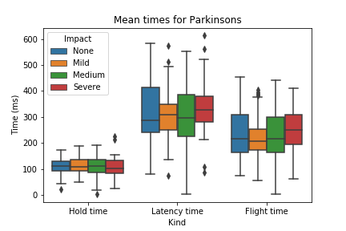
Exploratory Data Analysis: Tappy Data

Slide 7
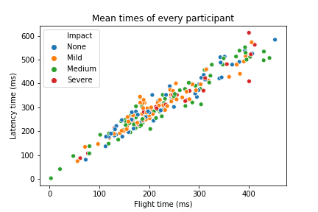
Machine Learning
“Given Tappydata, does this user suffer from Mild Parkinson?”
Labeled data: Supervised Learning
Target variable: Parkinsons (boolean) → Classification
Features: mean(HandTime,LatencyTime,FlightTime)
Hold time x Hand
Times x Direction
Time of the day?

