Slide 1


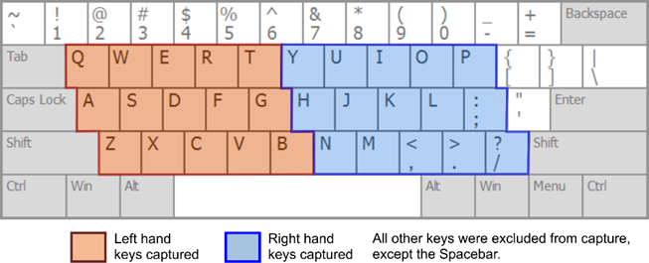
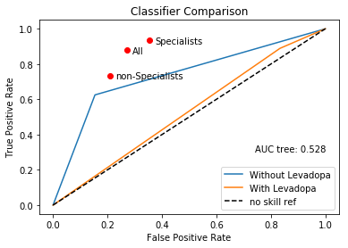

Thijme Langelaar, Simon Coopmans, Martijn van Haren, Sanne Westerveld
Center for Human Movement Sciences,
University Medical Center Groningen, University of Groningen, The Netherlands
Detecting Parkinson’s Disease
INTRODUCTION
Methods
Partly because there is no definitive test for diagnosing Parkinson’s Disease (PD) [1,2], too often the wrong diagnosis is made [1]. The rate of good diagnosis also depends on who is performing it [1]. In the early stages of Parkinson’s, there are subtle changes in the fine motor control [3], which can be detected during a fine motor control task, such as typing. As a solution to the diagnostic problem, this project looks for a way to use machine learning in the early detection of Parkinson’s disease and what the impact of L-Dopa us on the model.
The Tappy data used for this project was collected W.R Adams (2017). The data for building the classification model includes 69 participants, of which 26 had mild PD and did not use L-Dopa and 43 persons were healthy. To measure the influence of L-Dopa, there was data used of 26 mild PD patients who used L-Dopa.
For the prediction of Parkinson’s Disease, we looked at 27 features in the data. These were separated in two groups:
Hold time (9 features): elapsed time between pressing and releasing each key.
Latency time (18 features): elapsed time between pressing one key and the next key.
The mean difference between left (L) and right (R) for hold time, and between LL & RR, and LR & RL for latency time, are measures of asymmetry.
Study goals:
Predicting mild Parkinson’s disease using type data.
Study whether L-Dopa influences the results of the classification model.
Feature group | Feature
Hold | Hold time left fingers
 | Hold time right fingers
 | Mean difference between left and right
Latency | Left to right key latency
 | Right to left key latency
 | Left to left key latency
 | Right to right key latency
 | Mean difference between LR and RL
 | Mean difference between RR and LL
Fig.1. The keys that are used for the dataset [1]
Table.1. Features used for the classification model.
Fig. 2. ROC curve
Results
For all participants, we calculated the mean, standard deviation, kurtosis and skewness of the features (see table 1).
A Principle Component Analysis (PCA) was used to reduce the larger set of features to a smaller set. Hold 5 features and Latency 6 features with an explained variance of 90%.
The data used for building the classification model was randomly split in 70% training data and 30% test data, which was fitted using a 10 fold cross validation.
Different models (KNN, Logreg, Tree) were fitted to the data. The Tree classifier was the best and is used.
The classification model predicted with an accuracy of 76% the diagnosis of mild PD.
L-Dopa is almost the same as non PD patients (see figure 2). This shows that
PD/non-PD | 7/14
True Positive | 5
True Negative | 11
False Positive | 2
False Negative | 3
Sensitivity | 62.5%
Specificity | 84.6%
CONCLUSION
References
[1] Adams, W.R., (2017). High-accuracy detection of early Parkinson’s disease using multiple characteristics of finger movement while typing. PLoS ONE 12(11),
DOI 10.1371/journal.pone.0188226 ;
[2] Jankovic, J. (2008). Parkinson’s disease: clinical features and diagnosis. J Neurol Neurosurg Psychiatry 79:368–376, DOI: 10.1136/jnnp.2007.131045;
[3] Dahdal, P., Meyer, A., Chaturvedi M., Nowak, K., Roesch, A.D., Fuhr, P., Gschwandtner, U., (2016). Fine Motor Function Skills in Patients with Parkinson Disease with and without
Mild Cognitive Impairment, 42:127–134, DOI: 10.1159/000448751.
Center for Human Movement Sciences • P.O. Box 196, 9700 AD Groningen, The Netherlands • E-mail s.westerveld@student.rug.nl •

