Slide 1

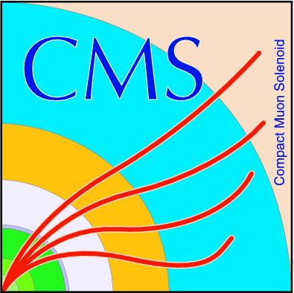
Search for Long-Lived Neutral Particles in Final States with Delayed Photons and Missing Transverse Energy in proton-proton collisions @
Norbert Tambe Ebai
Oral Exam
Nov 3, 2015

Slide 2
MENU
Introduction
ECAL Timing
Search Analysis
Result
Summary
2

Slide 3
Introduction
3

Slide 4
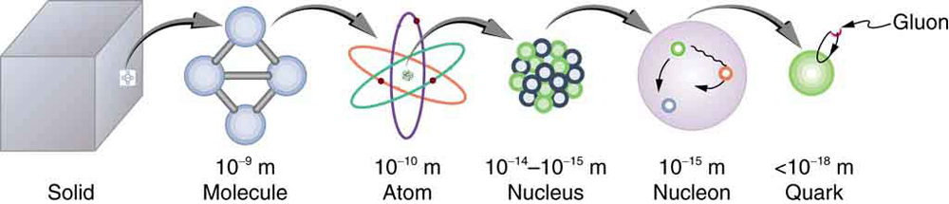
Introduction
Matter description at lengths of about one billionth of a billionth of a meter.
4

Slide 5
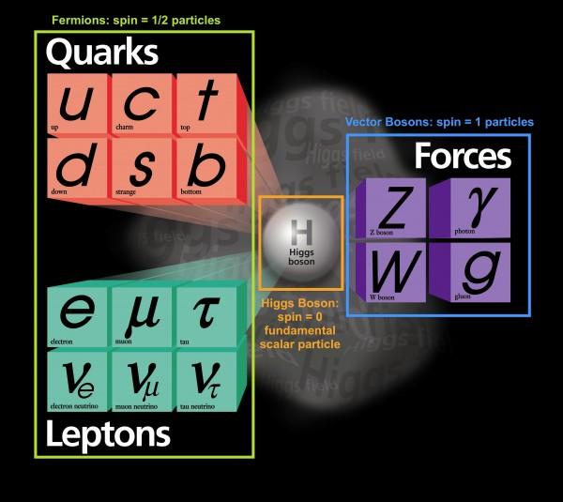
The Standard Model
Describes visible matter in the entire universe.
5

Slide 6
SM: Interactions & Lifetimes
Boson | Interaction | Symmetry | Lifetime
W, Z | Weak
Photon | Electromagnetic
Gluons | Strong
The SM does not describe gravity for which the typical lifetime is about the age of the universe(about 13.7 billion years).
6

Slide 7
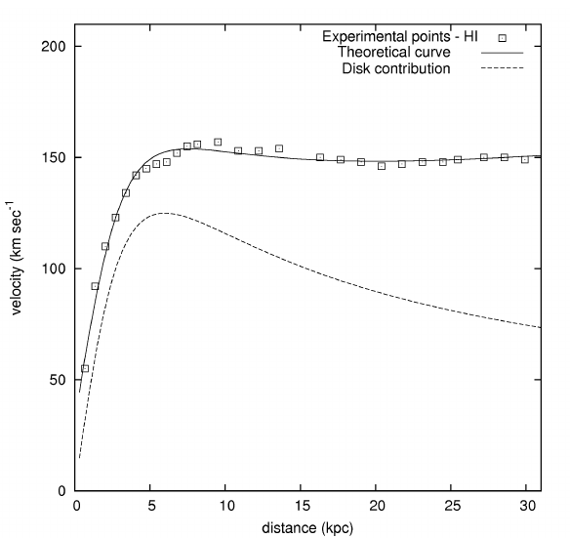
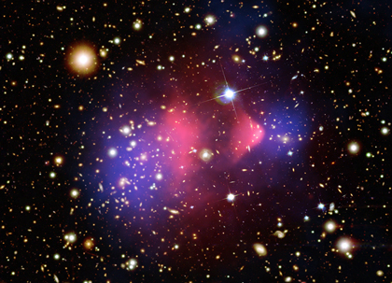
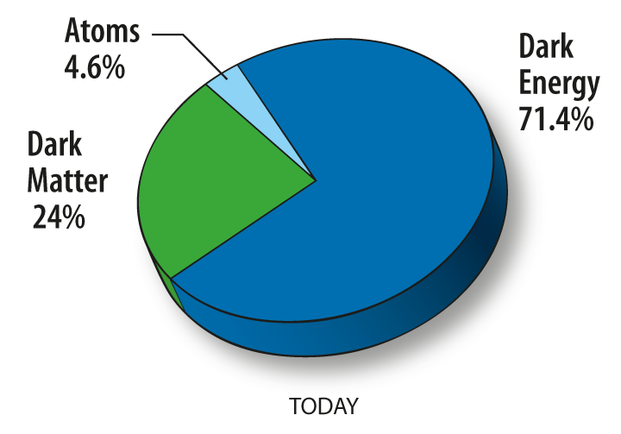
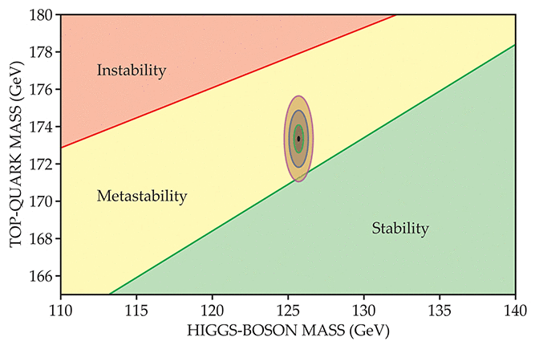
Exotic Forms of Matter
Non-Visible or Dark Matter.
Massive Long-Lived Particles.
Mass > 1 GeV/cc,
Lifetimes from one billionth of a second to 13.7 billion years,
Neutral or charged.
Meta-stable universe: V.Branchina et al: http://dx.doi.org/10.1007/JHEP09(2014)182
7

Slide 8
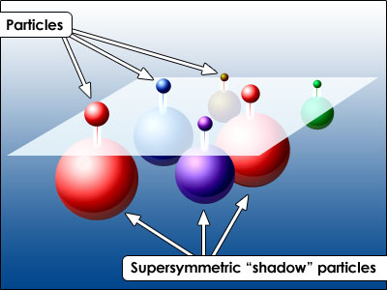
Long-Lived Particles Models
Supersymmetry (SUSY):
Gauge Mediated SUSY Breaking:
U(1) Gauge
N msgr fields, mass = M
Breaking sector
Visible sector
8

Slide 9
GMSB Long-Lived Models
Model parameters:
Typical lifetime of the NLSP with mass m is:
9

Slide 10
SPS8 Benchmark GMSB Model
Choice of parameters:
Lightest Neutralino is the NLSP and decays to photon and gravitino 83 to 94 % of the time.
Gravitino is the Lightest Supersymetric Particle(LSP).
Lifetime of NLSP ranges from few nanoseconds to several meters.
10

Slide 11
ECAL Timing
11

Slide 12
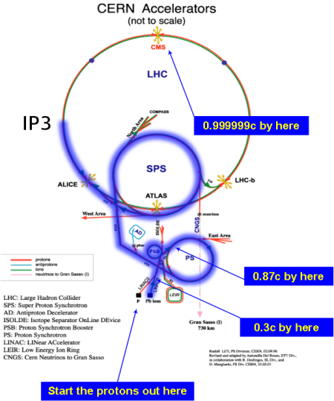
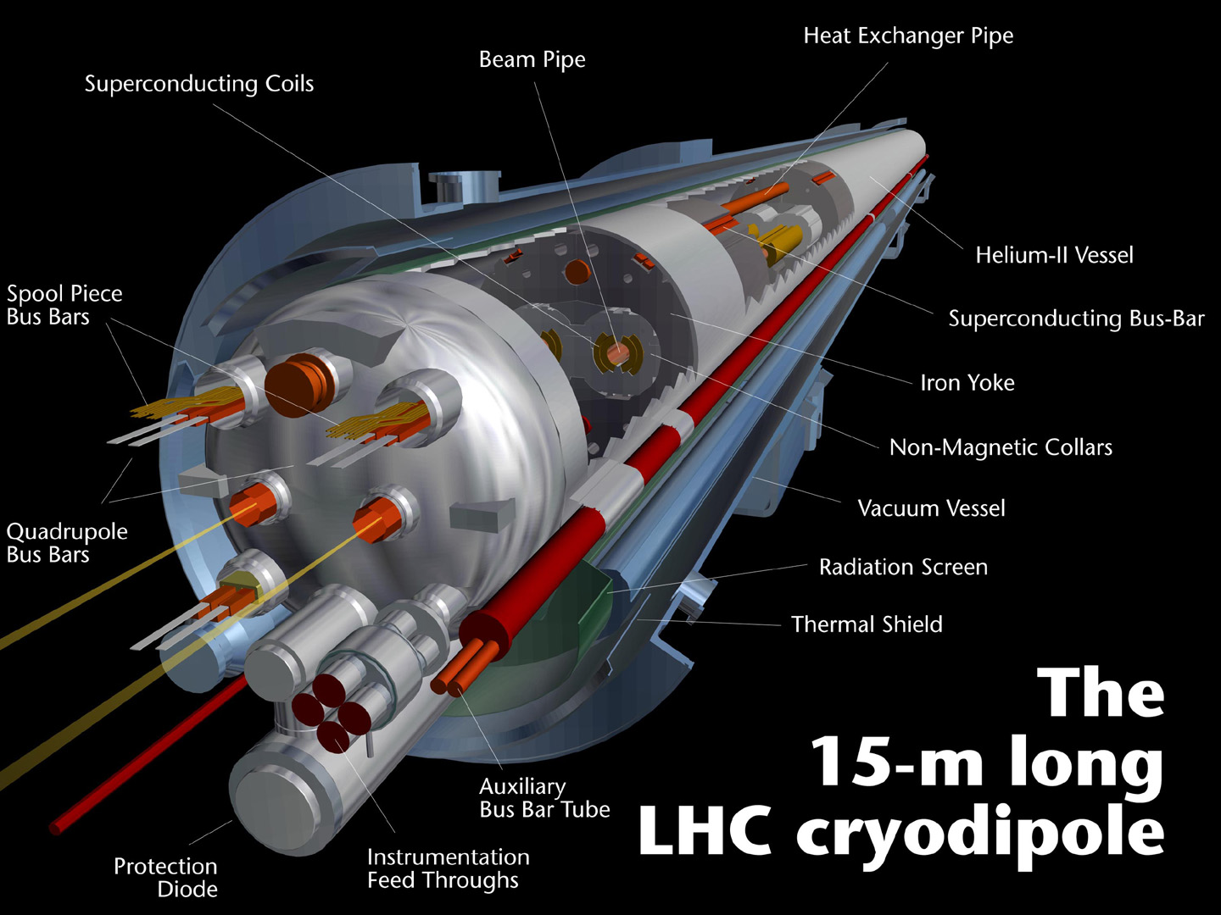
Large Hadron Collider
Aim is to search for Signatures of :
The Higgs Boson
Supersymmetry
Dark matter
Designed Specifications :
Proton-Proton bunch circulating in 26659m circumference synchrotron.
Accelerate protons up to 7TeV.
1.1 x10^11 protons collide every 25ns.
Dipole and quadrupole magnets steer proton beams.
12

Slide 13
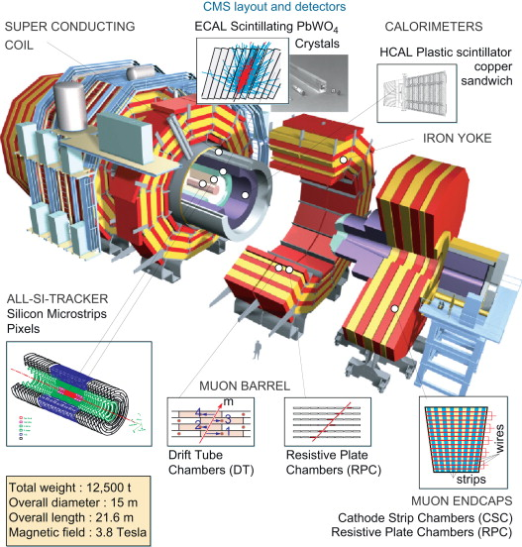
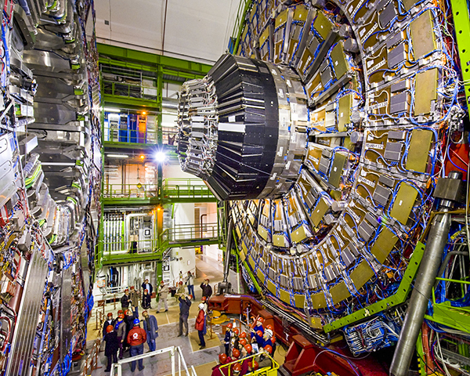
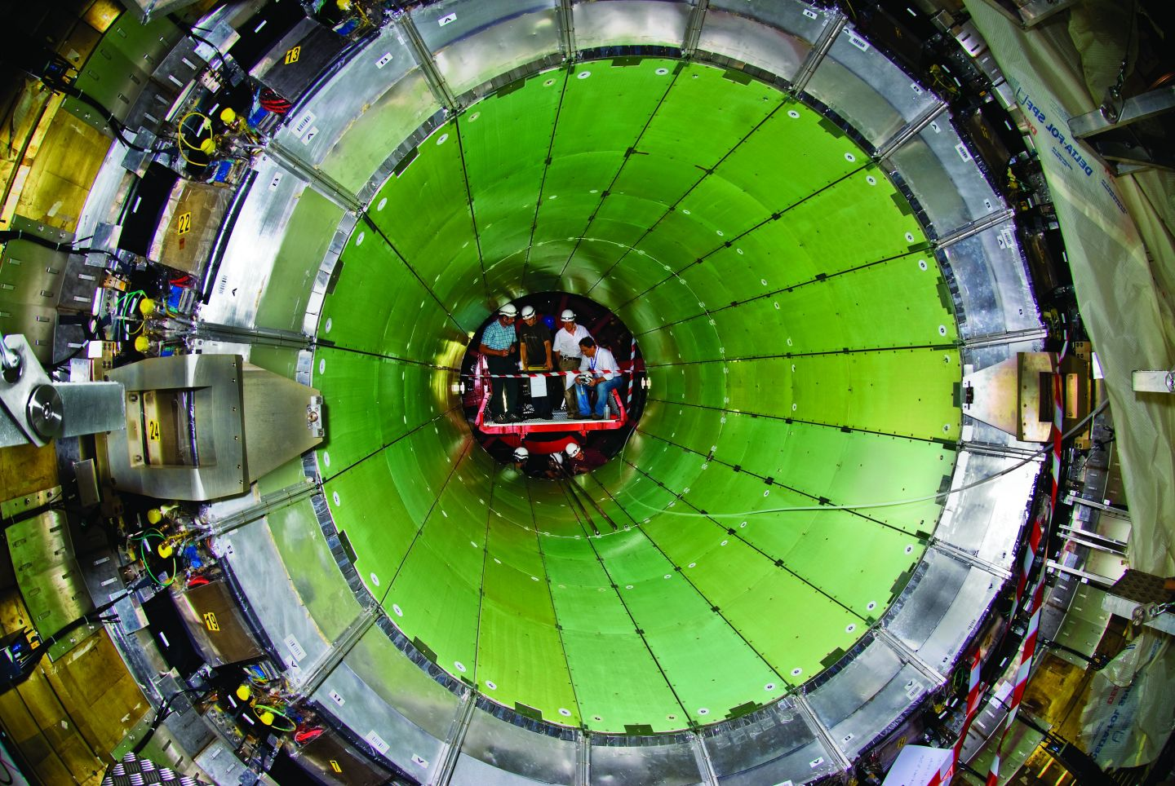
Compact Muon Solenoid
13

Slide 14
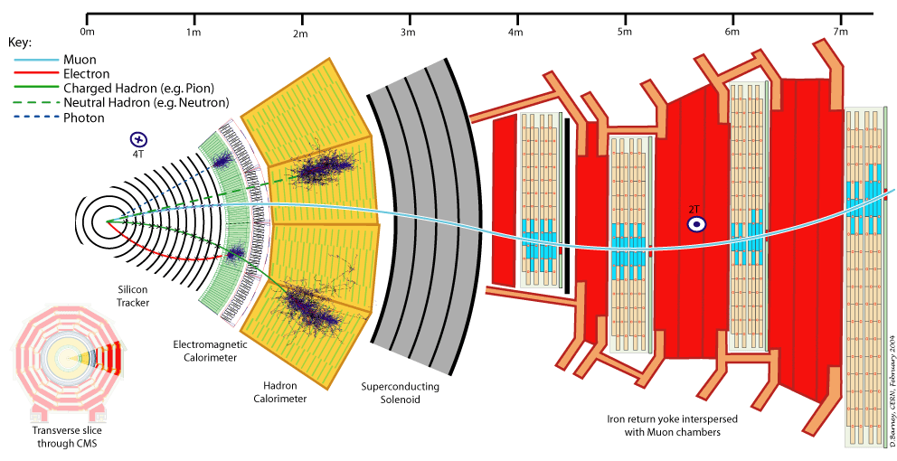
Particle Detection
14

Slide 15
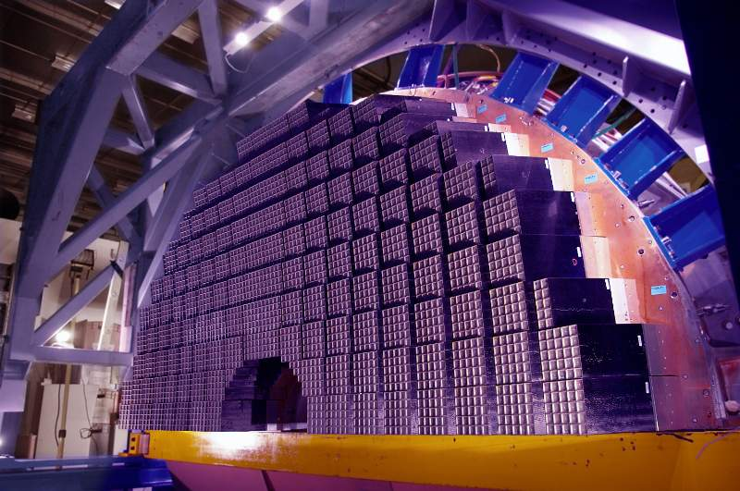
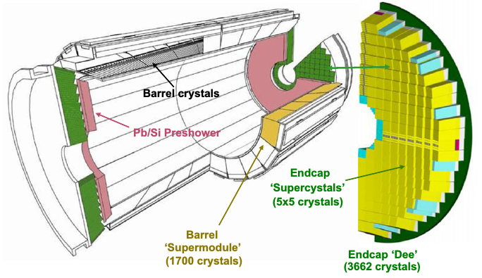
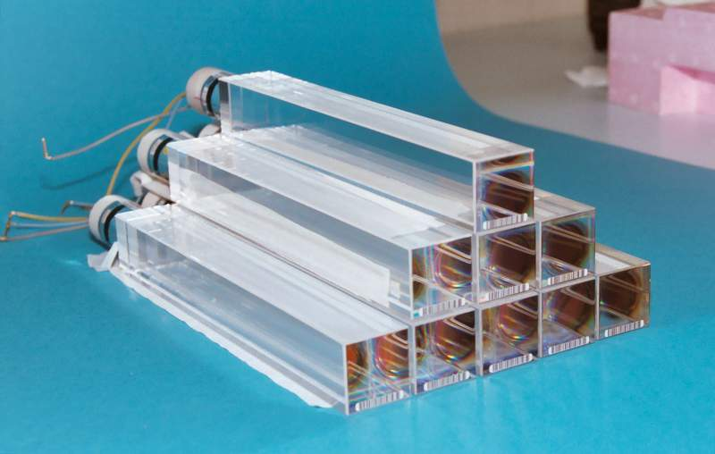
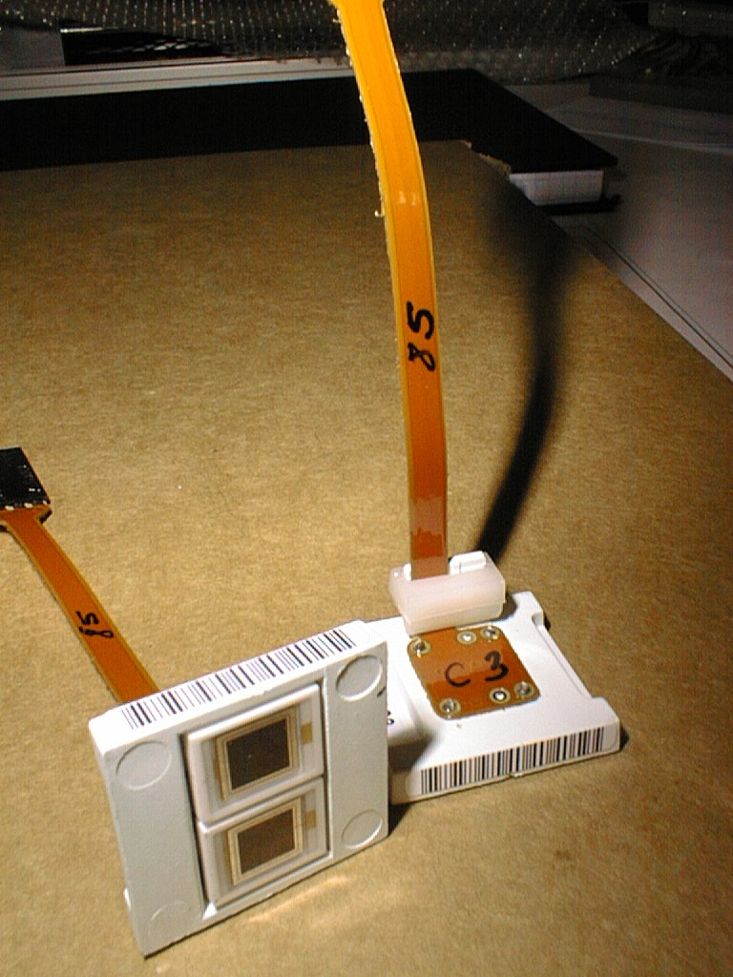
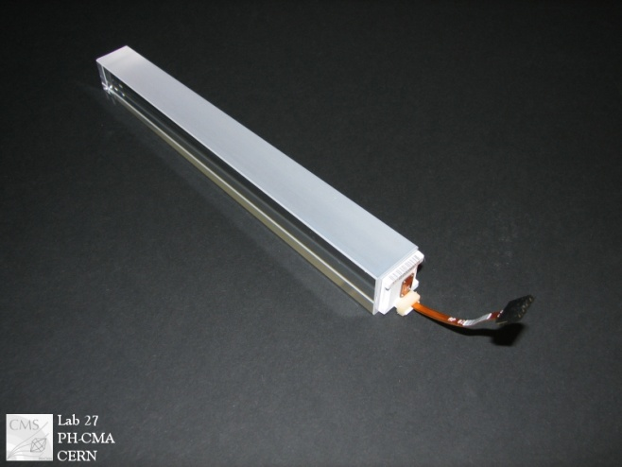
Electromagnetic Calorimeter
Lead Tungstate Homogeneous crystal calorimeter
Barrel(EB)
61200 crystals
Covers |eta| < 1.48
Uses APDs
Preshower(ES)
Pb/Si sampling calorimeter
Covers 1.65 < |eta| < 2.6
137216 Silicon Strips
Endcap(EE)
2 Endcap sides each 7324 crystals
Covers 1.48 < |eta| < 3.0
Uses VPTs photodetectors
15

Slide 16
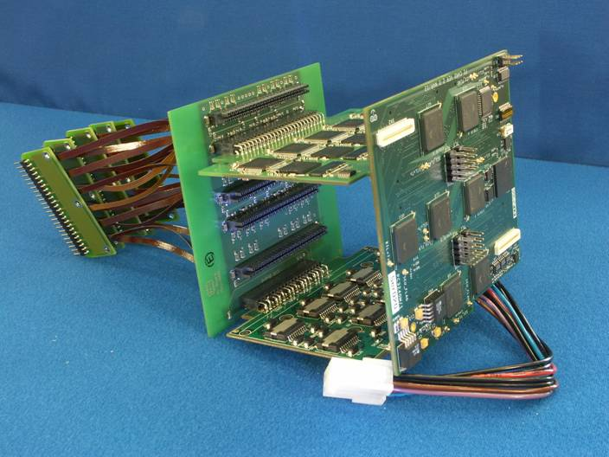
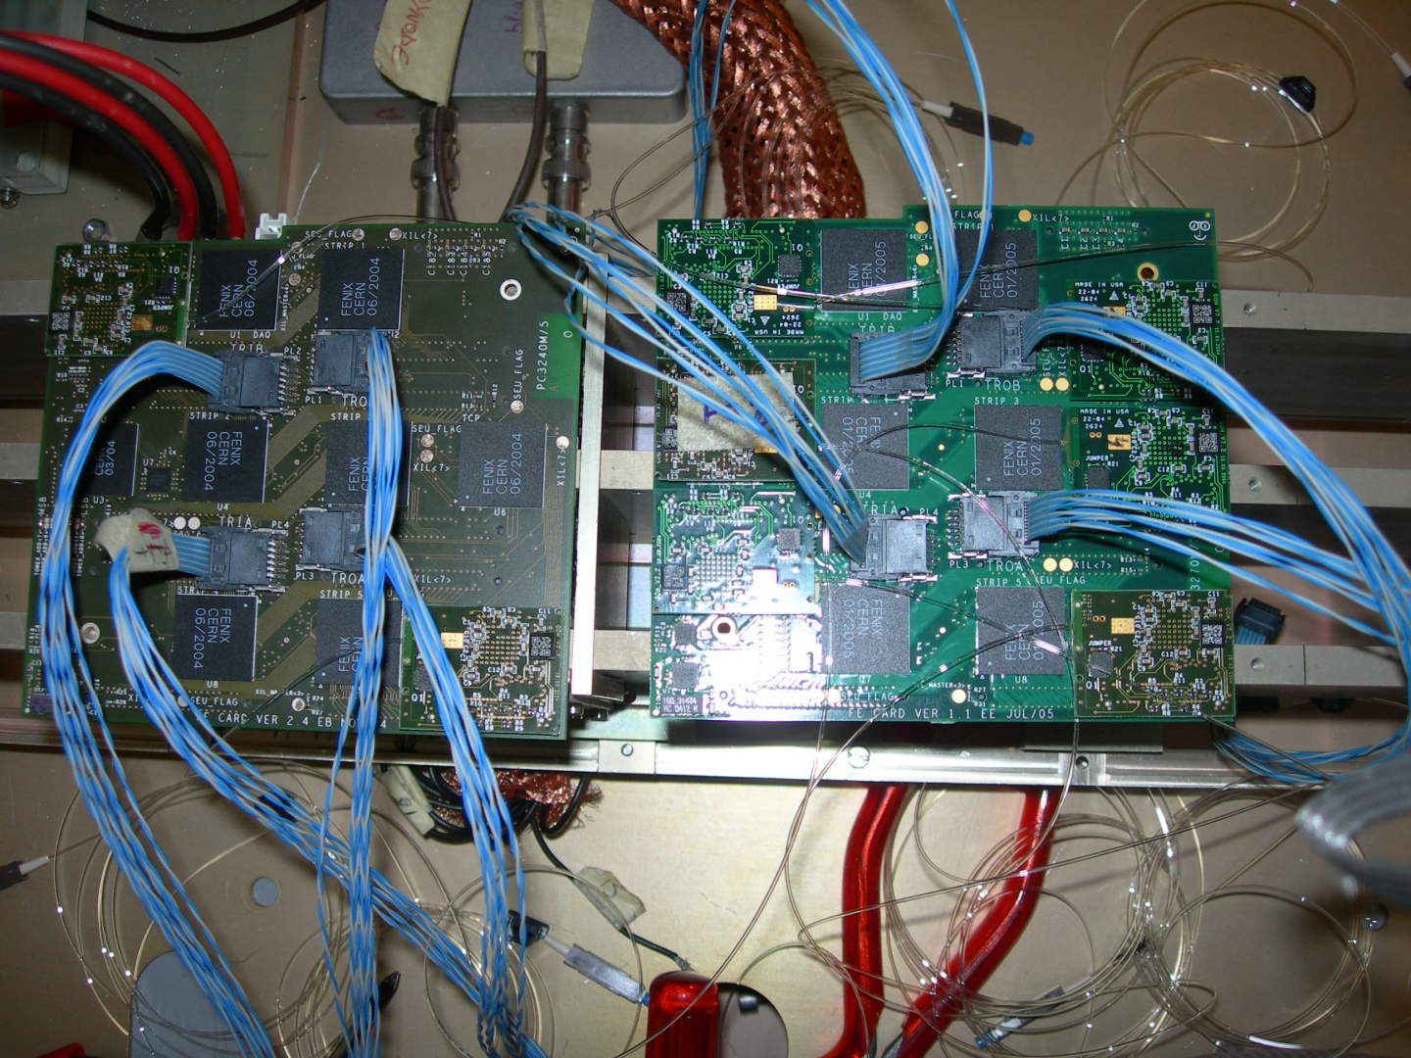
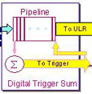
ECAL ReadOut Electronics
FE
VFE
LVR
MB
Energy
→
Light
Light
→
Current
Current
→
Voltage
Voltage
→
Bit
Bit
→
Light
DAQ
Optical Fiber
Crystal
APD
MB
MGPA
ADC
Trigger
VFE
FE
16

Slide 17
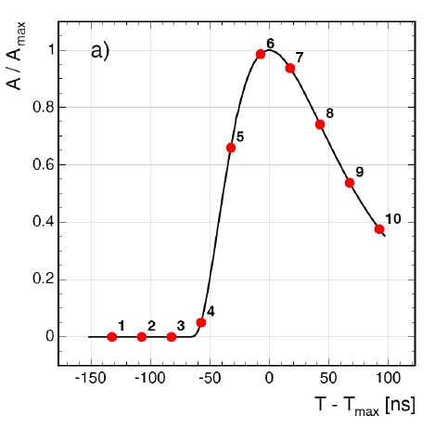
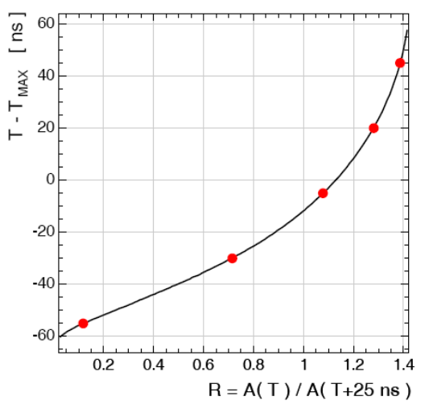
ECAL Time Measurement
Each Crystal/Channel: Pulse
Digitize pulse amplitude into 10 samples,
A_{Max} for energy and T_{Max} for time,
Re-write pule height in ratios:
Precise value of T_{Max}:
17

Slide 18
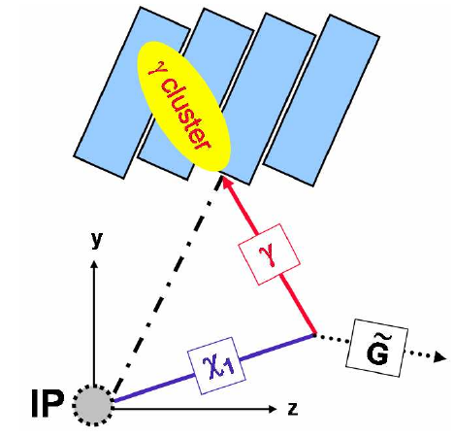
Crystal Time Alignment
Time Alignment:
Adjust crystal time such that:
 | Before Alignment |  | After Alignment
 | Avg. Mean Time[ns] | Sigma [ns] | Avg. Mean Time[ns] | Sigma[ns]
EB | -0.113 | 0.119 | -0.014 | 0.021
EE- | -0.337 | 0.282 | -0.003 | 0.002
EE+ | -0.346 | 0.256 | -0.004 | 0.021
18

Slide 19
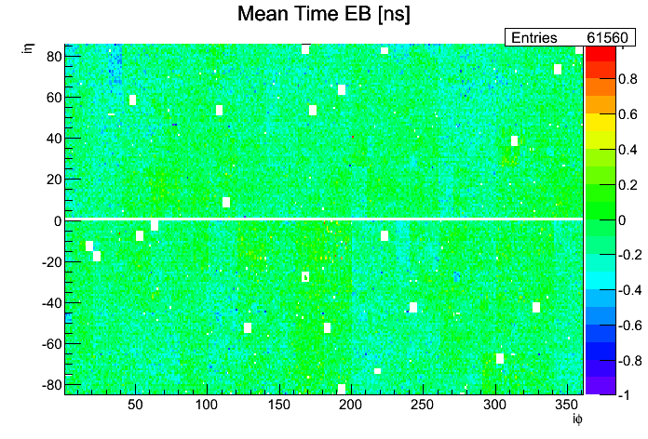
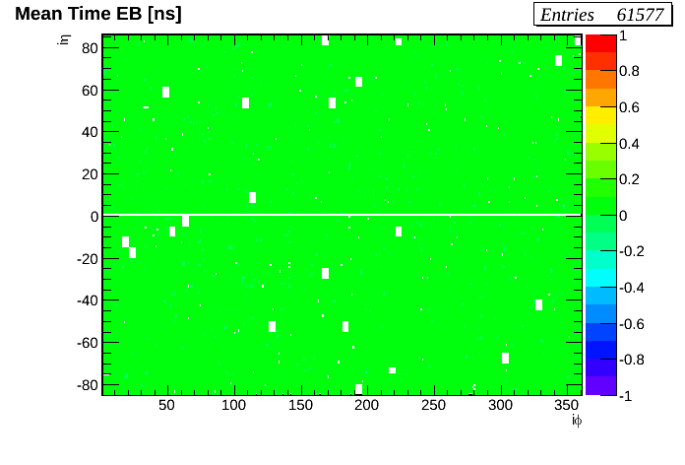
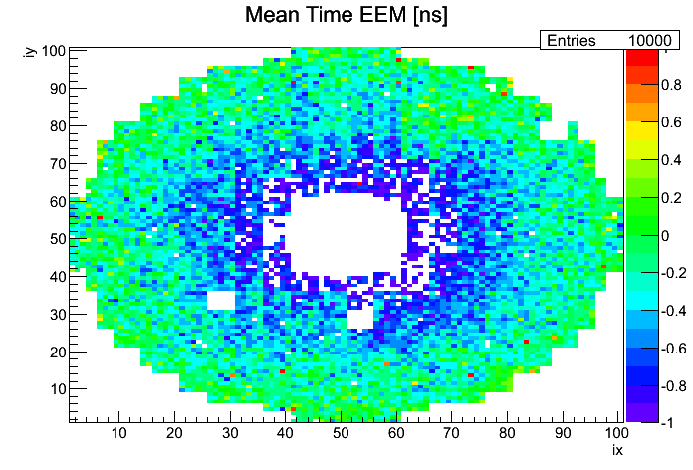
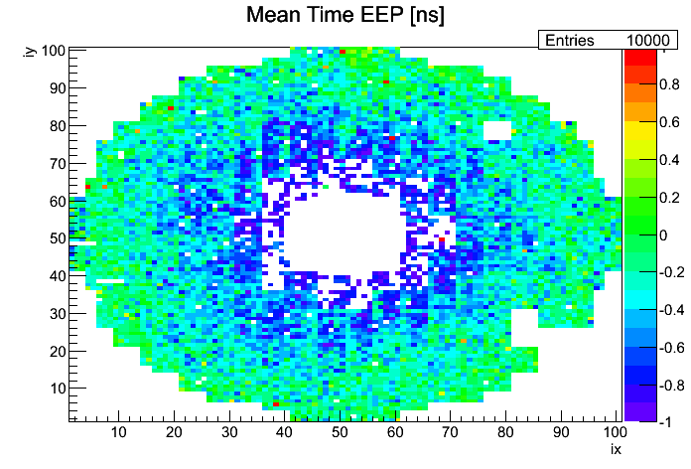
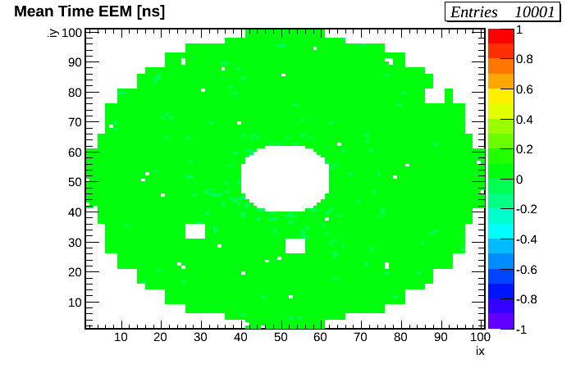
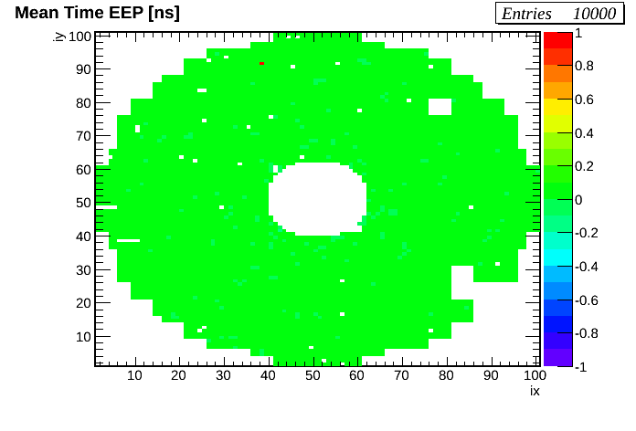
Crystal Time Alignment
Before Time Alignment
After Time Alignment
Most of the crystals have average time of zero after alignment.
19

Slide 20
ECAL Timing Resolution
Parametrized as:
N = Noise term: Depends on energy.
C = Constant term: Independent of energy.
Electronic Noise
Variations in pulse shape,
Systemetics in time alignment.
20

Slide 21
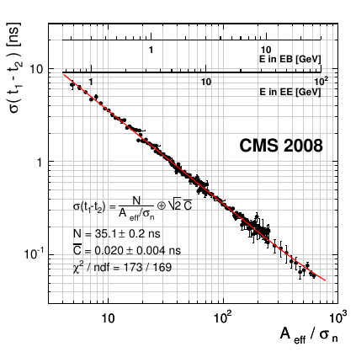
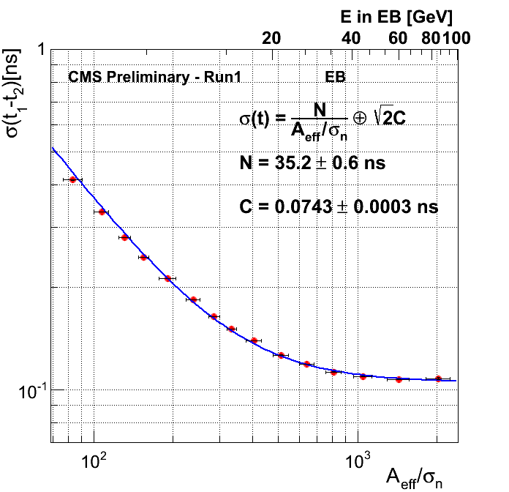
ECAL Timing Resolution
LHC Test Beam 2009
LHC Run 1 2012
ECAL timing resolution better than 400ps.
21

Slide 22
Search Analysis
22

Slide 23
Search Analysis Method
Uses ECAL Time to search for Late Photons,
Count events with late photon(s) & compare with expectation from background events,
Search is not restricted to any particular Theory model, however, to understand signal we study the SPS8 benchmark GMSB model,
Search is almost background free, veto events with late photons from proton beam activity & others and then estimate contribution from residual events using the ABCD background estimation method.
23

Slide 24
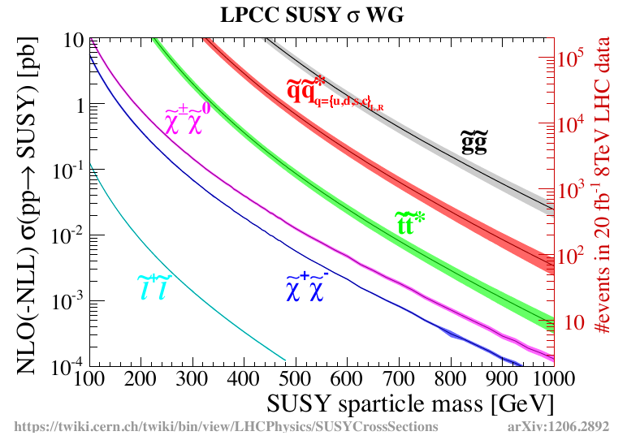
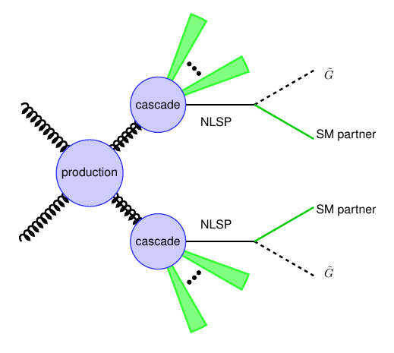
New Particles @ LHC
Event Rate = Cross Section(E)[cm^2]*Luminosity[/s cm^2]*Efficiency
1 barn[b] = 10^(-24)cm^2
Supersymmetry produced at LHC in strong interactions.
24

Slide 25
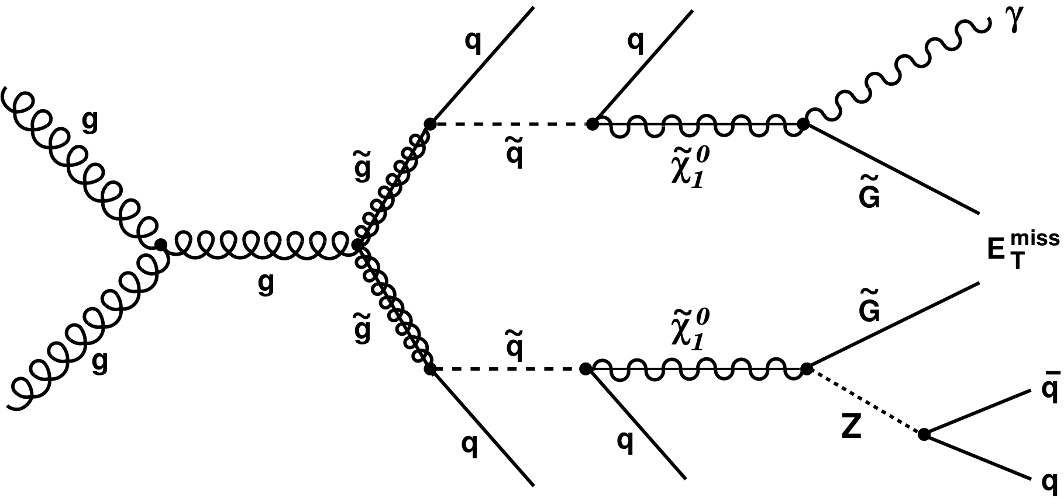
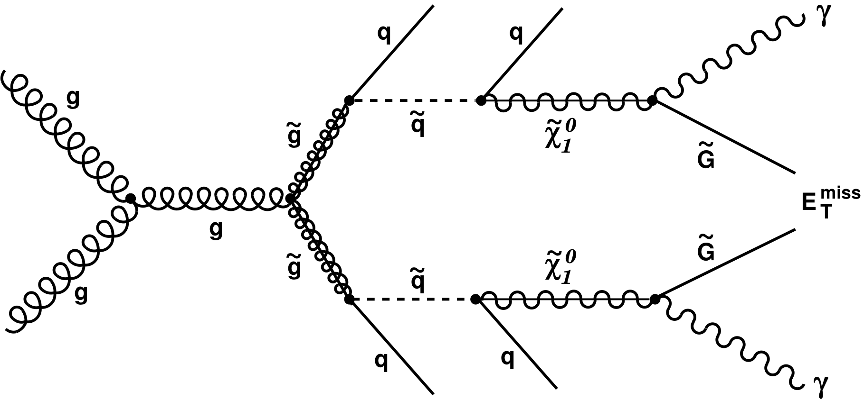
Signal & Background Events
Signal Events
>= 1 Late photon +
>= 2 Jets +
Large MET
Background Events
Collision Events
Mis-measured time QCD events,
Satellite events.
Non-Collision Events
Beam Halo Muon Events,
Cosmic Muon Events and spikes.
25

Slide 26
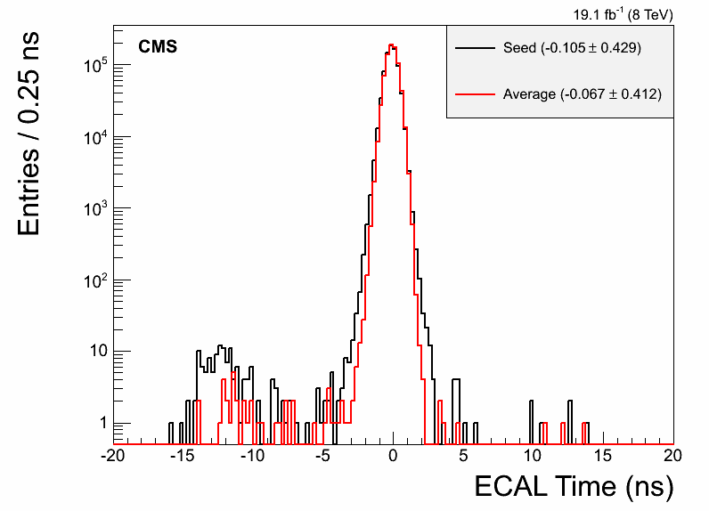
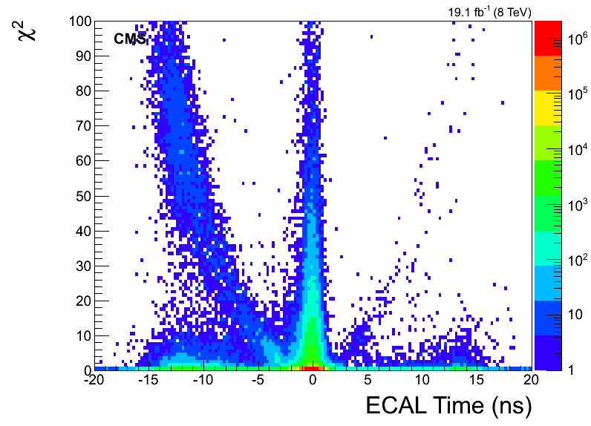
Photon ECAL Time
Photon time = time of crystal with highest energy deposit.
Late if photon time is within
3 to 13 ns.
Use Average cluster time to define chi2.
Seed crystal
Photon time Chi2
Chi2 > 4 populated by bad photon candidates.
26

Slide 27
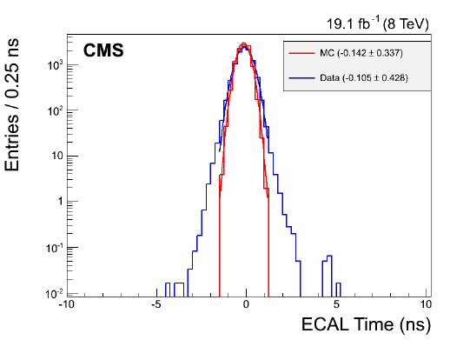
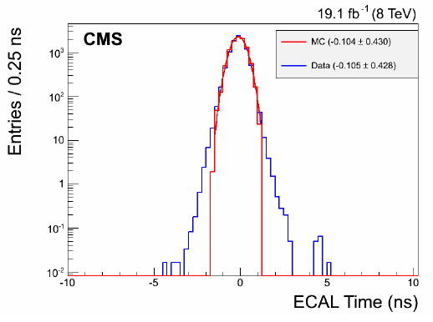
ECAL Time: MC Vs Data
Compare events passing selection requirement from photon + jet MC sample to data:
Extract shift in mean time & resolution between MC and data and adjust mean & smear sigma time of photons from signal MC samples.
At least 1 or 2 jet in events,
PF-Isolated photon with pt > 80 GeV,
Event MET < 30 GeV
27

Slide 28
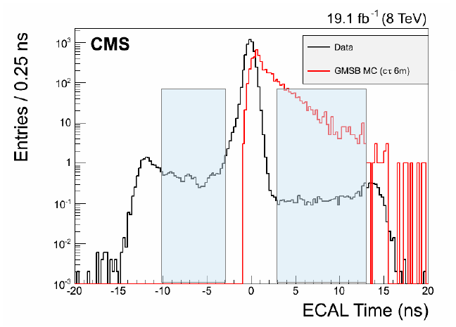
ECAL Time: MC Vs Data II
Search Window is photon time between 3 ns to 13 ns,
Photons time between -10 ns to -3 ns use as control sample,
Photons with time of about -12 ns are mostly “spikes”.
28

Slide 29
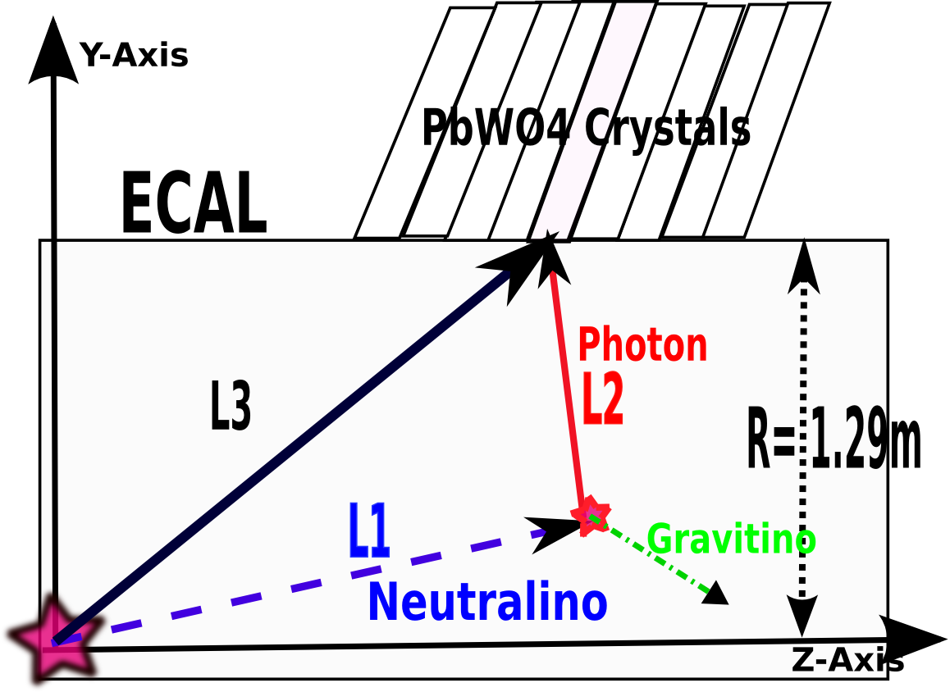
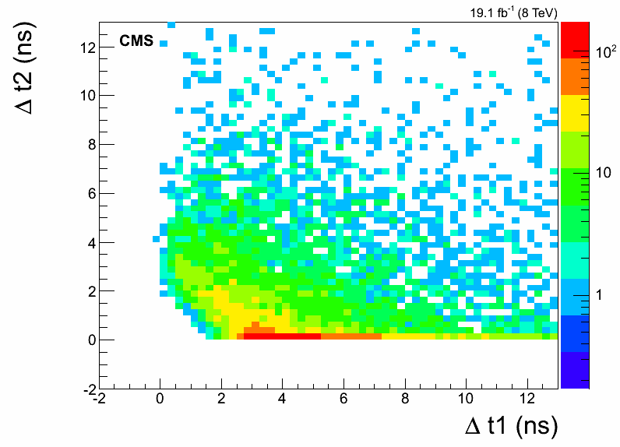
Photon Delay Mechanism
Distance traveled by Neutralino before decay :
Photon time measured by ECAL:
GMSB
For slow moving neutralino :
For Off-pointing neutralino :
Late photons mostly from slow moving neutralinos.
29

Slide 30
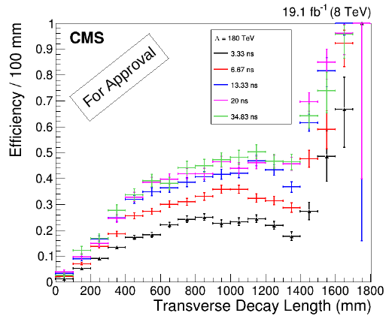
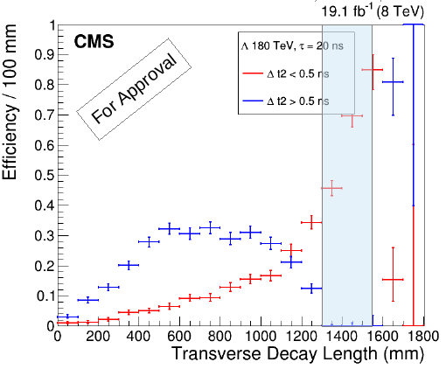
Effiency for Delayed Photons
Efficiency to detect photons with t > 3 ns, Vs Transverse decay length.
No event selection applied yet,
Efficiency = Number of photons with t > 3 ns /Number of reconstructed photons in EB.
Using Delta t2 to seperate the two types of delayed photons
Efficiency increases with lifetime, provided boost factor is not to large.
30

Slide 31
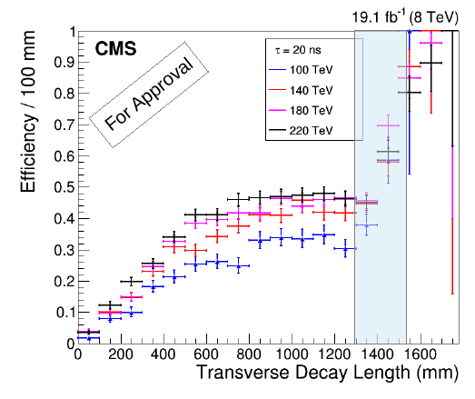
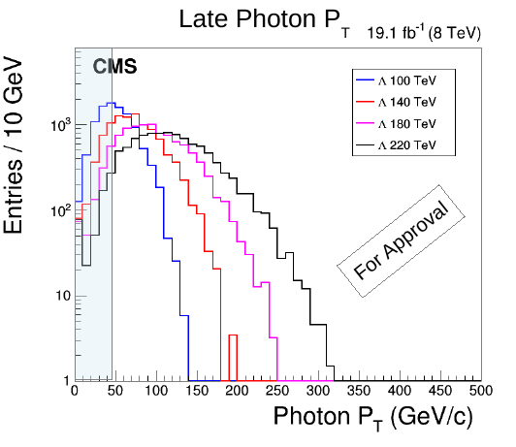
Effiency for Delayed Photons II
Efficiency of late photons, for different Neutralino Mass(Lambda) but fixed lifetime.
No event selection applied yet,
Efficiency = Number of photons with t > 3 ns /Number of reconstructed photons in EB.
Efficiency increases with lambda due to increase with photon pt.
31

Slide 32
Missing Transverse Energy
Event Missing Transverse Energy (MET) defined as:
Define new MET variable as:
seprates the different composition of background events.
Event Cathegory
Collision Bkg Events (QCD/Satellite) | < 60 GeV | > 60 GeV
Non-Collision Bkg Events(Halo, Cosmic,spike) | > 60 GeV | < 60 GeV
Signal Events | > 60 GeV | > 60 GeV
32

Slide 33
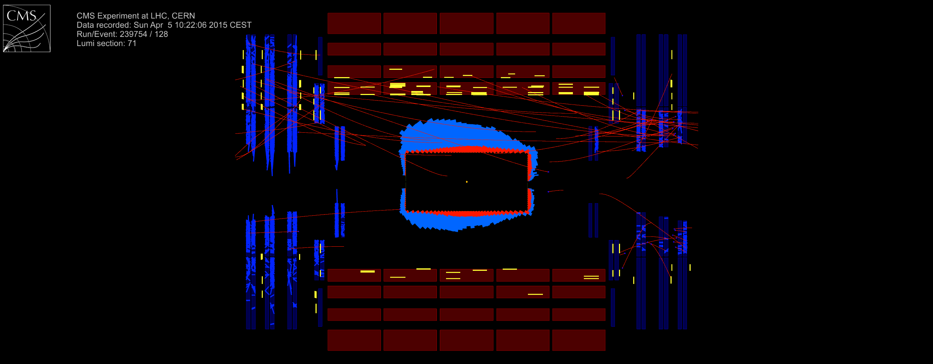
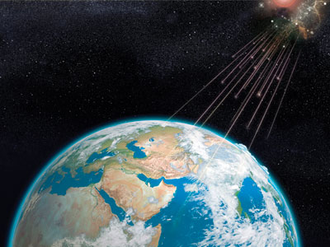



Non-Collision Bkg Events
Late photons from proton beam induced halo muons, Cosmic muons and anomalous photon events like spikes.
Beam Halo muon-induced photon
Cosmic Muon-Induced photon
Spike-seeded photon
33

Slide 34


Collision Bkg Events
Photons with mis-measured time from main bunch collision e.g QCD, W, top events.
Photons from satellite proton bunches.
Satellite bunches lead or trail the main bunch by 2.5 ns.
34

Slide 35
Event Samples: Data & MC
Data
Events with at least one photon passing the HLT-trigger: HLT_DisplacedPhoton65_CaloIdVL_IsoL_PFMET25
Total luminosity of 19.1/fb
SPS8 benchmark GMSB MC Samples
Signal MC events: ~50k events for each lifetime and Lambda point,
Lambda ranging from 100 TeV to 220 TeV( 6 points in total),
Lifetime(tau) ranging from 1.7 ns to 33.3 ns ( 7 points in total).
Data: SinglePhoton Events
Single photon events passing the HLT-trigger: HLT_Photon50_CaloIIdVL_IsoL
For studying Displace photon HLT trigger efficiency.
Cosmic Data: For studying cosmic tagging
MC Gamma + Jet: For MC time study sanity check.
35

Slide 36


Higher Level Trigger
HLT_DisplacedPhoton65_CaloIdVL_IsoL_PFMET25
Selects events: Isolated photon pt > 65 GeV/c + PFMET > 25 GeV
Efficiency = Events passing this HLT trigger / Events passing HLT_Photon50_CaloIdVL_IsoL HLT trigger.
Offline selection: photon pt > 80 GeV/c, PFMET > 60 GeV.
36

Slide 37
Event Selection
Photon:
Lead photon pt > 80 GeV/c, other photons pt > 45 GeV/c, photon must belong in EB, simple cut-based photon Id selection, dR(photon, track) > 0.6.
Jets:
PFJet of PFJet ID with pt > 35 GeV/c, must be within |eta| < 2.4 and dR(photon, Jet) > 0.3.
MET:
.
Signal Events: Final state with
ABCD Method Test: Events with final states
37

Slide 38
Background Estimation
Background estimation is Data-driven,
Compare in-time and out-of-time photon events:
Use 0- &1-jet events to study background events from non-proton-proton collision background sources,
Seperate events into t < -3 ns & t > 2 ns and find a method to veto non-collision background photons like Beam Halo-induced photons, Cosmic-Induced photons and Spike-seeded photons.
Using ABCD method estimate residual non-collision background events remaining after vetoing,
Use a Z→ee event sample to estimated the non-Gaussian tail of the photon ECAL time.
Most representative sample of collision background events( e.g QCD, sattelite proton bunch events),
Z mass constraint reduces contamination from non-collision background events.
29

Slide 39


Halo-Induced Photons
Halo-induced photons from beam halo muons from main and satellite bunches are a major source of out-of-time photons.
Their ECAL arrival time depends on eta,
Studied using 0&1-jet events,
Can be tagged and veto using:
39

Slide 40



Cosmic-Induced Photons
Cosmic-induced photons from muons from cosmic rays is also a source of out-of-time(random) photons.
Their ECAL arrival time is random,
Can be tagged and veto using:
Studied using real cosmic data (data recorded by CMS in the apsence of pp collisions),
Real Cosmic data
40

Slide 41
Spike-Seeded Photons
Spike-seeded photons from muons from cosmic rays is also a source of out-of-time(random) photons.
Their ECAL arrival time is random,
Studied using real cosmic data (data recorded by CMS in the apsence of pp collisions),
Can be tagged and veto using:
41

Slide 42

Photon Veto Performance
After Event Selection & Tagging
Miss-Tag Event Rate
Beam Halo Muons. | 3 %
Cosmic Muons. | 1.4%
Anomalous or Spike. | 0.4%
Our selection still does not completely remove ALL background events.
42

Slide 43
Background Estimation
Compare in-time and out-of-time photon events:
Use 0- &1-jet events to study background events from non-proton-proton collision background sources,
Seperate events into t < -3 ns & t > 2 ns and find a method to veto non-collision background events like Beam Halo-induced photons, Cosmic-Induced photons and Spike-seeded photons.
43

Slide 44

Background Estimation
ABCD background estimation using observed variables TIME and MET.
A
D
A/B = D/C
=>D = C*A/B
B
C
Compare D from expectation with D from observation to validate method.
42

Slide 45
Collision Bkg Estimation
ABCD background estimation using observed variables TIME and MET.
A
D
A/B = D/C
=>D = C*A/B
B
C
Compare D from expectation with D from observation to validate method.
43

Slide 46
Z→ee Method
ABCD background estimation using observed variables TIME and MET.
Compare D from expectation with D from observation to validate method.
44

Slide 47
Background Estimation
Background estimation is Data-driven,
Compare in-time and out-of-time photon events:
Use 0- &1-jet events to study background events from non-proton-proton collision background sources,
Seperate events into t < -3 ns & t > 2 ns and find a method to veto non-collision background photons like Beam Halo-induced photons, Cosmic-Induced photons and Spike-seeded photons.
Using ABCD method estimate residual non-collision background events remaining after vetoing,
Use a Z→ee event sample to estimated the non-Gaussian tail of the photon ECAL time.
Most representative sample of collision background events( e.g QCD, sattelite proton bunch events),
Z mass constraint reduces contamination from non-collision background events.
29

Slide 48
Results
44

Slide 49
Results
Expected Number of Events = 0.088
Observed Number of Events = 1
This Observed event turns out to be a cosmic muon mimicking the signal of a new Long-lived particle.
45

Slide 50

Observed Event Display
CMS Detector Transverse View
CMS event display of observed cosmic muon event in CMS detector.
46

Slide 51


Observed Event Display
3D View
Rho – Z View
CMS event Display of observed Cosmic Muon event in CMS detector.
47

Slide 52
Limit Setting & Interpretation
The possible sources of systematics considered in this search analysis and their contribution.
48

Slide 53
Systematics
The possible sources of systematics considered in this search analysis and their contribution.
Systematic Uncertainties.
Systematic Source | Uncertainty(%)
Absolute Reference ECAL Time | 10% to 6%
Unclustered Energy | 10% to 4%
Photon Energy Scale | 4% to 2%
ECAL Timing resolution | 5% to 2%
Jet Energy Scale | 9% to 3%
Jet Energy Resolution | 9% to 2%
Luminosity and Choice of PDF | 2.6 and < 1%
49

Slide 54

Signal Selection Efficiency
Signal Event selection efficiency times acceptance (TACC/ALL) peaks at 1.6% for lifetime = 6.7 ns.
50

Slide 55


Limits: Mass & Lifetime
51

Slide 56


Limits: Combined
Excluded Neutralino with Mass < 258 GeV/C^2 and Lifetime < 35 ns.
52

Slide 57
Summary
53

Slide 58
Summary
Motivation for performing a search for long-lived neutral particles at LHC.
Brief description of LHC collider and CMS detector particularly the ECAL as used.
We presented a search analysis for neutralino as a long-lived particle decaying to photon using CMS detector. ECAL timing measurement of the photon arrival time is used for identifying the delayed photon.
The search result is presented and limits shown for neutralino mass and lifetime.
Excluded regions relevant for future similar search for neutralino is also presented.
32

Slide 59
Thanks A LOT!
33

Slide 60





BackUp: Physics Objects in CMS
34

Slide 61


Efficiency & Acceptance
Transverse Detector Decay Length
Particle Inherent Decay Length
Efficiency and Acceptance determines our final Observed event rate.
35

Slide 62
Dark Matter?
Properties
Stable(long-lived).
Neutral; does not interact with light.
Light or massive?
Where are Dark Matter particles?
37

Slide 63


HCAL Electronics Upgrade
How data flow from HCAL-front-end to back-end electronics
HCAL Front-end Electronics
Current back-end (VME)
HCAL
Charge Integrator
(QIE)
Photo diodes
Fiber optic
link
HCAL Back-end Electronics (VME)
DAQ
Data Concentrator
Card
HCAL Trigger &
Readout Cards
Future back-end (μTCA)
Micro Telecommunication and Computing Architecture(uTCA) to handle high bandwidth for global DAQ. Current data transfer rate based on VME is 1.6Gbps compared to 4.8Gbps for uTCA.
13

