Slide 1
Time reconstruction and performance of Crystal ECAL
Daniele del Re
Universita’ di Roma “La Sapienza” & INFN Roma
S. Cooper, University of Minnesota
A. Ledovskoy, University of Virginia

Slide 2
Outline
Describing the paper:
Motivations
Time extraction with ECAL
Time measurement resolution studies using TB
Synchronization of the detector
Cross-check of resolution and linearity using cosmics
Conclusions
Details on issues raised during SEB reading

Slide 3
Motivations for This Paper
ECAL timing relevant for bkg rejection
cosmics, beam halo, electronic noise
ECAL timing to be used for new physics searches
heavy stable charged particle with small beta
photon from neutralinos with long lifetimes
Nice opportunity to have single paper with
Description of timing extraction
Evaluation of performance of the method
Description of calibration
First synchronization in view of LHC collisions and systematics evaluation
Use of cosmics to evaluate goodness of synchronization and cross-check resolution and linearity
Coherent picture and combination of different datasets (TB, beam splashes, cosmic ray muons) to show robustness of the detector

Slide 4
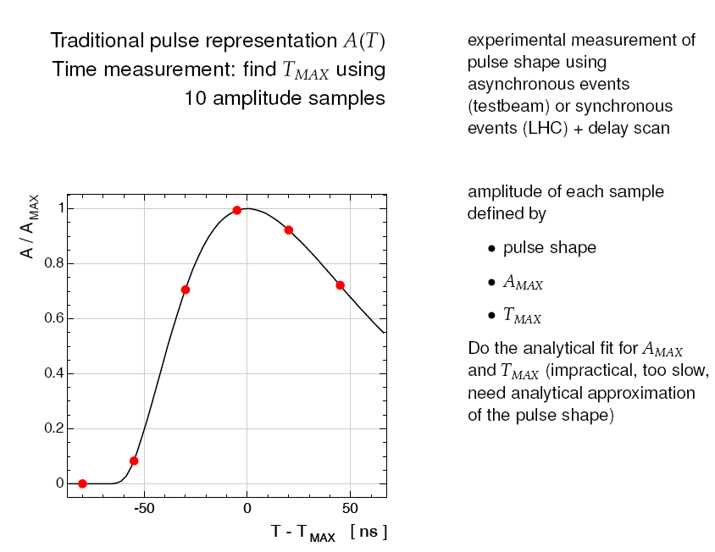


ECAL pulse shape and timing
Paper

Slide 5
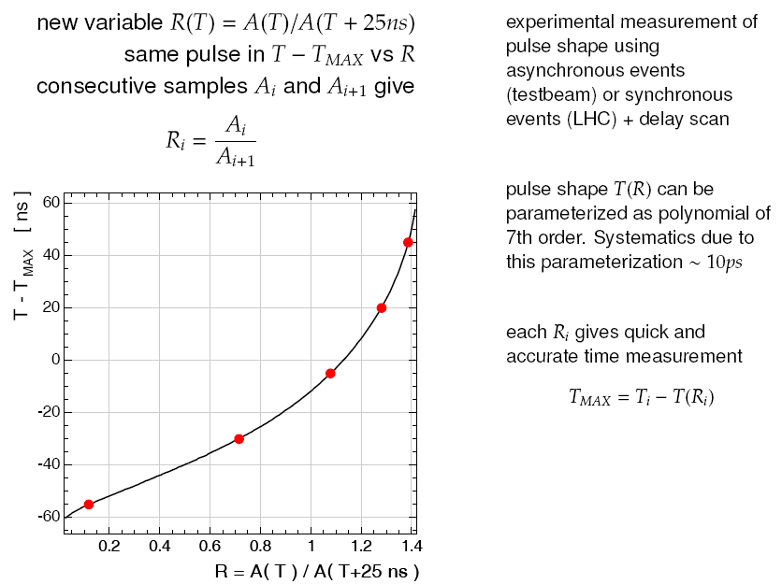
Ratios to Describe Pulse Shape
Paper

Slide 6
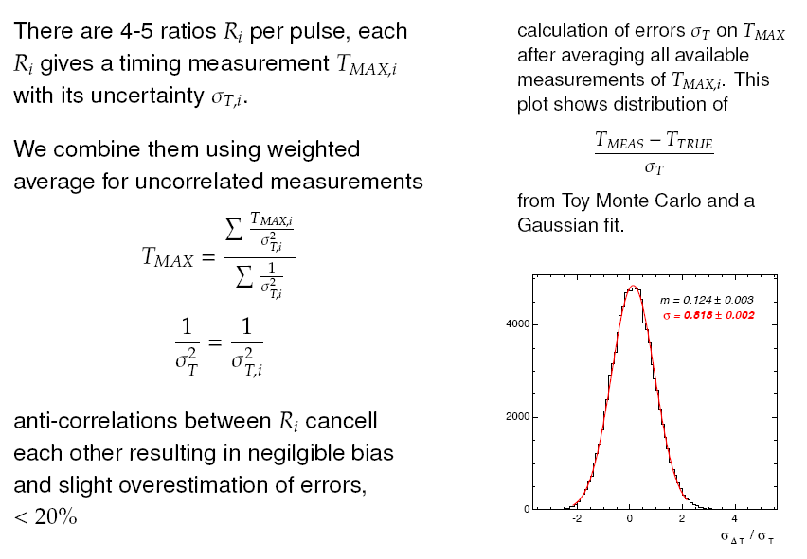
Combination of Ratios

Slide 7
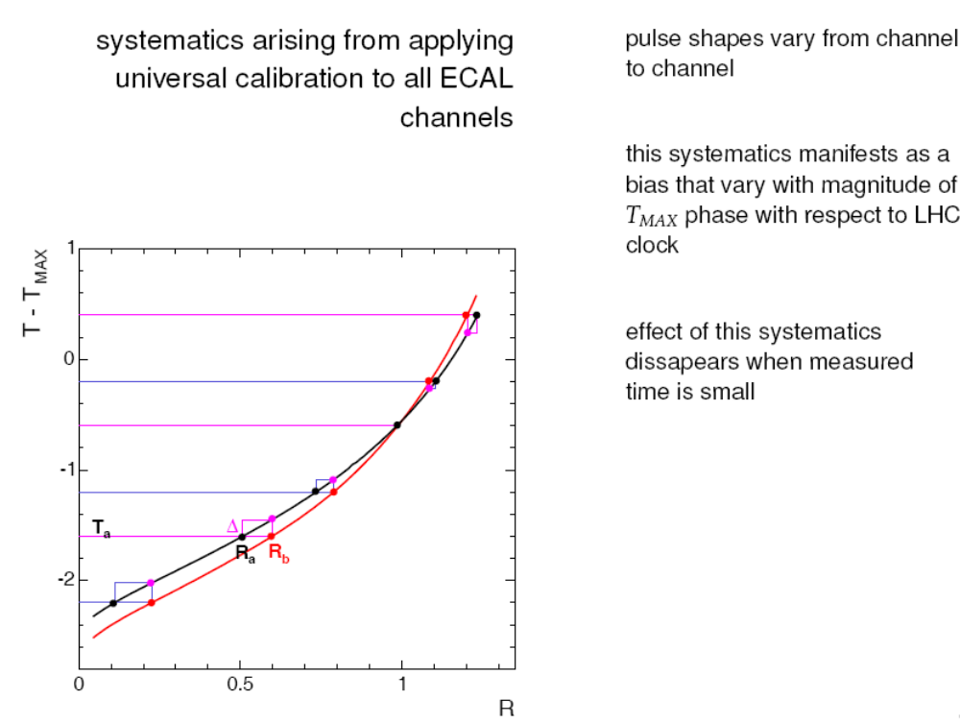
Syst. Induced by Pulse Shape Modeling

Slide 8
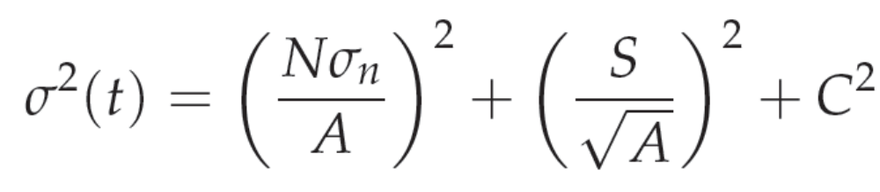
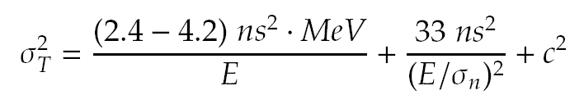
T Measurement Reso: Parameterization
Noise term:
induced by high
and low
frequency noise
Stochastic term:
induced by photo-
statistics and finite
time scint. emission
Constant term:
induced by effects vs Tmax phase, entrance pos., and any syst. in synchronization
Does this parameterization work and how big are the different terms?
Checked on toy MC studies
(details on backup slides)

Slide 9
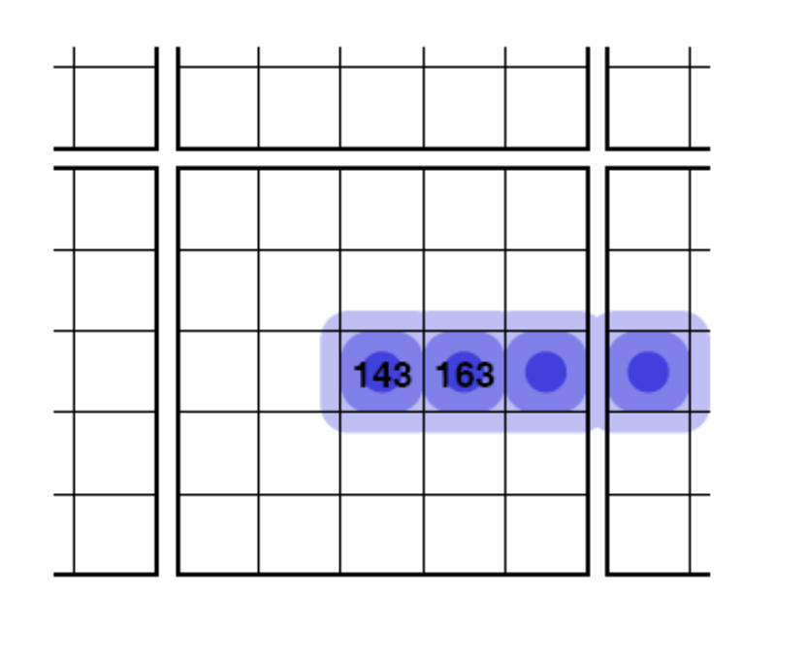
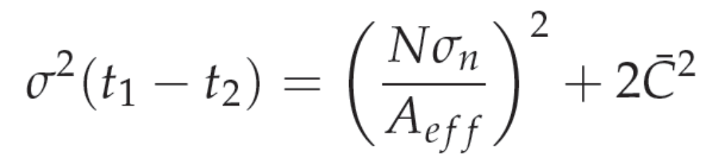

TB Electrons to Extract Resolution
Use of 230GeV TB electrons on EE
Compared time between crystals of the same electron cluster
  Synchronous by definition (modulo shower propagation)
Use time difference to extract resolution
Approach is much less sensitive to constant term
Effects due to synchronization
or differences in pulse shape affect
only mean
Residual contrib.
to constant term
(method)

Slide 10
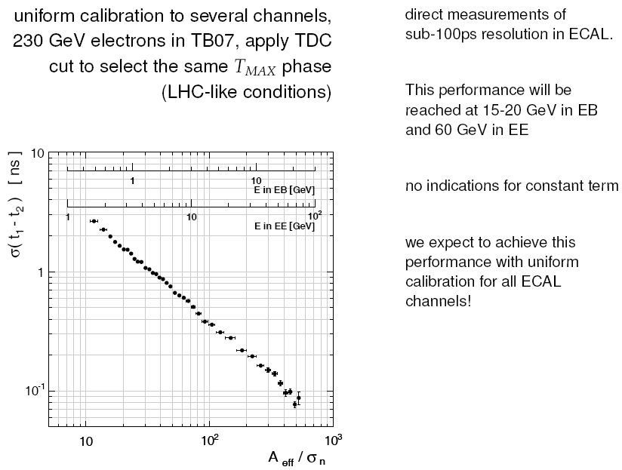

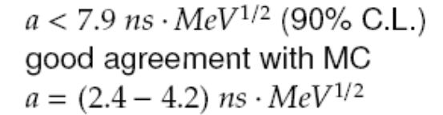
Results
Paper
(see backup for details)

Slide 11
Synchronization of ECAL
T_{MAX} phase for a given channel does not change with time
  Collisions synchronized with clock
  Time of flight from IP fixed
Possible to use corrections to synchronize all channels
Synchronization crucial to reduce biases of amplitude and timing reco
Two synchronizations:
  Hardware: step=1.04ns
  Software: limited by time measurement resolution (extraction method) and systematics (synchronization technique)
What’s needed: physics events with known T phase vs eta

Slide 12
How to Synch with LHC collisions
Excellent candidates given by minimum bias events
  Synchronous
  Illuminating whole ECAL with large stat and energy
No systematics induced by large T_{MAX} phase (i.e. they are in synch. with LHC clock by definition)
Estimate:
  About 1000hits/channel/day
  About 500MeV/channel in average
  ⇒ 100ps precision in one day of running

Slide 13
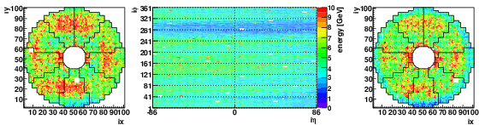
First Synch. Using Beam Splash Events
Nice sample to be used to synchronize already available:
  for a single event all horizontal muons are in synch
  Correction for TOF vs eta needed
  All crystals illuminated
  Many muons cross each crystal: <E>~few GeV’s
Figure illustrates energy map for a single beam splash event
Paper

Slide 14
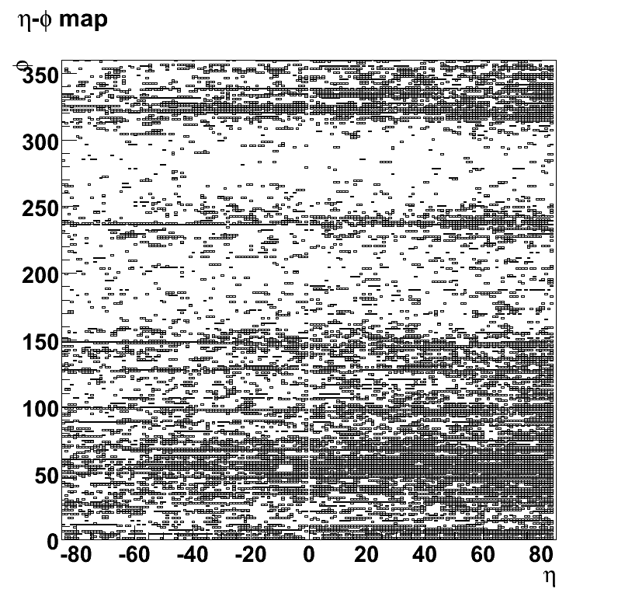
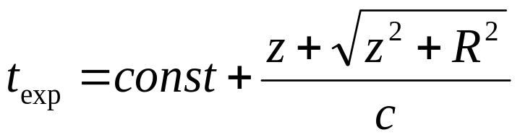
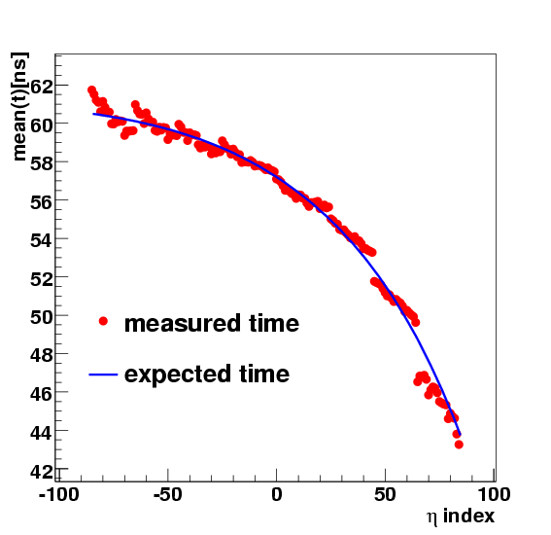
Beam Splash TOF
Formula for expected time
(correction for the barrel)
where:
  z is the z coordinate of the
  front face of the crystal
  R is the distance of ECAL barrel
  from beam axis
Event 13073, 2<E_{crys}<10GeV
muons

Slide 15
Calibration Procedure
For each splash event:
Correct for trigger jitter (typically few hundred ps)
Apply time-of-flight and ECAL readout corrections to each crystal (z-corrections, previous slide)
Apply amplitude > 25 ADC and chi2 cuts
Generate timing distribution for each crystal
Obtain mean and uncertainty on mean (weighted average)
Uncertainty on final mean is also compared with expectations (given N_{events} and <E>)

Slide 16
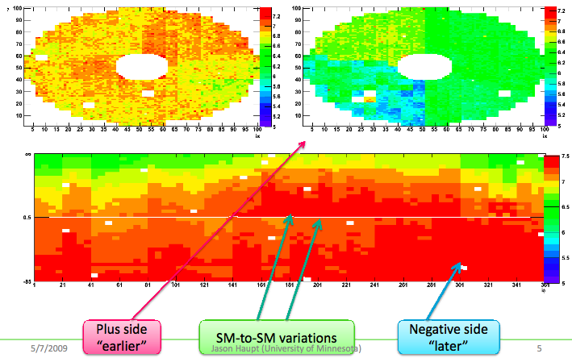
Time Map (w/o z-corrections)

Slide 17
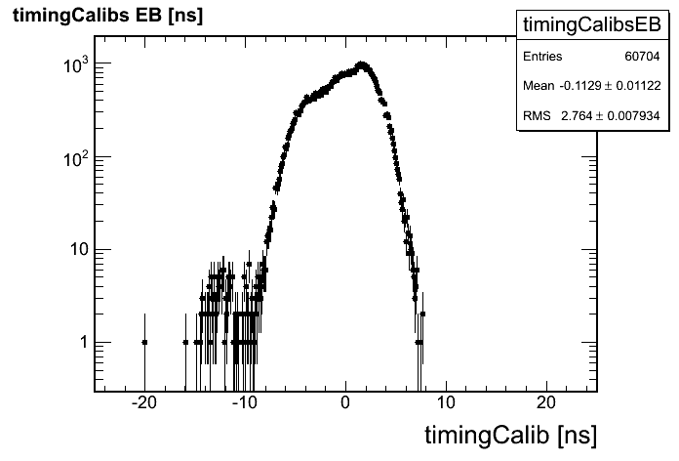
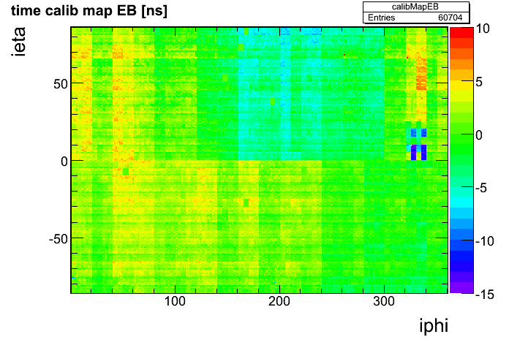
Calibration Map
Calibration obtained using all beam splash events (O(50))
  ~20 events with muons traveling in neg. z dir. (“- beam”)
  ~35 events with muons traveling in pos. z dir. (“+ beam”)
Systematic
Known from before

Slide 18
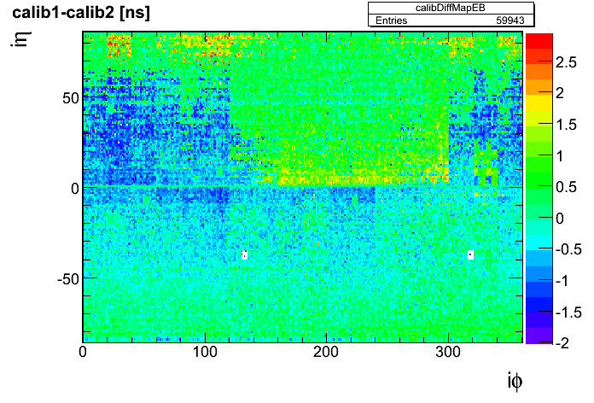
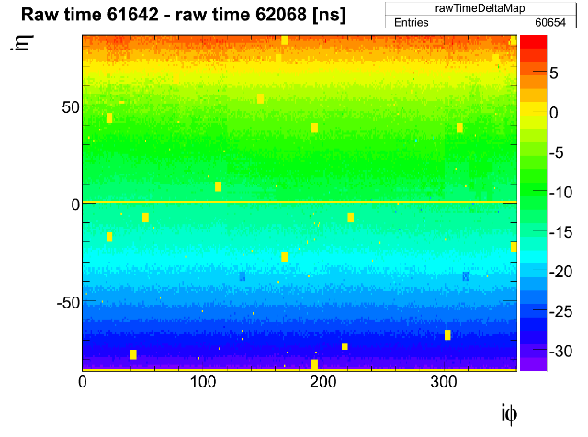
Systematics Evaluations
This method is affected by the “T_{MAX} phase” systematics
  Muon TOF >10ns
Goodness and systematics on calibration evaluated comparing “- beam” and “+ beam” calibration constants
  Very different “T_{MAX} phase” due to different muon propagation

Slide 19
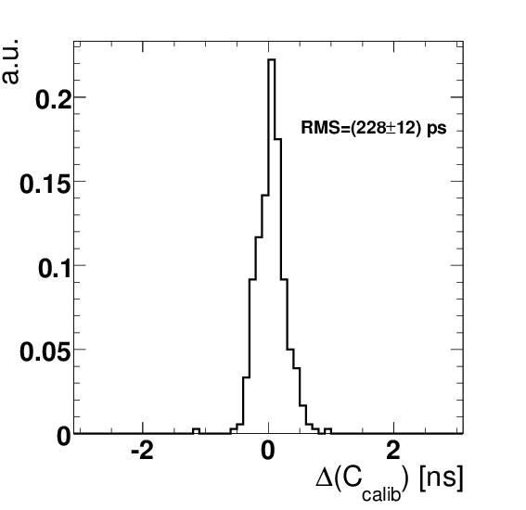
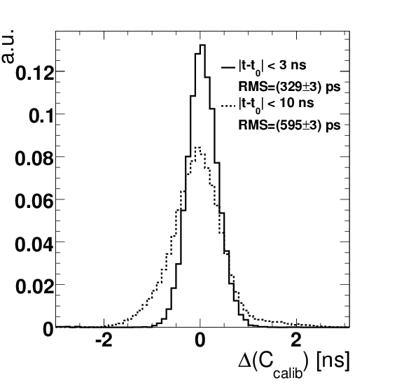
Synchronization Results
In eta ring where arrival times are the same, total spread is in good agreement with prediction from statistics alone (215 ps)
Remaining systematic (~ 500 ps) due to pulse shape differences combined with large range of absolute times
Paper

Slide 20
Study on Cosmics
Idea is to verify the resolution parameters (N and C) and the linearity of the time measurement using real data
Use of calibration constants extracted with beam splash events
Use of CRUZET 3 and 4 data without magnetic field
  Runs 50908, 50911, 50914, 51020 and 58537

Slide 21
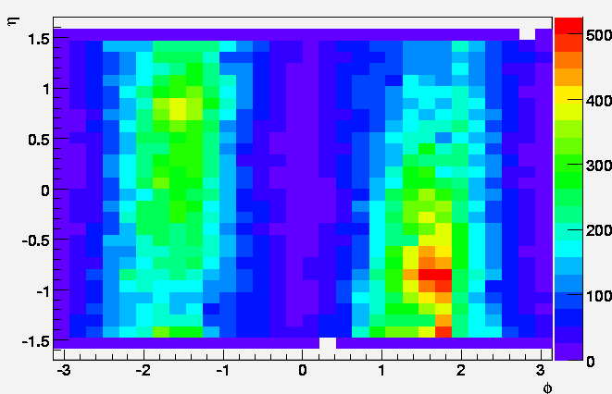
Selection of Good Muon Clusters
Use of SuperClusters (SC)
  island with fixed matrix
Good SC selected by
association with tracking
  Small distance between
  μ-track @ ECAL and SC
  required
  Criteria: Δφ<0.1 && Δη<0.1
η−φ map for associated clusters

Slide 22
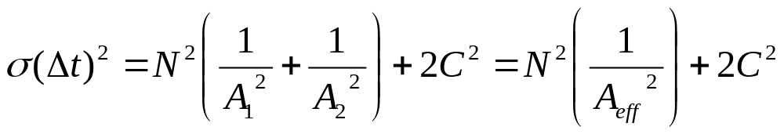
Resolution
Δ(time) between seed crystal and other crystals of SC
Δ(time) distribution fitted using 2 gaussians
  First one for core, second one for small amount of tails (fixed sigma=8ns)
Exact same TB method to extract statistical (N) and constant term (C), i.e.

Slide 23
Linearity
Measured vs expected correlation using two seeds belonging to up and down SCs (depending on their y coordinate) associated to the same muon
  TOF based on muon @ ECAL positions assuming that in average muon enters from the middles of a side of the crystal
  The TOF range between 0ns (basically tangent to ECAL) and 14ns

Slide 24
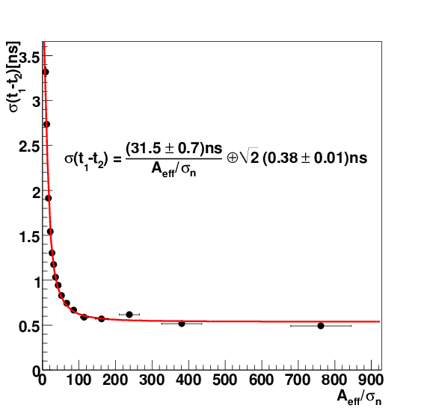
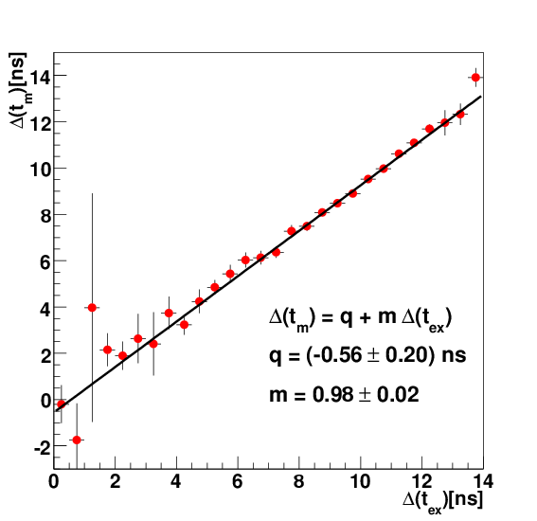
Results on Cosmics
Noise term consistent with
TB and MC
Constant term consistent with
systematics on calib. coeff.
m compatible with 1
q compatible with 0 within
systematics on calib. coeff.
Paper
Paper

Slide 25
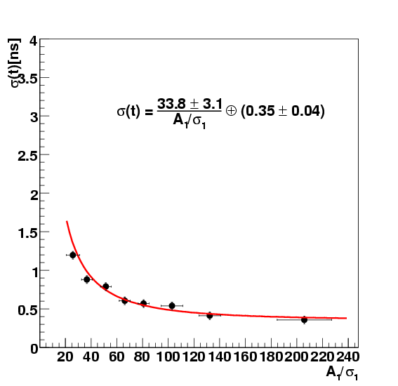
Extra Cross-check on Beam Splash
(not in the paper)
Noise and constant term
consistent studying beam
splash events

Slide 26
Issues during
SEB reading

Slide 27
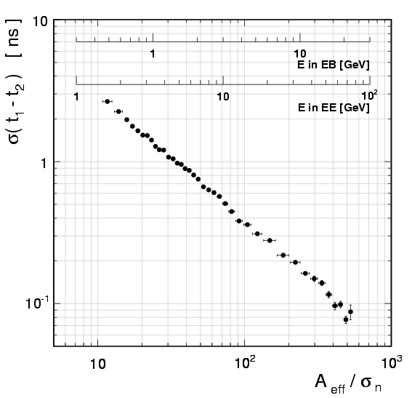
Log-log Scale and Constant Term
It is not true that all functions are linear in log-log scale
Main goal of this figure is to
show that contribution of
constant term on TB analysis
is negligible
We did additional tests on different samples and (presenting them in log-log and linear-linear scale, next slides)

Slide 28
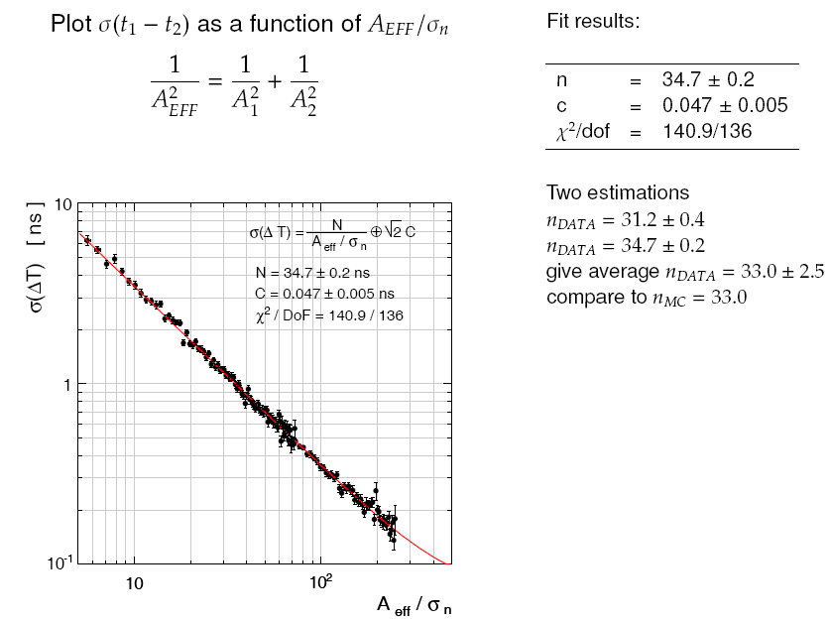
Check on 120GeV TB electrons

Slide 29
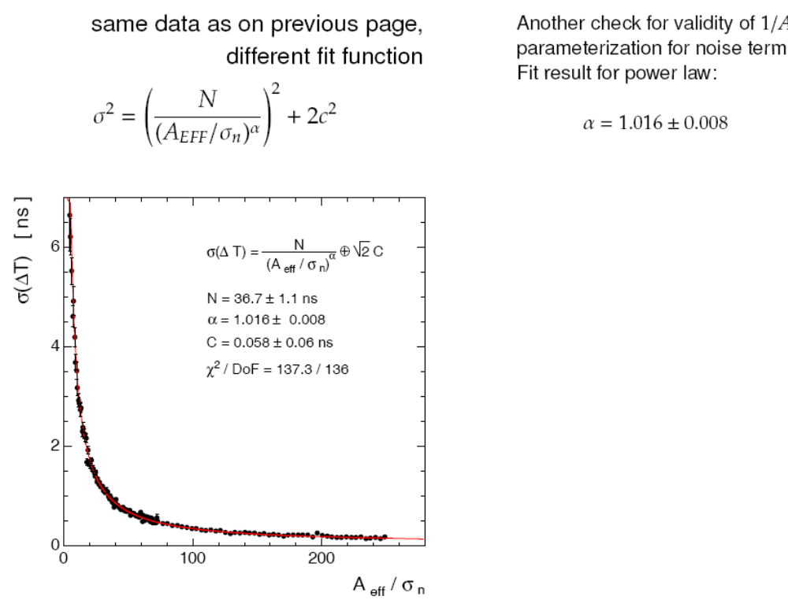
Check on 120GeV TB electrons (lin)

Slide 30
Ref. to Paper on Amplitude Reco
We put a reference just after the ratio method descritpion, saying:
“This method represents an improvement to what
was previously shown in [6] since it is much less
affected by the ”T_{MAX} phase.”

Slide 31
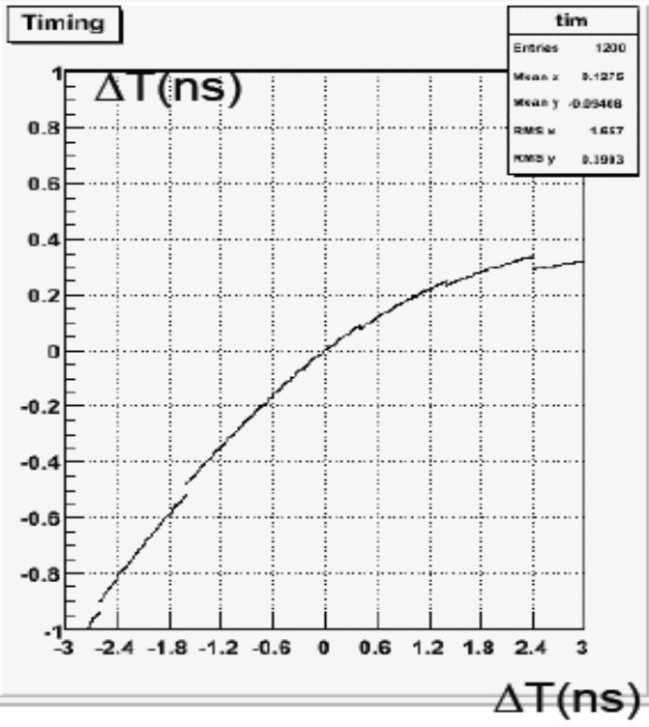
Poor Resolution at Large t Values?
500ps syst is small compared
to weight method (see plot)
BTW, not relevant if all hits will be synchronized (as for the LHC collisions, see slide 7)
Could affect new physics searches but small impact (only if delay is very large)
T bias vs t
for weight method

Slide 32
Conclusions
Performance of time measurement performance investigated using TB, beam splash, and cosmics events
Resolution parameters extracted (consistent with expectations and MC studies)
  With perfect time alignment resolution better than 100ps for large energies (>20GeV in barrel)
Linearity verified on cosmics
First synchronization of ECAL crystals using beam splash events
  Uncertainty on synchronization ~500ps in average
  Will be much improved using collision data

Slide 33
BACKUP

Slide 34
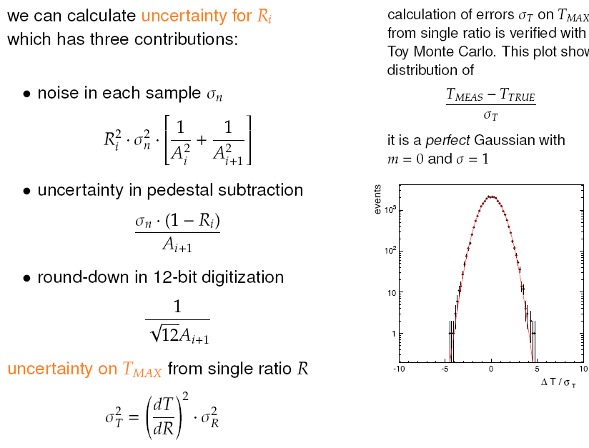
Details on Ratio Method Uncer.

Slide 35
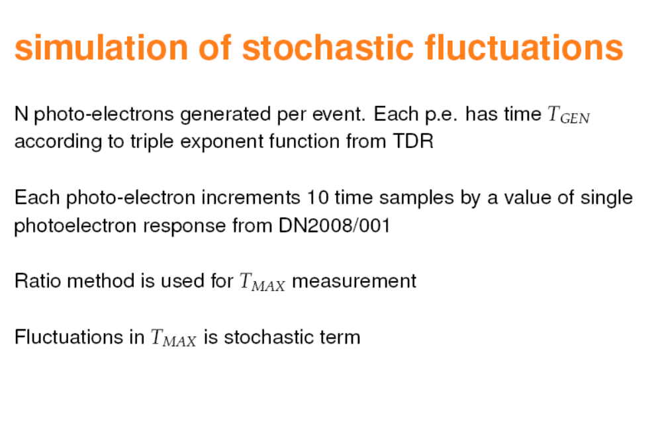

Slide 36
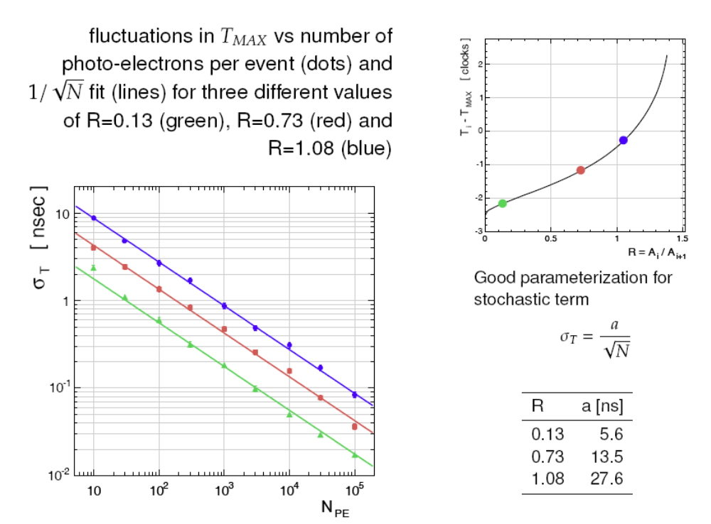

Slide 37
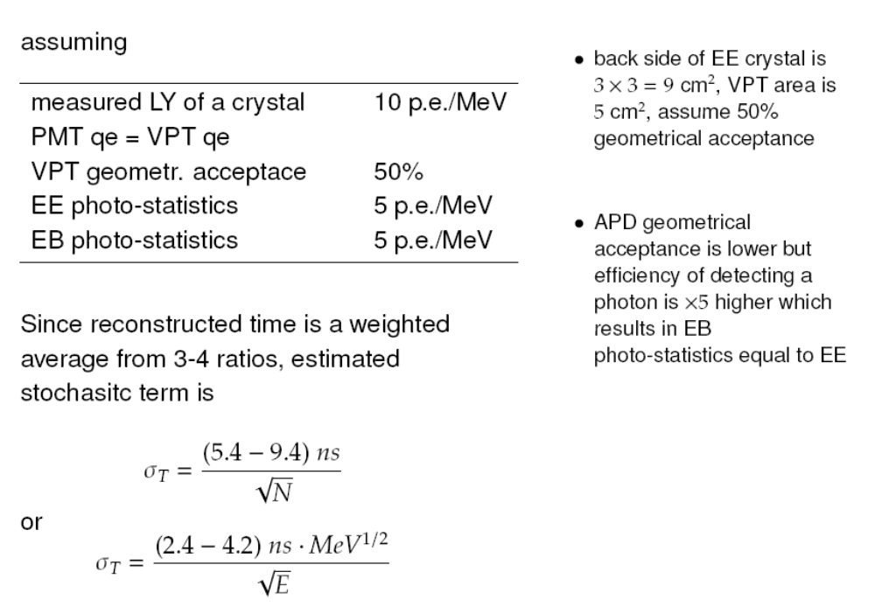

Slide 38
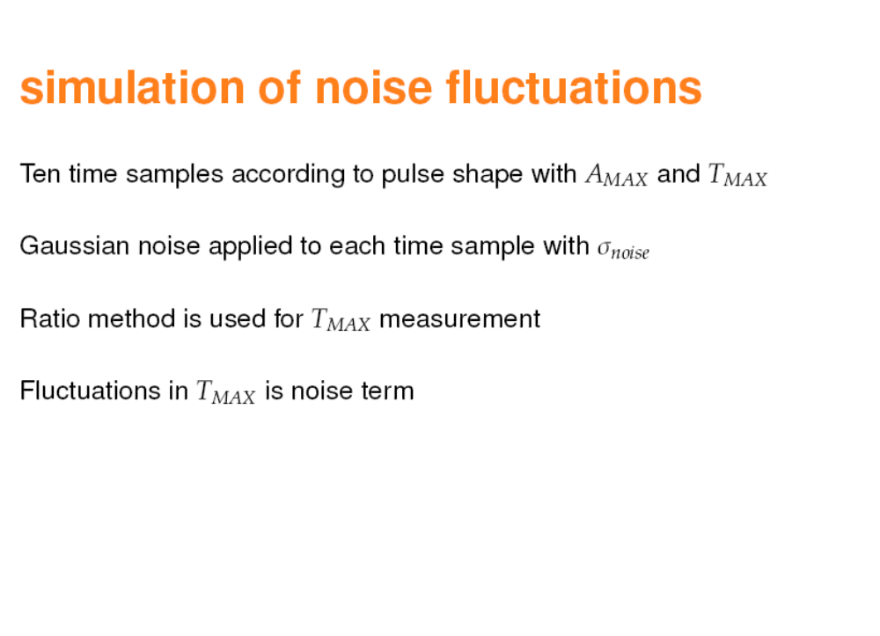

Slide 39
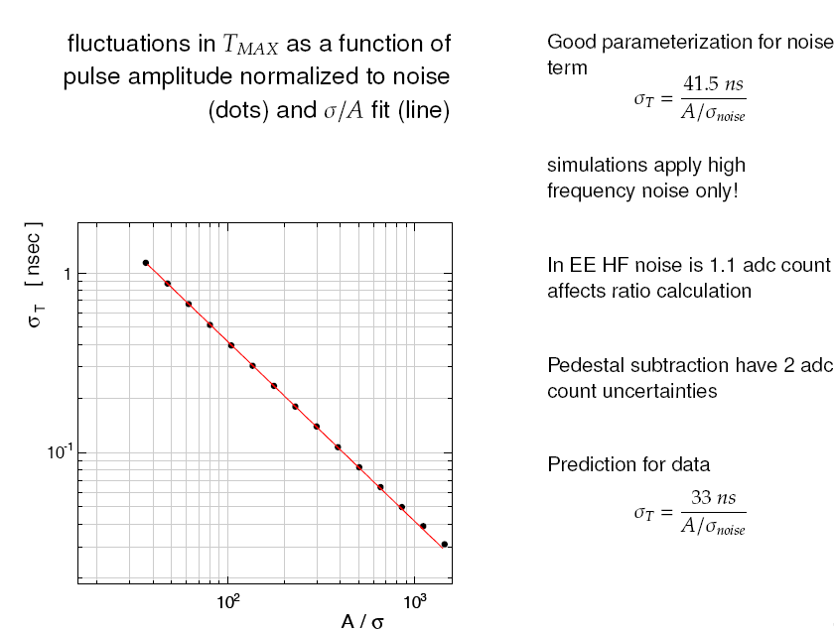

Slide 40
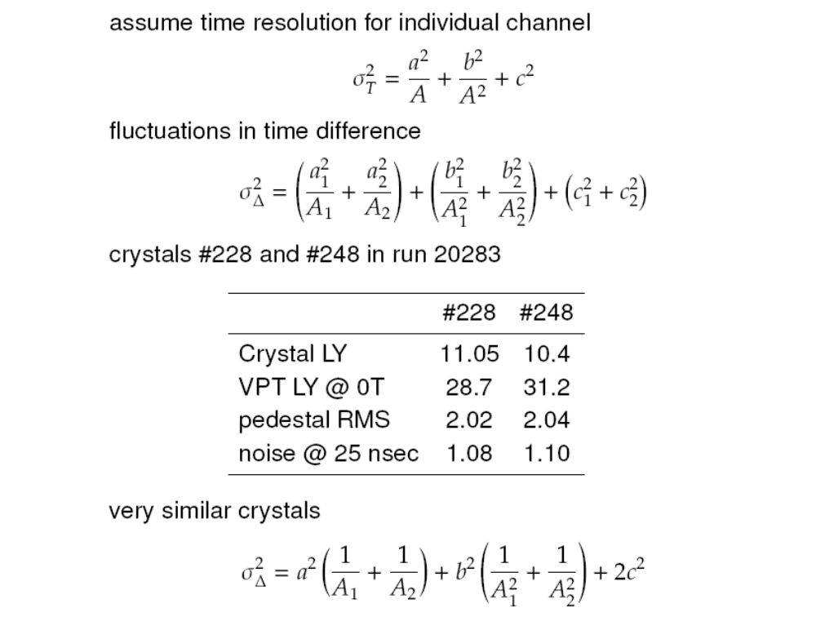
Stochastic Term

Slide 41
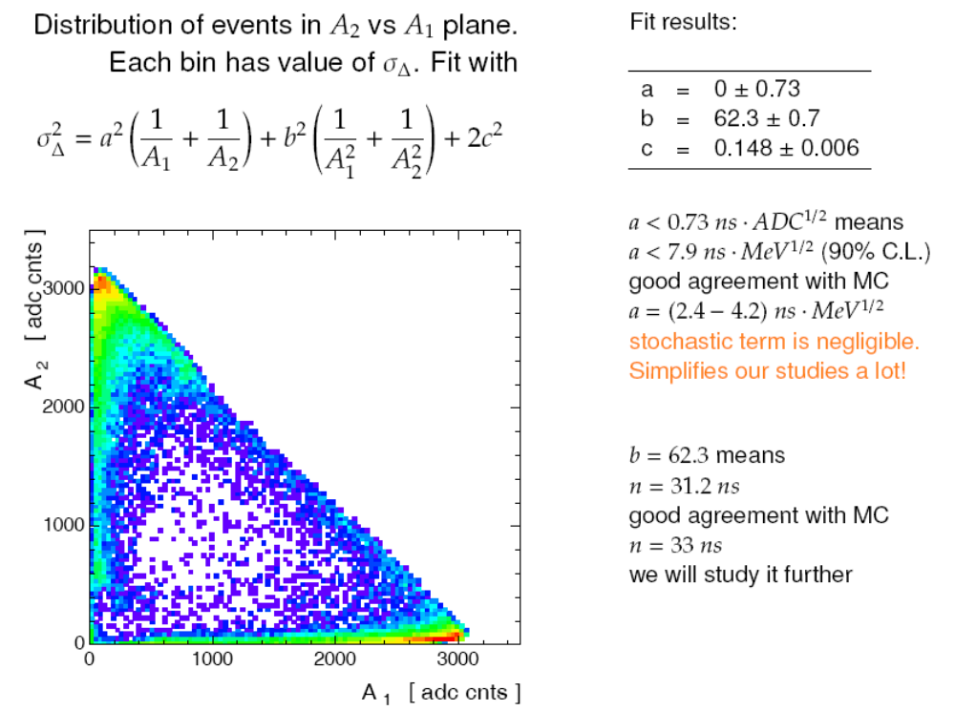
Stochastic Term

Slide 42
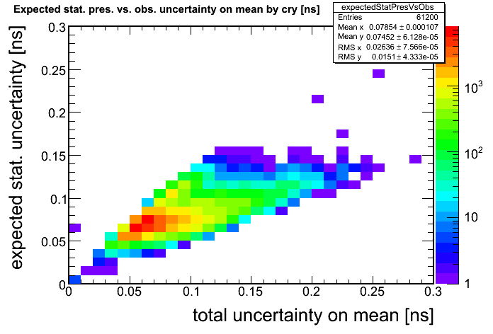
Calc. vs. Obs. Uncertainties on the Mean

