Slide 1
Saturday 3rd November - morning
09:05 lost fill 3259 to a fault on RB.A67 energy extraction (on-going problem)
3259: 143 pb⁻¹ in 9h27m
Access for:
ALICE – reasonably urgent 4 hour access
P6 for MPE piquet and QPS expert, Bozhidar. A micro-switch was found faulty and exchanged.
13:45 Pre-cycle started
14:30 Cryo operator warns of the loss of two low pressure compressors at P2, potentially affecting the stability of the DFB's.

Slide 2
Saturday 3rd November - afternoon
15:45 The cryo problem is due to a faulty cable in a control card.
Manage to fix the cable (worn insulation) and recover situation
16:10 Cryo give OK to proceed
16:42 Successful start-up of daughter number 2
3.55 kg, 50 cm
Nappy fill #5 – commissioning in progress
16:40 Injecting physic beam
Had attempted to run without batch-by-batch blow-up but not straightforward – settle for reducing target bunch length (thanks to Daniel Valuch for his help)
Transfer line steering required – beam in OK but still not ideal

Slide 3
Saturday 3rd November - afternoon
19:15 Stable beams fill 3261
Initial luminosity: 7.27e33 cm⁻²s⁻¹
00:55 Beams lost to possible spurious BLM trigger (tbc)
Fill 3261: 105 pb-1 in 5h 42m
refilled with similar conditions as the fill before
Ib=1.66e11 ppb and emittances between 1.6 - 1.8
04:00 brought 3262 into PHYSICS with peak luminosities of ~7e33 cm-2s-1
04:30 that fill was lost after ~31 min. by a BLM trigger in P7 (RS1 on TCLA.B6R7)
an instability in both planes of B1 was recorded by the BBQ-PM

Slide 4
Sunday 4th November
Prepared the machine for the next fill and lost a vertical COD in S12 during rampdown, which could be reset and restarted
Had two GPM on B2 probes while correcting the orbit, due to one or several bad BPM readings
Before being able to verify the B2-probe orbit the SPS MKE4 switched to local control and the piquet was called to intervene
07:15 beam back in SPS
Fun at injection
ADT suspect – Daniel Valuch on his way

Slide 5
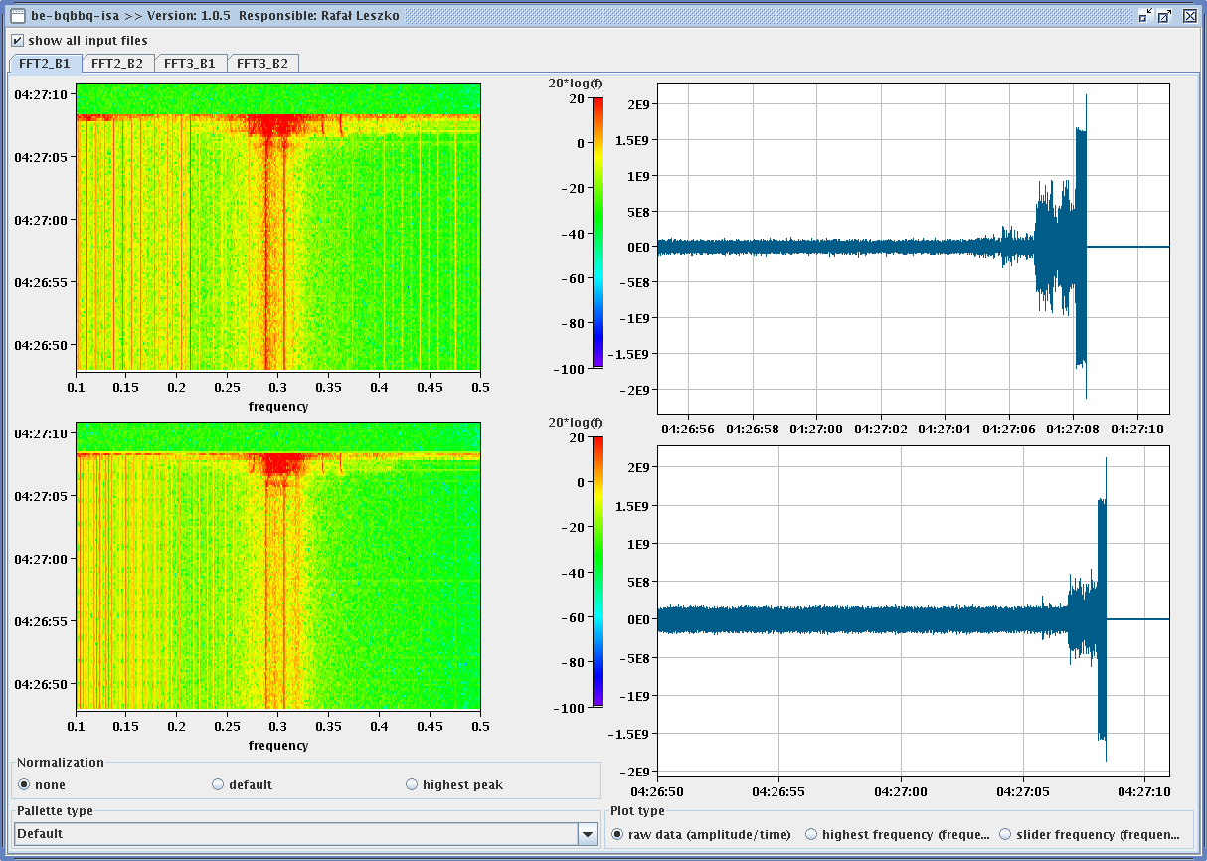
End fill 3262

Slide 6
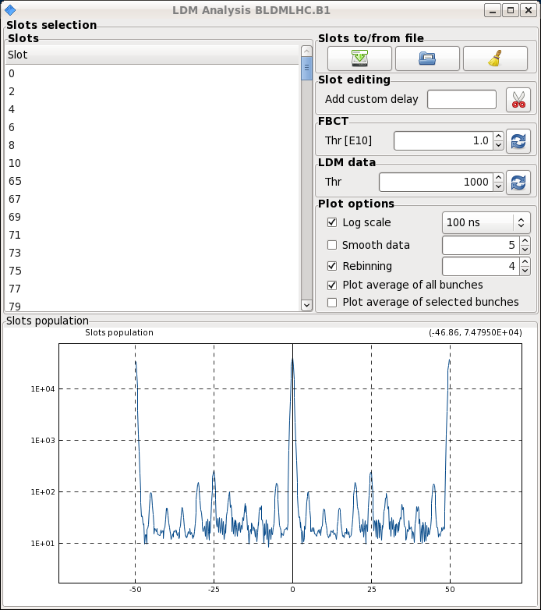
Beam 1 – ghosts & satellites

Slide 7
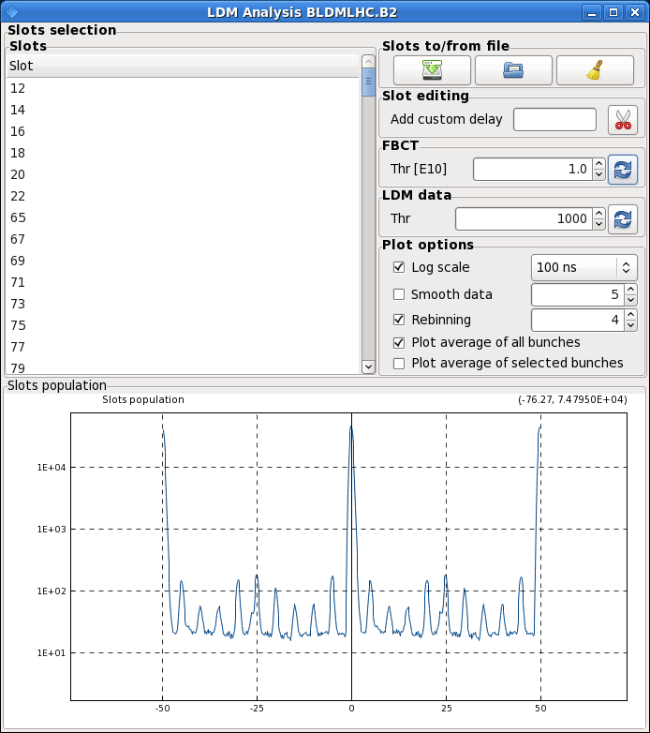
Beam 2 – ghosts & satellites
large 5ns satellites

Slide 8
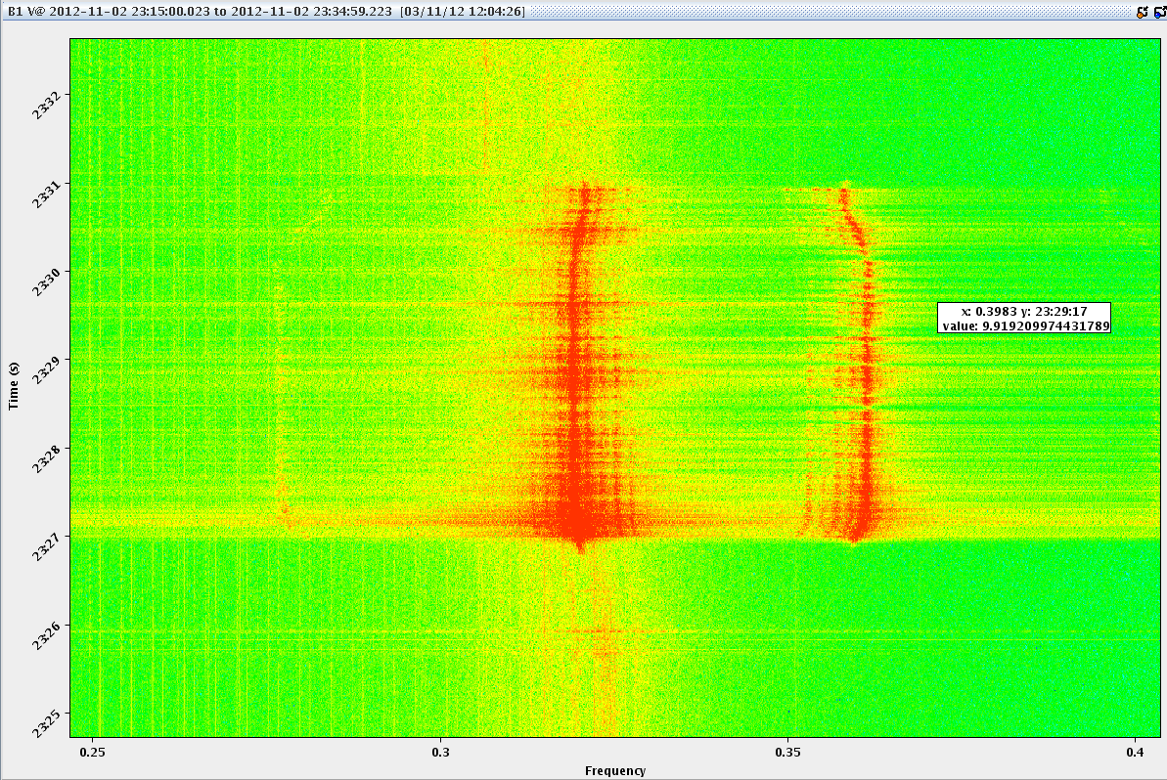
Instability end squeeze (out of interest)

Slide 9
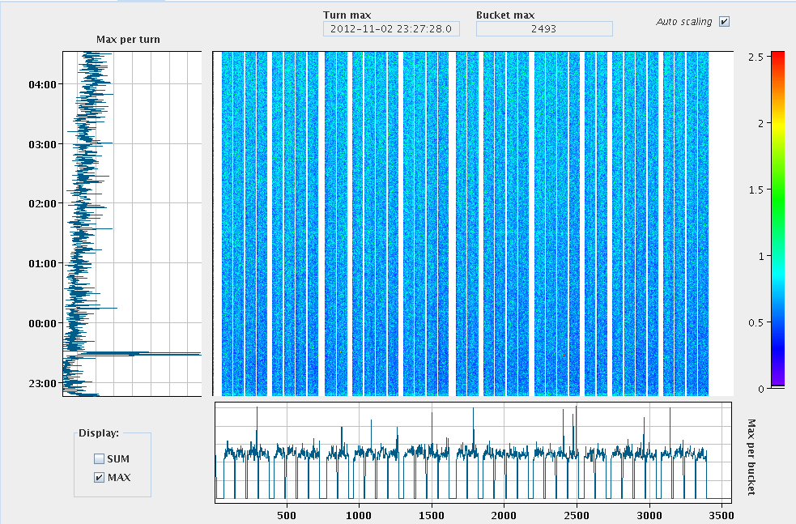
Instability end squeeze (out of interest)

Slide 10
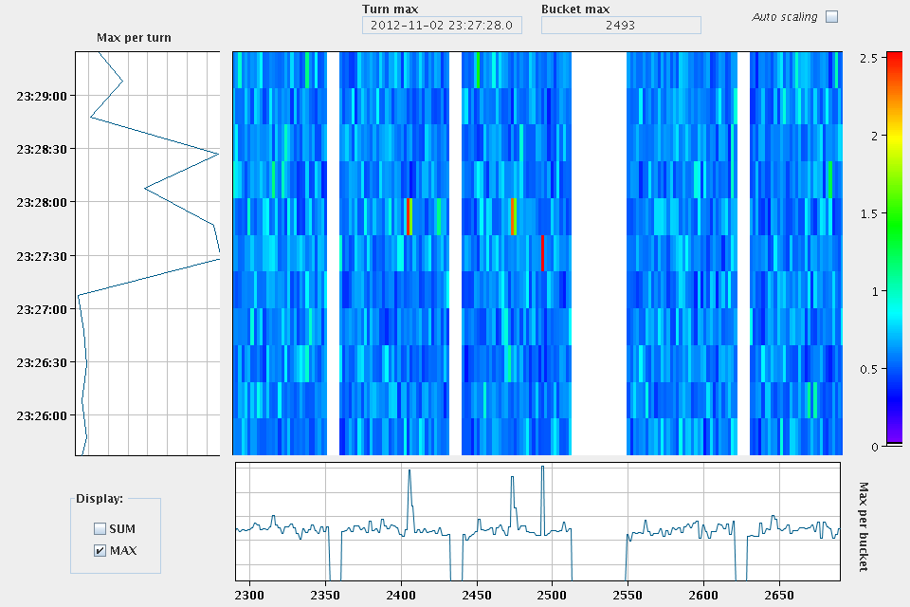
Instability end squeeze (out of interest)

Slide 11
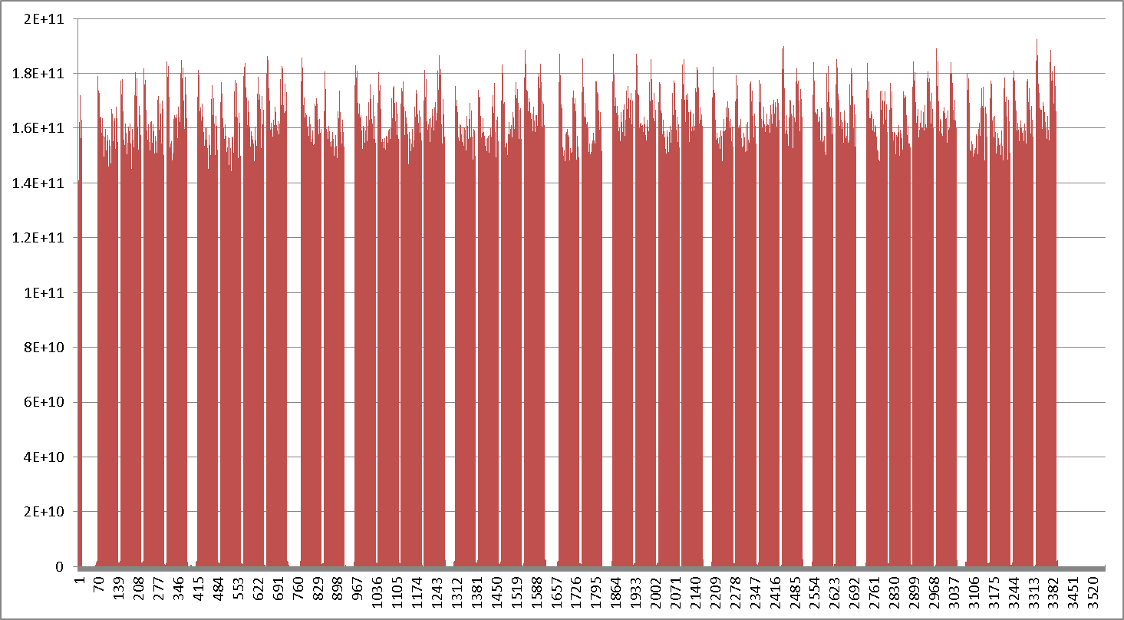
Bunch intensity

Slide 12
Incoming
ALFA & TOTEM
If we can get a long-ish fill in
Injection still ropey – to be re-visited
Check ghost and satellite production in SPS

